Slide 1
Lecture 20
CSE 331
Oct 19, 2022

Slide 2
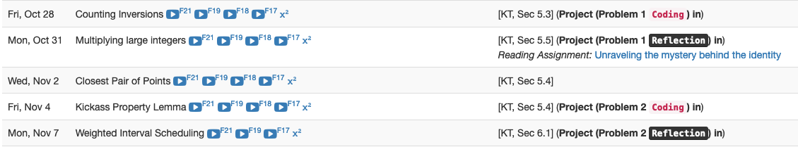
Project deadlines coming up

Slide 3
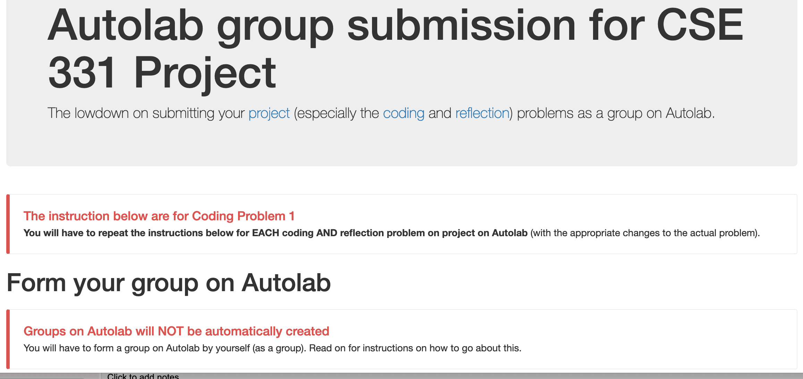
Group formation instructions
Follow instructions EXACTLY as they are stated

Slide 4
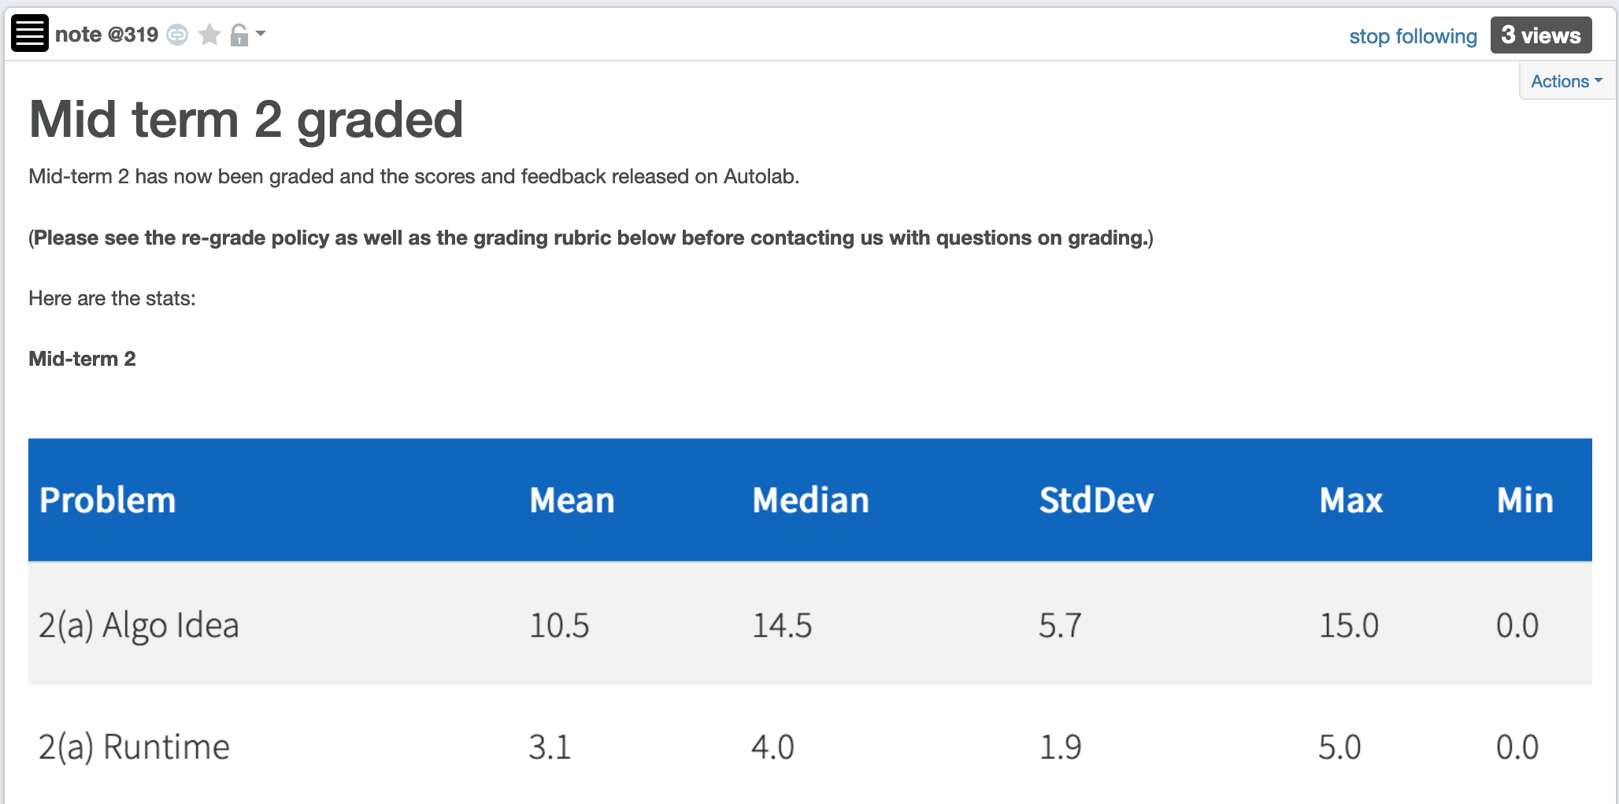
Mid-terms graded

Slide 5
Mid-term temp grades
Will be assigned hopefully by tonight

Slide 6
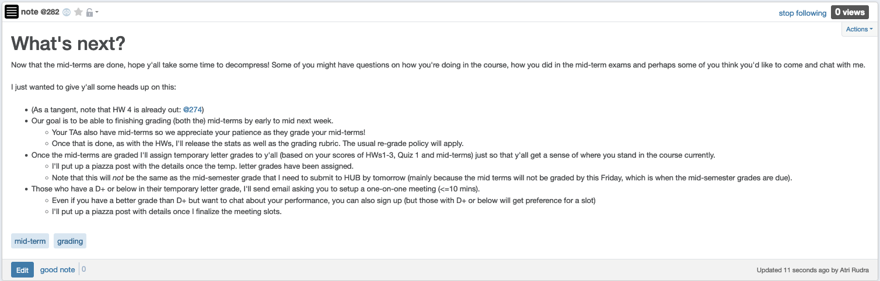
Some other stuff coming up

Slide 7
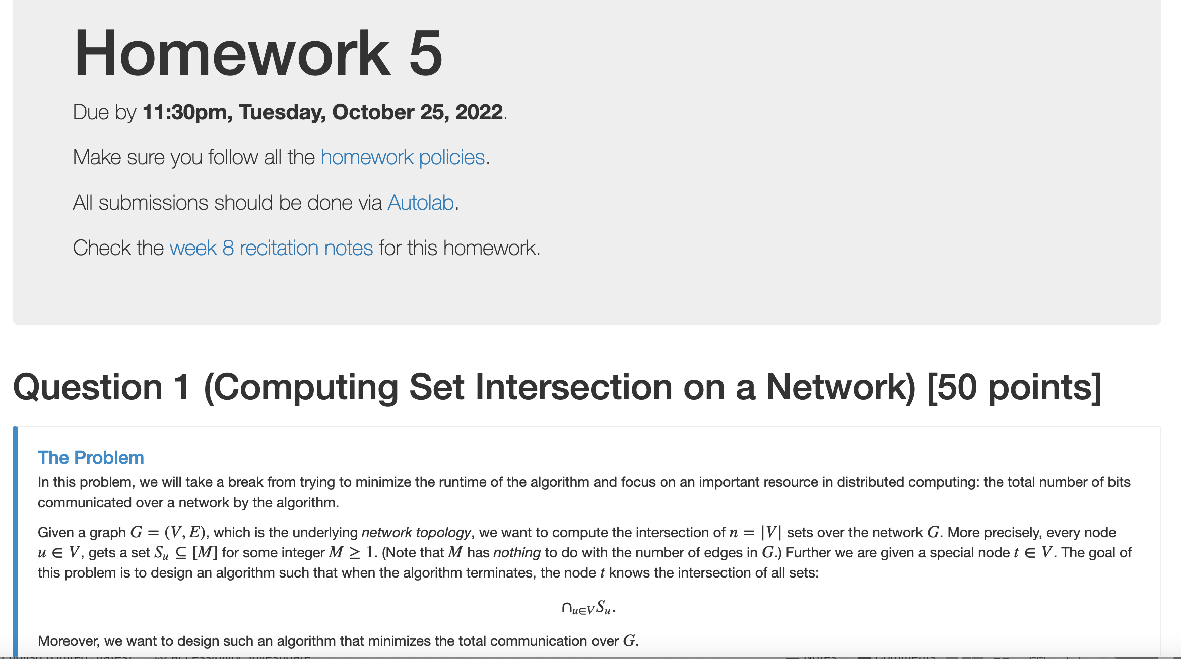
HW 5 is out

Slide 8
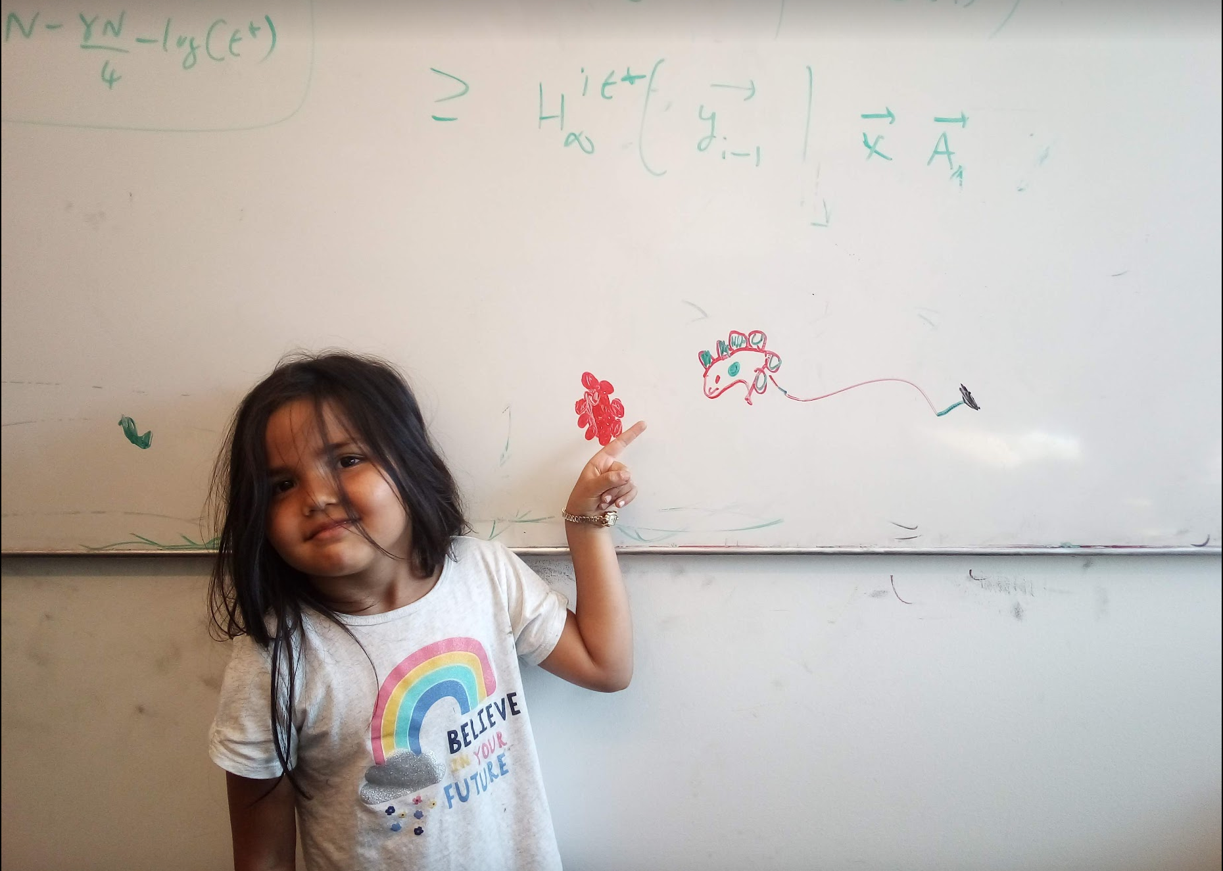
Questions/Comments?

Slide 9
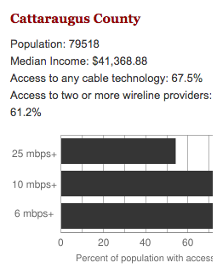
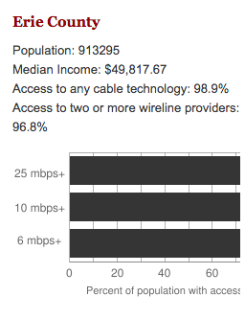
Make broadband more available
BOTH technical and societal issues
Say you are tasked to come up with the infrastructure

Slide 10
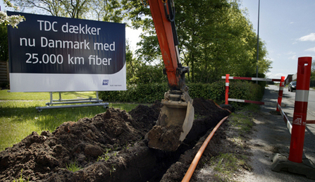
Building a fiber network
Lay down fibers to connect n locations
All n locations should be connected
Laying down a fiber costs money
What is the cheapest way to lay down the fibers?

Slide 11
Today’s agenda
Minimum Spanning Tree (MST) Problem
Greedy algorithm(s) for MST problem

Slide 12
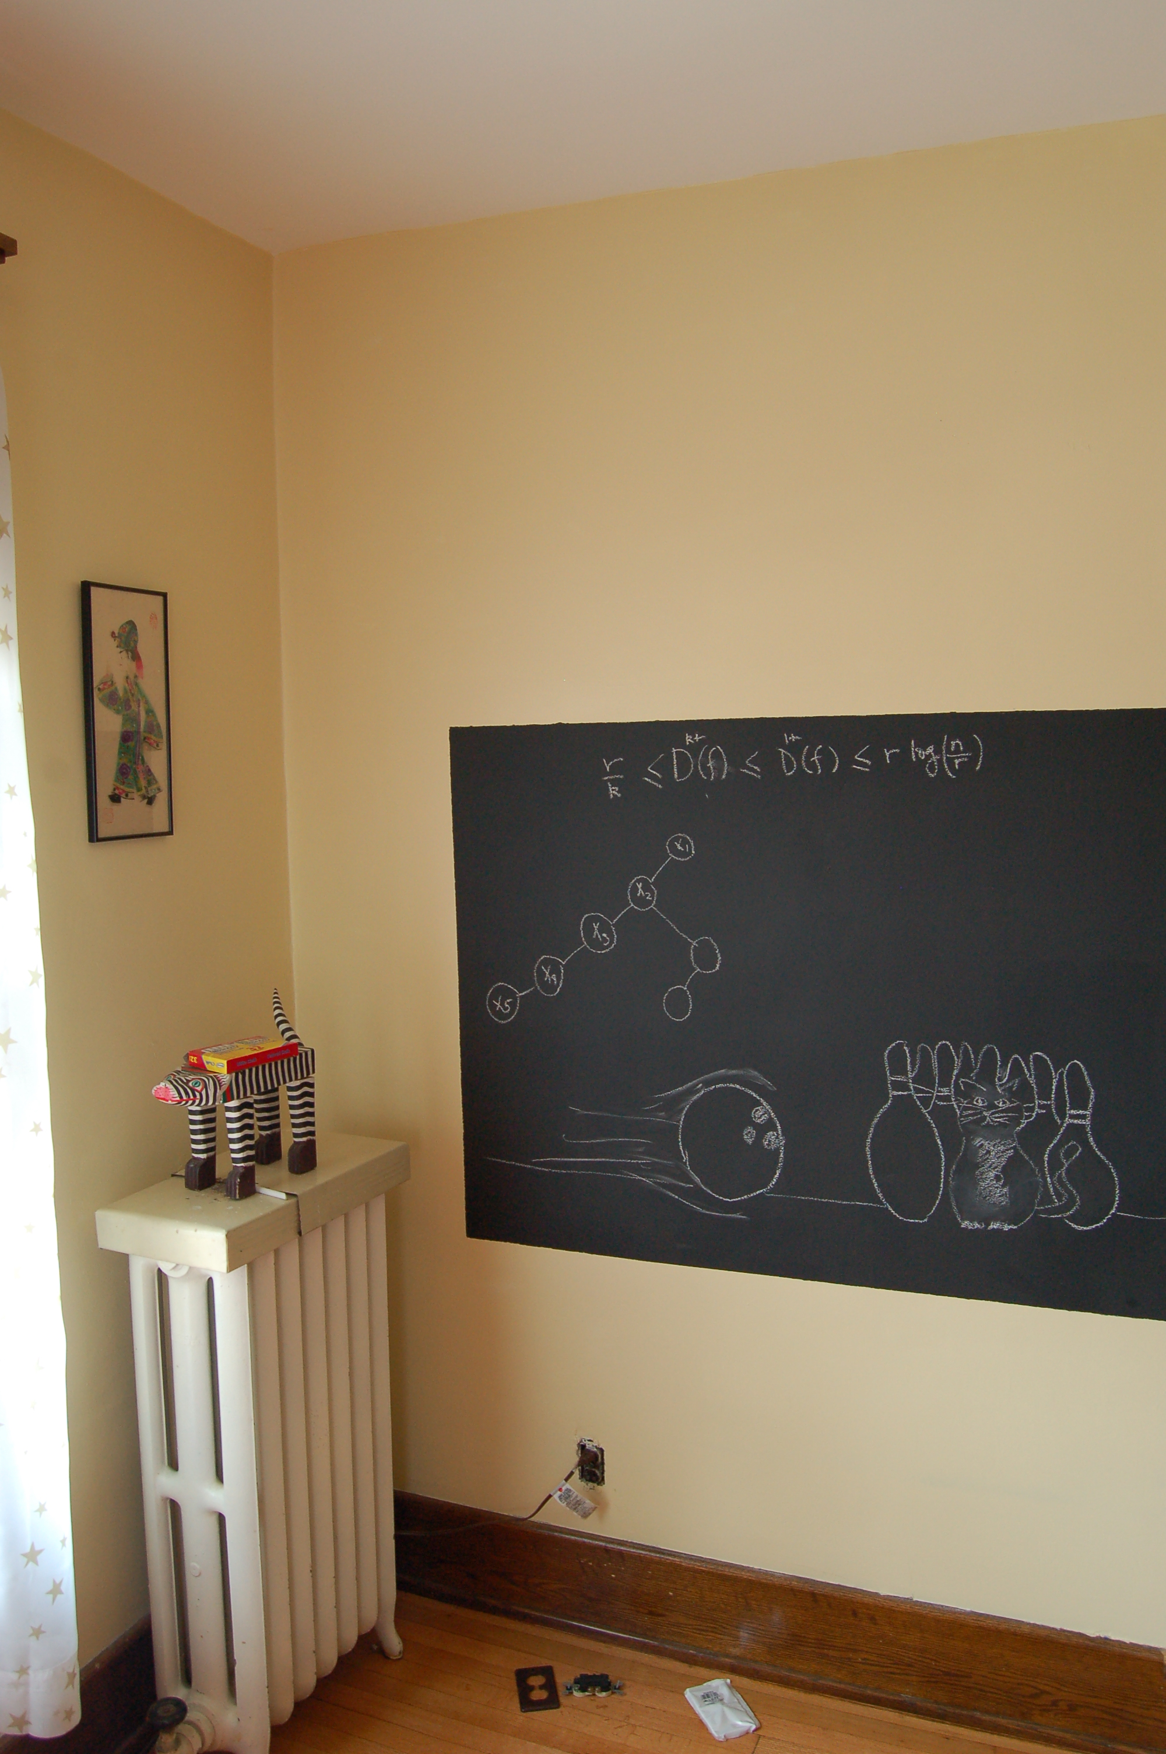
On to the board…

Slide 13
Minimum Spanning Tree Problem
Input: Undirected, connected G = (V,E), edge costs c_{e}
Output: Subset E’ ⊆ E, s.t. T = (V,E’) is connected
C(T) is minimized
If all c_{e} > 0, then T is indeed a tree

Slide 14
Rest of today’s agenda
Greedy algorithm(s) for MST problem

Slide 15

Discuss: Greedy algorithm!

Slide 16
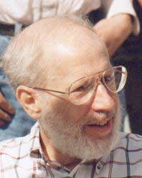
Kruskal’s Algorithm
Input: G=(V,E), c_{e}> 0 for every e in E
T = Ø
Sort edges in increasing order of their cost
Joseph B. Kruskal
Consider edges in sorted order
If an edge can be added to T without adding a cycle then add it to T

Slide 17
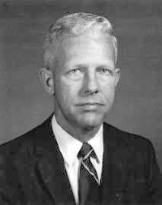
Prim’s algorithm
Similar to Dijkstra’s algorithm
2
0.5
1
3
50
51
Robert Prim
2
0.5
Input: G=(V,E), c_{e}> 0 for every e in E
S = {s}, T = Ø
1
50
While S is not the same as V
Among edges e= (u,w) with u in S and w not in S, pick one with minimum cost
Add w to S, e to T

Slide 18
Reverse-Delete Algorithm
2
0.5
1
3
50
51
Input: G=(V,E), c_{e}> 0 for every e in E
2
0.5
T = E
1
3
50
Sort edges in decreasing order of their cost
51
Consider edges in sorted order
If an edge can be removed T without disconnecting T then remove it

Slide 19
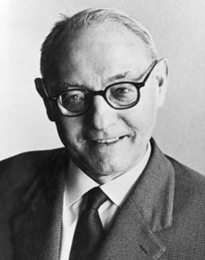
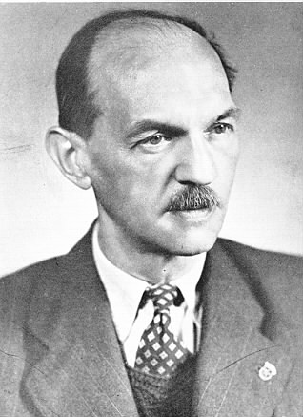
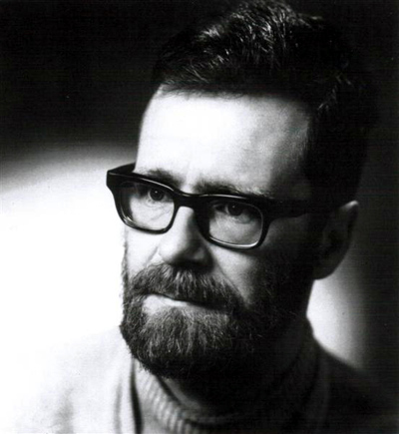
(Old) History of MST algorithms
1920: Otakar Borůvka
1930: Vojtěch Jarník
Same algo!
1956: Kruskal
1957: Prim
1959: Dijkstra

