Slide 1
Lecture 22
CSE 331
Oct 24, 2022

Slide 2
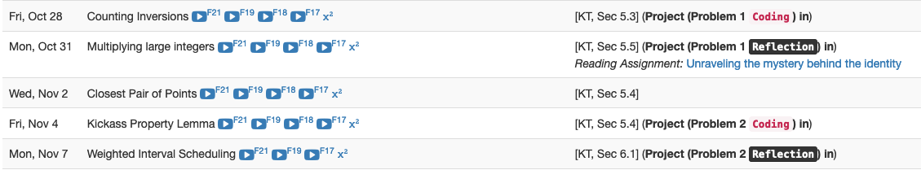
Project deadlines coming up

Slide 3
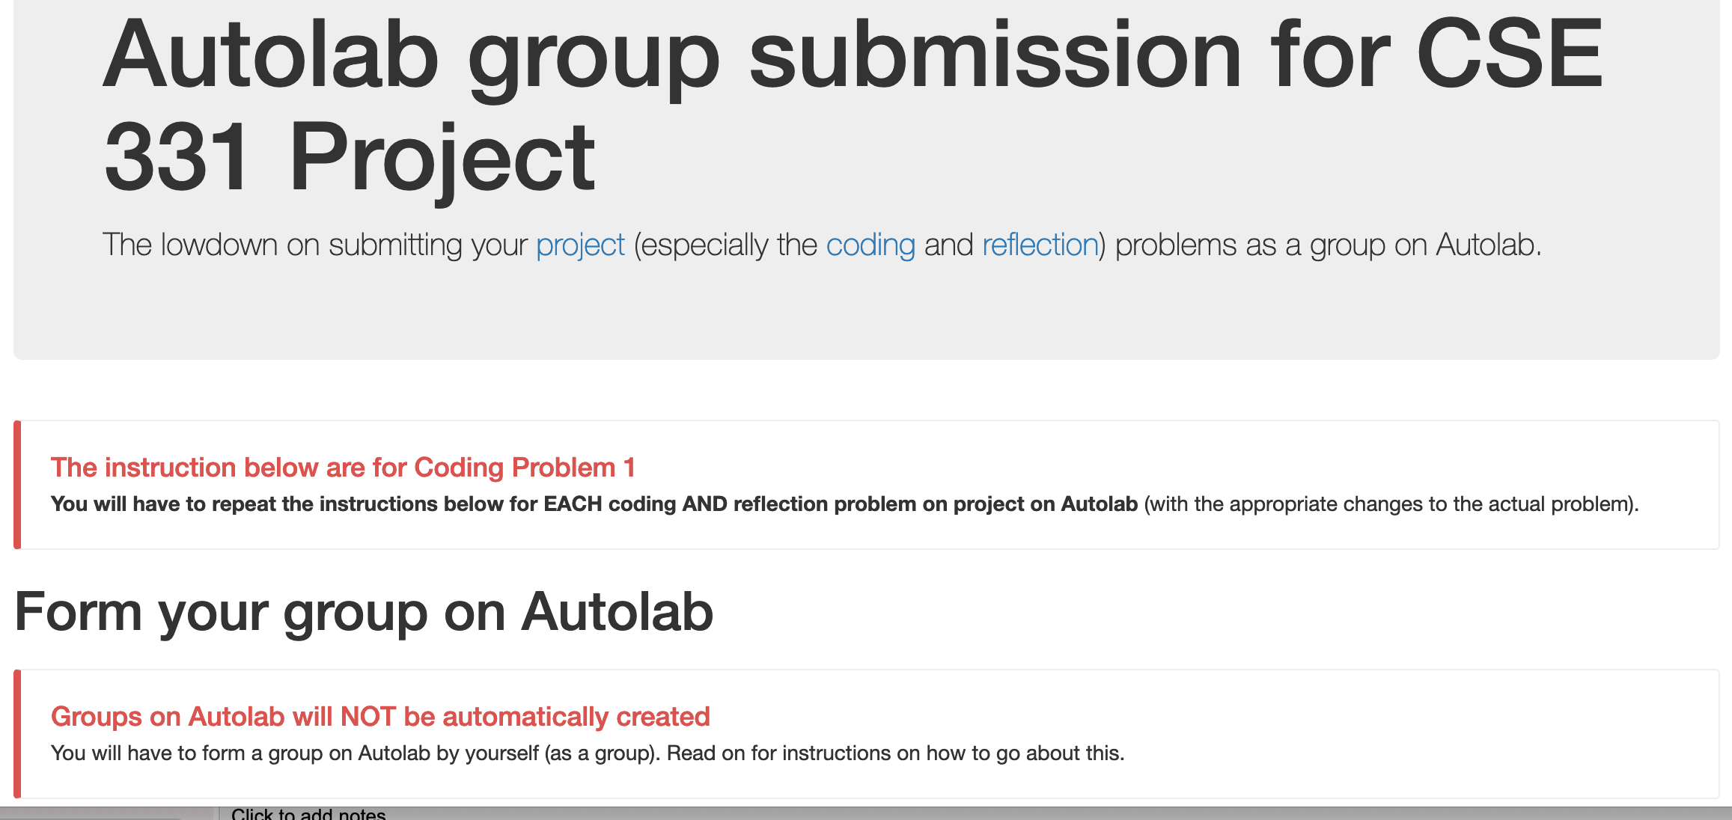
Group formation instructions
Follow instructions EXACTLY as they are stated

Slide 4
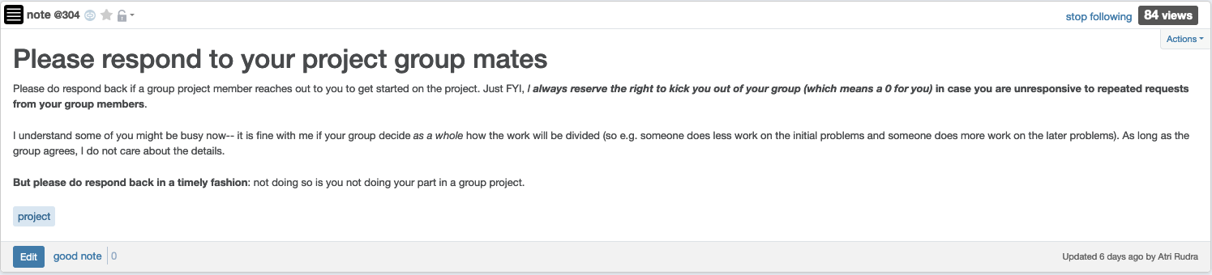
Please be in touch w/ your group

Slide 5
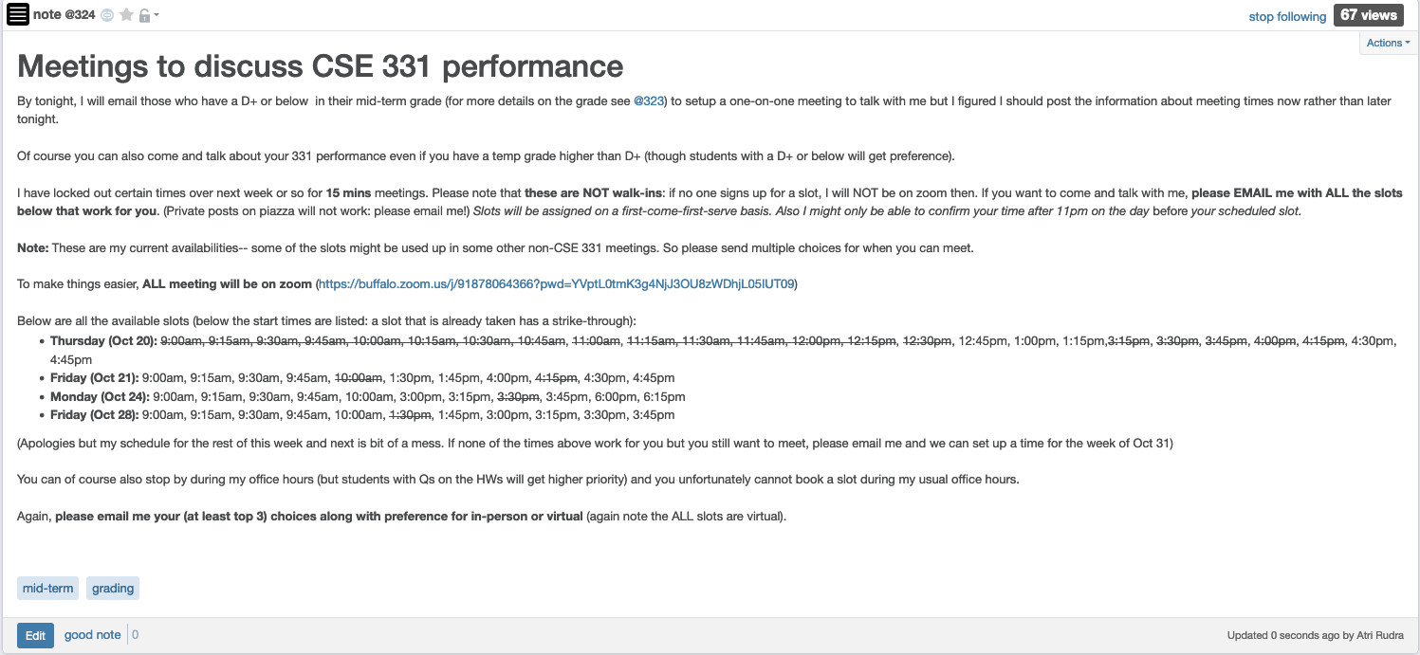
1-on-1 meetings

Slide 6

Guest lecture on Wed
Trevor will run late night OH
My 4pm OH canceled
A. Erdem Sarıyüce

Slide 7
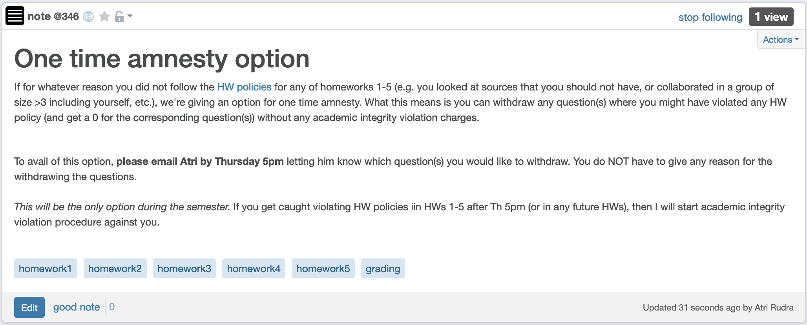
One time amnesty for AI violation

Slide 8
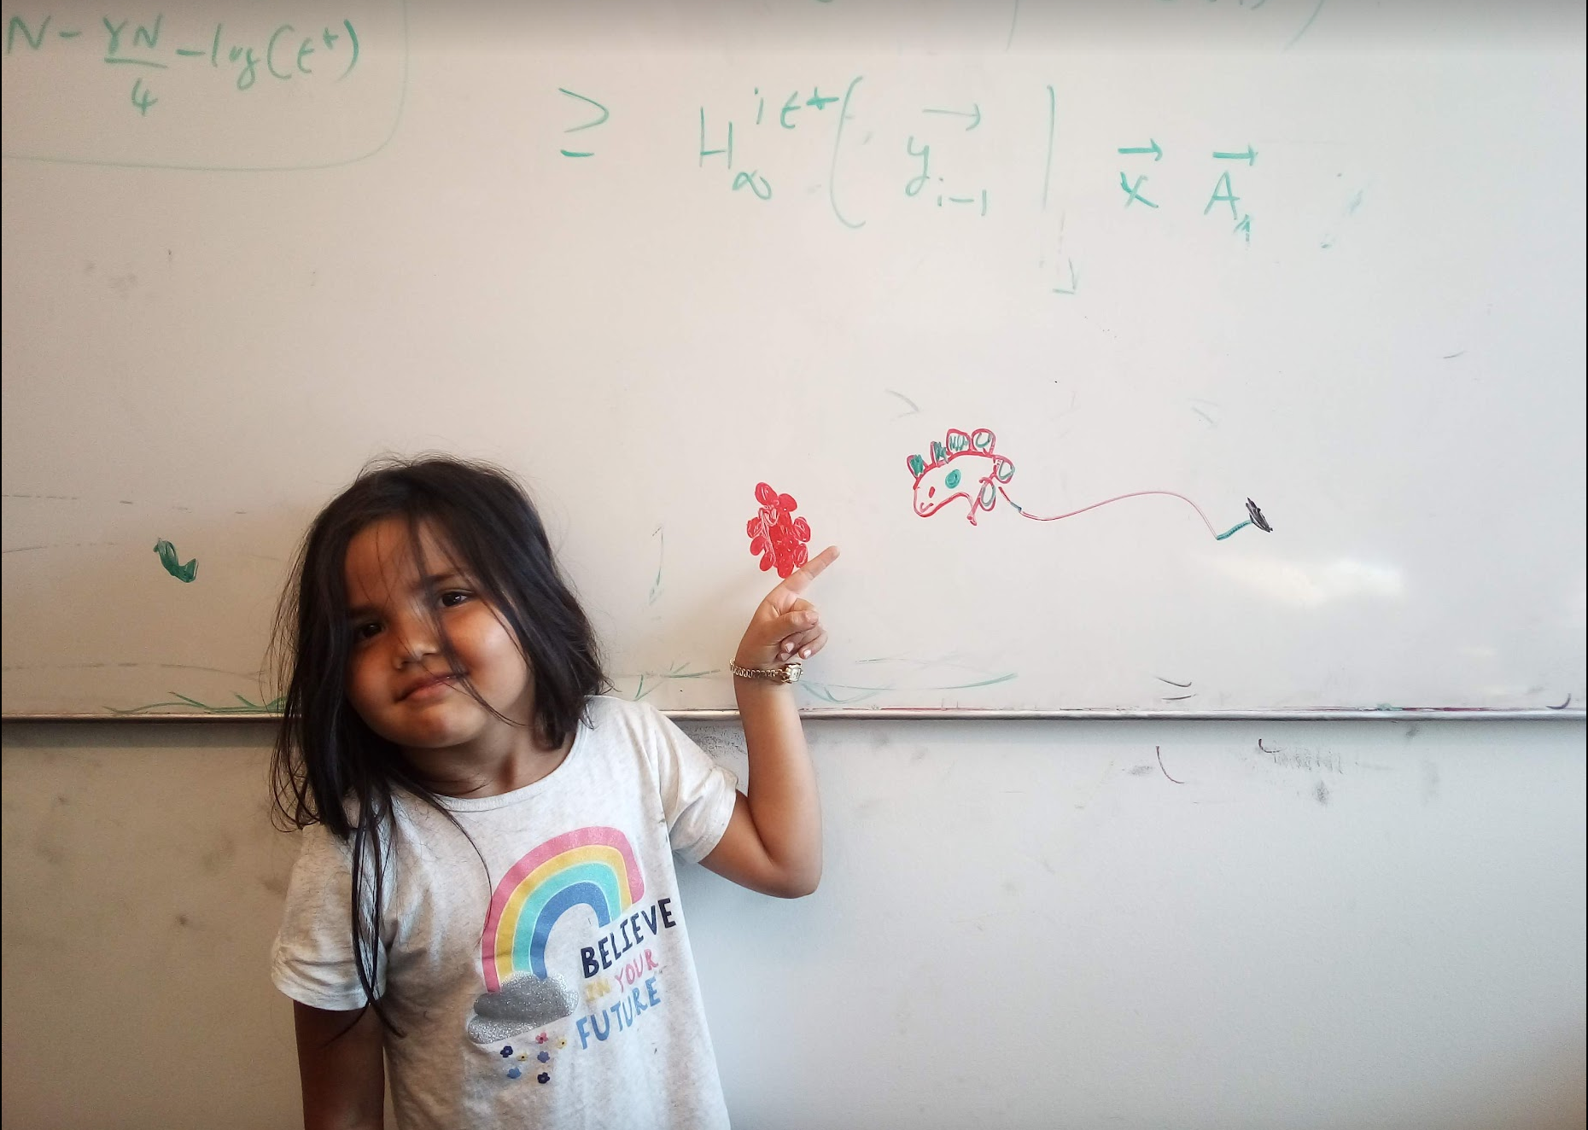
Questions/Comments?

Slide 9
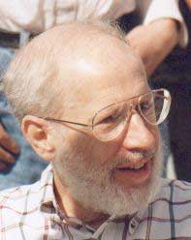
Kruskal’s Algorithm
Input: G=(V,E), c_{e}> 0 for every e in E
T = Ø
Sort edges in increasing order of their cost
Joseph B. Kruskal
Consider edges in sorted order
If an edge can be added to T without adding a cycle then add it to T

Slide 10
Cut Property Lemma for MSTs
Condition: S and V\S are non-empty
V \ S
S
Cheapest crossing edge is in all MSTs
Assumption: All edge costs are distinct

Slide 11
Questions/Comments?

Slide 12
Today’s agenda
Optimality of Kruskal’s algorithm
Remove distinct edge weights assumption
Quick runtime analysis of Prim’s+Kruskal’s

Slide 13
Optimality of Kruskal’s Algorithm
S
V \ S
S
Nodes connected to red in (V,T)
Input: G=(V,E), c_{e}> 0 for every e in E
S is non-empty
T = Ø
V\S is non-empty
Sort edges in increasing order of their cost
First crossing edge considered
Consider edges in sorted order
If an edge can be added to T without adding a cycle then add it to T

Slide 14

Is (V,T) a spanning tree?
No cycles by design
G is disconnected!
Just need to show that (V,T) is connected
V \ S’
S’
No edges here

Slide 15


Removing distinct cost assumption
Change all edge weights by very small amounts
Make sure that all edge weights are distinct
MST for “perturbed” weights is the same as for original
Changes have to be small enough so that this holds
EXERCISE: Figure out how to change costs

Slide 16
Questions/Comments?

Slide 17
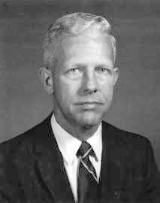
Running time for Prim’s algorithm
Similar to Dijkstra’s algorithm
O(m log n)
Input: G=(V,E), c_{e}> 0 for every e in E
S = {s}, T = Ø
While S is not the same as V
Among edges e= (u,w) with u in S and w not in S, pick one with minimum cost
Add w to S, e to T

Slide 18
Running time for Kruskal’s Algorithm
Can be implemented in O(m log n) time (Union-find DS)
Input: G=(V,E), c_{e}> 0 for every e in E
O(m²) time overall
T = Ø
Sort edges in increasing order of their cost
Joseph B. Kruskal
Consider edges in sorted order
If an edge can be added to T without adding a cycle then add it to T
Can be verified in O(m+n) time

Slide 19
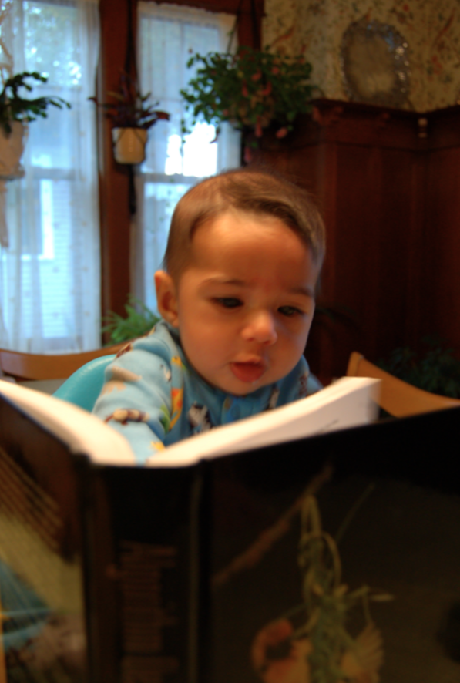
Reading Assignment
Sec 4.5, 4.6 of [KT]

Slide 20
High Level view of the course
Problem Statement
Problem Definition
Three general techniques
Done with greedy
Algorithm
“Implementation”
Data Structures
Analysis
Correctness+Runtime Analysis

Slide 21

Trivia

Slide 22
Divide and Conquer
Divide up the problem into at least two sub-problems
Recursively solve the sub-problems
“Patch up” the solutions to the sub-problems for the final solution

Slide 23
Sorting
Given n numbers order them from smallest to largest
Works for any set of elements on which there is a total order

Slide 24
Insertion Sort
Make sure that all the processed numbers are sorted
Input: a₁, a₂,…., a_{n}
Output: b₁,b₂,…,b_{n}
O(n²) overall
b₁= a₁
for i =2 … n
Find 1 ≤ j ≤ i s.t. a_{i} lies between b_{j-1} and b_{j}
Move b_{j} to b_{i-1} one cell “down”
a
b
O(log n)
4
2
4
1
b_{j}=a_{i}
3
3
3
2
4
2
4
3
O(n)
1
4

Slide 25
Other O(n²) sorting algorithms
Selection Sort: In every round pick the min among remaining numbers
Bubble sort: The smallest number “bubbles” up

Slide 26
Divide and Conquer
Divide up the problem into at least two sub-problems
Recursively solve the sub-problems
“Patch up” the solutions to the sub-problems for the final solution

Slide 27
Mergesort Algorithm
Divide up the numbers in the middle
Unless n=2
Sort each half recursively
Merge the two sorted halves into one sorted output

Slide 28
How fast can sorted arrays be merged?
Group talk time

Slide 29
Mergesort algorithm
Input: a₁, a₂, …, a_{n}
Output: Numbers in sorted order
MergeSort( a, n )
If n = 1 return the order a₁
If n = 2 return the order min(a₁,a₂); max(a₁,a₂)
a_{L} = a₁,…, a_{n/2}
a_{R} = a_{n/2+1},…, a_{n}
return MERGE ( MergeSort(a_{L}, n/2), MergeSort(a_{R}, n/2) )

Slide 30
An example run
51
1
100
19
2
8
4
3
1
51
19
100
2
8
3
4
1
19
51
100
2
3
4
8
1
2
3
4
8
19
51
100
MergeSort( a, n )
If n = 1 return the order a₁
If n = 2 return the order min(a₁,a₂); max(a₁,a₂)
a_{L} = a₁,…, a_{n/2}
a_{R} = a_{n/2+1},…, a_{n}
return MERGE ( MergeSort(a_{L}, n/2), MergeSort(a_{R}, n/2) )

Slide 31
Correctness
Input: a₁, a₂, …, a_{n}
Output: Numbers in sorted order
By induction on n
MergeSort( a, n )
If n = 1 return the order a₁
If n = 2 return the order min(a₁,a₂); max(a₁,a₂)
a_{L} = a₁,…, a_{n/2}
a_{R} = a_{n/2+1},…, a_{n}
return MERGE ( MergeSort(a_{L}, n/2), MergeSort(a_{R}, n/2) )
Inductive step follows from correctness of MERGE

Slide 32
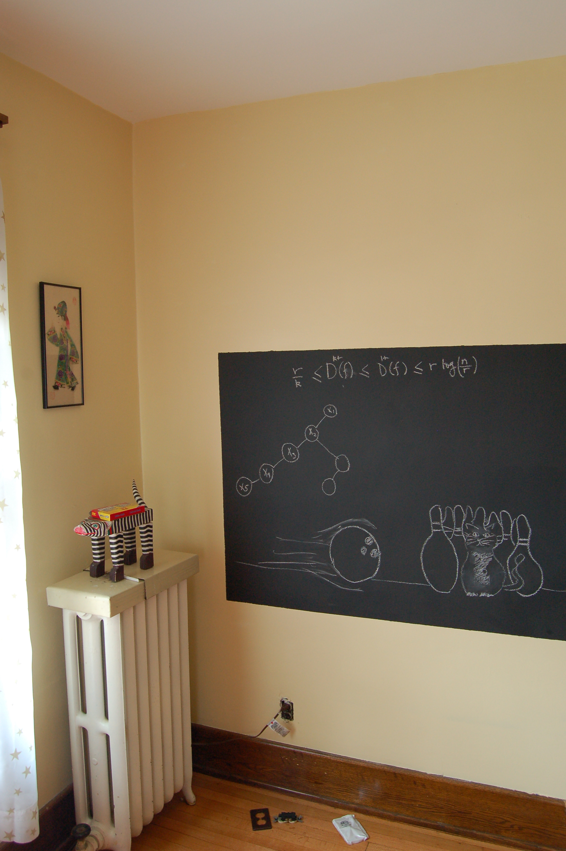
Runtime analysis on the board…

