Slide 1
Lecture 28
CSE 331
Nov 7, 2022

Slide 2
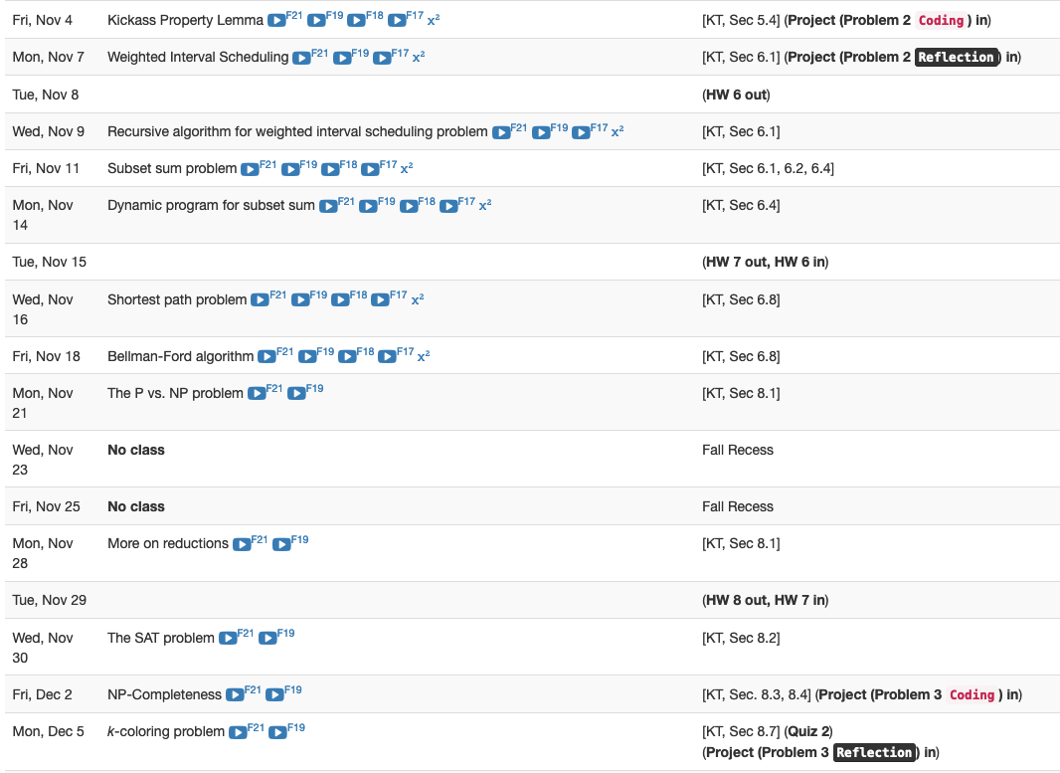
Reflection P2 due TODAY

Slide 3
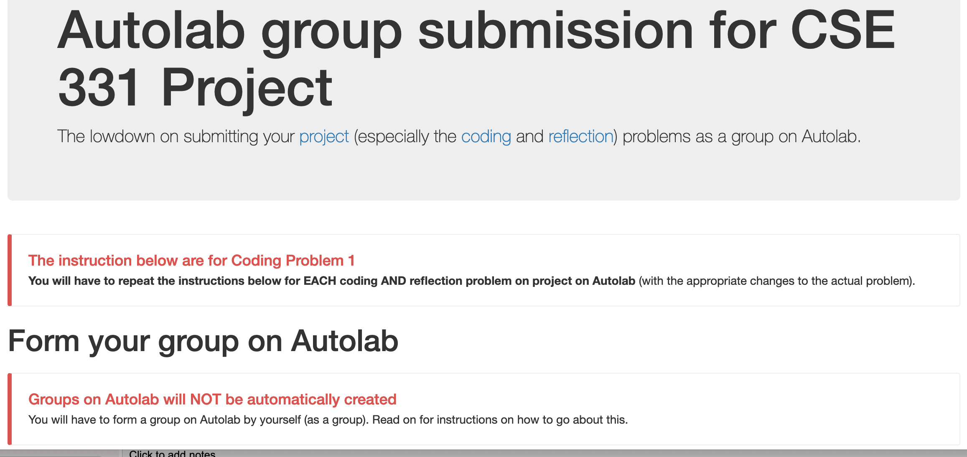
Group formation instructions
Follow instructions EXACTLY as they are stated

Slide 4
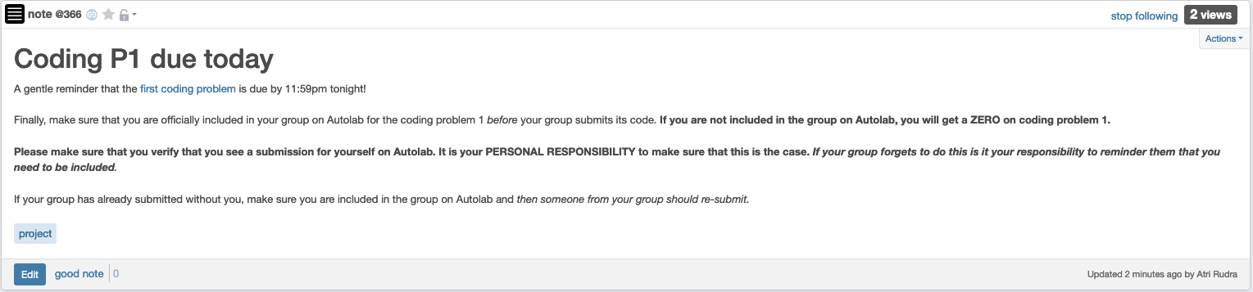
Make sure you are in your group

Slide 5
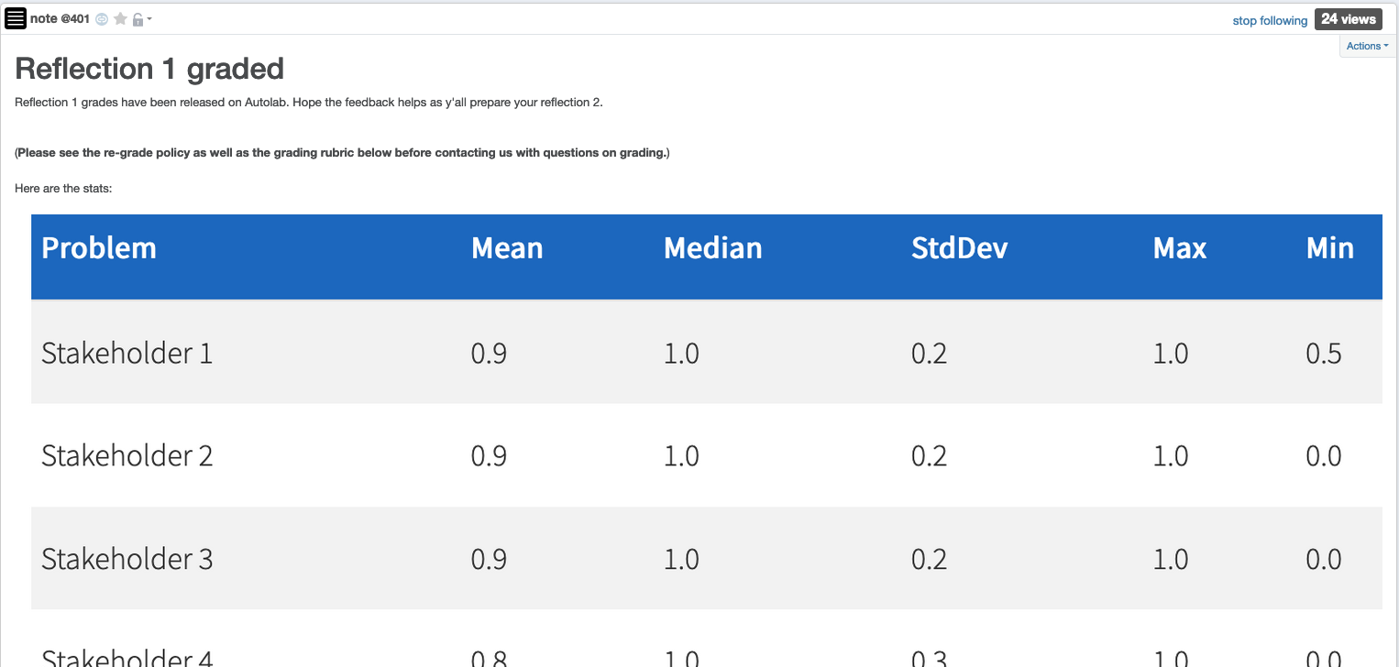
Reflection P1 graded

Slide 6
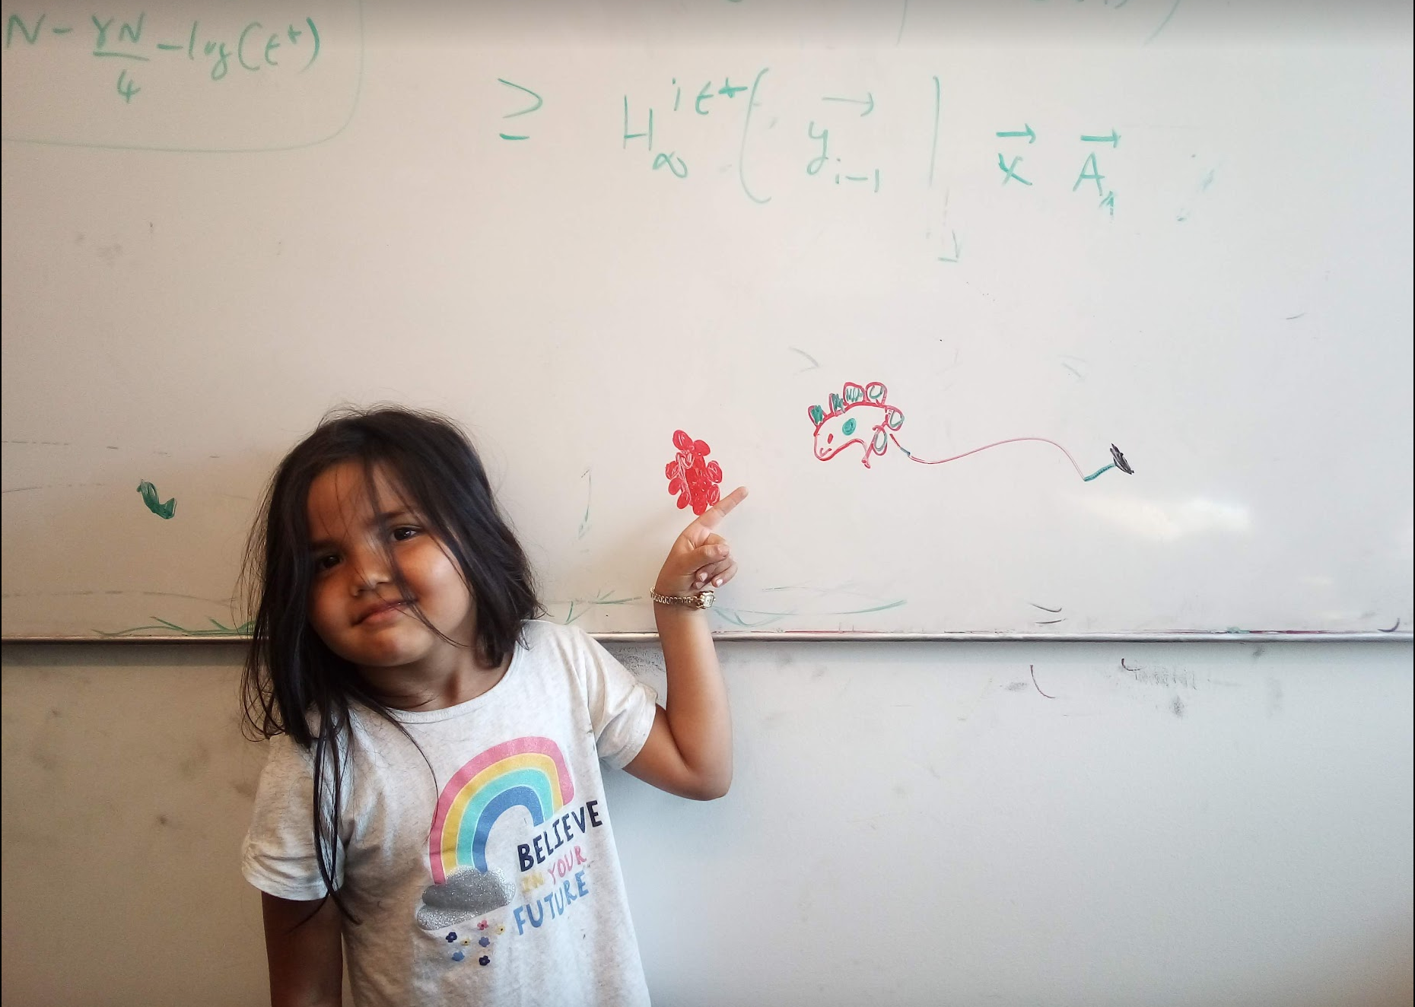
Questions/Comments?

Slide 7
High level view of CSE 331
Problem Statement
Problem Definition
Three general techniques
Algorithm
“Implementation”
Data Structures
Analysis
Correctness+Runtime Analysis

Slide 8


Greedy Algorithms
Natural algorithms
Reduced exponential running time to polynomial

Slide 9

Divide and Conquer
Recursive algorithmic paradigm
Reduced large polynomial time to smaller polynomial time

Slide 10
A new algorithmic technique
Dynamic Programming

Slide 11

Dynamic programming vs. Divide & Conquer

Slide 12
Same same because
Both design recursive algorithms

Slide 13
Different because
Dynamic programming is smarter about solving recursive sub-problems

Slide 14

End of Semester blues
Can only do one thing at any day: what is the optimal schedule to obtain maximum value?
Write up a term paper
(10)
Party!
(2)
Exam study
(5)
331 HW
(3)
Project
(30)
Friday
Saturday
Sunday
Monday
Tuesday

Slide 15
Previous Greedy algorithm
Order by end time and pick jobs greedily
Greedy value = 5+2+3= 10
Write up a term paper
(10)
OPT = 30
Party!
(2)
Exam study
(5)
331 HW
(3)
Project
(30)
Friday
Saturday
Sunday
Monday
Tuesday

Slide 16
Questions/Comments?

Slide 17
Today’s agenda
Formal definition of the problem
Start designing a recursive algorithm for the problem

Slide 18
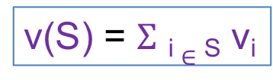
Weighted Interval Scheduling
Input: n jobs/intervals. Interval i is triple (s_{i}, f_{i}, v_{i})
start time
value
finish time
v₃ = 2
v₂ = 4
v₄ = 3
v₁ = 30
0
1
2
3

Slide 19
Questions/Comments?

Slide 20

Previous Greedy Algorithm
R = original set of jobs
While R is not empty
Choose i in R where f_{i} is the smallest
Add i to S
Remove all requests that conflict with i from R
Return S* = S
v₃ = 2
v₂ = 4
v₄ = 3
v₁ = 30
0
1
2
3

Slide 21
Perhaps be greedy differently?
R = original set of jobs
While R is not empty
Choose i in R where v_{i}/(f_{i} – s_{i}) is the largest
Add i to S
Remove all requests that conflict with i from R
Return S* = S
v₃ = 2
v₂ = 4
v₄ = 3
v₁ = 30
0
1
2
3

Slide 22
Can this work?
R = original set of jobs
While R is not empty
Choose i in R where v_{i}/(f_{i} – s_{i}) is the largest
Add i to S
Remove all requests that conflict with i from R
Return S* = S
v₃ = 2
v₂ = 6
v₄ = 3
v₁ = 12
0
1
2
3

Slide 23

Avoiding the greedy rabbit hole
Provably IMPOSSIBLE for a large class of greedy algos
https://www.writerightwords.com/down-the-rabbit-hole/
There are no known greedy algorithm to solve this problem

Slide 24
Questions/Comments?

Slide 25
Perhaps a divide & conquer algo?
Divide the problem in 2 or more many EQUAL SIZED
INDEPENDENT problems
Recursively solve the sub-problems
Patchup the SOLUTIONS to the sub-problems

Slide 26
Perhaps a divide & conquer algo?
RecurWeightedInt([n])
if n = 1 return the only interval
Would this general scheme work?
L = first n/2 intervals
R = last n/2 intervals
S_{L} = RecurWeightedInt(L)
S_{R} = RecurWeightedInt(R)
PatchUp(S_{L}, S_{R})
Divide the problem in 2 or more many EQUAL SIZED
INDEPENDENT problems

Slide 27
Sub-problems NOT independent!
v₆ = 20
v₃ = 10
v₁ = 1
v₂ = 2
v₄ = 4
v₅ = 5
0
1
2
3

Slide 28
Perhaps patchup can help?
Patchup the SOLUTIONS to the sub-problems
v₆ = 20
v₃ = 10
v₁ = 1
v₂ = 2
0
1
2
3

Slide 29
Sometimes patchup NOT needed!
v₆ = 0
v₃ = 10
v₁ = 1
v₂ = 2
v₄ = 4
v₅ = 5
0
1
2
3

Slide 30
Check for two cases?
6 is in the optimal solution
v₆ = 20
v₃ = 10
v₁ = 1
v₂ = 2
v₄ = 4
v₅ = 5
0
1
2
3
6 is NOT in the optimal solution
v₆ = 0
v₃ = 10
v₁ = 1
v₂ = 2
v₄ = 4
v₅ = 5
0
1
2
3

Slide 31
Check if v₆ is the largest value?
6 is in the optimal solution
v₆ = 20
Cannot decide this greedily. Need to have a global view!
v₃ = 10
v₁ = 1
v₂ = 2
v₄ = 4
v₅ = 5
0
1
2
3
6 is NOT in the optimal solution
v₆ = 0
v₆ = 20
v₃ = 10
v₁ = 1
v₂ = 2
v₄= 14
v₅ =15
0
1
2
3

Slide 32
Check out both options!
v₆ = 20
v₃ = 10
v₁ = 1
v₂ = 2
v₄ = 4
v₅ = 5
0
1
2
3
Case 1: 6 is in the optimal solution

Slide 33
6 is not in optimal solution
v₆ = 20
v₃ = 10
v₁ = 1
v₂ = 2
v₄= 14
v₅ =15
0
1
2
3

Slide 34


Slide 35
So what sub-problems?
Divide the problem in 2 or more many EQUAL SIZED
INDEPENDENT problems
Sub problem 3
Original problem
Sub-problem 2
Sub-problem 5
Sub problem 1
Sub problem 4

