Slide 1
Lecture 32
CSE 331
Nov 16, 2022

Slide 2
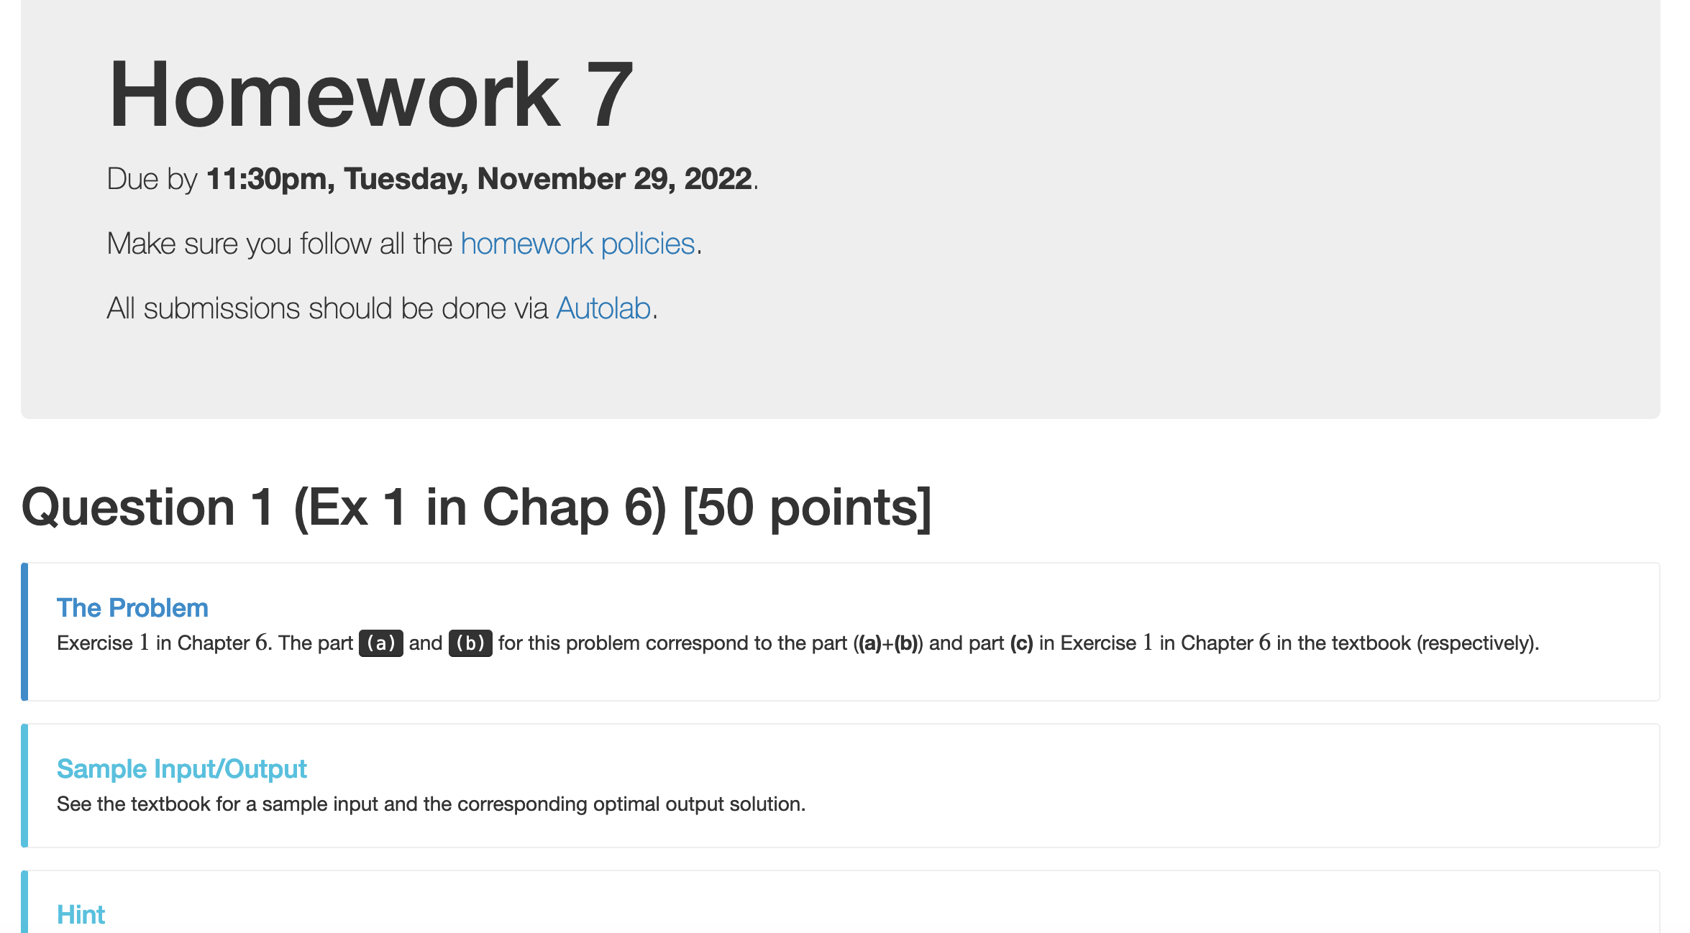
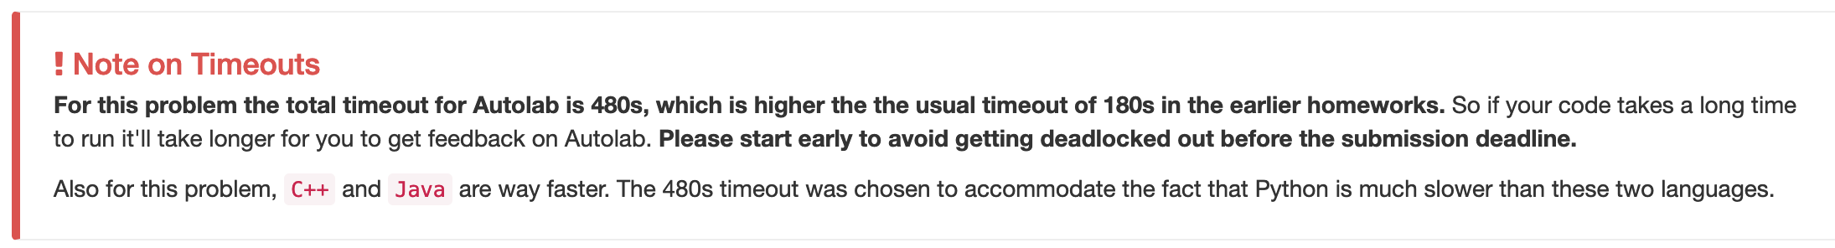
HW 7 out

Slide 3
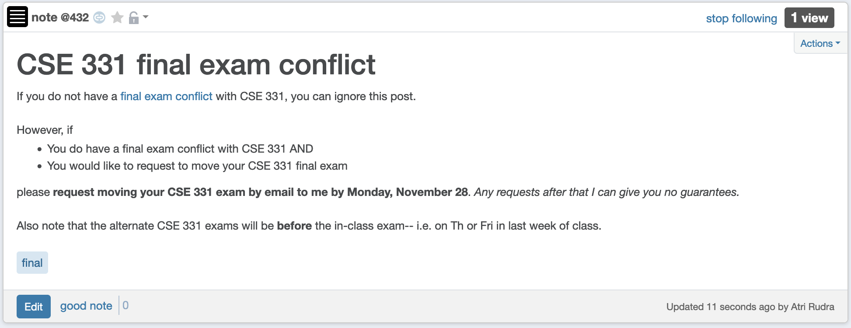
CSE 331 final exam conflict

Slide 4
Subset sum problem
Input:
n integers w₁, w₂, …, w_{n}
bound W
Output:
subset S of [n] such that
sum of w_{i} for all i in S is at most W
w(S) is maximized

Slide 5
Recursive formula
OPT(j, B) = max value out of w₁,..,w_{j} with bound B
If w_{j} > B
OPT(j, B) = OPT(j-1, B)
else
OPT(j, B) = max { OPT(j-1, B), w_{j} + OPT(j-1,B-w_{j}) }

Slide 6

Questions?

Slide 7
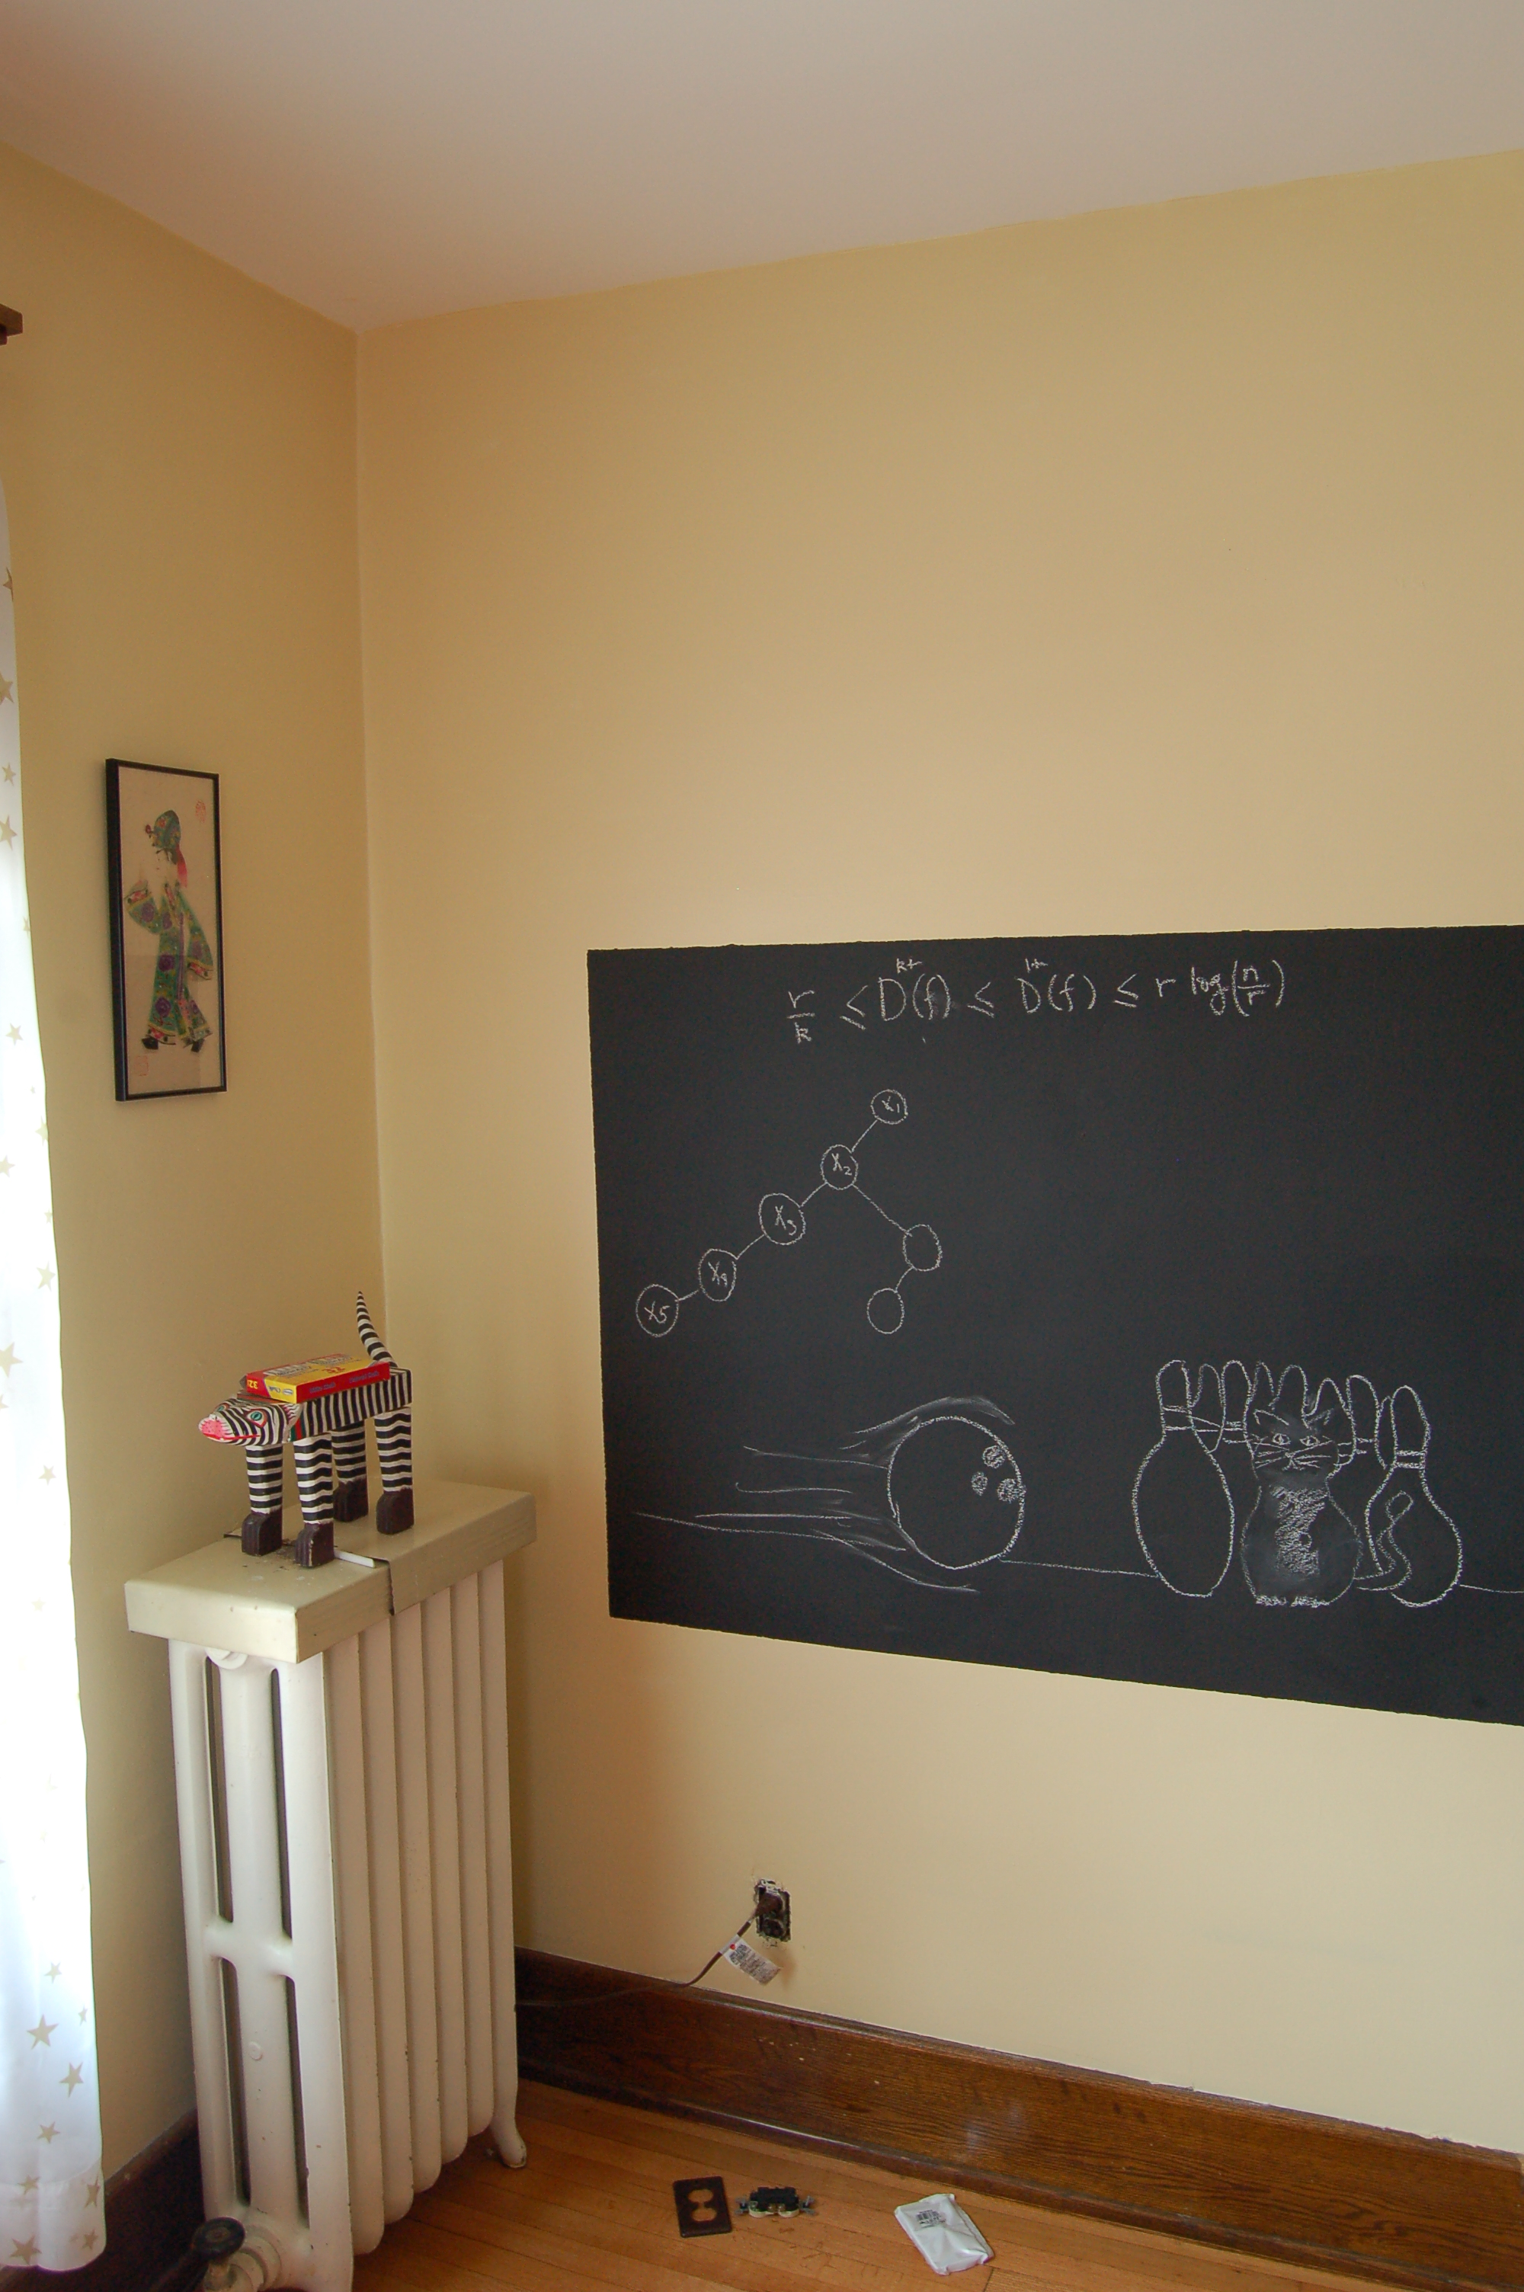
Algo run on the board…

Slide 8
Recursive formula
OPT(j, B) = max value out of w₁,..,w_{j} with bound B
Can compute final S with recursion/ backtracking
If w_{j} > B
OPT(j, B) = OPT(j-1, B)
j not in OPT
j in OPT
else
OPT(j, B) = max { OPT(j-1, B), w_{j} + OPT(j-1,B-w_{j}) }

Slide 9
Knapsack problem
n pairs (w_{1,} v₁), …, (w_{n,} v_{n}),
Input:
n integers w₁, w₂, …, w_{n}
bound W
Output:
subset S of [n] such that
sum of w_{i} for all i in S is at most W
(2) w(S) is maximized
(2) v(S) is maximized

Slide 10
Questions?

Slide 11
Shortest Path Problem
Input: (Directed) Graph G=(V,E) and for every edge e has a cost c_{e} (can be <0)
t in V
Output: Shortest path from every s to t
Assume that G has no negative cycle
1
1
s
t
Shortest path has cost negative infinity
899
100
-1000

Slide 12
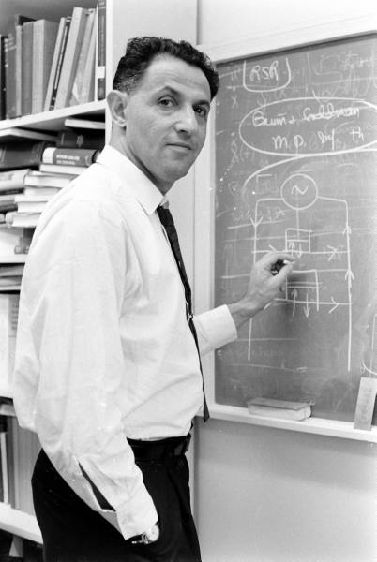
When to use Dynamic Programming
There are polynomially many sub-problems
Richard Bellman
Optimal solution can be computed from solutions to sub-problems
There is an ordering among sub-problem that allows for iterative solution

Slide 13
Rest of today’s agenda
Bellman-Ford algorithm

