Slide 1
Lecture 33
CSE 331
Nov 21, 2022

Slide 2
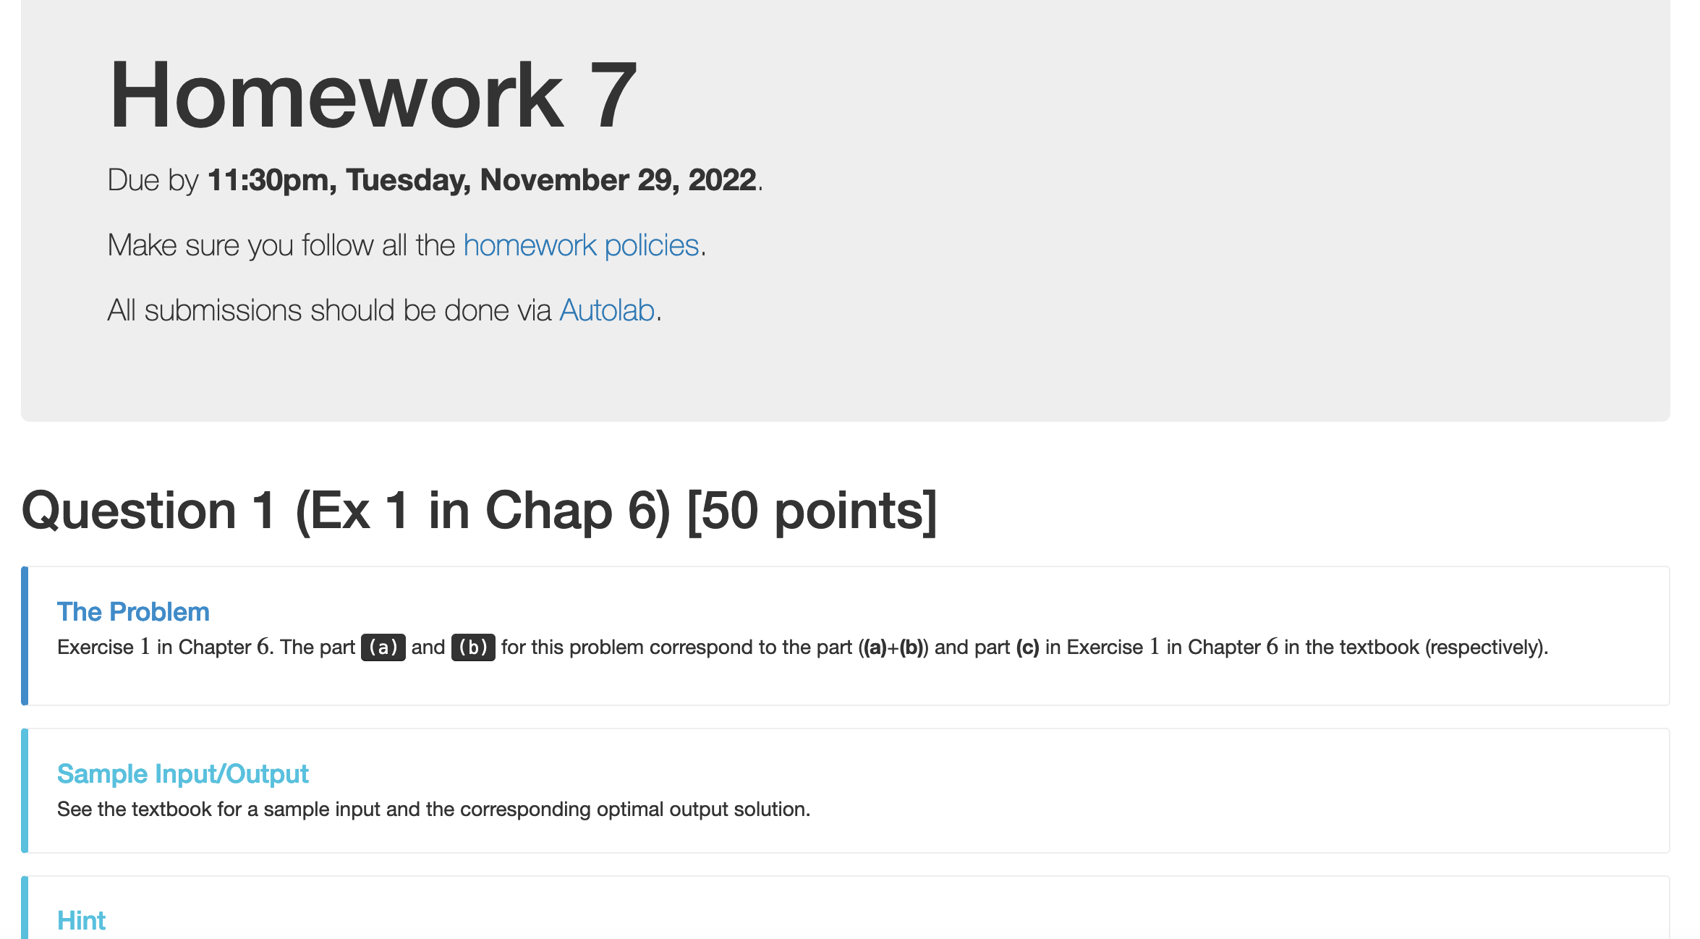
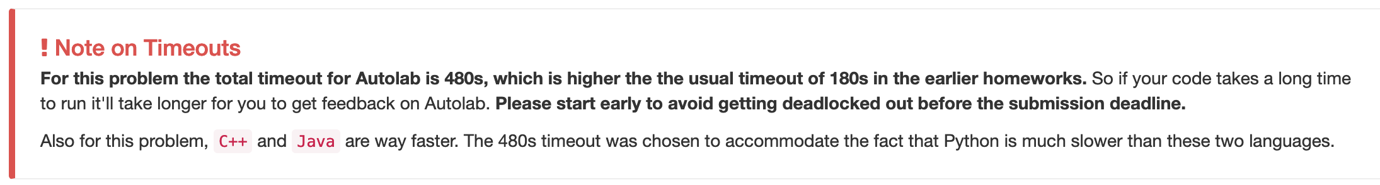
HW 7 reminders

Slide 3
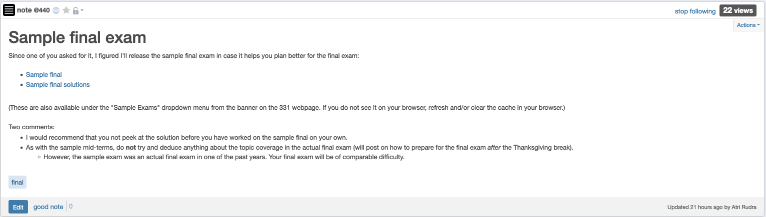
Sample final exam

Slide 4
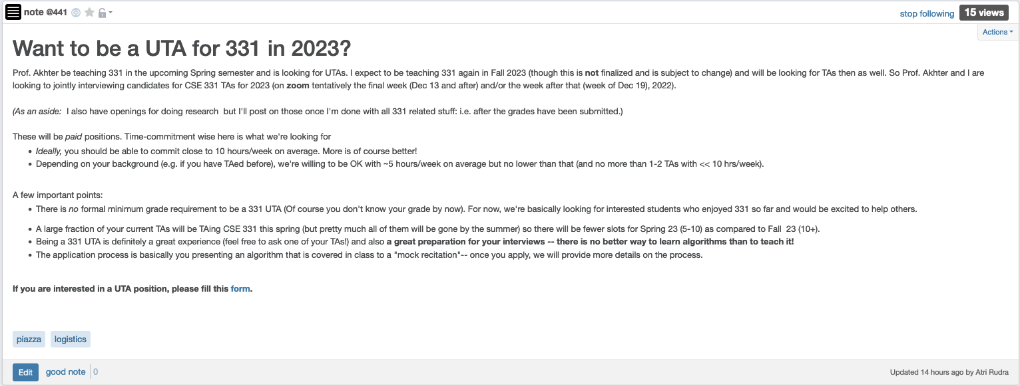
CSE 331 UTA positions for 2023

Slide 5
Shortest Path Problem
Input: (Directed) Graph G=(V,E) and for every edge e has a cost c_{e} (can be <0)
t in V
Output: Shortest path from every s to t
Assume that G has no negative cycle
1
1
s
t
Shortest path has cost negative infinity
899
100
-1000

Slide 6
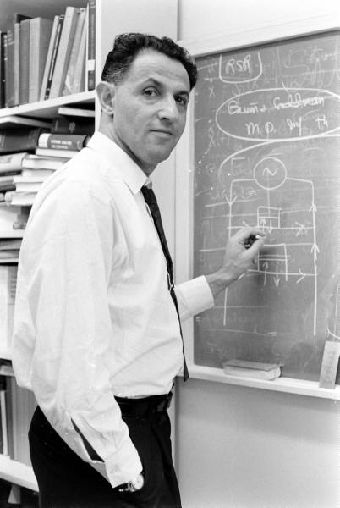
When to use Dynamic Programming
There are polynomially many sub-problems
Richard Bellman
Optimal solution can be computed from solutions to sub-problems
There is an ordering among sub-problem that allows for iterative solution

Slide 7
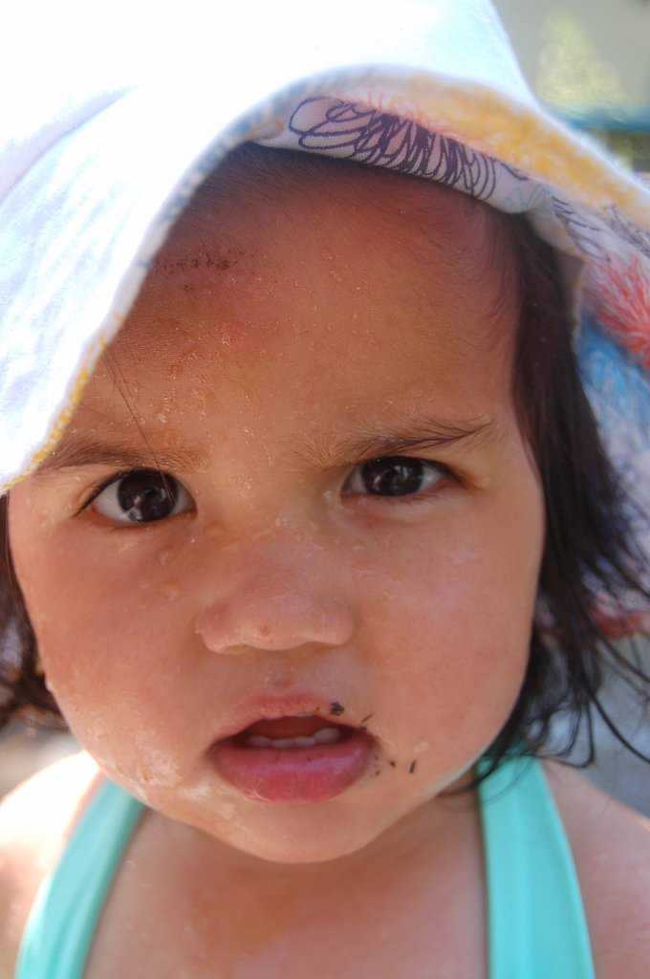
Questions?

Slide 8
Today’s agenda
Bellman-Ford algorithm
Analyze the run time

Slide 9
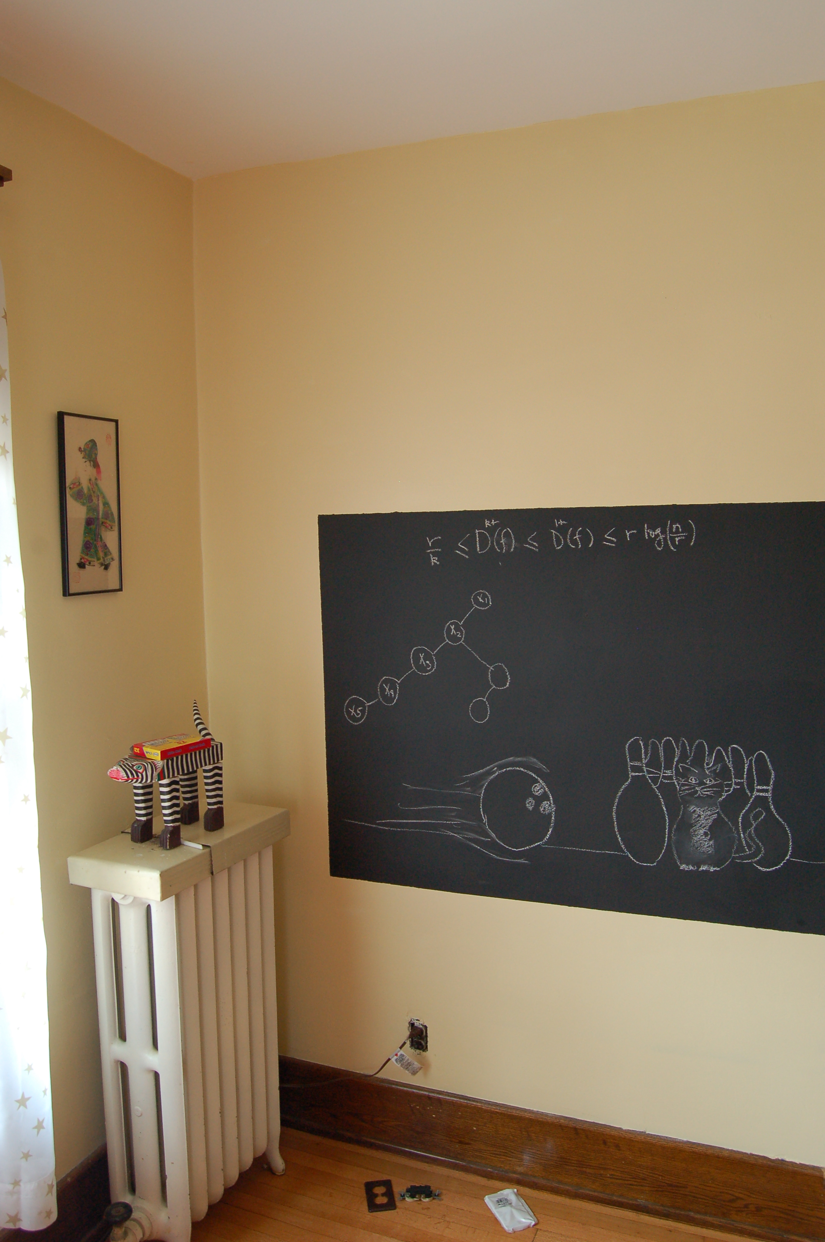
Algo on the board…

Slide 10
The recurrence
OPT(u,i) = shortest path from u to t with at most i edges
OPT(u,i) = min { OPT(u,i-1), min_{(u,w) in E} { c_{u,w} + OPT(w, i-1)} }

Slide 11
Some consequences
OPT(u,i) = cost of shortest path from u to t with at most i edges
OPT(u,i) = min { OPT(u, i-1), min_{(u,w) in E} { c_{u,w} + OPT(w,i-1)} }
OPT(u,n-1) is shortest path cost between u and t
Group talk time:
How to compute the shortest path between s and t given all OPT(u,i) values

