Slide 1
Lecture 38
CSE 331
Dec 7, 2022

Slide 2
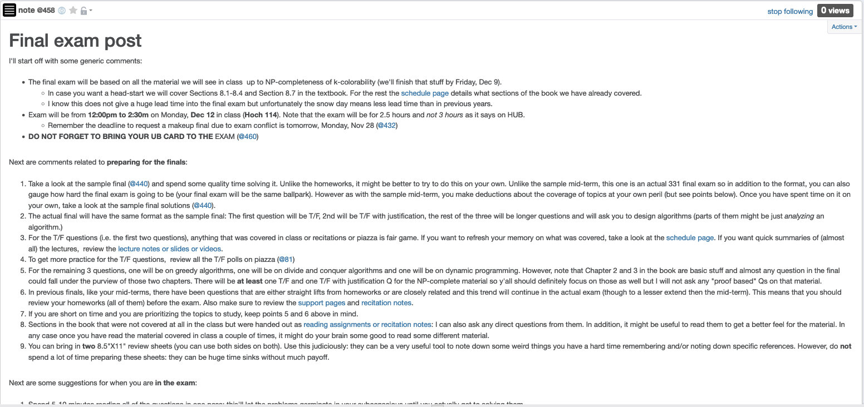
Final exam post

Slide 3
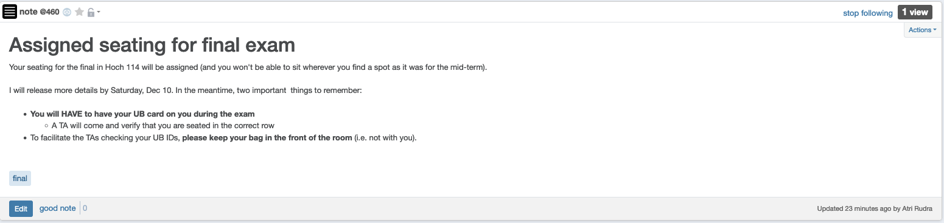
Bring your UB card to final

Slide 4
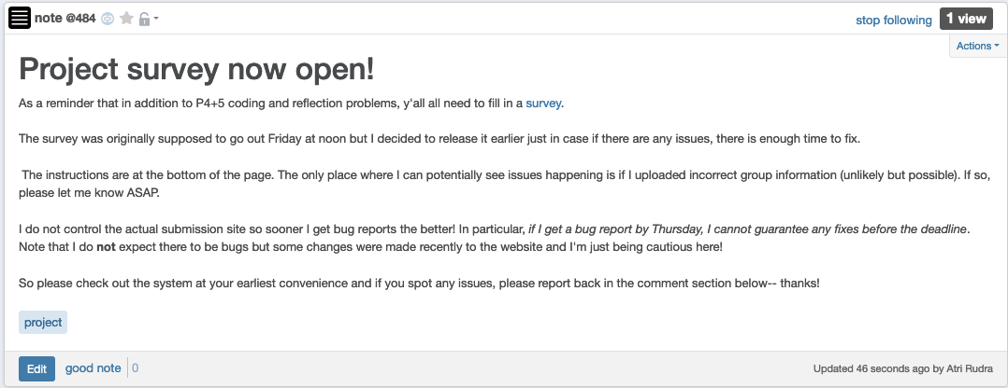
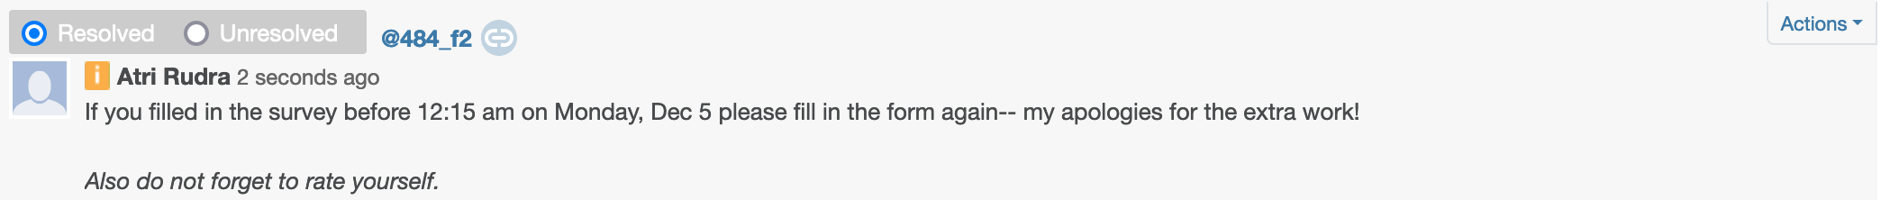
Project surveys are now open

Slide 5
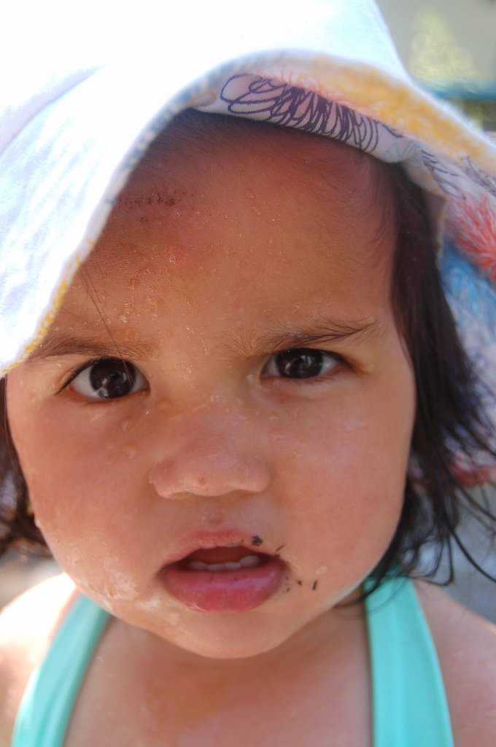
Questions?

Slide 6



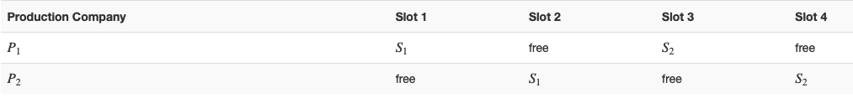
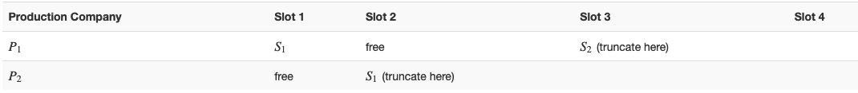



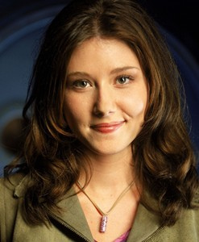
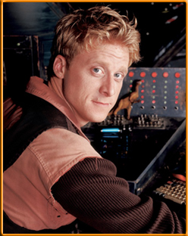

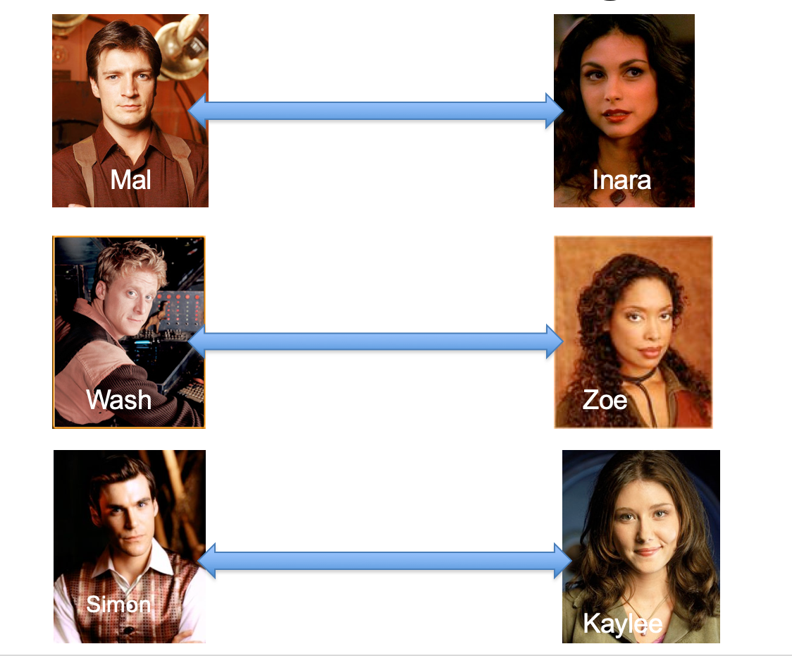
Poly time steps
Arbitrary Y instance
ANY algo for stable matching problem works!
Pre-process the input
Output for Y instance
All processing
is poly-time
Algo for X
Post-process the output

Slide 7



No poly time algo for Y
Poly time algo for X
Arbitrary Y instance
No poly time algo for X
Poly time algo for Y
Pre-process the input
Output for Y instance
All processing
is poly-time
Algo for X
Post-process the output

Slide 8
Today’s agenda
Bit more on redux from 3-SAT to IS
Recap of NP-completeness
NP-completeness of k-colorability

