Slide 1
Lecture 39
CSE 331
Dec 9, 2022

Slide 2
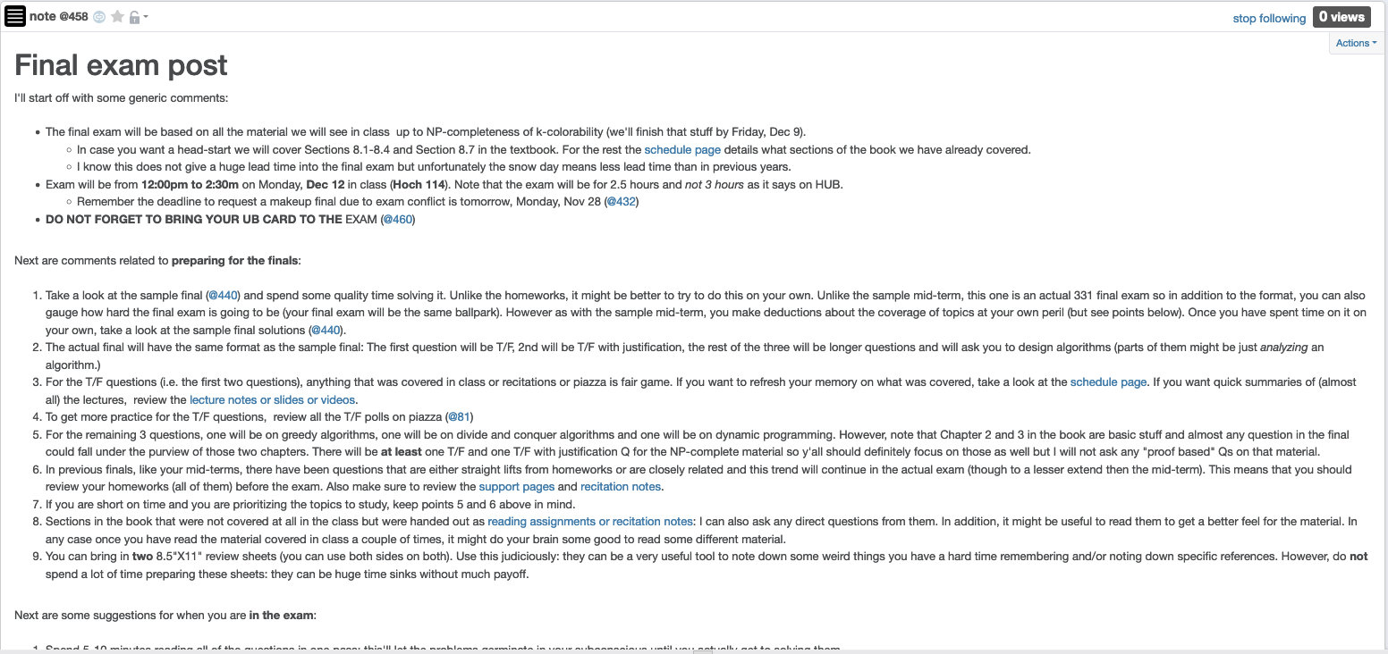
Final exam post

Slide 3
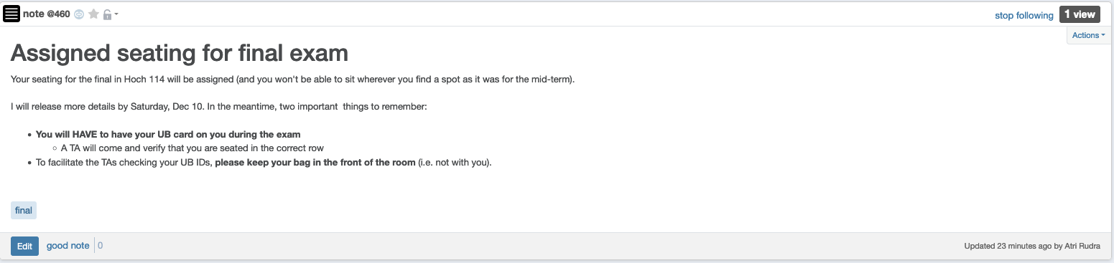
Bring your UB card to final

Slide 4
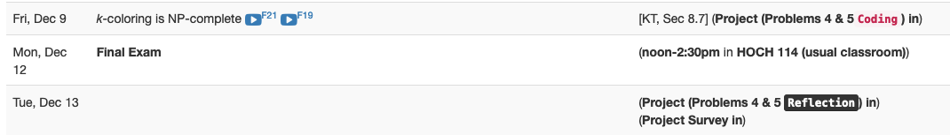
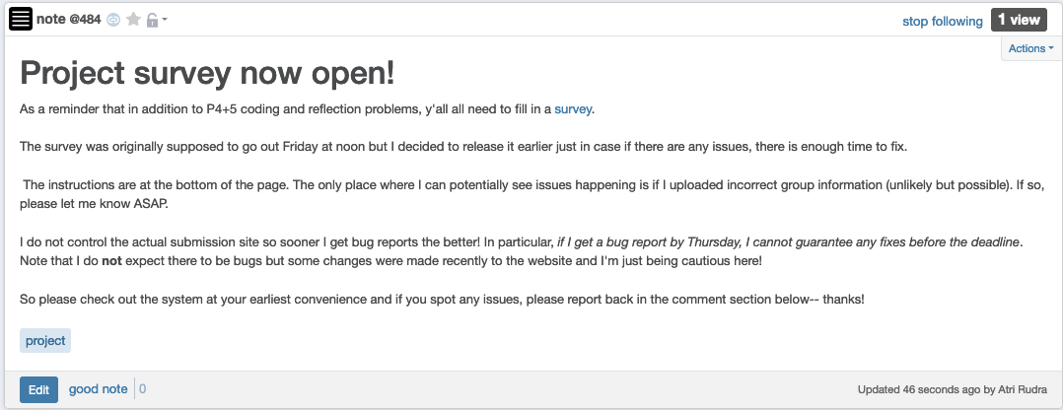
Two more project deadlines

Slide 5
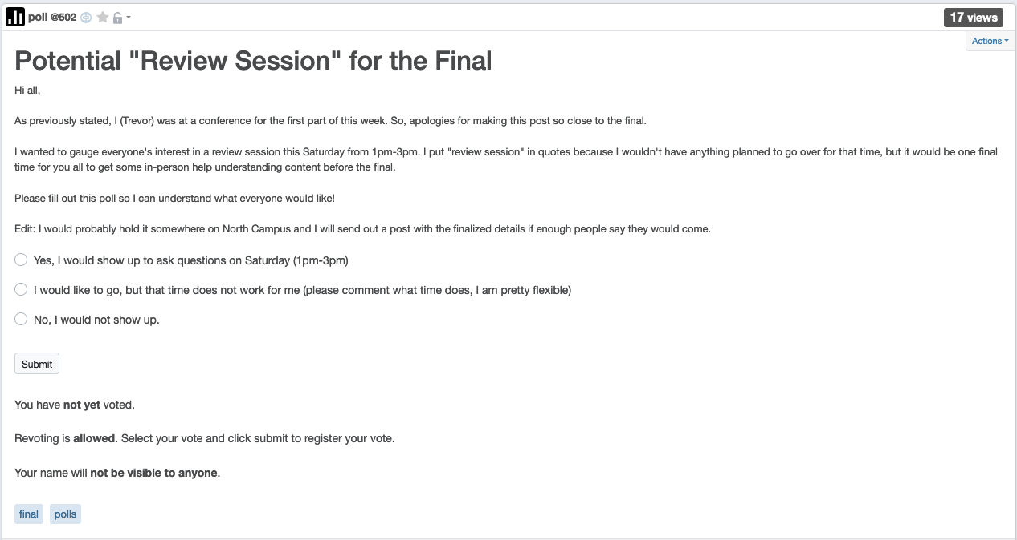
Potential “review session” Sat

Slide 6
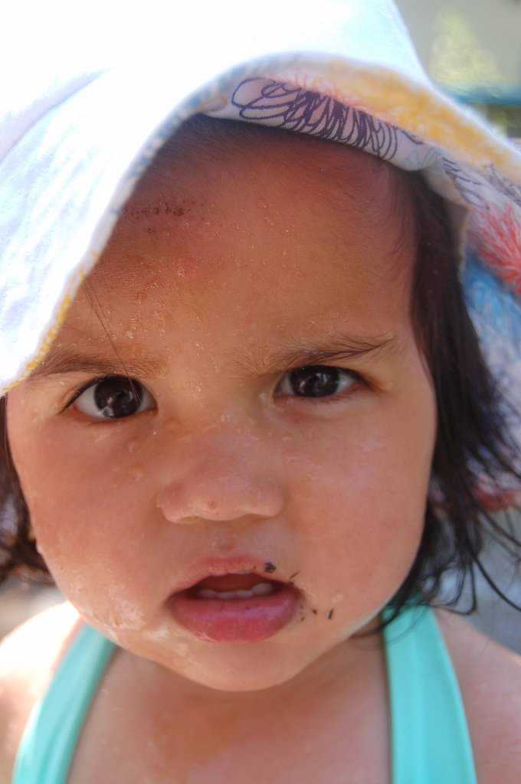
Questions?

Slide 7



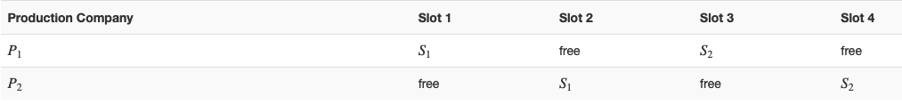
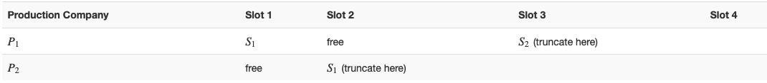



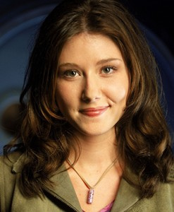
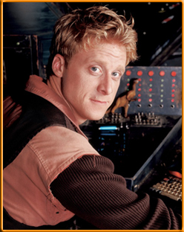

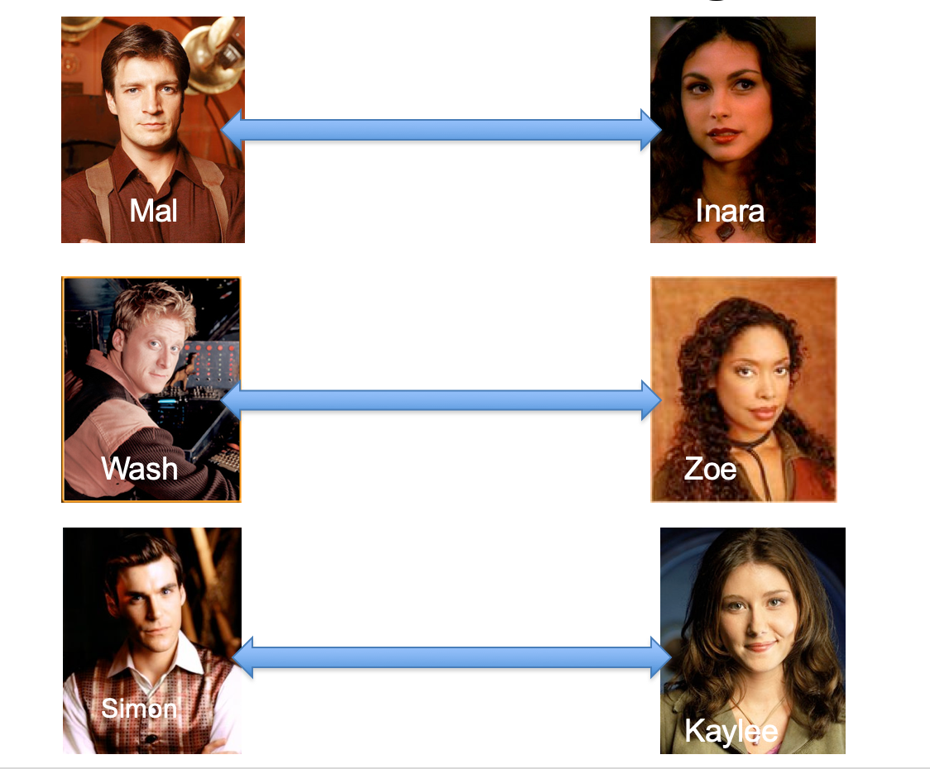
Poly time steps
Arbitrary Y instance
ANY algo for stable matching problem works!
Pre-process the input
Output for Y instance
All processing
is poly-time
Algo for X
Post-process the output

Slide 8



No poly time algo for Y
Poly time algo for X
Arbitrary Y instance
No poly time algo for X
Poly time algo for Y
Pre-process the input
Output for Y instance
All processing
is poly-time
Algo for X
Post-process the output

Slide 9

Arbitrary Y instance
AlgoIS (G,k)
G’ = G
Pre-process the input
Output for Y instance
k’ = n-k
b = AlgoVC(G’,k’)
Algo for X
return b
Post-process the output
(G,n-k)
Algo for VC
(G,k)

Slide 10
Questions?

Slide 11
Today’s agenda
NP-completeness of k-colorability
Beyond NP-completeness

Slide 12
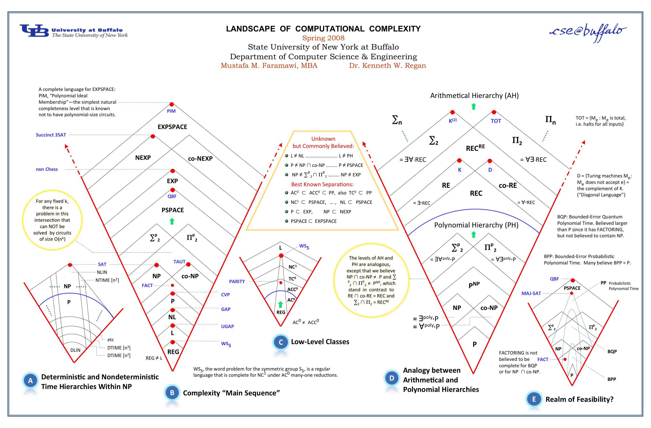
Anything > NP and < undecidability?

Slide 13


Whatever your impression of the 331
IT WAS
RIDING

Slide 14
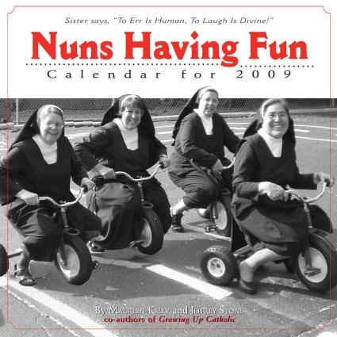
Hopefully it was fun!

Slide 15

Thanks!
Except of course Project P4+5, survey and the final exam

