Slide 1
Lecture 5
CSE 331
Sep 9, 2022

Slide 2
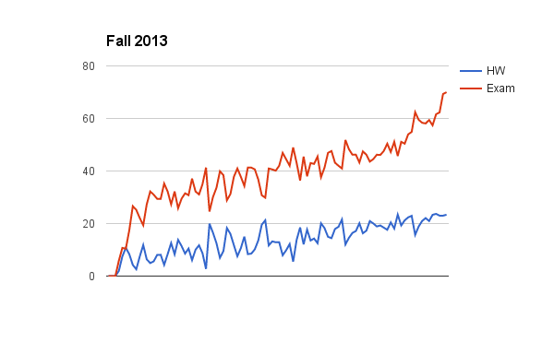
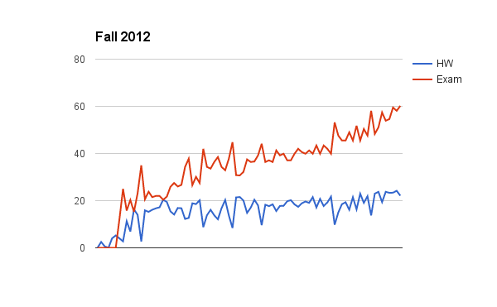
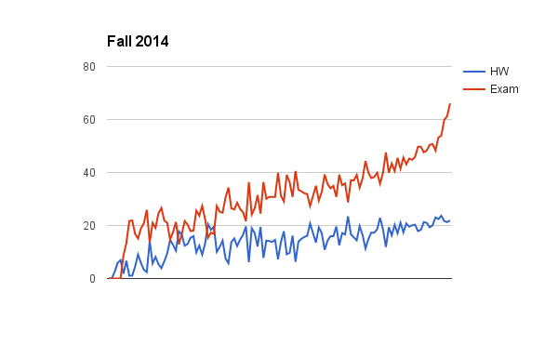
Can you guess the correlation?

Slide 3
Another comment
Discomfort with proofs
I will not cover proof basics in class anymore
Please read support pages and some utilize (next few) Office hours!

Slide 4
Lecture pace (until Fall 18)
Mid-term

Slide 5
Lecture pace
Mid-term

Slide 6
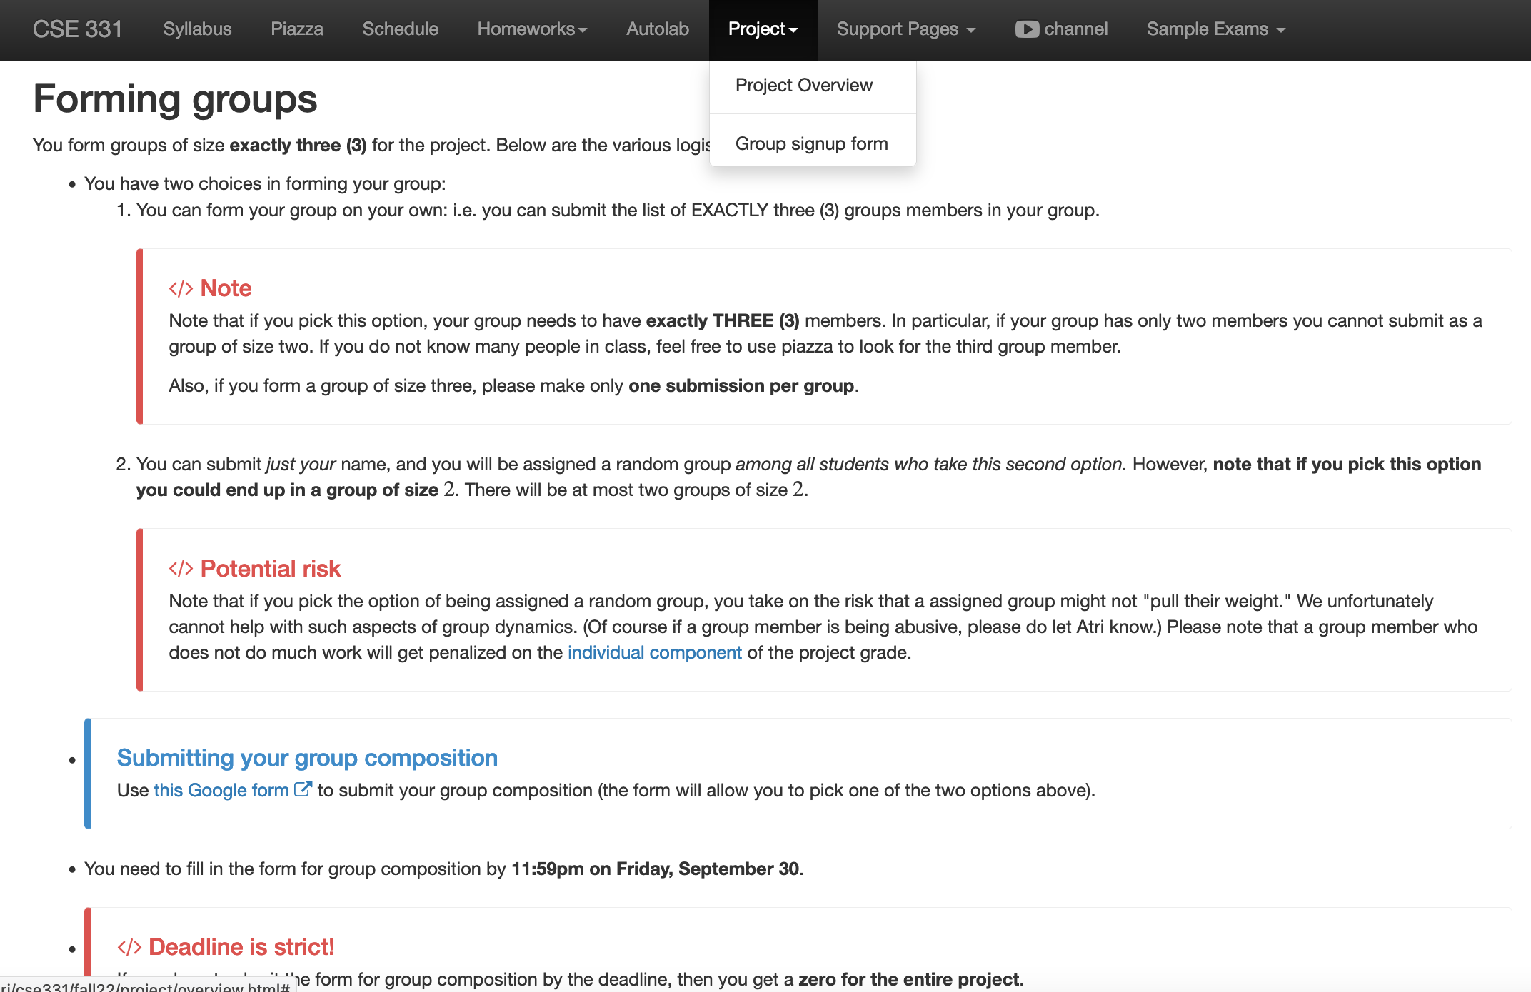
Register your project groups
Deadline: Friday, Sep 30, 11:59pm

Slide 7
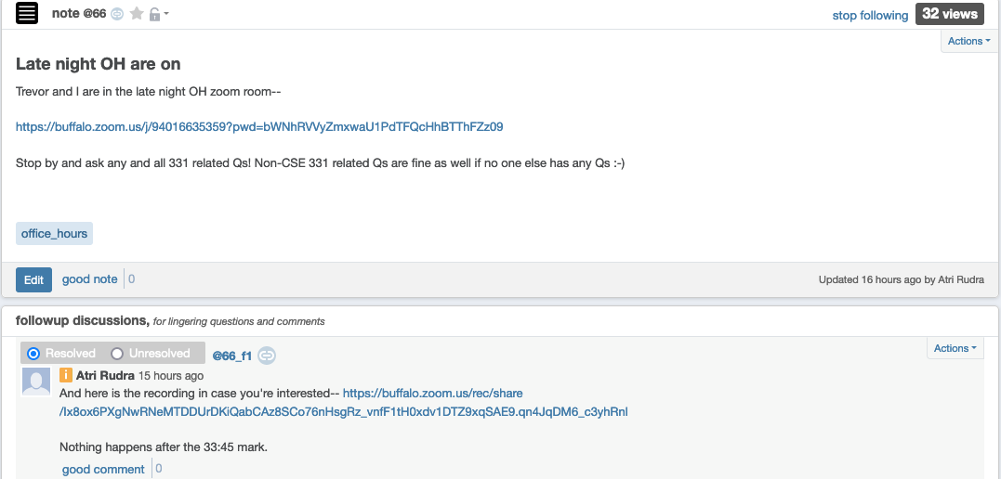
Do come to late night OH!

Slide 8
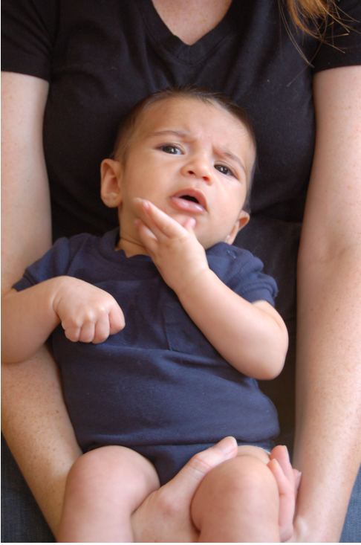
Questions/Comments?

Slide 9
(Perfect) Matching
S is a set of pairs (m,w) where m in M and w in W
exactly
(1) For every woman w in W, exist at most one m such that (m,w) in S
exactly
(2) For every man m in M, exist at most one w such that (m,w) in S
Perfect matching

Slide 10
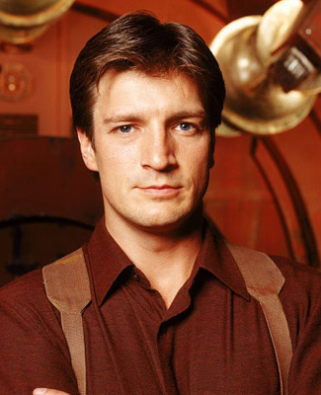
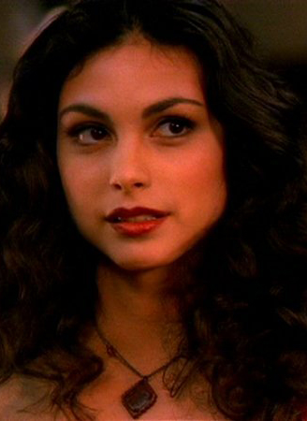
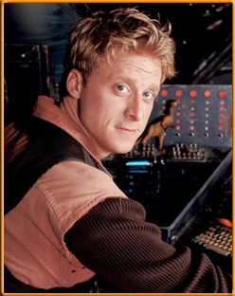
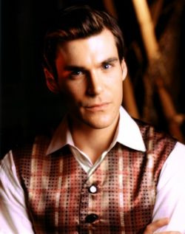
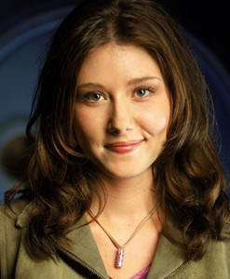
On matchings
Mal
Inara
Wash
Zoe
Simon
Kaylee

Slide 11
A valid matching
Mal
Inara
Wash
Zoe
Simon
Kaylee

Slide 12
Not a matching
Mal
Inara
Wash
Zoe
Simon
Kaylee

Slide 13
Perfect Matching
Mal
Inara
Wash
Zoe
Simon
Kaylee

Slide 14
Preferences
Mal
Inara
Wash
Zoe
Simon
Kaylee

Slide 15
Instability
Mal
Inara
Wash
Zoe
Simon
Kaylee

Slide 16
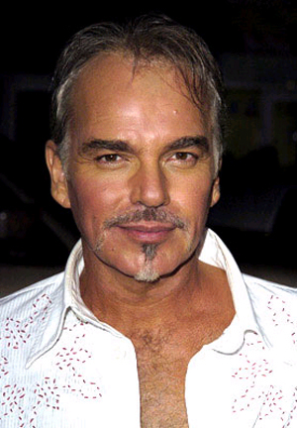
A stable matching
Even though BBT and JA are not very happy
Brad Pitt
Angelina Jolie
Billy Bob Thornton
Jennifer Aniston

Slide 17
Two stable matchings
Brad Pitt
Angelina Jolie
Billy Bob Thornton
Jennifer Aniston

Slide 18
Stable Matching problem
Input: M and W with preferences
Output: Stable Matching
Set of men M and women W
Preferences (ranking of potential spouses)
Matching (no polyandry/gamy in M X W)
Perfect Matching (everyone gets married)
m
w
Instablity
m’
w’
Stable matching = perfect matching+ no instablity

Slide 19
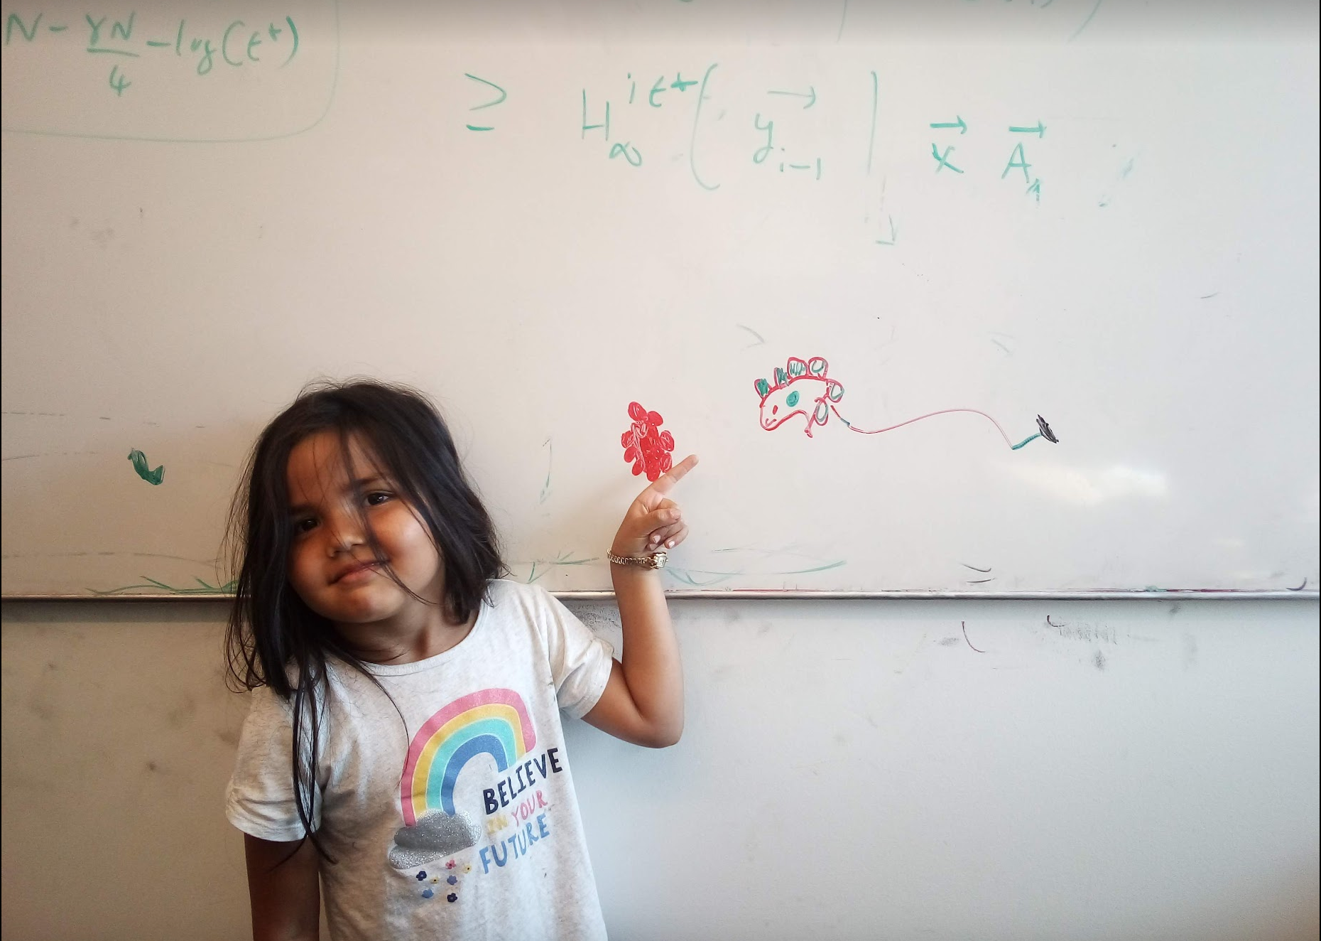
Questions/Comments?

Slide 20
Two Questions
Does a stable marriage always exist?
If one exists, how quickly can we
compute one?

Slide 21
Today’s lecture
Naïve algorithm
Gale-Shapley algorithm for Stable Marriage problem

Slide 22
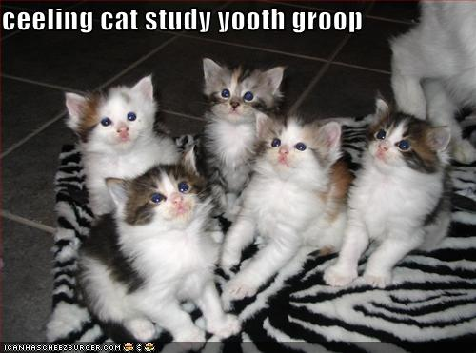
Discuss: Naïve algorithm!

Slide 23
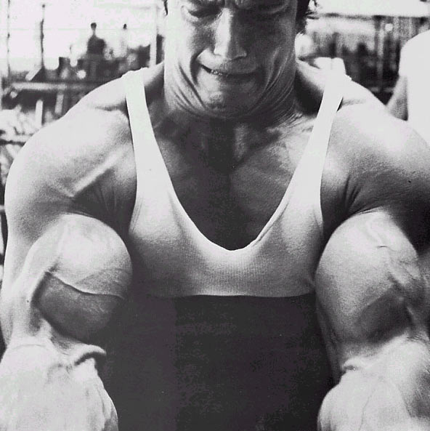
The naïve algorithm
Incremental algorithm to produce all n! prefect matchings?
Go through all possible perfect matchings S
If S is a stable matching
then Stop
n! matchings
Else move to the next perfect matching

Slide 24
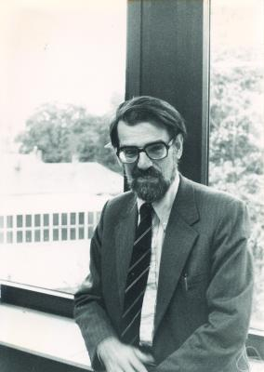
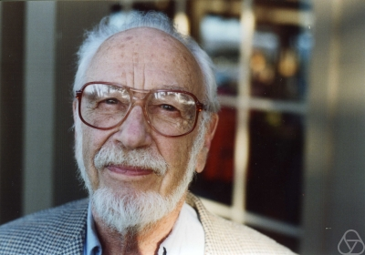
Gale-Shapley Algorithm
David Gale
Lloyd Shapley
O(n²) algorithm

Slide 25
Moral of the story…
>

Slide 26
Questions/Comments?

Slide 27
Rest of today’s agenda
Gale Shapley (GS) algorithm
Run of GS algorithm on an instance

