Slide 1
Lecture 7
CSE 331
Sep 14, 2022

Slide 2
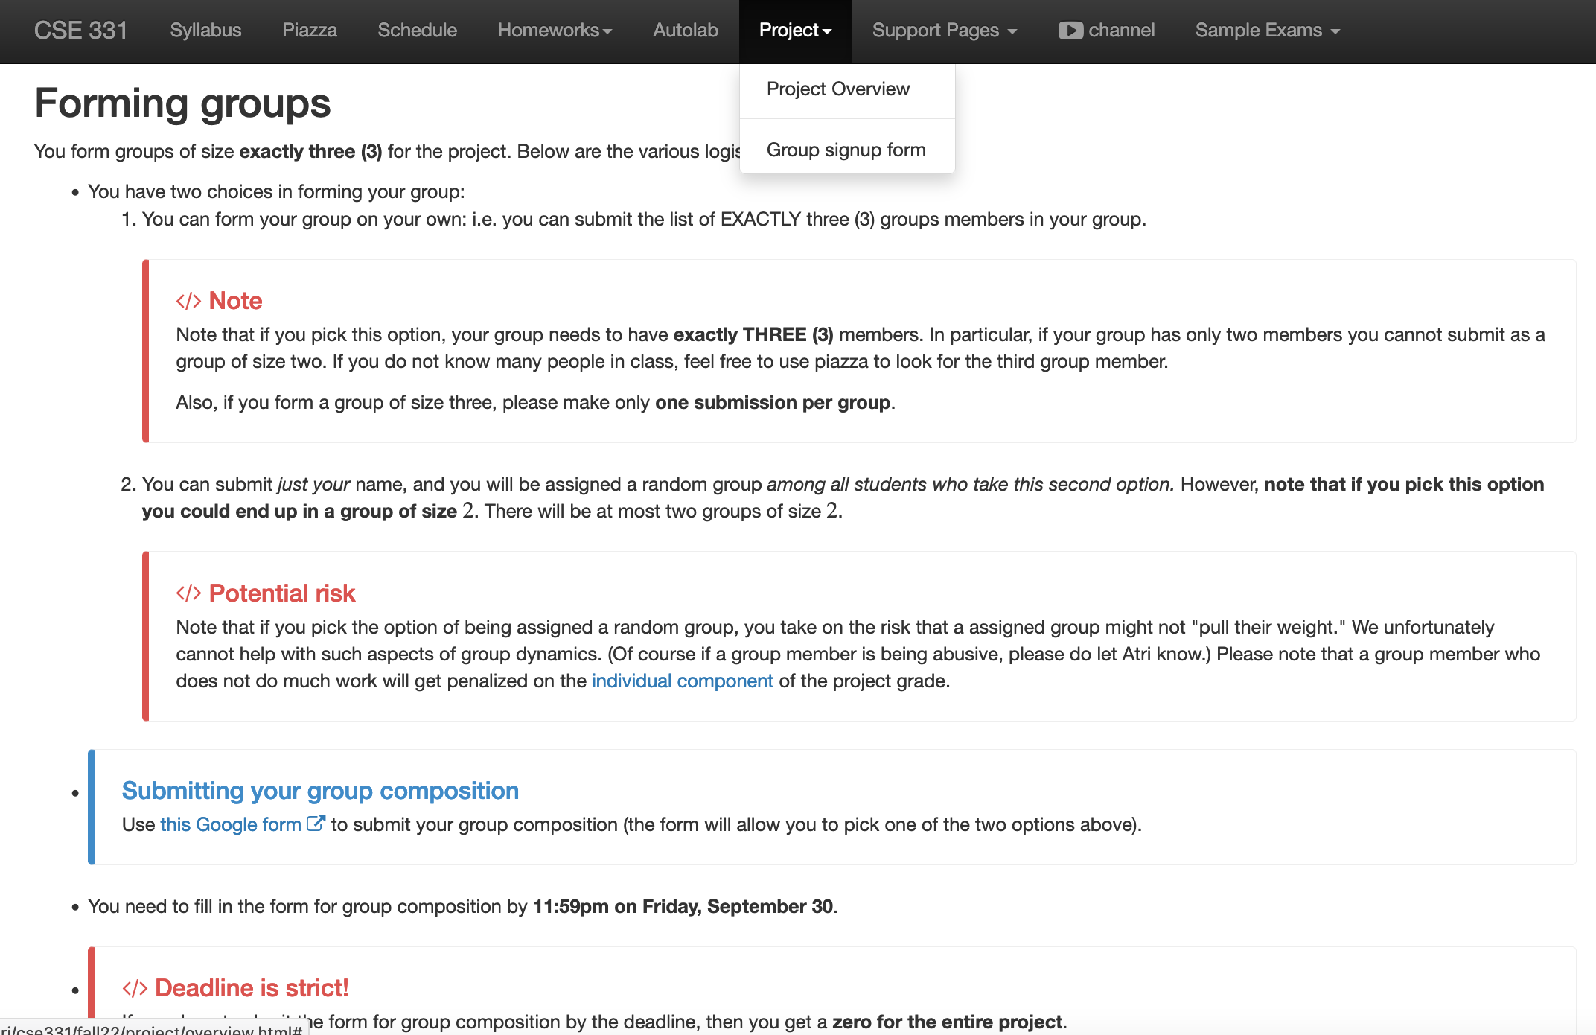
Register your project groups
Deadline: Friday, Sep 30, 11:59pm

Slide 3
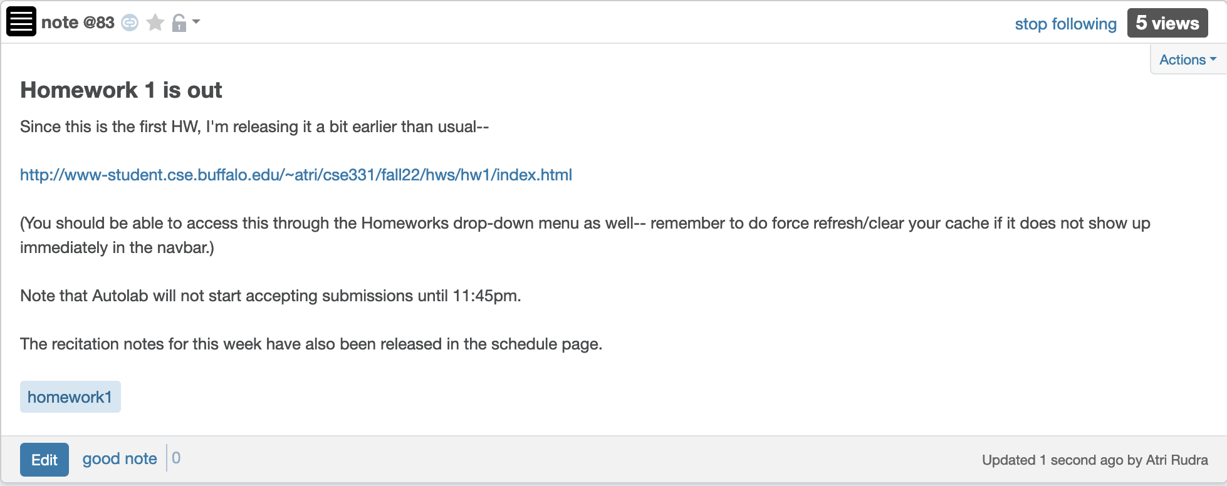
HW 1 is out!

Slide 4
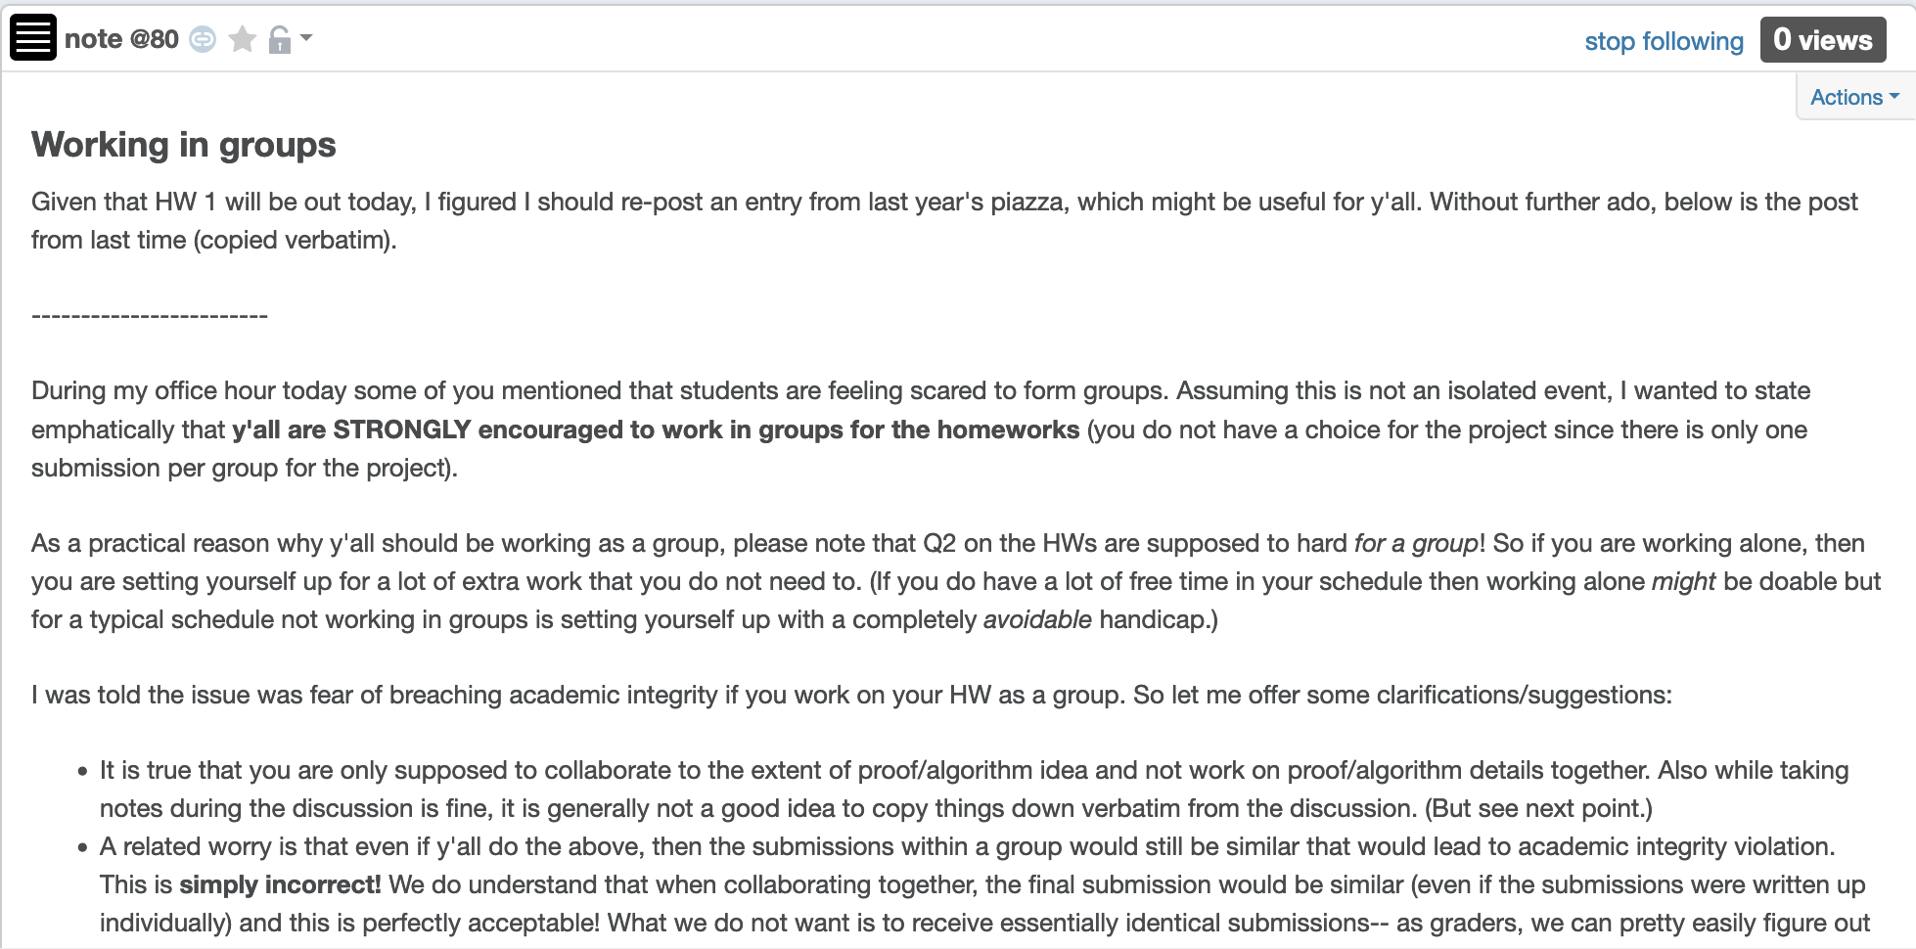
Working in groups

Slide 5
Just putting in time is not enough
You will be graded on what you submit and not how much time you spent
Be smart in how you spend your time
Please ask for help, get feedback if you get stuck!

Slide 6
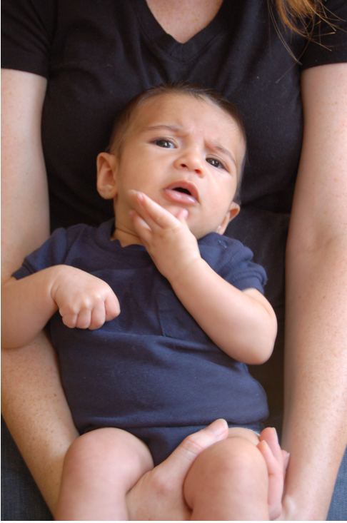
Questions/Comments?

Slide 7
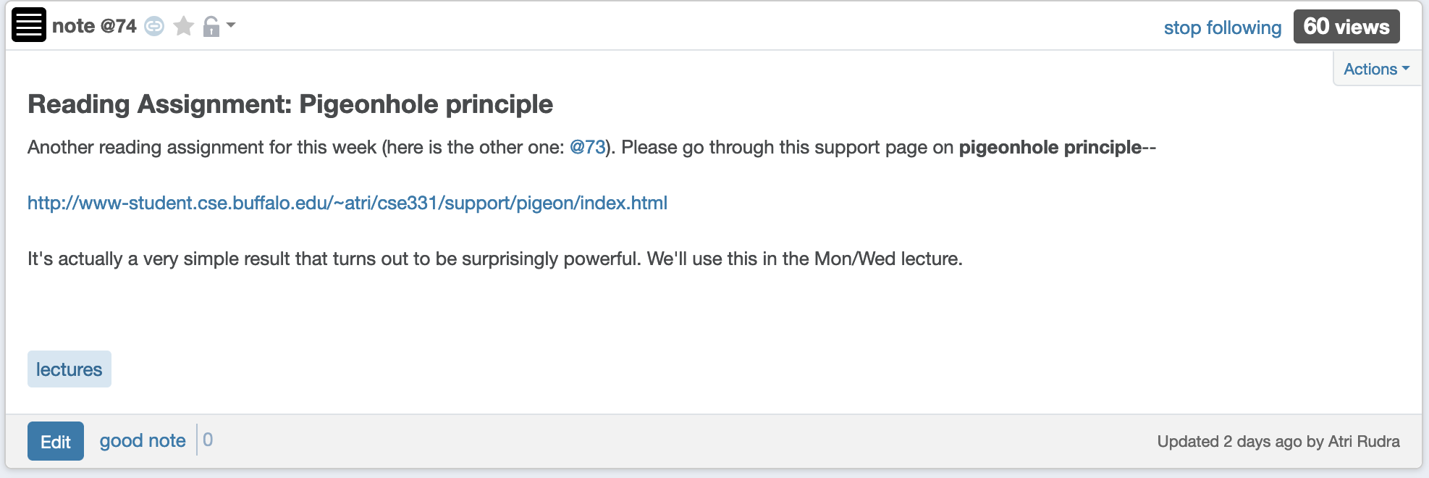
Read your reading assignment?

Slide 8
Gale-Shapley Algorithm
Intially all men and women are free
While there exists a free woman who can propose
Let w be such a woman and m be the best man she has not proposed to
w proposes to m
If m is free
(m,w) get engaged
Else (m,w’) are engaged
If m prefers w’ to w
w remains free
Else
(m,w) get engaged and w’ is free
Output the engaged pairs as the final output

Slide 9
Observation 1
Intially all men and women are free
While there exists a free woman who can propose
Let w be such a woman and m be the best man she has not proposed to
w proposes to m
If m is free
(m,w) get engaged
Once a man gets engaged, he remains engaged (to “better” women)
Else (m,w’) are engaged
If m prefers w’ to w
w remains free
Else
(m,w) get engaged and w’ is free
Output the engaged pairs as the final output

Slide 10
Observation 2
Intially all men and women are free
While there exists a free woman who can propose
Let w be such a woman and m be the best man she has not proposed to
w proposes to m
If m is free
If w proposes to m after m’, then she prefers m’ to m
(m,w) get engaged
Else (m,w’) are engaged
If m prefers w’ to w
w remains free
Else
(m,w) get engaged and w’ is free
Output the set S of engaged pairs as the final output

Slide 11
Questions/Comments?

Slide 12
Today’s lecture
GS algorithms always outputs a stable marriage

Slide 13
The Lemmas
Lemma 1: The GS algorithm has at most n² iterations
Lemma 2: S is a perfect matching
Lemma 3: S has no instability

Slide 14
Questions/Comments?

Slide 15
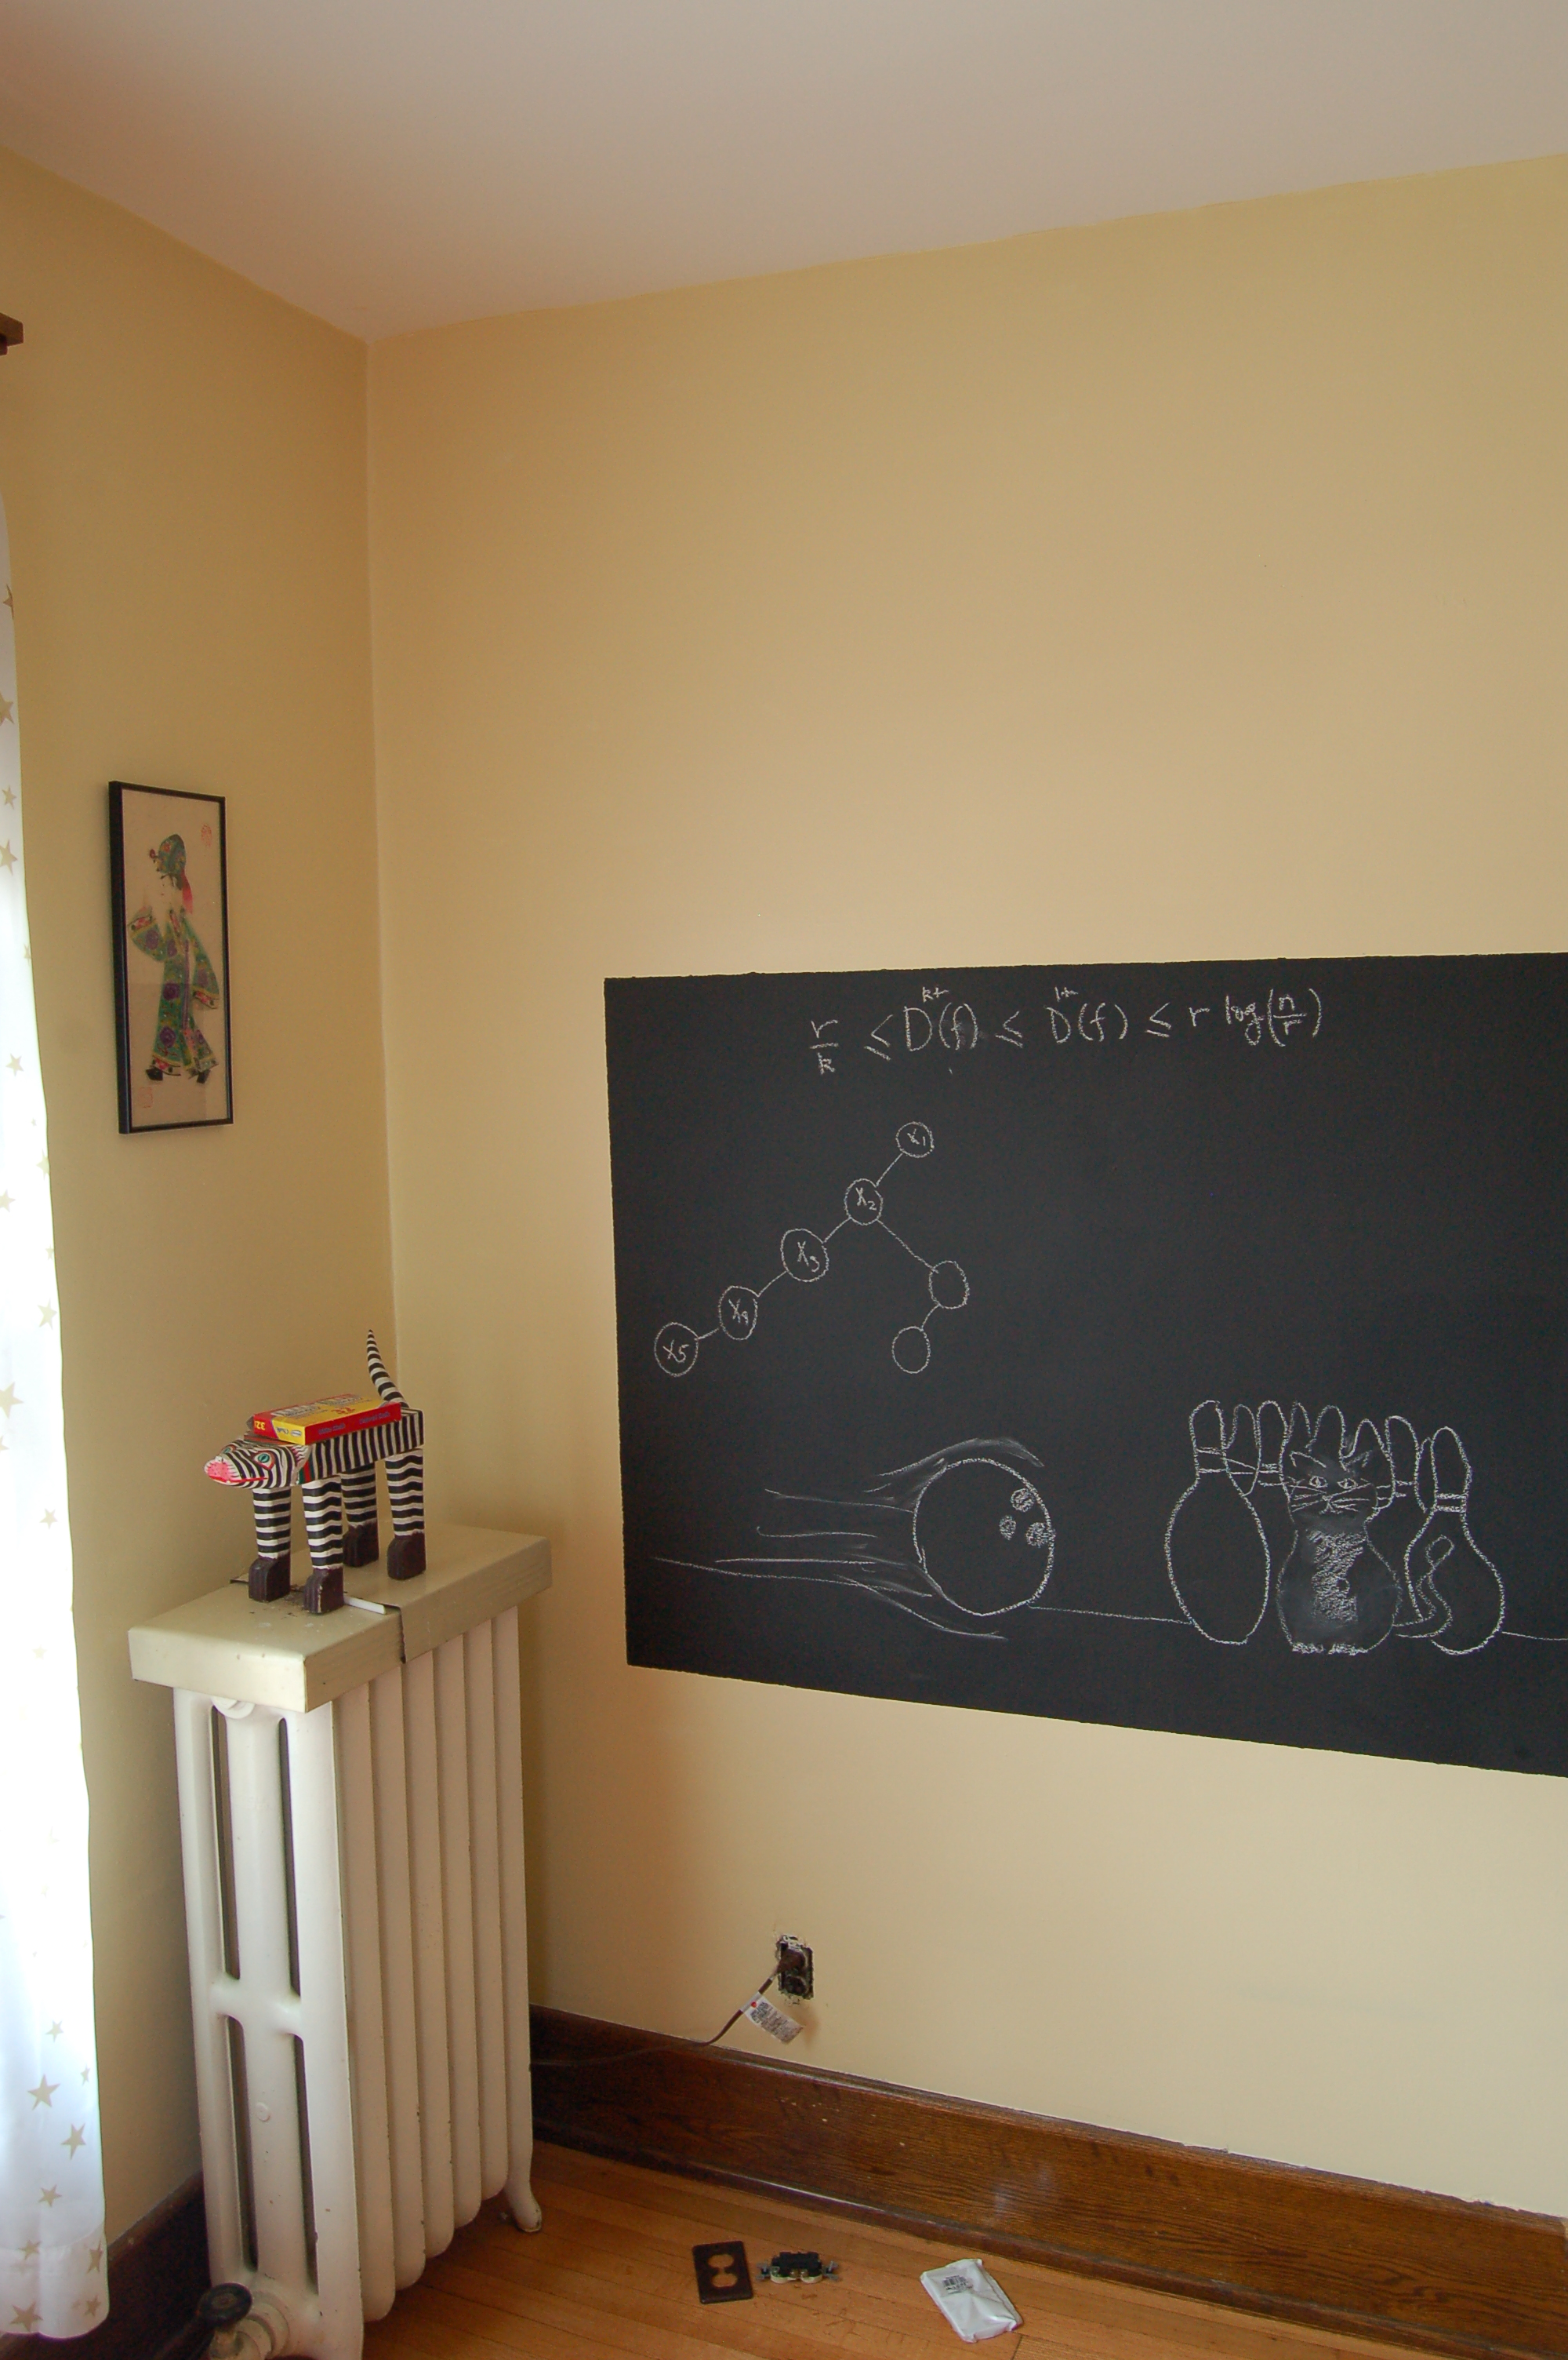
On to the board…

