Slide 1
Lecture 10
CSE 331
Sep 20, 2023

Slide 2
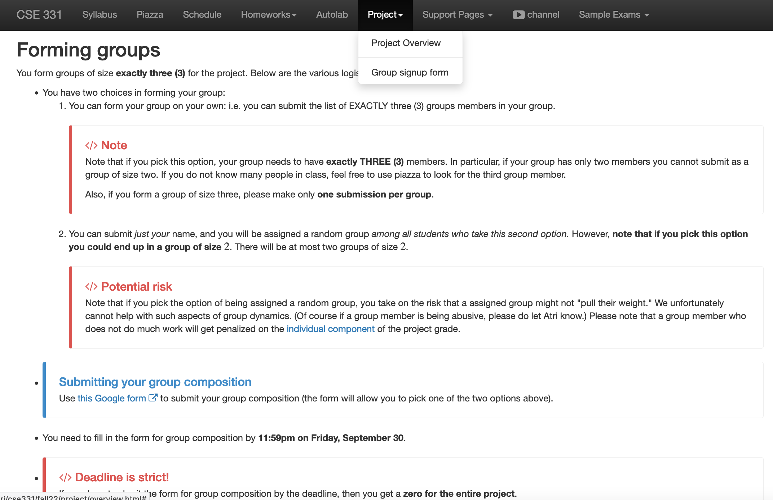
Project groups due in <2 weeks
Deadline: Friday, Sep 29, 11:59pm

Slide 3
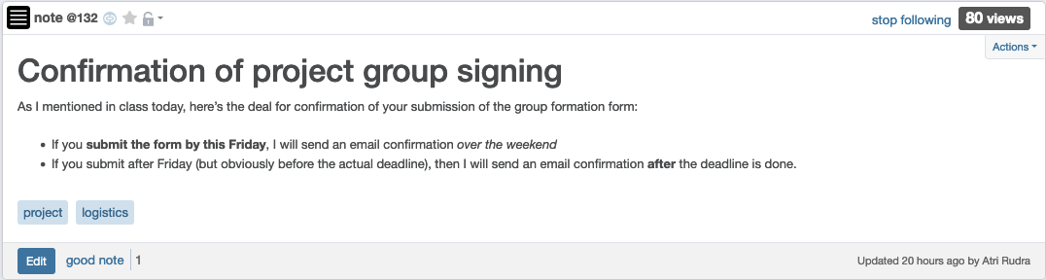
Confirmation of form submission

Slide 4

If you need it, ask for help

Slide 5
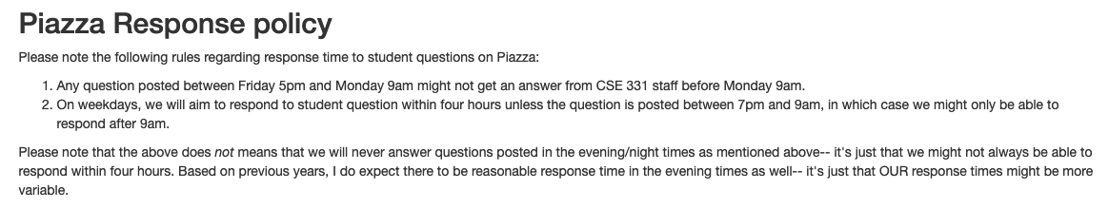
Piazza response policy

Slide 6
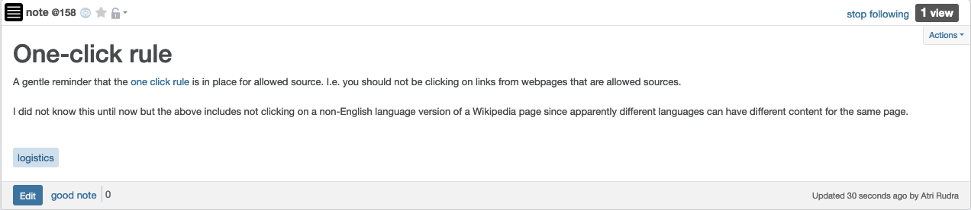
“One click” rule

Slide 7
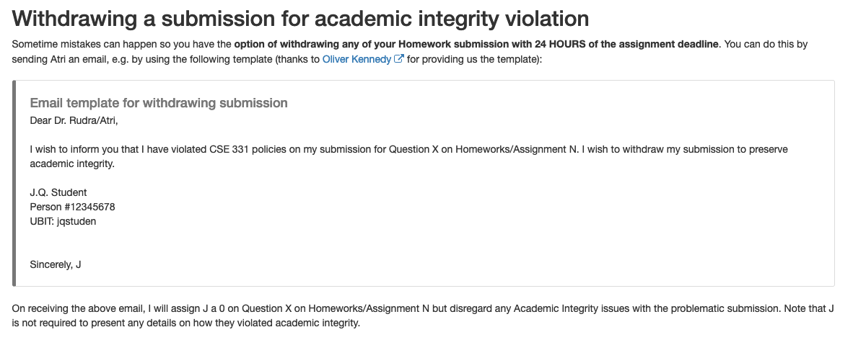
If you did an AI violation on HW 1
You can still withdraw it with no penalty by 11:59pm tonight

Slide 8
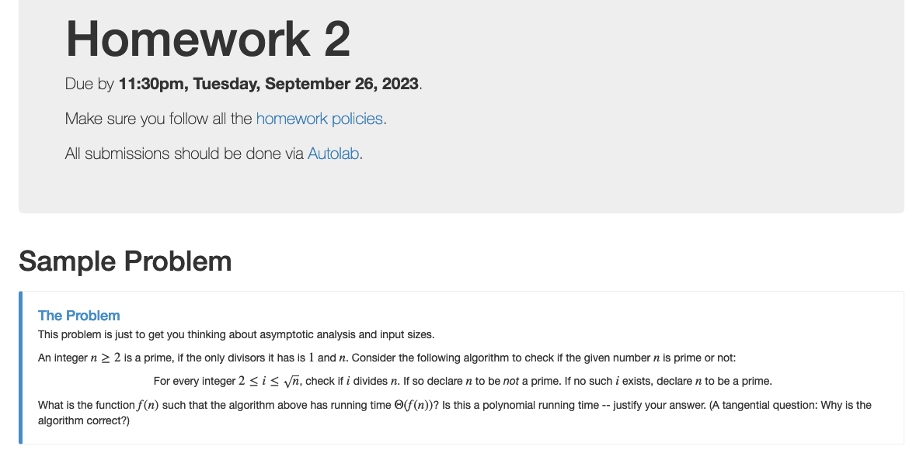
Homework 2 out!

Slide 9
HW 1 solutions

Slide 10
Implementation Steps
(0) How to represent the input?
2D arrays: WomanPref, ManPref
(1) How do we find a free woman w?
Linked list: free
(2) How would w pick her best unproposed man m?
Array: next
(3) How do we know who m is engaged to?
Array: current
O(n) init
O(1) query/update
(4) How do we decide if m prefers w’ to w?

Slide 11
Overall running time
Init(1-4)
n² X ( Query/Update(1-4) )

Slide 12

Questions?

Slide 13

Answering Q4
rank i
w
w’
woman w
man m
w
w’
man m
j
k
ManPref [m][i]
Initialization time?
O(n²) time overall
Ranking [m][w]
O(1) query time
(4) How do we decide if m prefers w’ to w?

Slide 14
Puzzle
Prove that any algorithm for the SMP takes Ω(n²) time

Slide 15








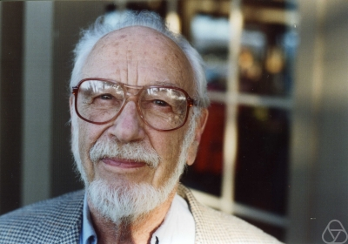
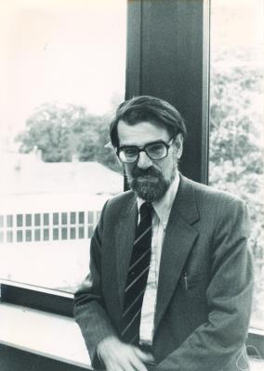
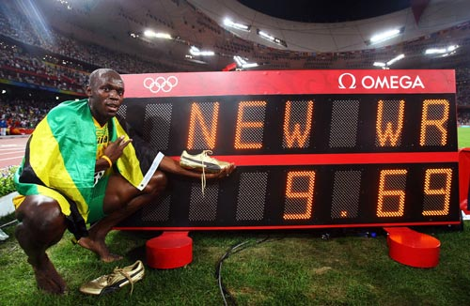
Main Steps in Algorithm Design
Problem Statement
Problem Definition
Algorithm
n!
“Implementation”
Analysis
Correctness Analysis

Slide 16

Reading Assignments
Sec 1.1 and Chap. 2 in [KT]

Slide 17
Up Next….
Problem Statement
A generic tool to abstract out problems
Problem Definition
Algorithm
“Implementation”
Analysis

Slide 18







Graphs
Representation of relationships between pairs of entities/elements
Edge
Entities: News hosts
Relationship: Mention in other’s program
Vertex/Node

Slide 19
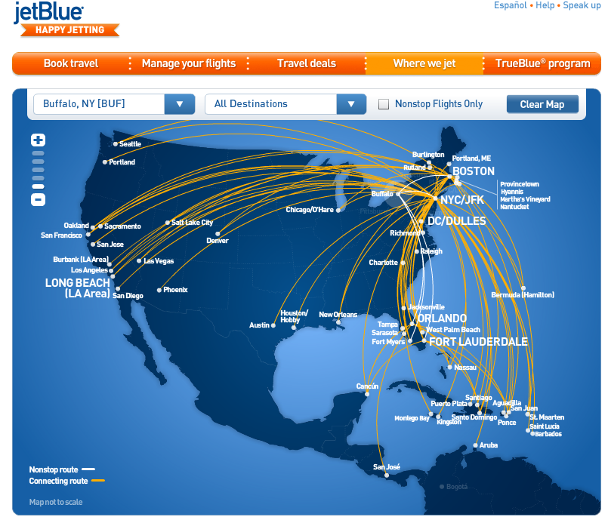
Graphs are omnipresent
Airline Route maps

Slide 20
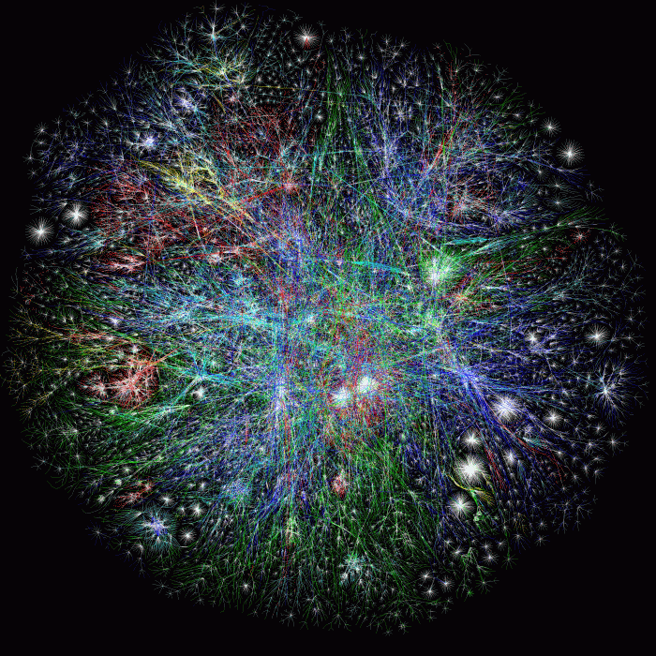
What does this graph represent?
Internet

Slide 21
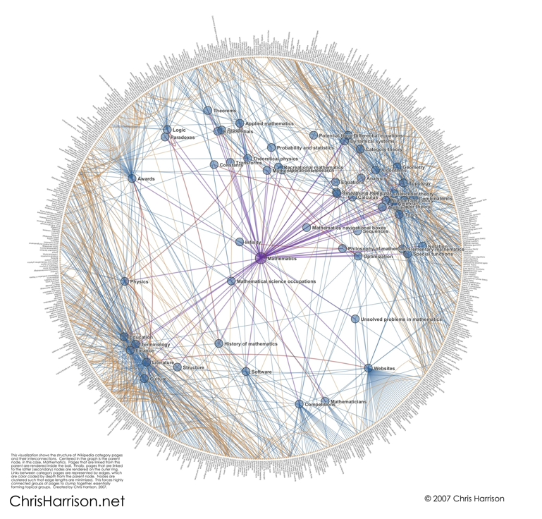
And this one?
Math articles on Wikipedia

Slide 22
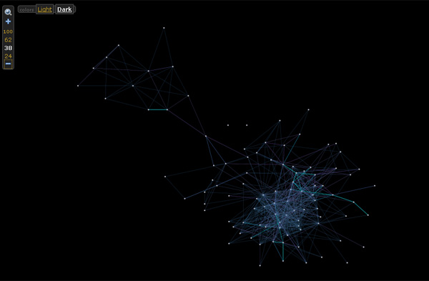

And this one?

Slide 23
Rest of today’s agenda
Basic Graph definitions

Slide 24

Paths
,
Sequence of vertices connected by edges
Connected
Path length 3
,
,
,

Slide 25
Connectivity
u and w are connected iff there is a path between them
A graph is connected iff all pairs of vertices are connected

Slide 26


Connected Graphs
Every pair of vertices has a path between them

Slide 27
Cycles
Sequence of k vertices connected by edges, first k-1 are distinct
,
,
,

Slide 28


Slide 29
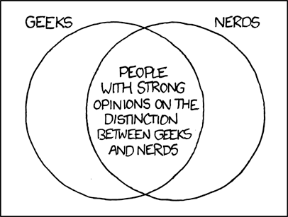
Formally define everything
http://imgs.xkcd.com/comics/geeks_and_nerds.png

