Slide 1
Lecture 13
CSE 331
Sep 27, 2023

Slide 2
BFS Tree
BFS naturally defines a tree rooted at s
Add non-tree edges
L_{j} forms the jth “level” in the tree
u in L_{j+1} is child of v in L_{j} from which it was “discovered”
1
7
9
1
L₀
2
3
L₁
2
3
8
0
4
5
4
5
7
8
L₂
6
6
L₃

Slide 3
Two facts about BFS trees
(1) All non-tree edges are in the same or consecutive layer
(2) If u is in L_{i} then dist(s,u) = i

Slide 4
Rest of today’s agenda
Computing Connected component

Slide 5










Computing Connected Component
Explore(s)
Start with R = {s}
While exists (u,w) edge w not in R and u in R
Add w to R
Output R* = R
BFS (Build layers of vertices)
L₀ = {s}
Assume L₀,..,L_{j} have been constructed
L_{j+1} set of vertices not chosen yet but are connected to L_{j}
Stop when new layer is empty

Slide 6
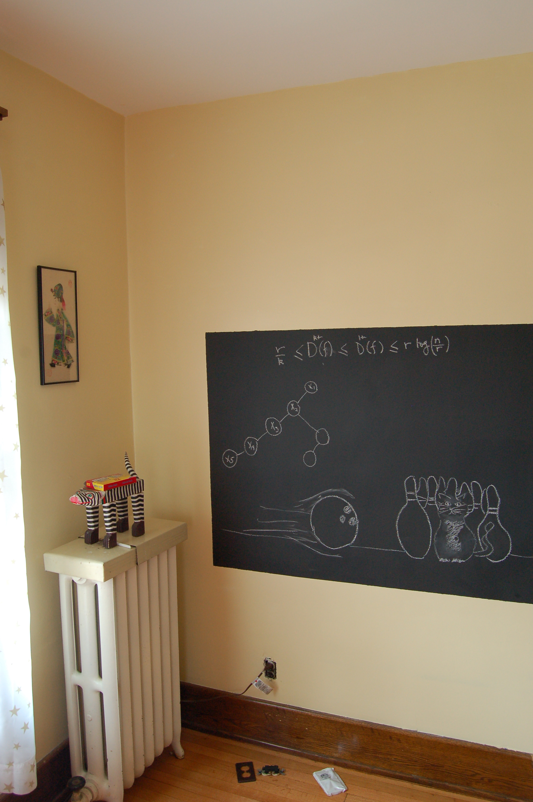
Argue correctness on the board…

Slide 7

BFS
all

Slide 8

Depth First Search (DFS)
http://xkcd.com/761/

Slide 9
DFS(u)
Mark u as explored and add u to R
For each edge (u,v)
If v is not explored then DFS(v)

Slide 10

Why is DFS a special case of Explore?

Slide 11
A DFS run
Every non-tree edge is between a node and its ancestor
1
DFS(u)
1
7
u is explored
2
2
3
For every unexplored
neighbor v of u
8
4
DFS(v)
4
5
5
DFS tree
6
6
3
8
7
Notes:
Note that the tree is arbitrary based on which neighbor was visited first.

Slide 12

Questions/Comments?

Slide 13
Connected components are disjoint
Either connected components of s and t are the same or are disjoint
Algorithm to compute ALL the connected components?
Can run Explore instead of BFS
Run BFS on some node s. Then run BFS on t that is not connected to s

Slide 14
Computing all CCs
9
0
1
7
9
1
L₀
2
3
L₁
2
3
8
0
4
5
4
5
7
8
L₂
6
6
L₃

Slide 15
Questions/Comments?

