Slide 1
Lecture 16
CSE 331
Oct 4, 2023

Slide 2
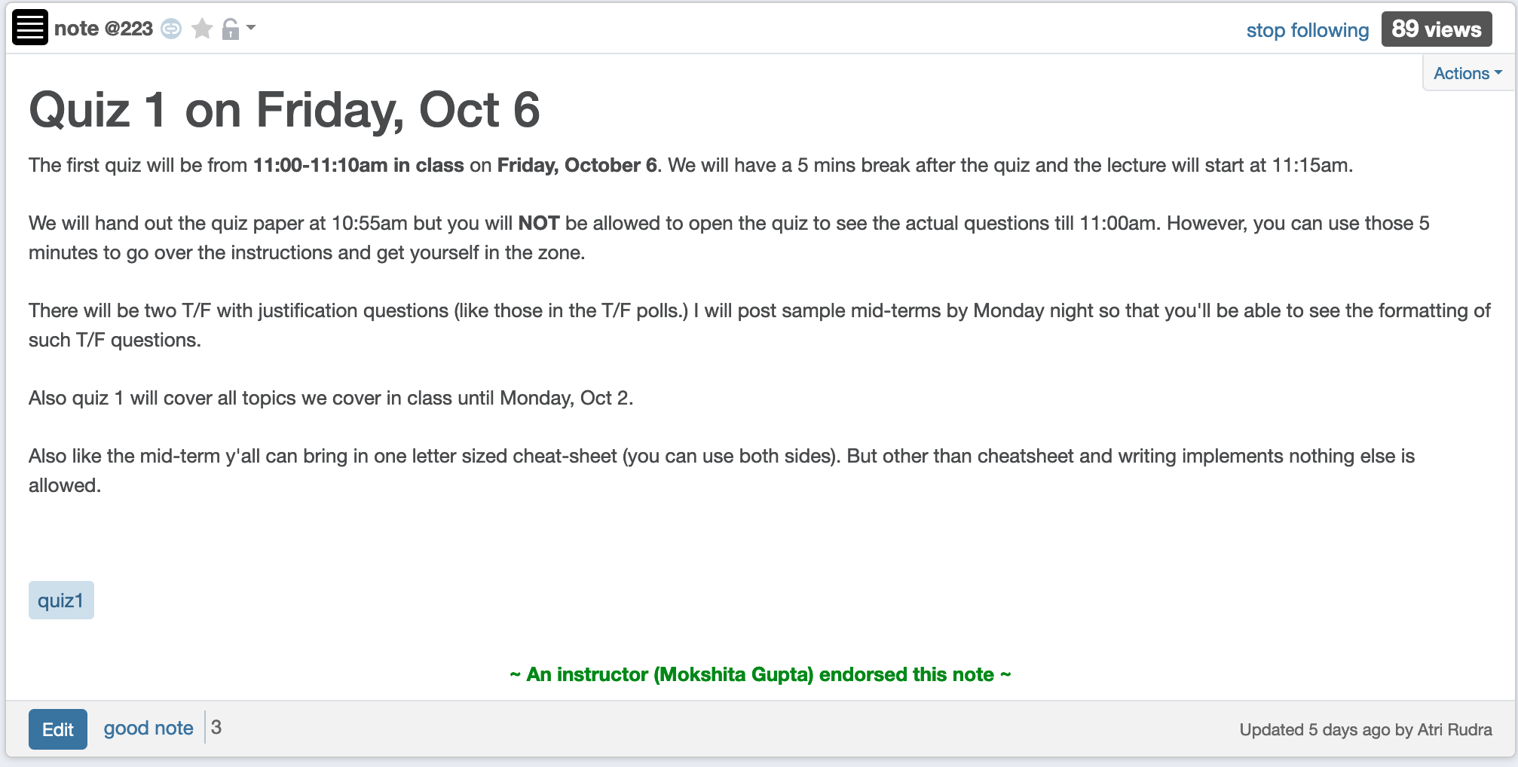
Quiz 1 this FRIDAY

Slide 3
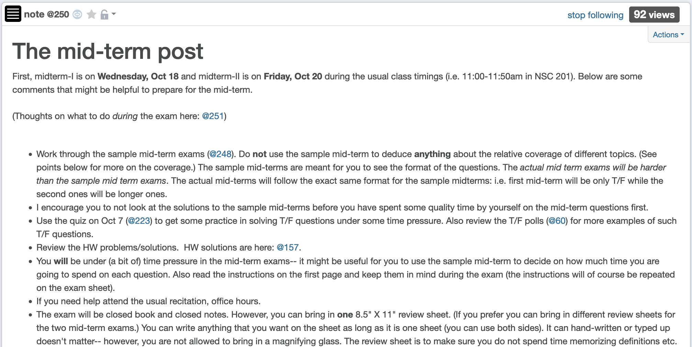
Mid-term post 1

Slide 4
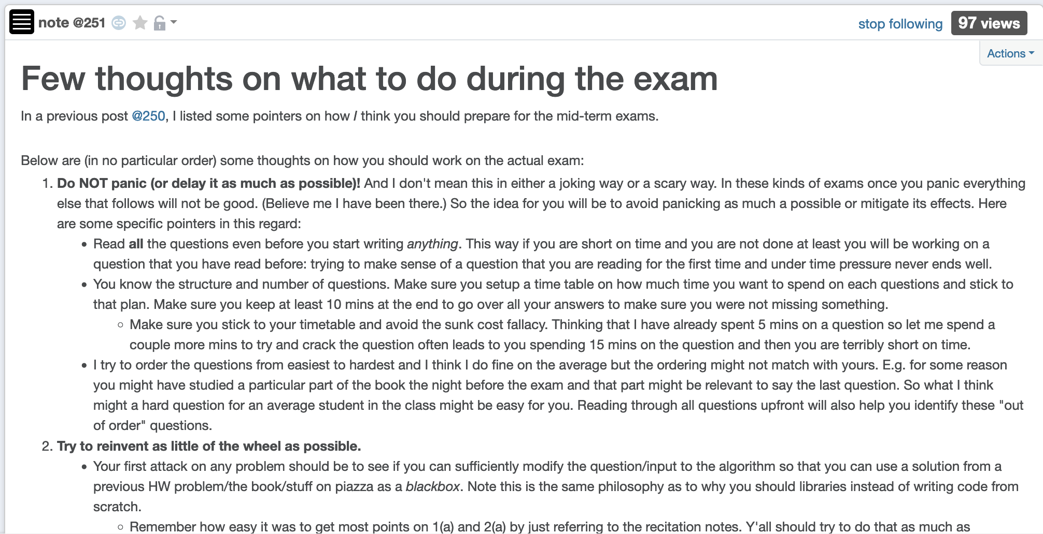
Mid-term post 2

Slide 5
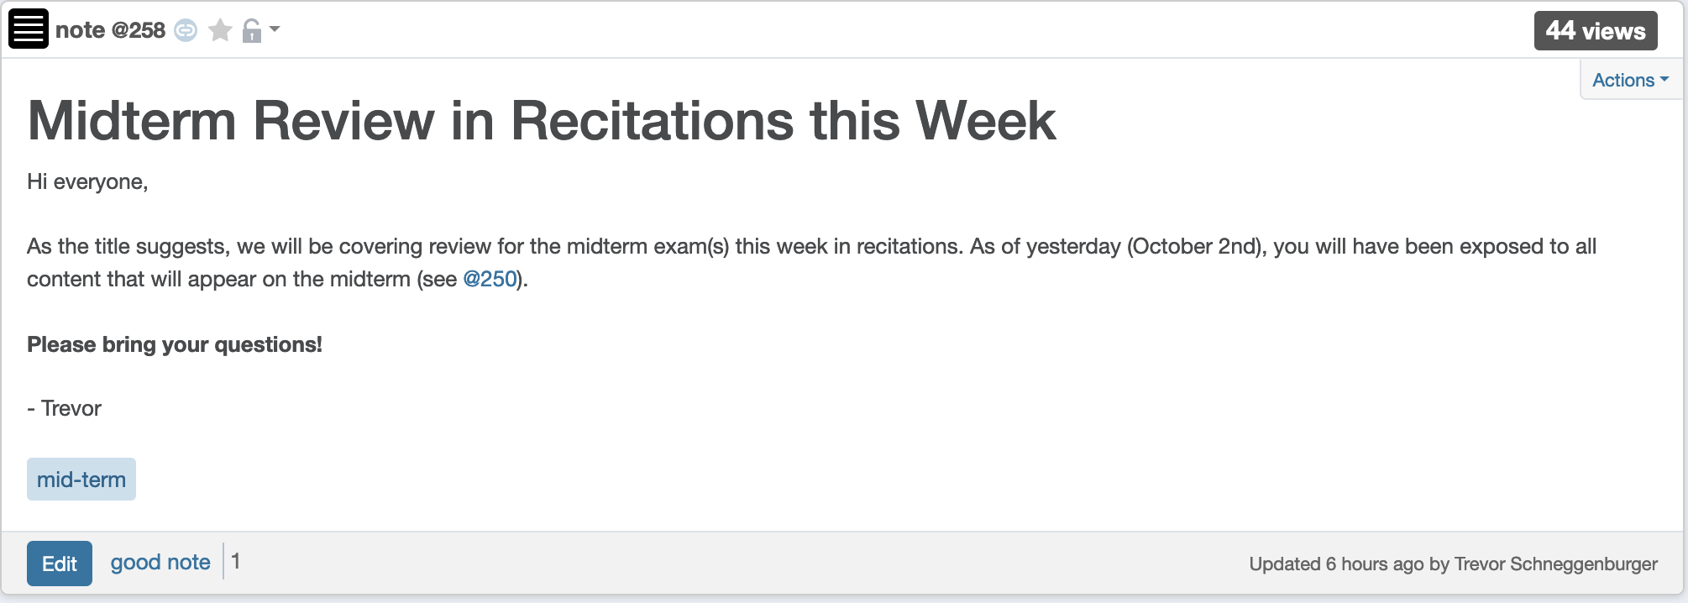
Recitation this week

Slide 6
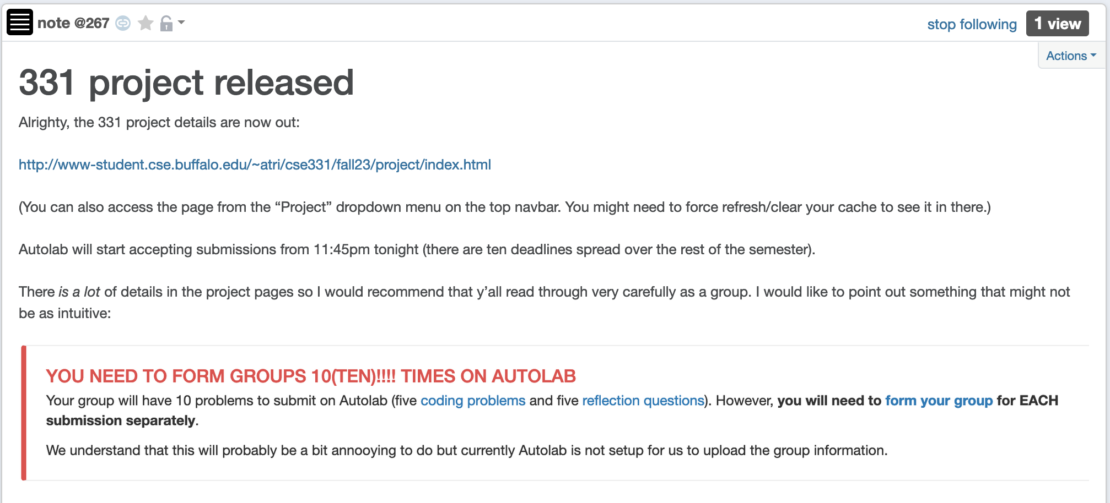
Project released

Slide 7
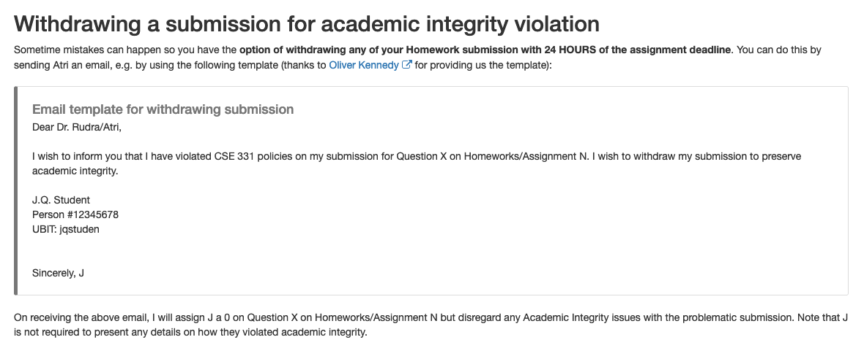
Withdraw submission due to AI

Slide 8
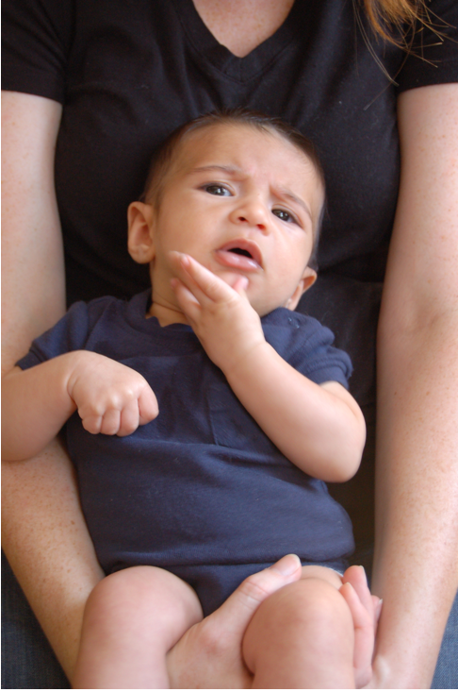
Questions?

Slide 9

End of Semester blues
Can only do one thing at any day: what is the maximum number of tasks that you can do?
Write up a term paper
Party!
Exam study
331 homework
331 HW
Project
Friday
Saturday
Sunday
Monday
Tuesday

Slide 10
The optimal solution
Can only do one thing at any day: what is the maximum number of tasks that you can do?
Party!
Exam study
331 HW
Friday
Saturday
Sunday
Monday
Tuesday

Slide 11
Interval Scheduling Problem
Input: n intervals [s(i), f(i)) for 1≤ i ≤ n
{ s(i), … ,f(i)-1 }
Output: A schedule S of the n intervals
No two intervals in S conflict
|S| is maximized

Slide 12
Questions?

Slide 13
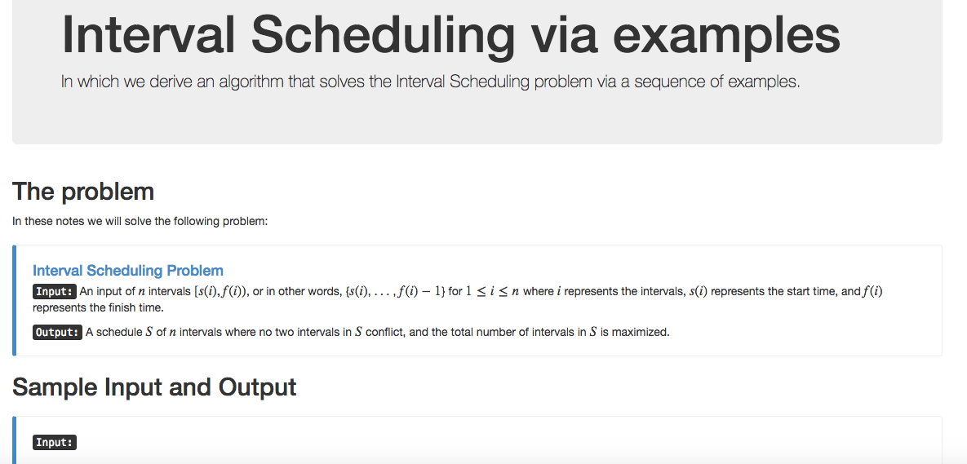
Algorithm with examples

Slide 14
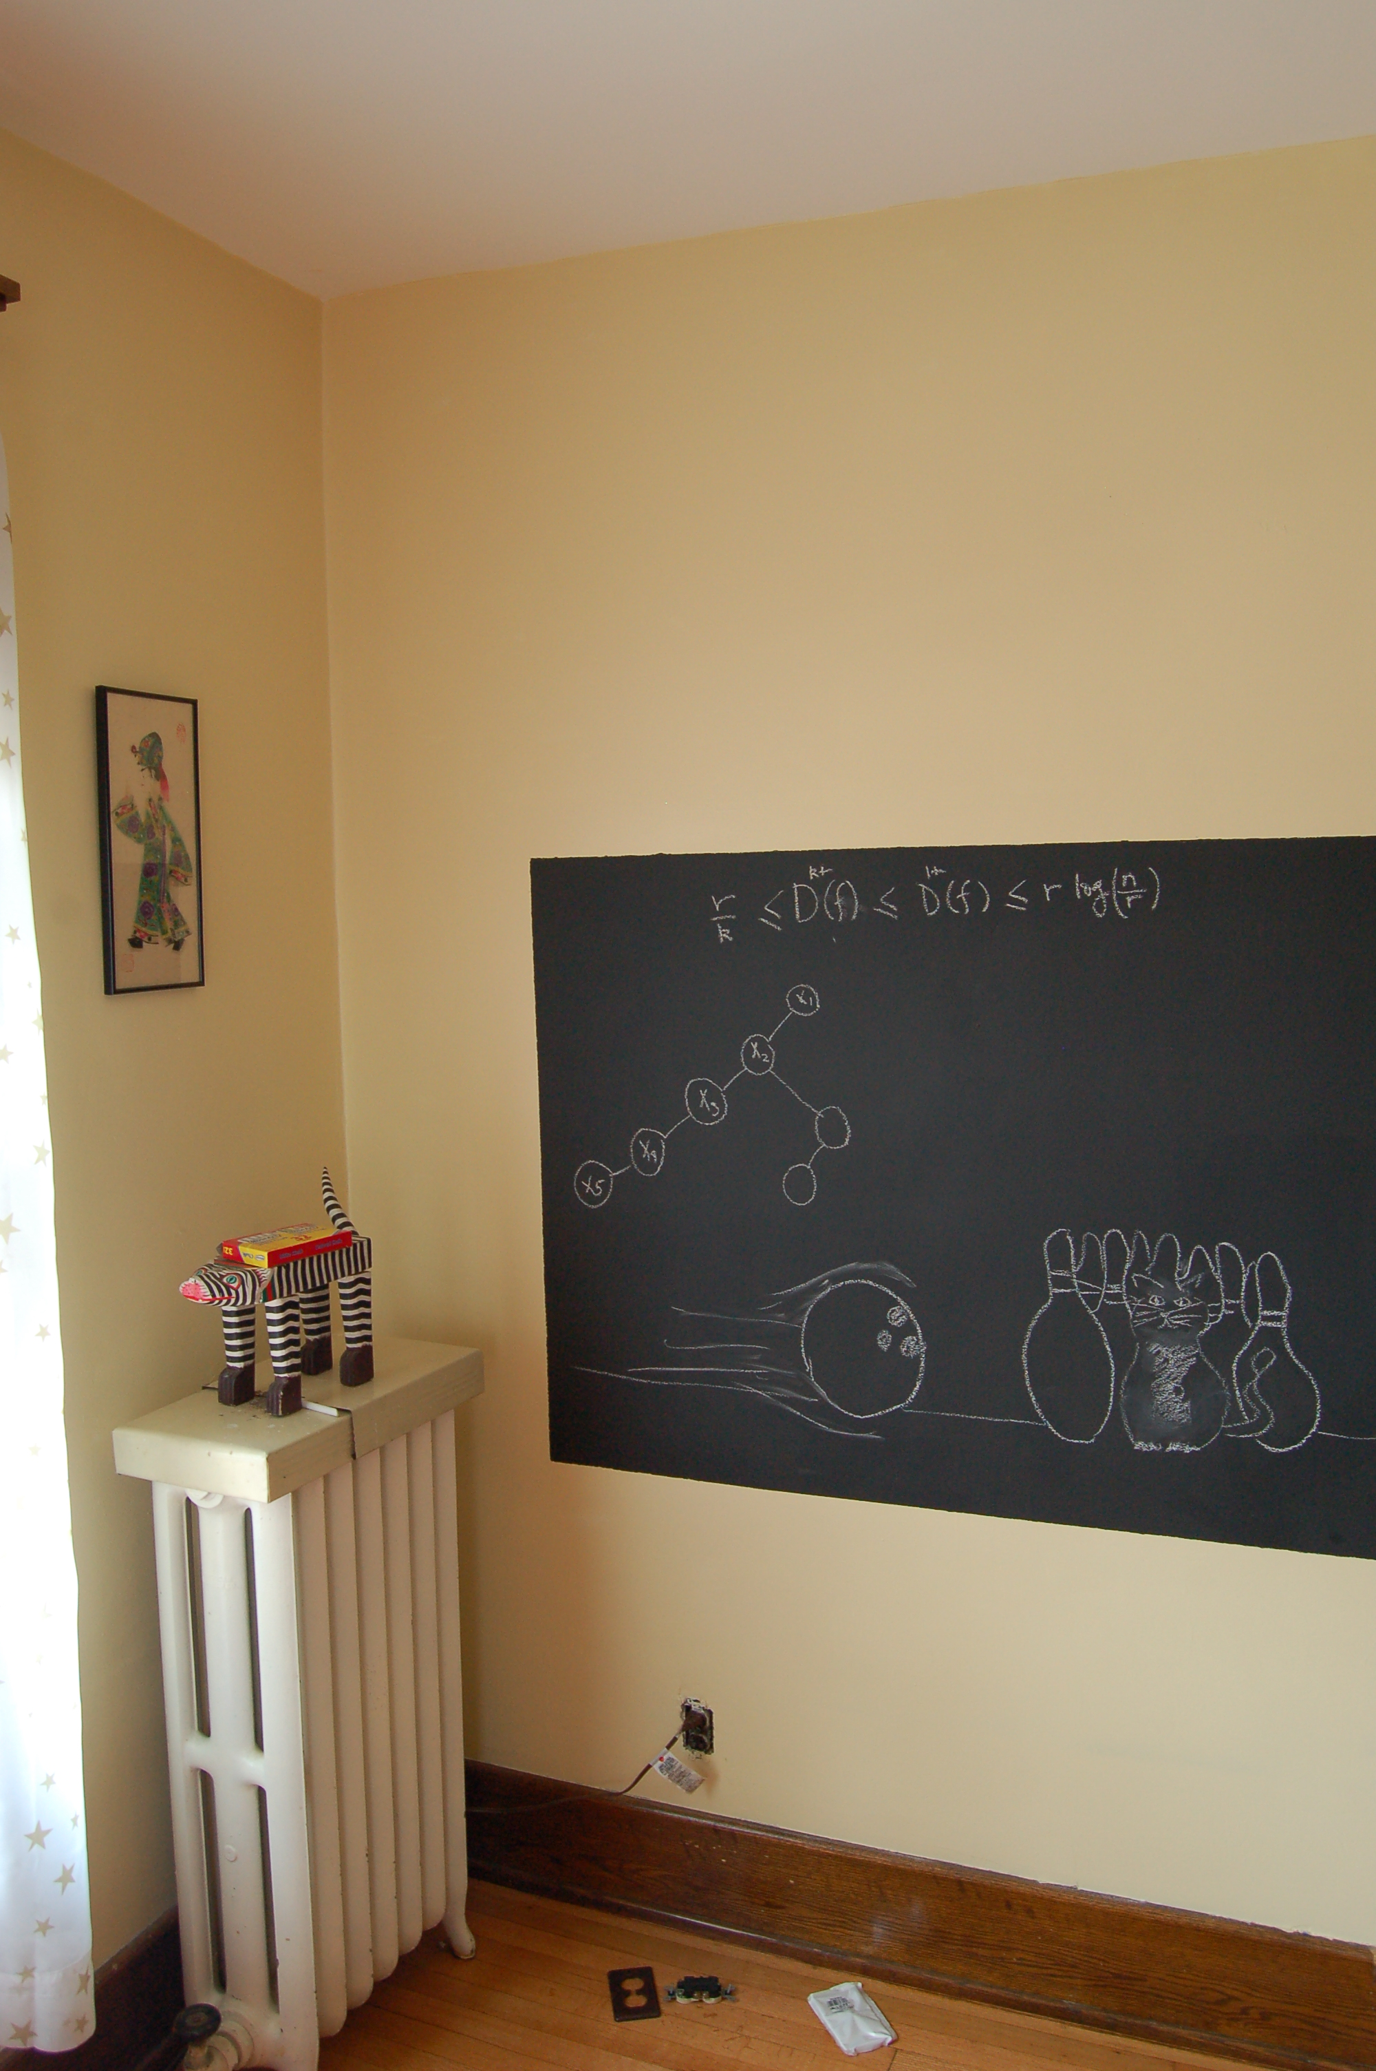
Re-define problem on the board…

Slide 15
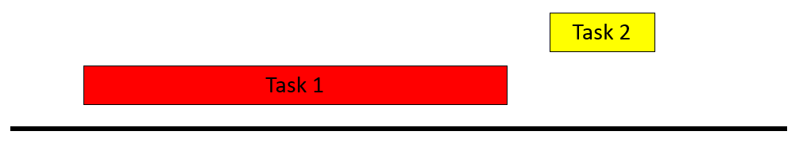
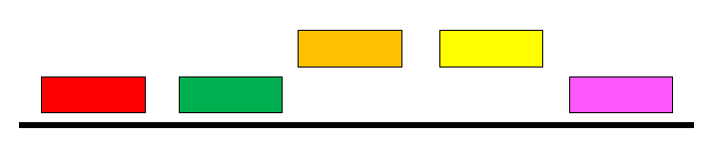
Example 1
No intervals overlap

Slide 16
Algorithm?
No intervals overlap
R: set of requests
Set S to be the empty set
While R is not empty
Choose i in R
Add i to S
Remove i from R
Return S*= S

Slide 17
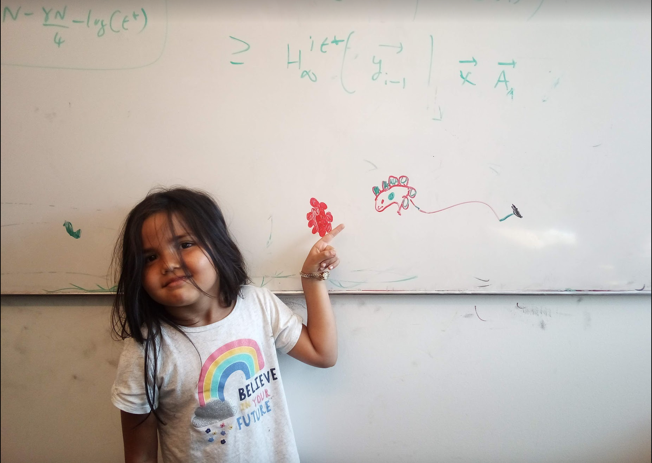
Questions/Comments?

Slide 18
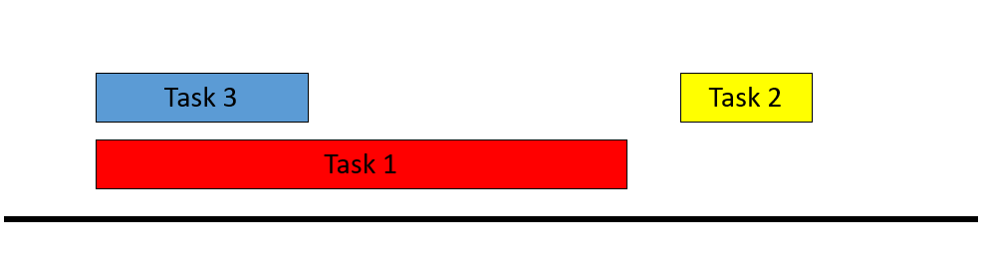
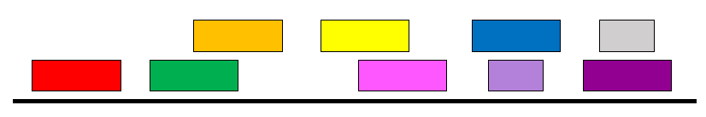
Example 2
At most one overlap/task

Slide 19
Algorithm?
At most one overlap
R: set of requests
Set S to be the empty set
While R is not empty
Choose i in R
Add i to S
Remove all tasks that conflict with i from R
Remove i from R
Return S*= S

Slide 20
Example 3
Task 4
Task 5
More than one conflict
Task 3
Task 2
Task 1
Set S to be the empty set
While R is not empty
Choose i in R
Add i to S
Remove all tasks that conflict with i from R
Return S*= S

Slide 21
Greedily solve your blues!
Arrange tasks in some order and iteratively pick non-overlapping tasks
Write up a term paper
Party!
Exam study
331 HW
Project
Saturday
Sunday
Monday
Tuesday
Wednesday

Slide 22
Making it more formal
Task 4
Task 5
More than one conflict
Task 3
Task 2
Task 1
Set S to be the empty set
Associate a value v(i) with task i
While R is not empty
Choose i in R
Choose i in R that minimizes v(i)
Add i to S
Remove all tasks that conflict with i from R
Return S*= S

Slide 23
Questions/Comments?

Slide 24
What is a good choice for v(i)?
Task 4
Task 5
More than one conflict
Task 3
Task 2
Task 1
Set S to be the empty set
Associate a value v(i) with task i
While R is not empty
Choose i in R that minimizes v(i)
Add i to S
Remove all tasks that conflict with i from R
Return S*= S

Slide 25
v(i) = f(i) – s(i)
Task 4
Task 5
Smallest duration first
Task 3
Task 2
Task 1
Set S to be the empty set
While R is not empty
Choose i in R that minimizes f(i) – s(i)
Add i to S
Remove all tasks that conflict with i from R
Return S*= S

Slide 26
v(i) = s(i)
Task 4
Task 5
Earliest time first?
Task 3
Task 2
Task 1
So are we done?
Set S to be the empty set
While R is not empty
Choose i in R that minimizes s(i)
Add i to S
Remove all tasks that conflict with i from R
Return S*= S

Slide 27
Not so fast….
Task 4
Task 5
Earliest time first?
Task 3
Task 2
Task 1
Task 6
Set S to be the empty set
While R is not empty
Choose i in R that minimizes s(i)
Add i to S
Remove all tasks that conflict with i from R
Return S*= S

Slide 28
Pick job with minimum conflicts
Task 4
Task 5
Task 3
Task 2
Task 1
Task 6
Set S to be the empty set
So are we done?
While R is not empty
Choose i in R that has smallest number of conflicts
Add i to S
Remove all tasks that conflict with i from R
Return S*= S

Slide 29
Questions/Comments?

Slide 30
Nope (but harder to show)
Set S to be the empty set
While R is not empty
Choose i in R that has smallest number of conflicts
Add i to S
Remove all tasks that conflict with i from R
Return S*= S

Slide 31
Task 7
Task 4
Task 5
Task 17
Task 18
Task 3
Task 2
Task 15
Task 16
Task 1
Task 12
Task 13
Task 14
Task 6
Task 8
Task 9
Task 10
Task 11
Set S to be the empty set
While R is not empty
Choose i in R that has smallest number of conflicts
Add i to S
Remove all tasks that conflict with i from R
Return S*= S

Slide 32
Algorithm?
Task 7
Task 4
Task 5
Task 17
Task 18
Task 3
Task 2
Task 15
Task 16
Task 1
Task 12
Task 13
Task 14
Task 6
Task 8
Task 9
Task 10
Task 11
Set S to be the empty set
While R is not empty
Choose i in R that minimizes v(i)
Add i to S
Remove all tasks that conflict with i from R
Return S*= S

Slide 33
Earliest finish time first
Task 7
Task 4
Task 5
Task 17
Task 18
Task 3
Task 2
Task 15
Task 16
Task 1
Task 12
Task 13
Task 14
Task 6
Task 8
Task 9
Task 10
Task 11
Set S to be the empty set
While R is not empty
Choose i in R that minimizes f(i)
Add i to S
Remove all tasks that conflict with i from R
Return S*= S

Slide 34
Find a counter-example?
Task 7
Task 4
Task 5
Task 17
Task 18
Task 3
Task 2
Task 15
Task 16
Task 1
Task 12
Task 13
Task 14
Task 6
Task 8
Task 9
Task 10
Task 11
It works!
Set S to be the empty set
While R is not empty
Choose i in R that minimizes f(i)
Add i to S
Remove all tasks that conflict with i from R
Return S*= S

Slide 35
Questions/Comments?

Slide 36
Today’s agenda
Prove the correctness of the algorithm

Slide 37
Final Algorithm
R: set of requests
Set S to be the empty set
While R is not empty
Choose i in R with the earliest finish time
Add i to S
Remove all requests that conflict with i from R
Return S*= S

Slide 38
Argue correctness on the board…

