Slide 1
Lecture 20
CSE 331
Oct 16, 2023

Slide 2
Exams this week
Mid-term 1: Wednesday
Mid-term 2: Friday

Slide 3

Project Group formation

Slide 4

My response to your feedback

Slide 5

Questions?

Slide 6
Shortest Path problem
s
100
Input: Directed graph G=(V,E)
Edge lengths, l_{e} for e in E
“start” vertex s in V
w
5
15
u
s
s
w
5
5
15
u
u
Output: Length of shortest paths from s to all nodes in V

Slide 7
Towards Dijkstra’s algo: part ek
Determine d(t) one by one
s
d(s) = 0
u
x
y

Slide 8

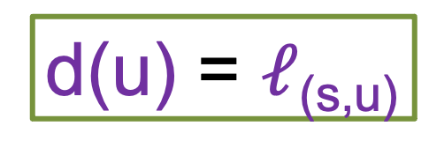
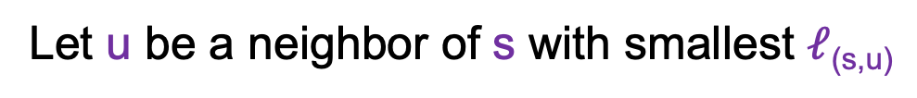
Towards Dijkstra’s algo: part do
Determine d(t) one by one
Let u be a neighbor of s with smallest $ℓ$_{(s,u)}
s
100
3
4
u
x
y
d(u) = $ℓ$_{(s,u)}
Not making any claim on other vertices

Slide 9



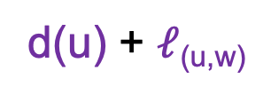
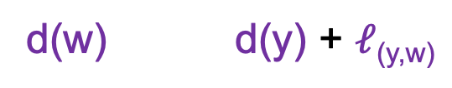
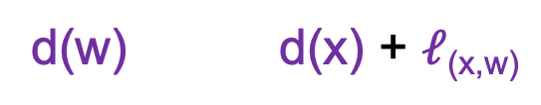
Towards Dijkstra’s algo: part teen
Determine d(t) one by one
R
Assume we know d(v) for every v in R
s
u
x
y
Compute an upper bound d’(w) for every w not in R
d(w)
d(u) + $ℓ$_{(u,w)}
w
d(w) d(x) + $ℓ$_{(x,w)}
d’(w) = min _{e=(u,w) in E, u in R} d(u)+ $ℓ$_{e}
d(w) d(y) + $ℓ$_{(y,w)}

Slide 10
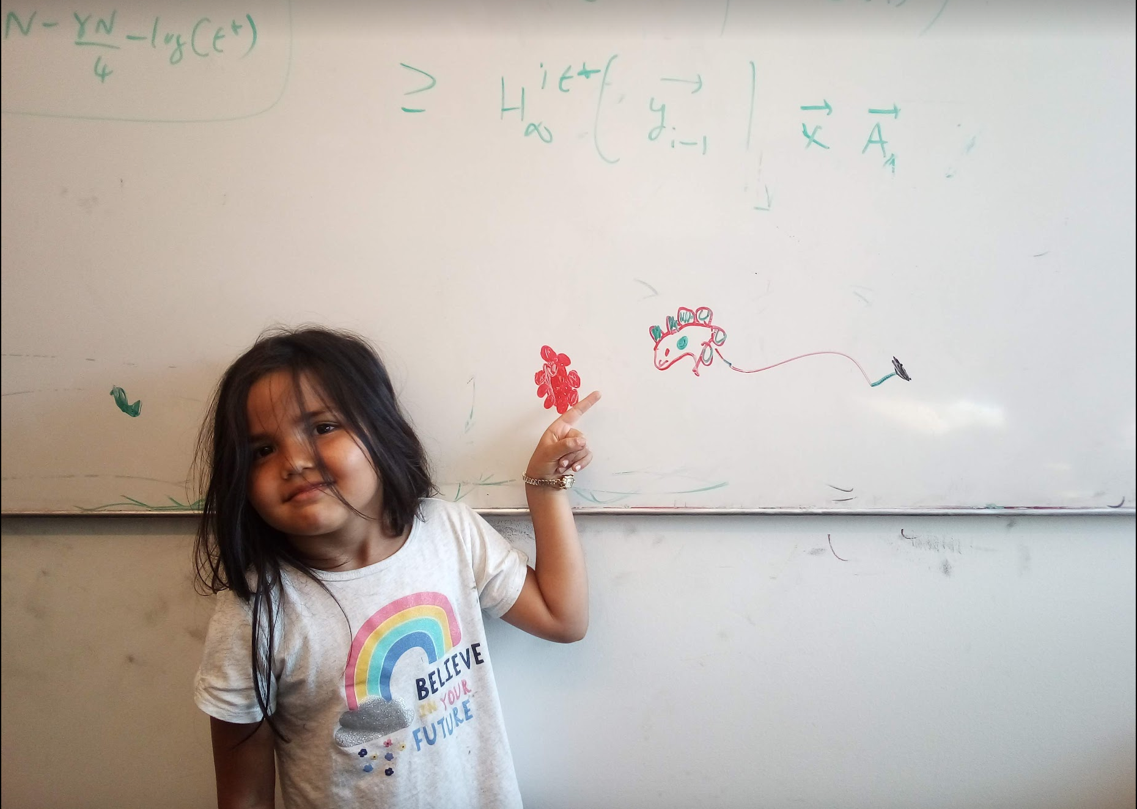
Questions/Comments?

Slide 11


Dijkstra’s shortest path algorithm
1
d’(w) = min _{e=(u,w) in E, u in R} d(u)+ $ℓ$_{e}
3
y
3
u
4
1
1
1
d(s) = 0
d(u) = 1
s
4
x
4
2
d(w) = 2
d(x) = 2
2
2
2
d(y) = 3
d(z) = 4
w
z
5
3
4
2
s
Input: Directed G=(V,E), $ℓ$_{e} ≥ 0, s in V
u
w
R = {s}, d(s) =0
Shortest paths
While there is a x not in R with (u,x) in E, u in R
x
Pick w that minimizes d’(w)
Add w to R
y
z
d(w) = d’(w)

Slide 12
Questions/Comments?

Slide 13
Couple of remarks
The Dijkstra’s algo does not explicitly compute the shortest paths
Can maintain “shortest path tree” separately
Dijkstra’s algorithm does not work with negative weights
Left as an exercise

Slide 14
Rest of Today’s agenda
Prove the correctness of Dijkstra’s Algorithm

Slide 15


Dijkstra’s shortest path algorithm
d’(w) = min _{e=(u,w) in E, u in R} d(u)+$ℓ$_{e}
P_{u} shortest s-u path in “Dijkstra tree”
Input: Directed G=(V,E), $ℓ$_{e} ≥ 0, s in V
R = {s}, d(s) =0
While there is a x not in R with (u,x) in E, u in R
Pick w that minimizes d’(w)
Add w to R
d(w) = d’(w)
Lemma 1: At end of each iteration, if u in R, then P_{u} is a shortest s-u path
Lemma 2: If u is connected to s, then u in R at the end

Slide 16
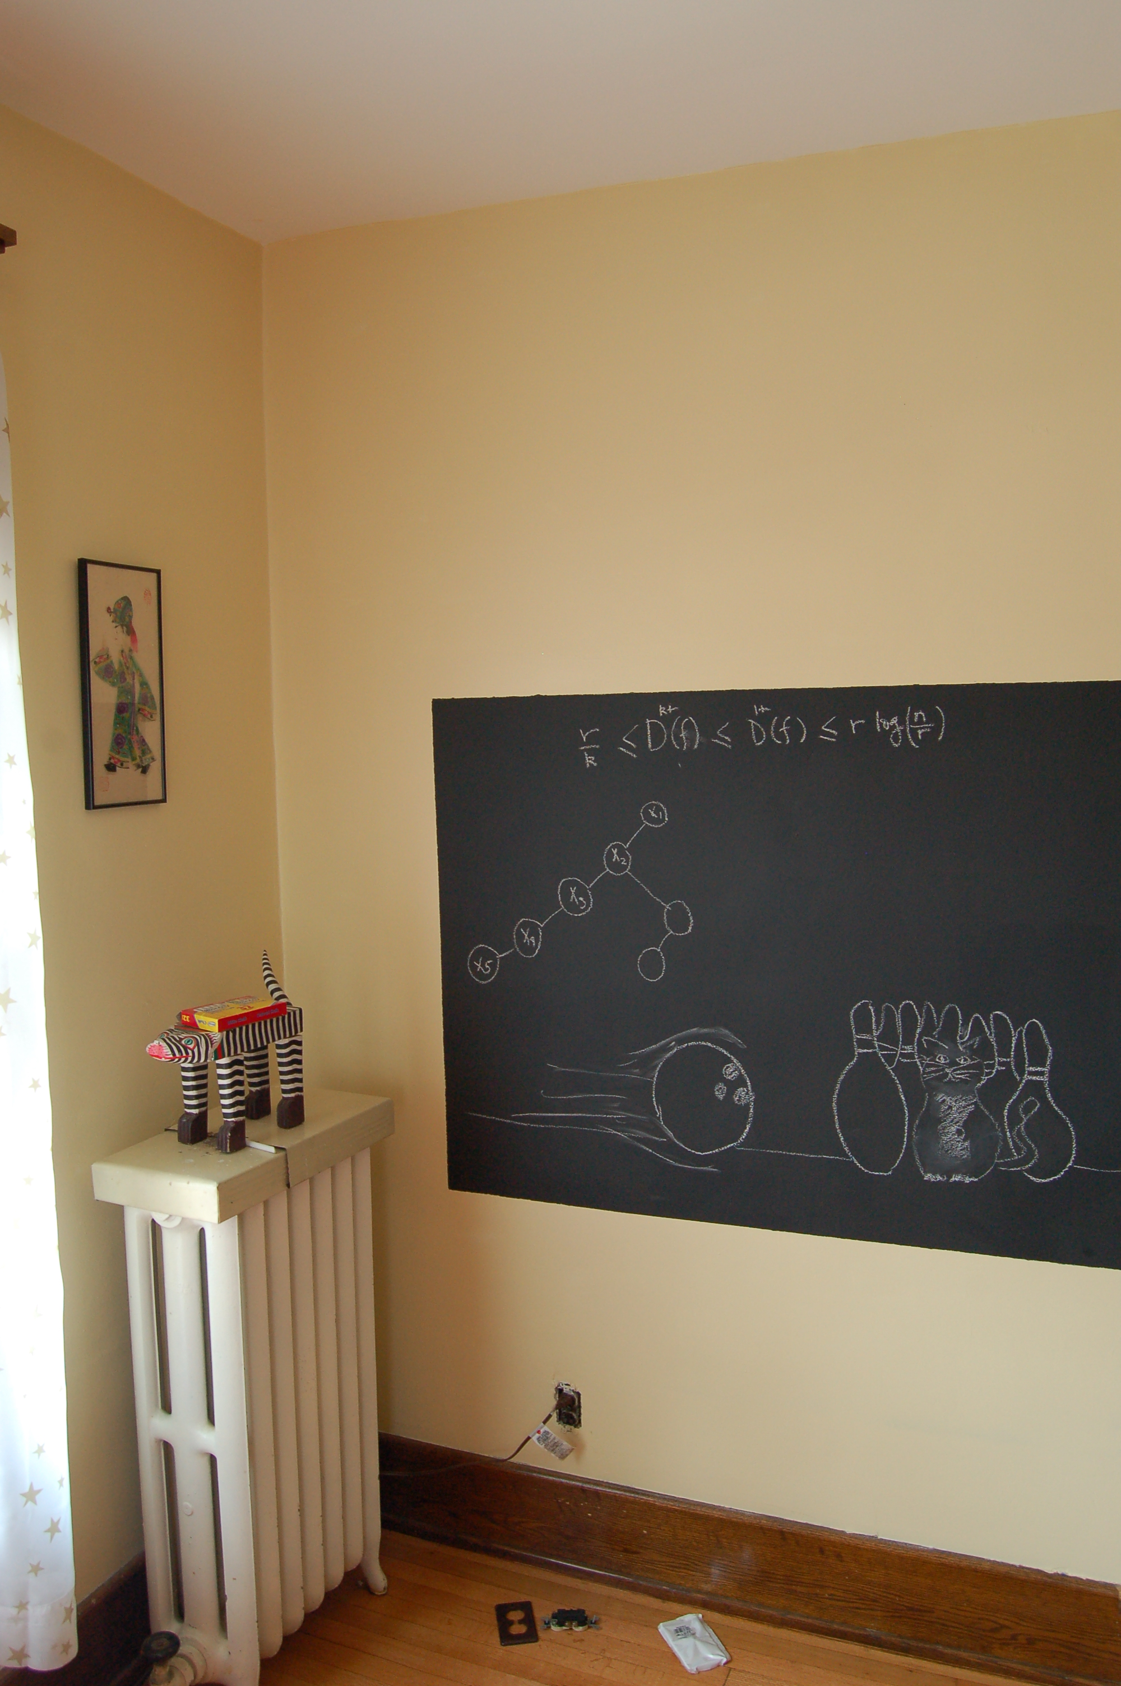
Proof idea of Lemma 1

Slide 17

Dijkstra’s shortest path algorithm
d’(w) = min _{e=(u,w) in E, u in R} d(u)+$ℓ$_{e}
Input: Directed G=(V,E), $ℓ$_{e} ≥ 0, s in V
R = {s}, d(s) =0
While there is a x not in R with (u,x) in E, u in R
At most n iterations
Pick w that minimizes d’(w)
Add w to R
d(w) = d’(w)
O((m+n)n) time bound is trivial
O((m+n) log n) time implementation with priority Q

Slide 18

Reading Assignment
Sec 4.4 of [KT]

