Slide 1
Lecture 21
CSE 331
Oct 23, 2023

Slide 2
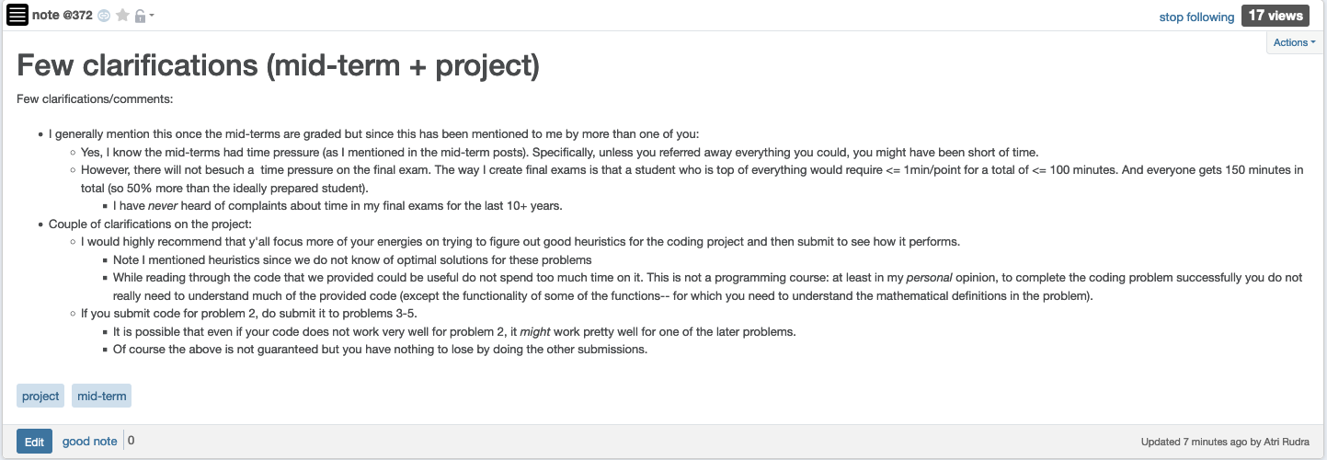
Time pressure on mid-term(s)

Slide 3
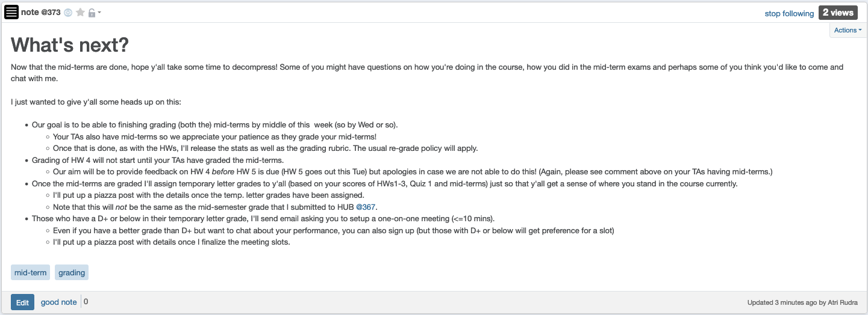
Some other stuff coming up

Slide 4
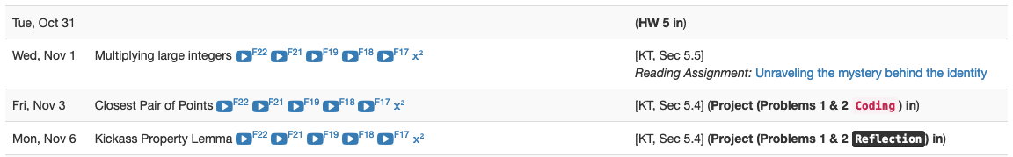
Project deadlines coming up

Slide 5
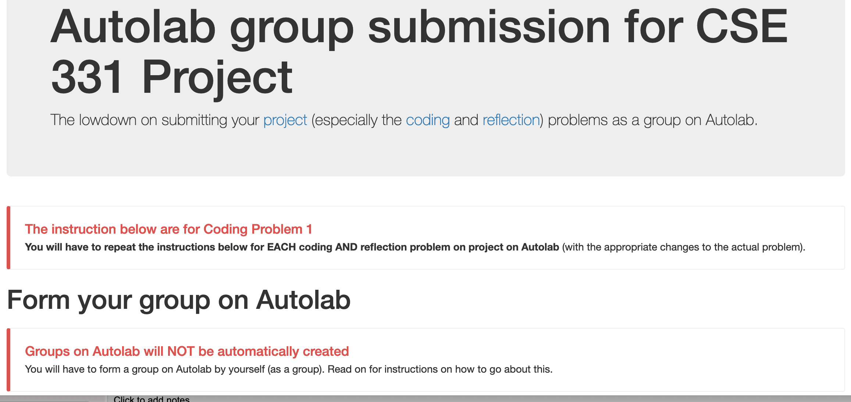
Group formation instructions
Follow instructions EXACTLY as they are stated

Slide 6
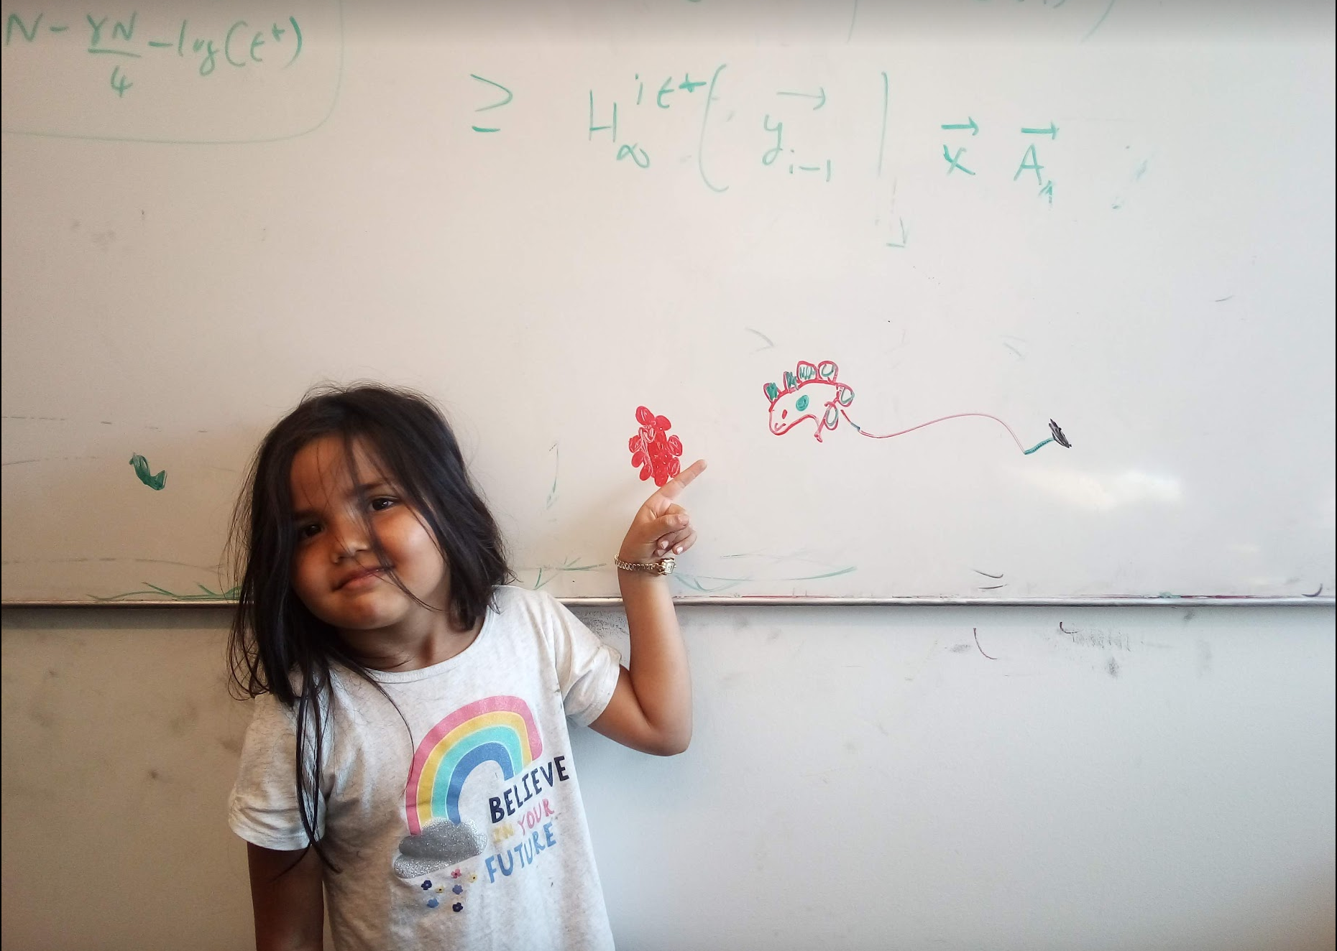
Questions/Comments?

Slide 7
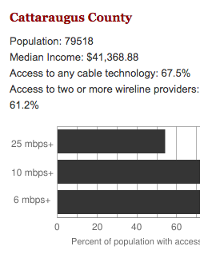
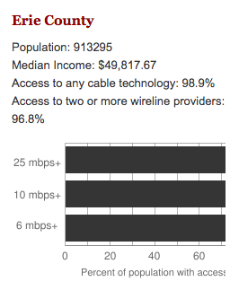
Make broadband more available
BOTH technical and societal issues
Say you are tasked to come up with the infrastructure

Slide 8
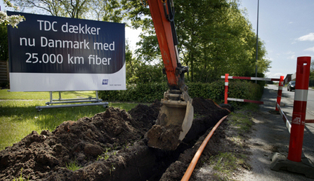
Building a fiber network
Lay down fibers to connect n locations
All n locations should be connected
Laying down a fiber costs money
What is the cheapest way to lay down the fibers?

Slide 9
Today’s agenda
Minimum Spanning Tree (MST) Problem
Greedy algorithm(s) for MST problem

Slide 10
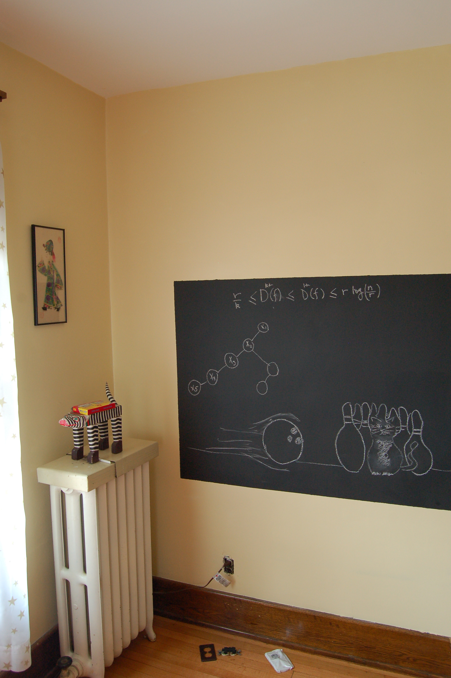
On to the board…

Slide 11
Minimum Spanning Tree Problem
Input: Undirected, connected G = (V,E), edge costs c_{e}
Output: Subset E’ ⊆ E, s.t. T = (V,E’) is connected
C(T) is minimized
If all c_{e} > 0, then T is indeed a tree

Slide 12
Rest of today’s agenda
Greedy algorithm(s) for MST problem

Slide 13

Discuss: Greedy algorithm!

Slide 14
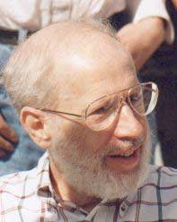
Kruskal’s Algorithm
Input: G=(V,E), c_{e}> 0 for every e in E
T = Ø
Sort edges in increasing order of their cost
Joseph B. Kruskal
Consider edges in sorted order
If an edge can be added to T without adding a cycle then add it to T

Slide 15
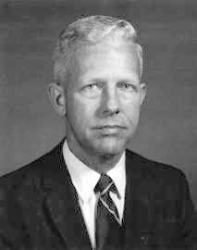
Prim’s algorithm
Similar to Dijkstra’s algorithm
2
0.5
1
3
50
51
Robert Prim
2
0.5
Input: G=(V,E), c_{e}> 0 for every e in E
S = {s}, T = Ø
1
50
While S is not the same as V
Among edges e= (u,w) with u in S and w not in S, pick one with minimum cost
Add w to S, e to T

Slide 16
Reverse-Delete Algorithm
2
0.5
1
3
50
51
Input: G=(V,E), c_{e}> 0 for every e in E
2
0.5
T = E
1
3
50
Sort edges in decreasing order of their cost
51
Consider edges in sorted order
If an edge can be removed T without disconnecting T then remove it

Slide 17
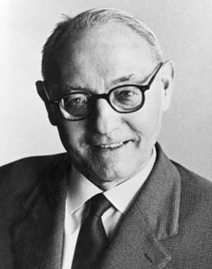
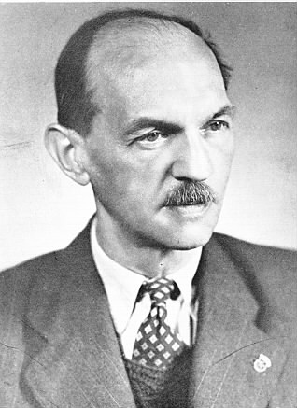
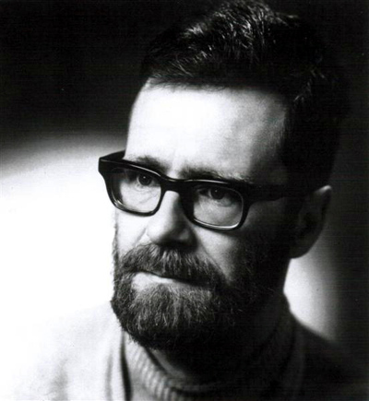
(Old) History of MST algorithms
1920: Otakar Borůvka
1930: Vojtěch Jarník
Same algo!
1956: Kruskal
1957: Prim
1959: Dijkstra

