Slide 1
Lecture 22
CSE 331
Oct 25, 2023

Slide 2
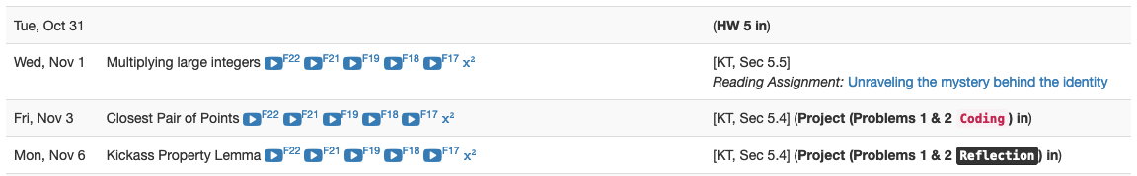
Project deadlines coming up

Slide 3
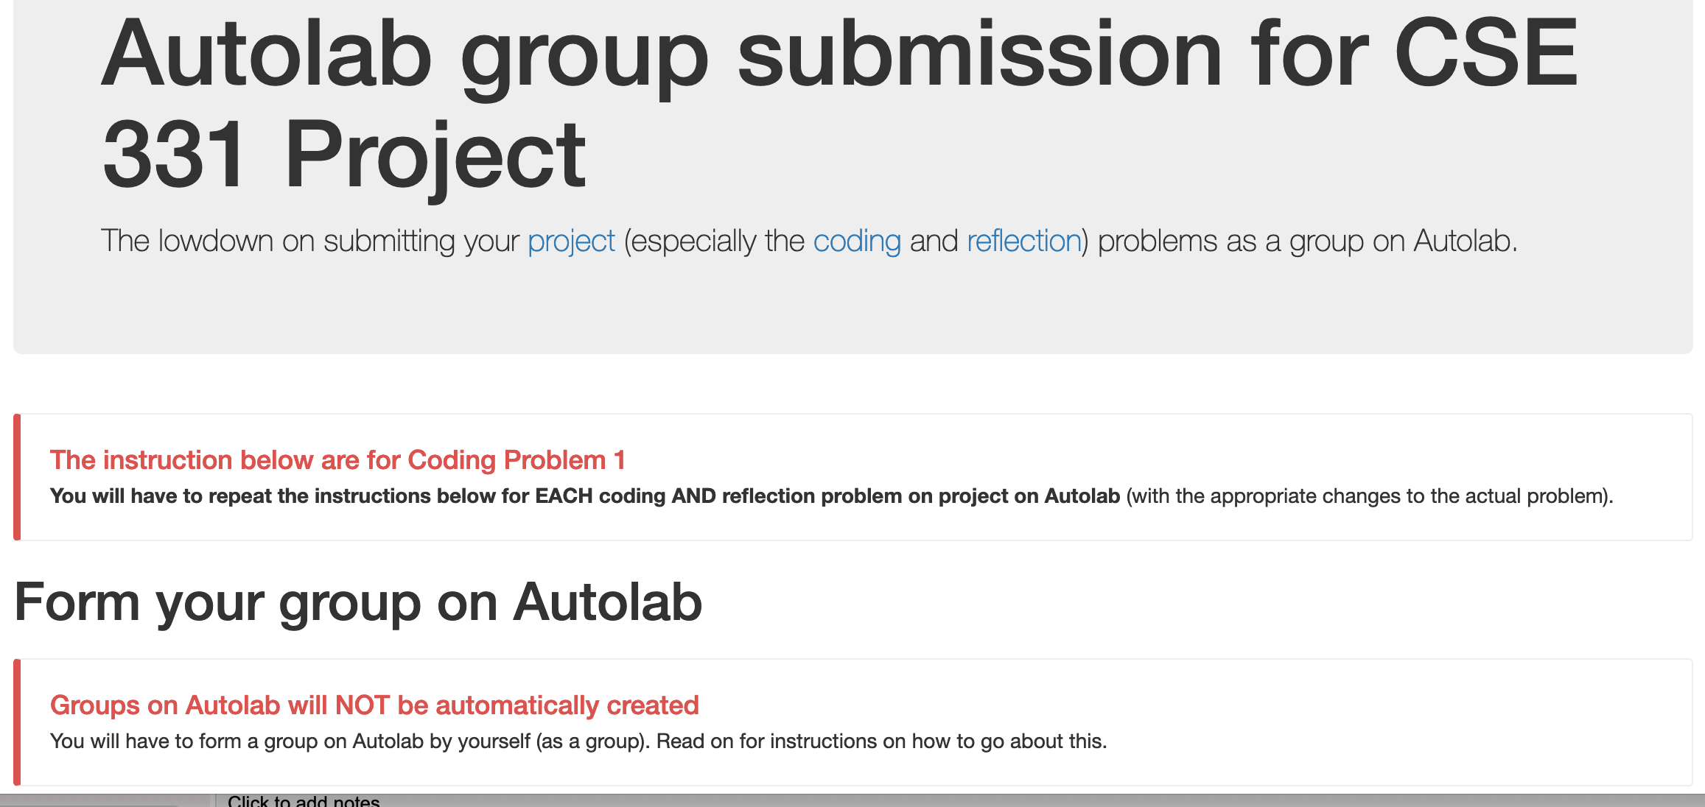
Group formation instructions
Follow instructions EXACTLY as they are stated

Slide 4
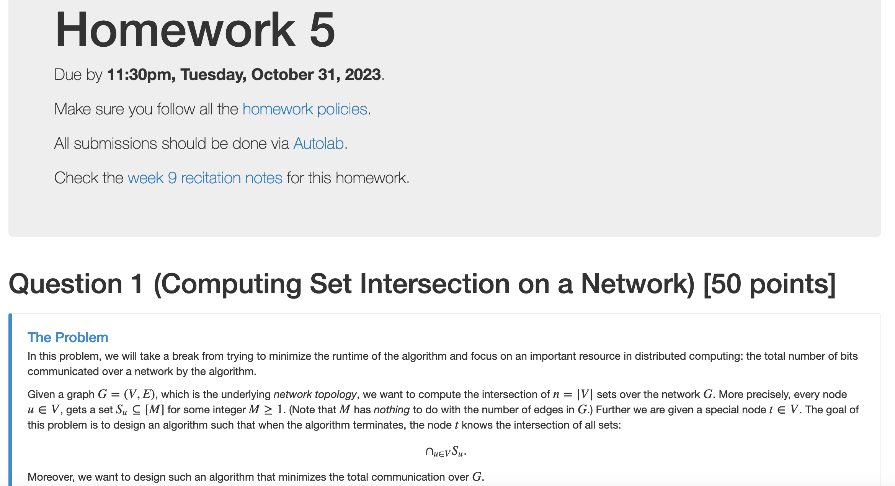
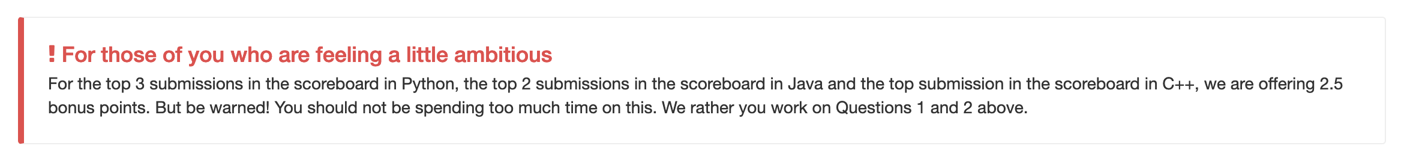
HW 5 out

Slide 5
I finished grading all Q3(b)s
Mid-term grades should be out by <= tomorrow afternoon
It was not pretty……
And I don’t get why many of you just left Q3(b) blank!
You get better by struggling and not giving up!

Slide 6
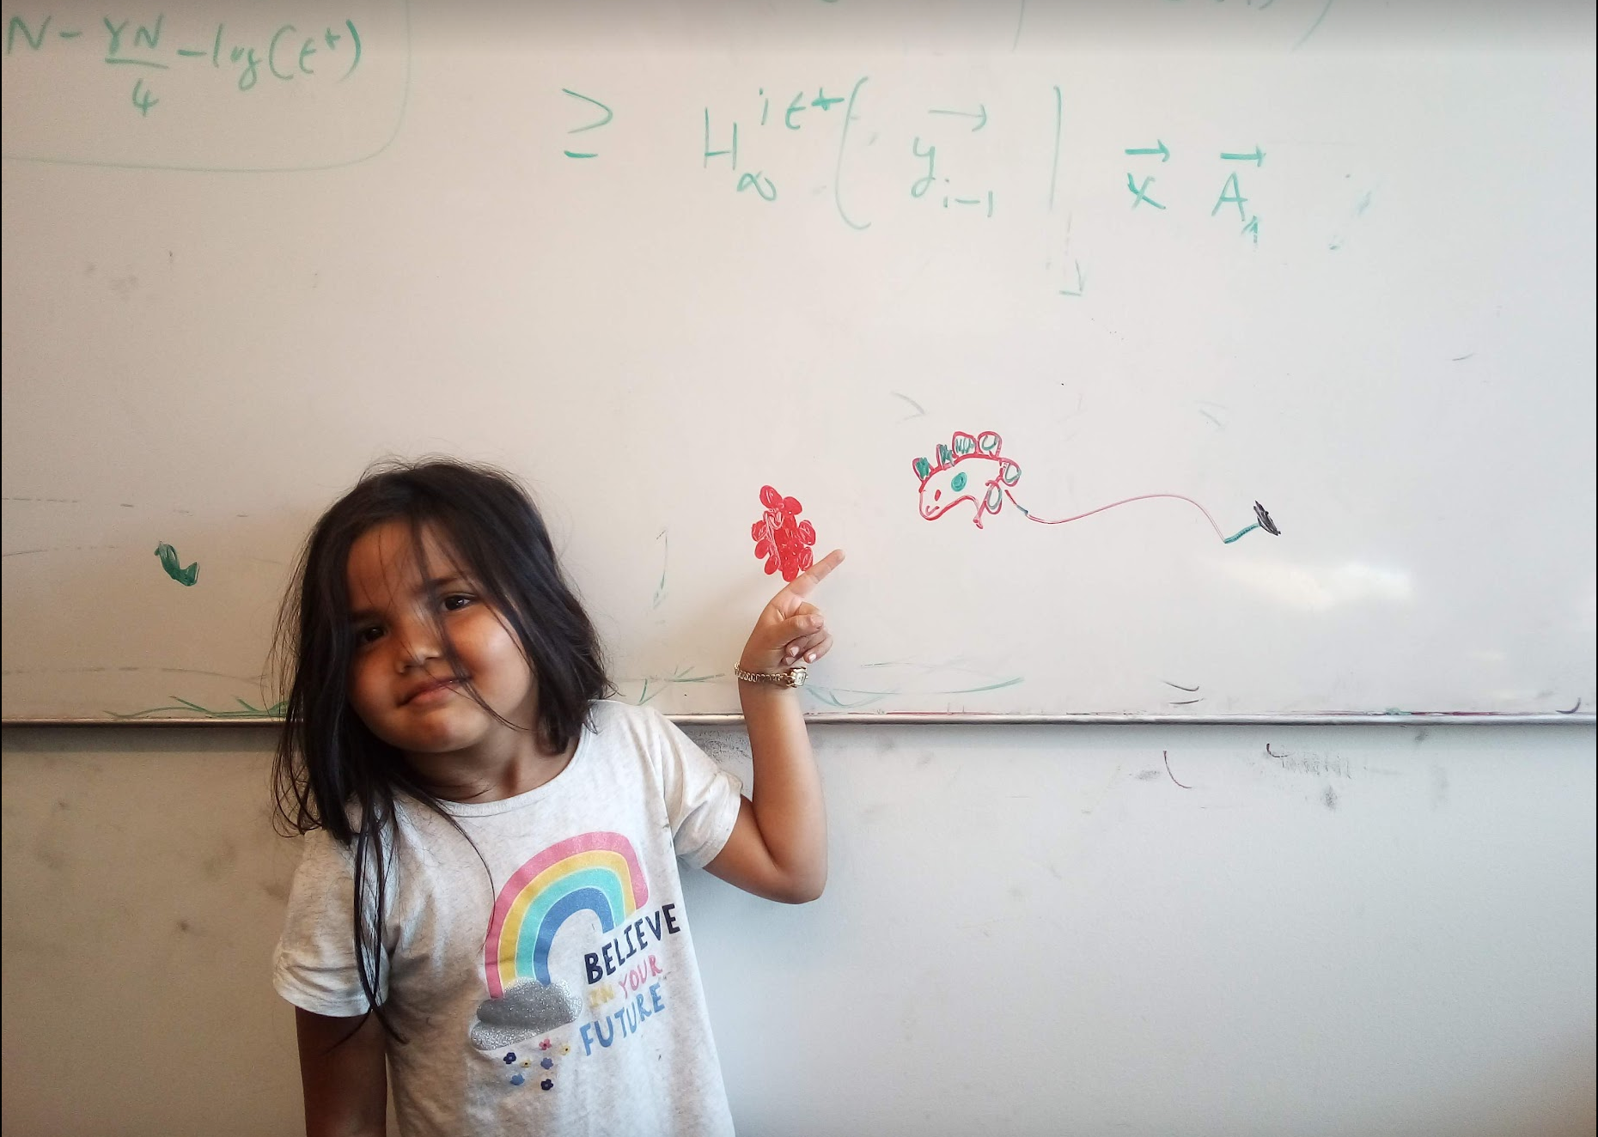
Questions/Comments?

Slide 7
Minimum Spanning Tree Problem
Input: Undirected, connected G = (V,E), edge costs c_{e}
Output: Subset E’ ⊆ E, s.t. T = (V,E’) is connected
C(T) is minimized
If all c_{e} > 0, then T is indeed a tree

Slide 8
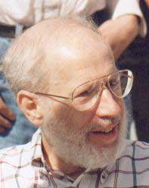
Kruskal’s Algorithm
Input: G=(V,E), c_{e}> 0 for every e in E
T = Ø
Sort edges in increasing order of their cost
Joseph B. Kruskal
Consider edges in sorted order
If an edge can be added to T without adding a cycle then add it to T

Slide 9
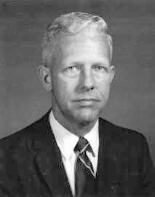
Prim’s algorithm
Similar to Dijkstra’s algorithm
Robert Prim
Input: G=(V,E), c_{e}> 0 for every e in E
S = {s}, T = Ø
While S is not the same as V
Among edges e= (u,w) with u in S and w not in S, pick one with minimum cost
Add w to S, e to T

Slide 10
Cut Property Lemma for MSTs
Condition: S and V\S are non-empty
V \ S
S
Cheapest crossing edge is in all MSTs
Assumption: All edge costs are distinct

Slide 11
Questions/Comments?

Slide 12
Today’s agenda
Optimality of Prim’s algorithm
Prove Cut Property Lemma
Optimality of Kruskal’s algorithm
Remove distinct edge weights assumption

Slide 13
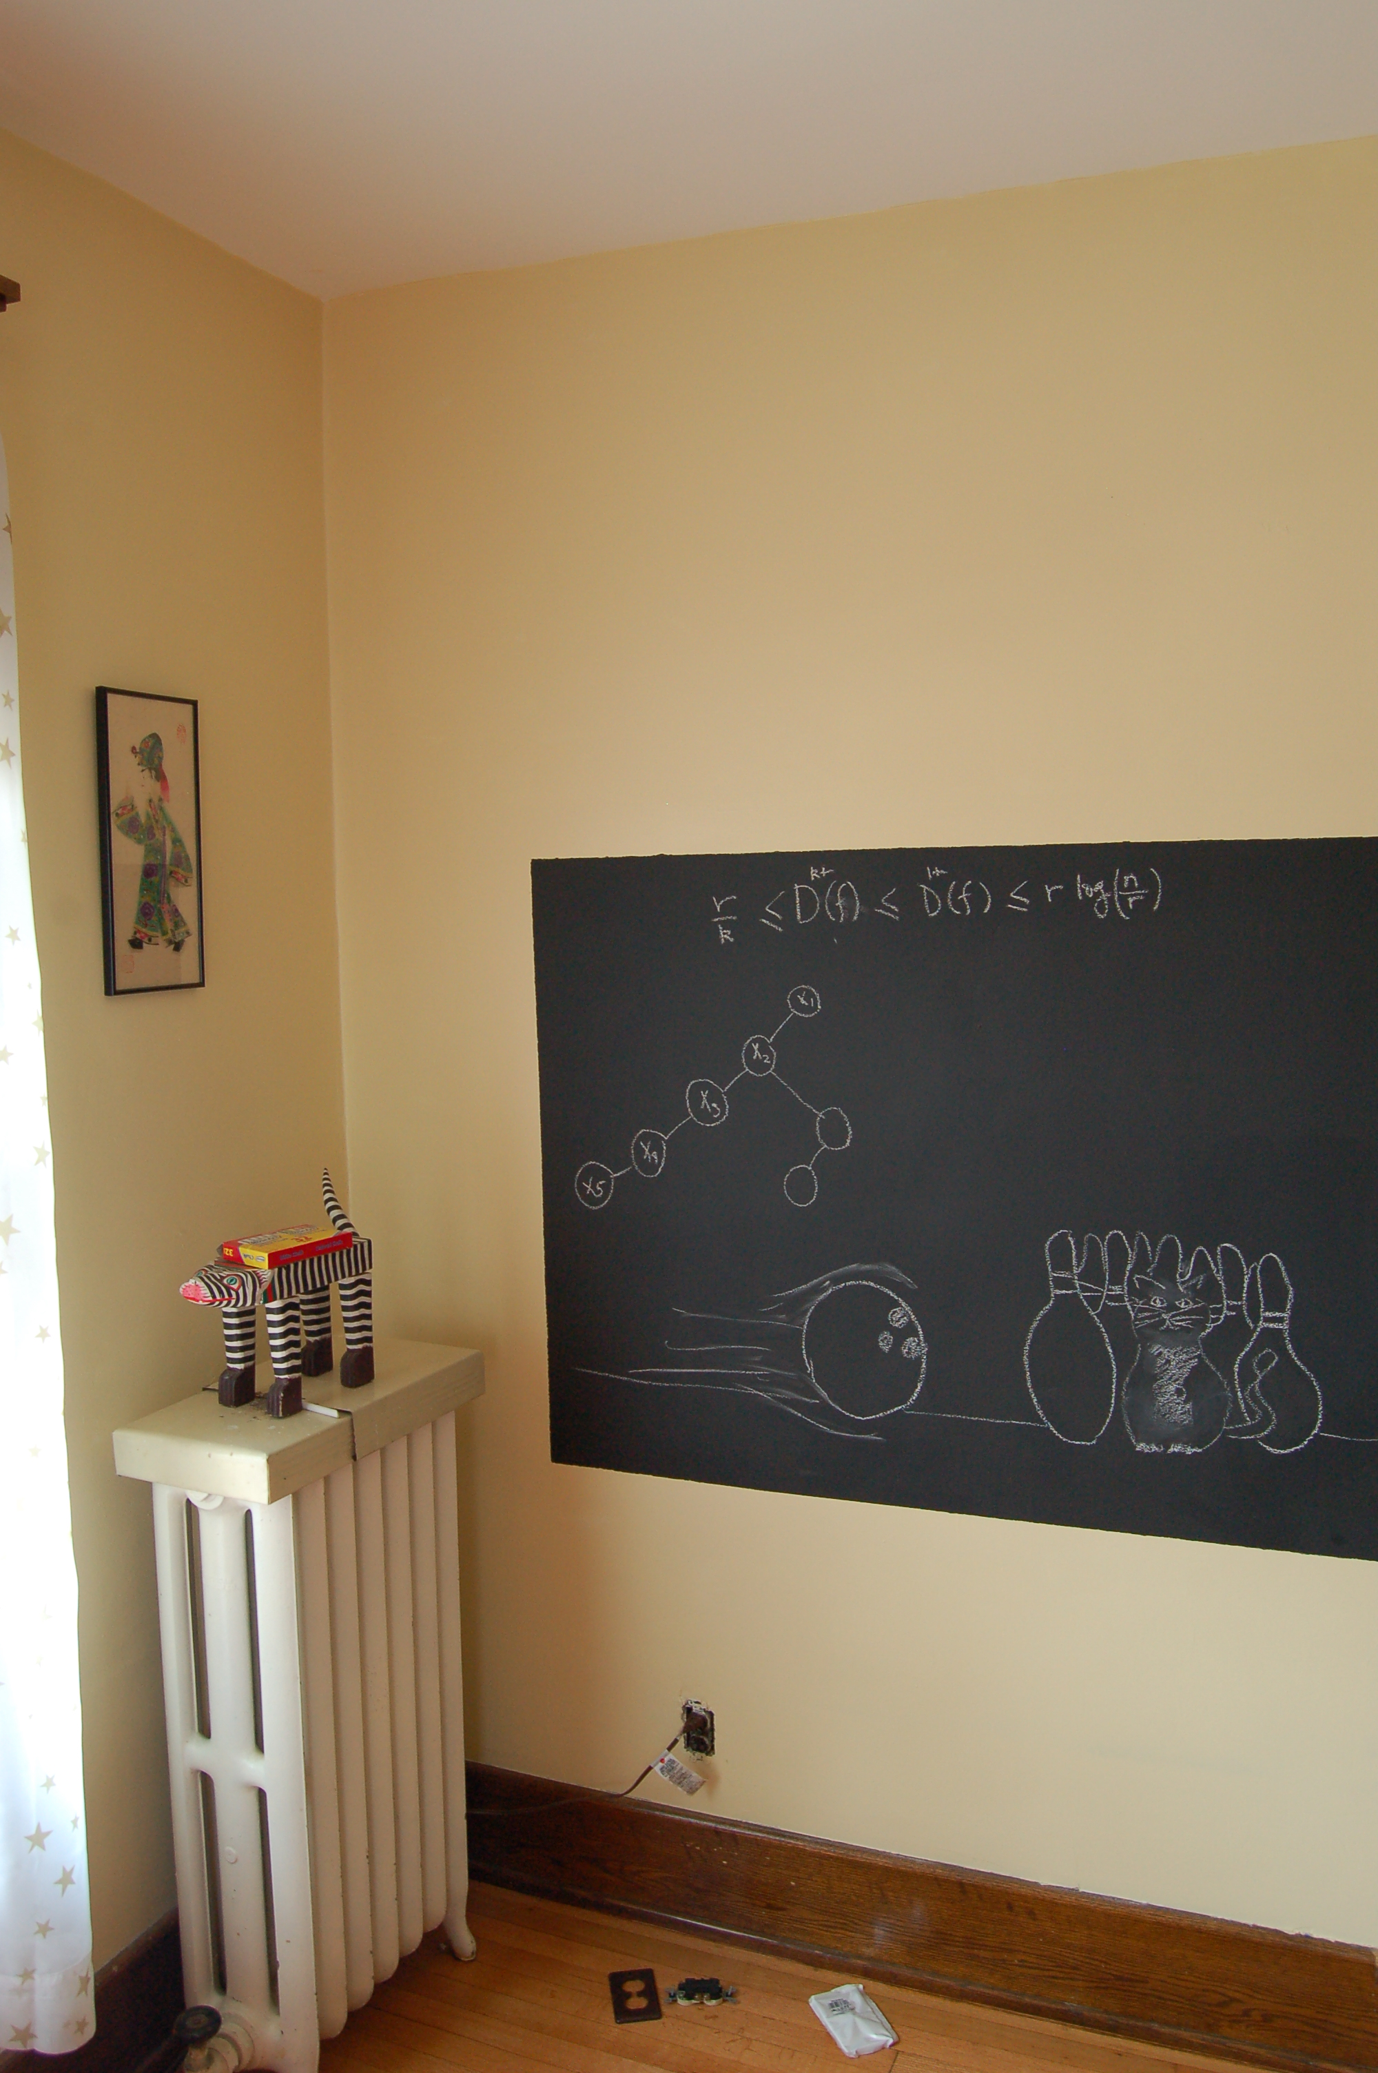
On to the board…

Slide 14
Optimality of Kruskal’s Algorithm
S
V \ S
S
Nodes connected to red in (V,T)
Input: G=(V,E), c_{e}> 0 for every e in E
S is non-empty
T = Ø
V\S is non-empty
Sort edges in increasing order of their cost
First crossing edge considered
Consider edges in sorted order
If an edge can be added to T without adding a cycle then add it to T

