Slide 1
Lecture 25
CSE 331
Nov 1, 2023

Slide 2
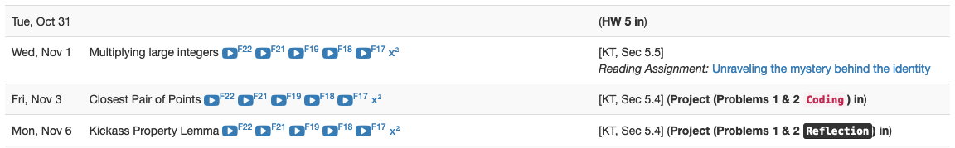
Project deadlines coming up

Slide 3
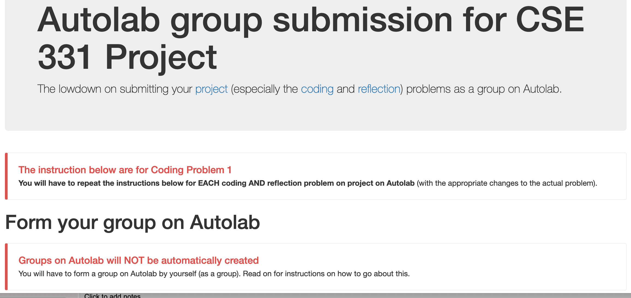
Group formation instructions
Follow instructions EXACTLY as they are stated

Slide 4
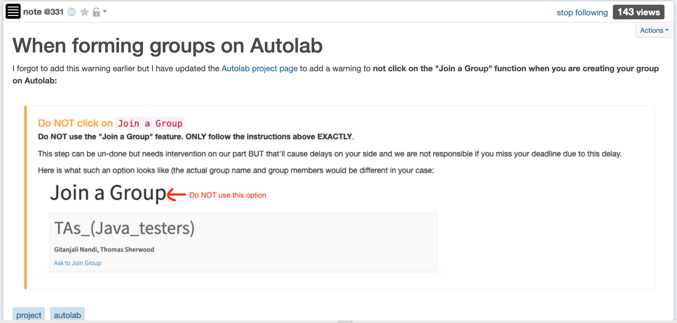
Do not use Join a Group “feature”

Slide 5
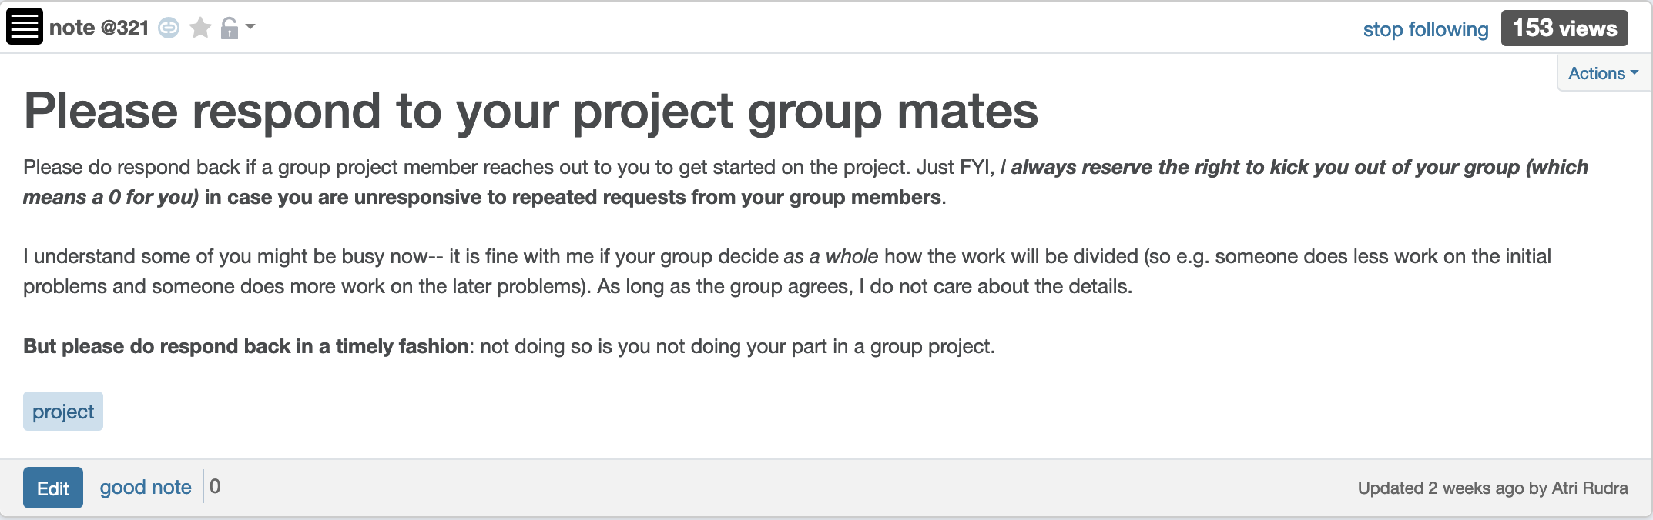
Please be in touch w/ your group

Slide 6

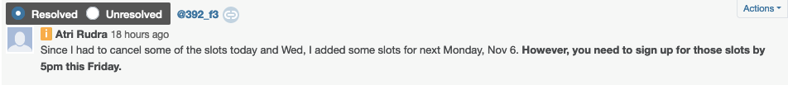
1-on-1 meeting slots

Slide 7

Questions/Comments?

Slide 8
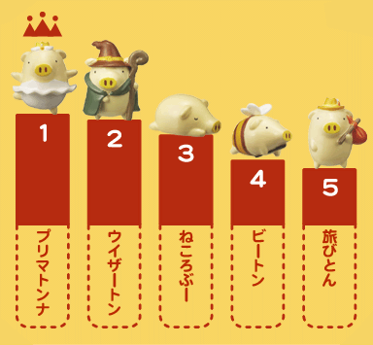
Rankings

Slide 9


How close are two rankings?

Slide 10
Rest of today’s agenda
Formal problem: Counting inversions
Divide and Conquer algorithm

Slide 11
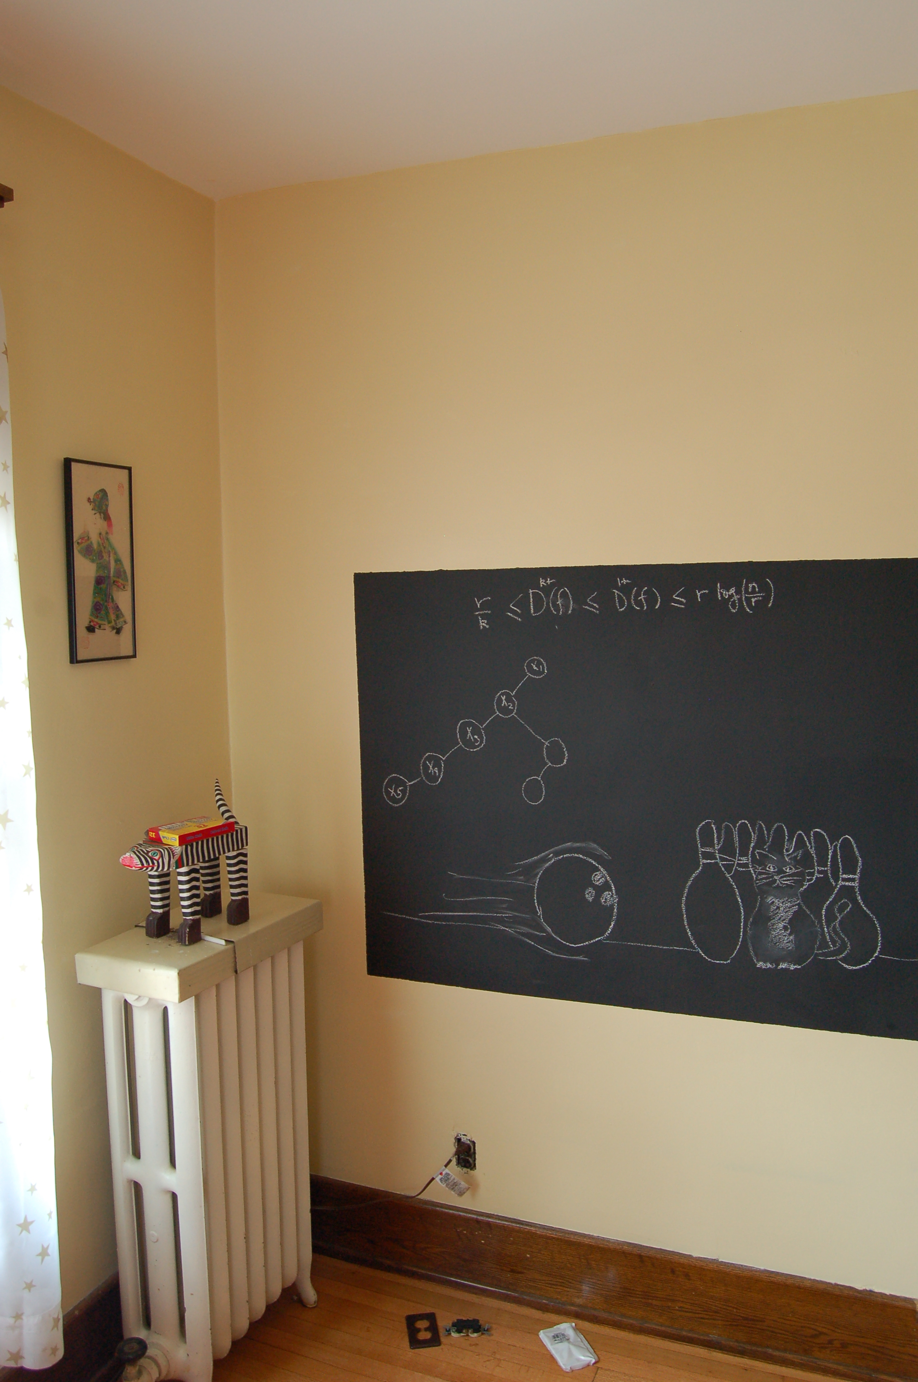
Problem definition on the board…

Slide 12

Solve a harder problem
Input: a₁, .., a_{n}
Output: LIST of all inversions
Optimal for the listing problem
for i in 1 to n-1
for j in i+1 to n
If a_{i} > a_{j}
add (i,j) to L
return L

Slide 13
Example 1: All inversions-- (2i-1,2i)
Only check (i,i+1) pairs
2 | 1 | 3 | 4 | 6 | 5 | 7 | 8
Q1: Solve listing problem in O(n) time?
Q2: Recursive divide and conquer algorithm to count the number of inversions?
CountInv (a,n)
if n = 1 return 0
if n = 2 return a₁ > a₂
a_{L} = a₁ , .., a_{[n/2]}
a_{R} = a_{[n/2]+1} , .., a_{n}
return CountInv(a_{L}, [n/2]) + CountInv(a_{R}, n- [n/2])

Slide 14
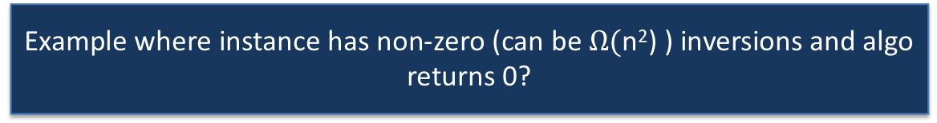
Can be horribly wrong in general
CountInv (a,n)
if n = 1 return 0
if n = 2 return a₁ > a₂
a_{L} = a₁ , .., a_{[n/2]}
a_{R} = a_{[n/2]+1} , .., a_{n}
return CountInv(a_{L}, [n/2]) + CountInv(a_{R}, n- [n/2])
5
6
1
2
All 4 “crossing” pairs are inversions

Slide 15
Bad case: “crossing inversions”
CountInv (a,n)
Are a_{L} and a_{R} sorted?
if n = 1 return 0
Yes!
if n = 2 return a₁ > a₂
a_{L} = a₁ , .., a_{[n/2]}
a_{R} = a_{[n/2]+1} , .., a_{n}
return CountInv(a_{L}, [n/2]) + CountInv(a_{R}, n- [n/2])
a_{L}
a_{R}

Slide 16
Example 2: Solving the bad case
5
6
…..
1
a_{L}
a_{R}
a_{L} is sorted
First element is a_{L} is larger than first/only element in a_{R}
O(1) algorithm to count number of inversions?
return size of a_{L}

Slide 17
Example 3: Solving the bad case
1
5
6
…..
a_{L}
a_{R}
a_{R} is sorted
First/only element is a_{L} is smaller than first element in a_{R}
O(1) algorithm to count number of inversions?
return 0

Slide 18
Solving the bad case
Try to modify the MERGE algorithm
First element of a_{L} is larger than first element of a_{R}
5
6
…..
1
a_{L}
a_{R}
First element of a_{L} is smaller than first element of a_{R}
1
5
6
…..
a_{L}
a_{R}
a_{L}
a_{R}

Slide 19
Divide and Conquer
Divide up the problem into at least two sub-problems
Solve all sub-problems: Mergesort
Recursively solve the sub-problems
Solve stronger sub-problems: Inversions
“Patch up” the solutions to the sub-problems for the final solution

Slide 20
MergeSortCount algorithm
Input: a₁, a₂, …, a_{n}
Output: Numbers in sorted order+ #inversion
T(2) = c
MergeSortCount( a, n )
T(n) = 2T(n/2) + cn
If n = 1 return ( 0 , a₁)
If n = 2 return ( a1 > a2, min(a₁,a₂); max(a₁,a₂))
O(n log n) time
a_{L} = a₁,…, a_{n/2}
a_{R} = a_{n/2+1},…, a_{n}
(c_{L}, a_{L}) = MergeSortCount(a_{L}, n/2)
O(n)
(c_{R}, a_{R}) = MergeSortCount(a_{R}, n/2)
Counts #crossing-inversions+ MERGE
(c, a) = MERGE-COUNT(a_{L},a_{R})
return (c+c_{L}+c_{R},a)

Slide 21


MERGE-COUNT(a_{L},a_{R})
a_{L} = l₁,…, l_{n’}
a_{R} = r₁,…, r_{m}
c = 0
i,j = 1
if l_{i} $≤$ r_{j}
1
5
6
…..
add l_{i} to output
a_{L}
a_{R}
i ++
else
add r_{j} to output
5
6
…..
1
j ++
c += n’- i +1
a_{L}
a_{R}
Output any remaining items
return c

