Slide 1
Lecture 26
CSE 331
Nov 3, 2023

Slide 2
Coding Project 1+2 due today

Slide 3
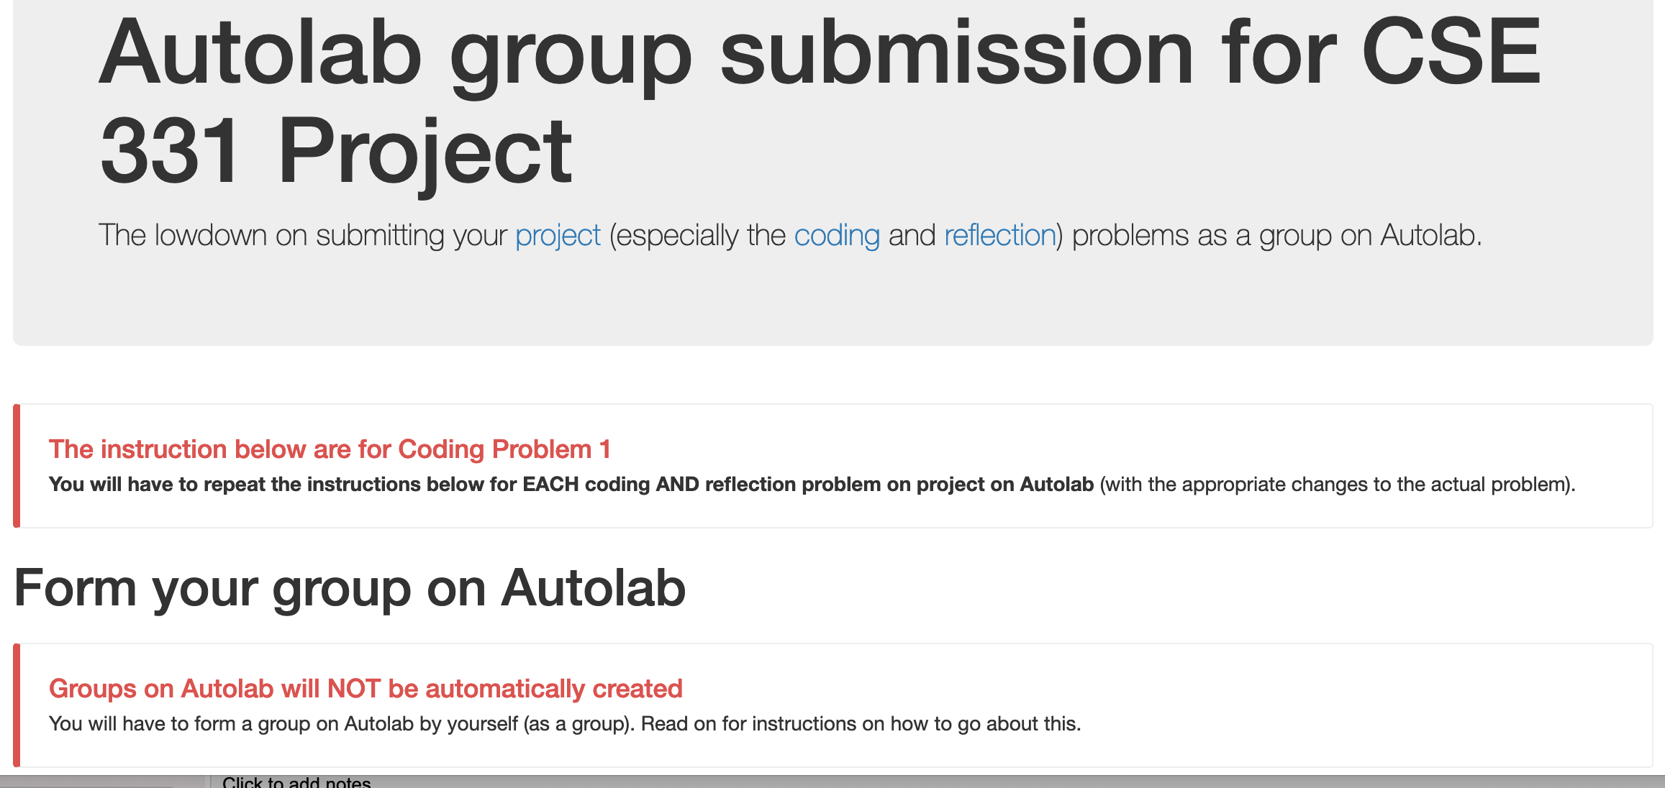
Group formation instructions
Follow instructions EXACTLY as they are stated

Slide 4
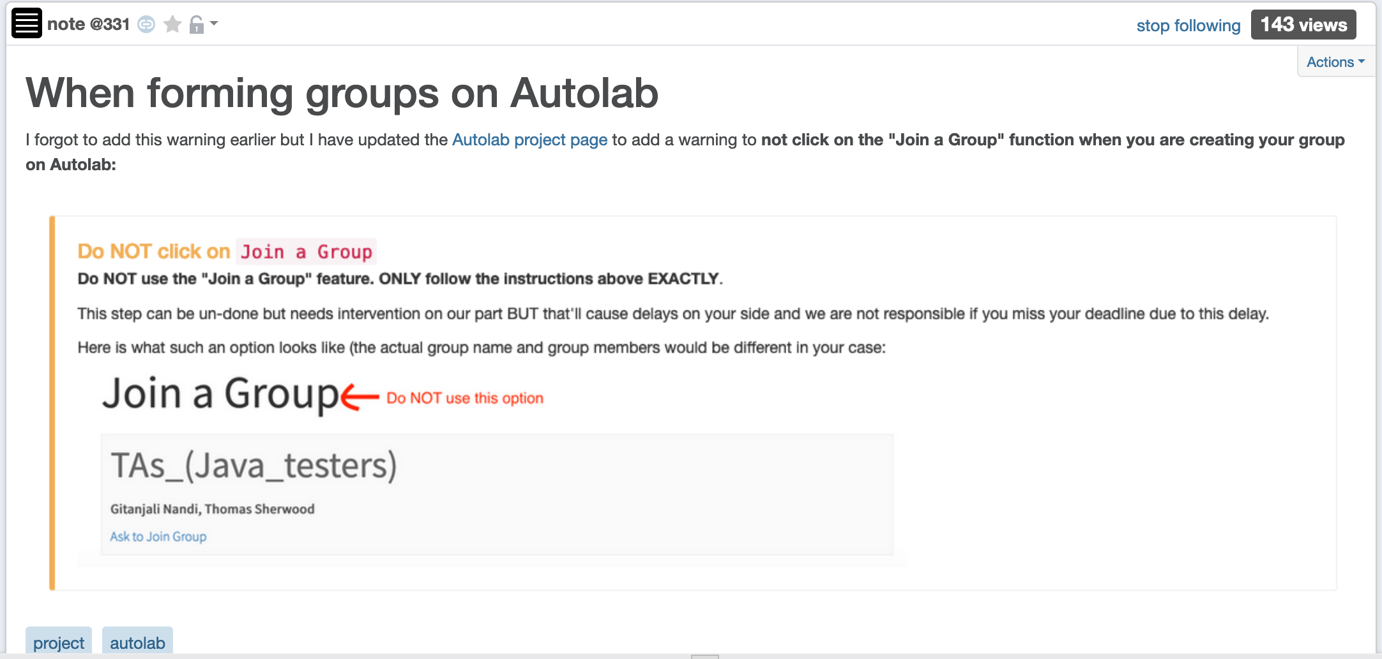
Do not use Join a Group “feature”

Slide 5
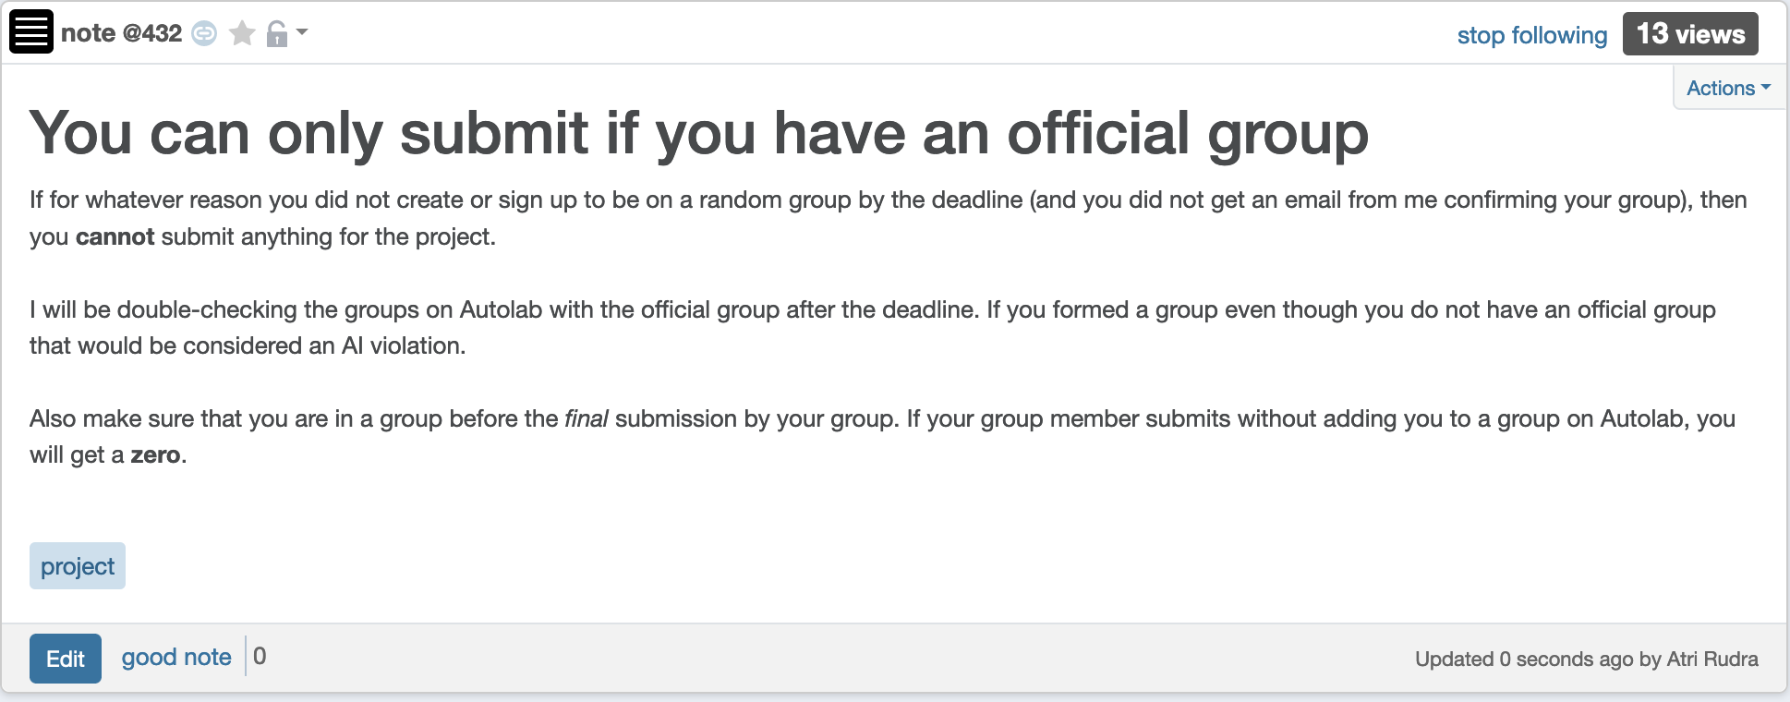
No project group => no submission

Slide 6
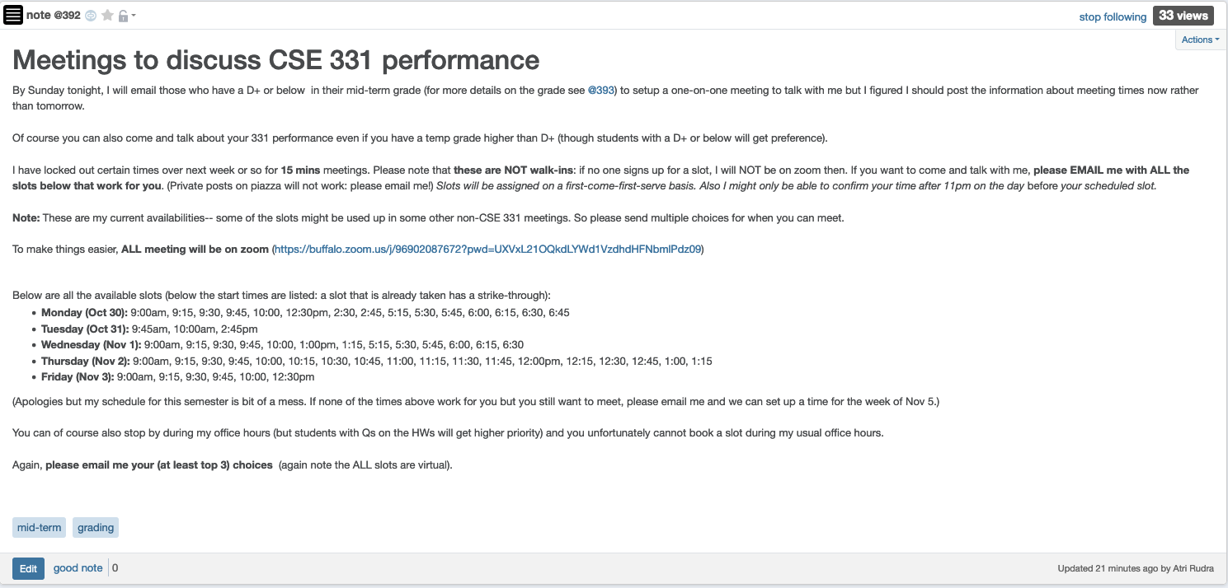
1-on-1 meeting slots

Slide 7
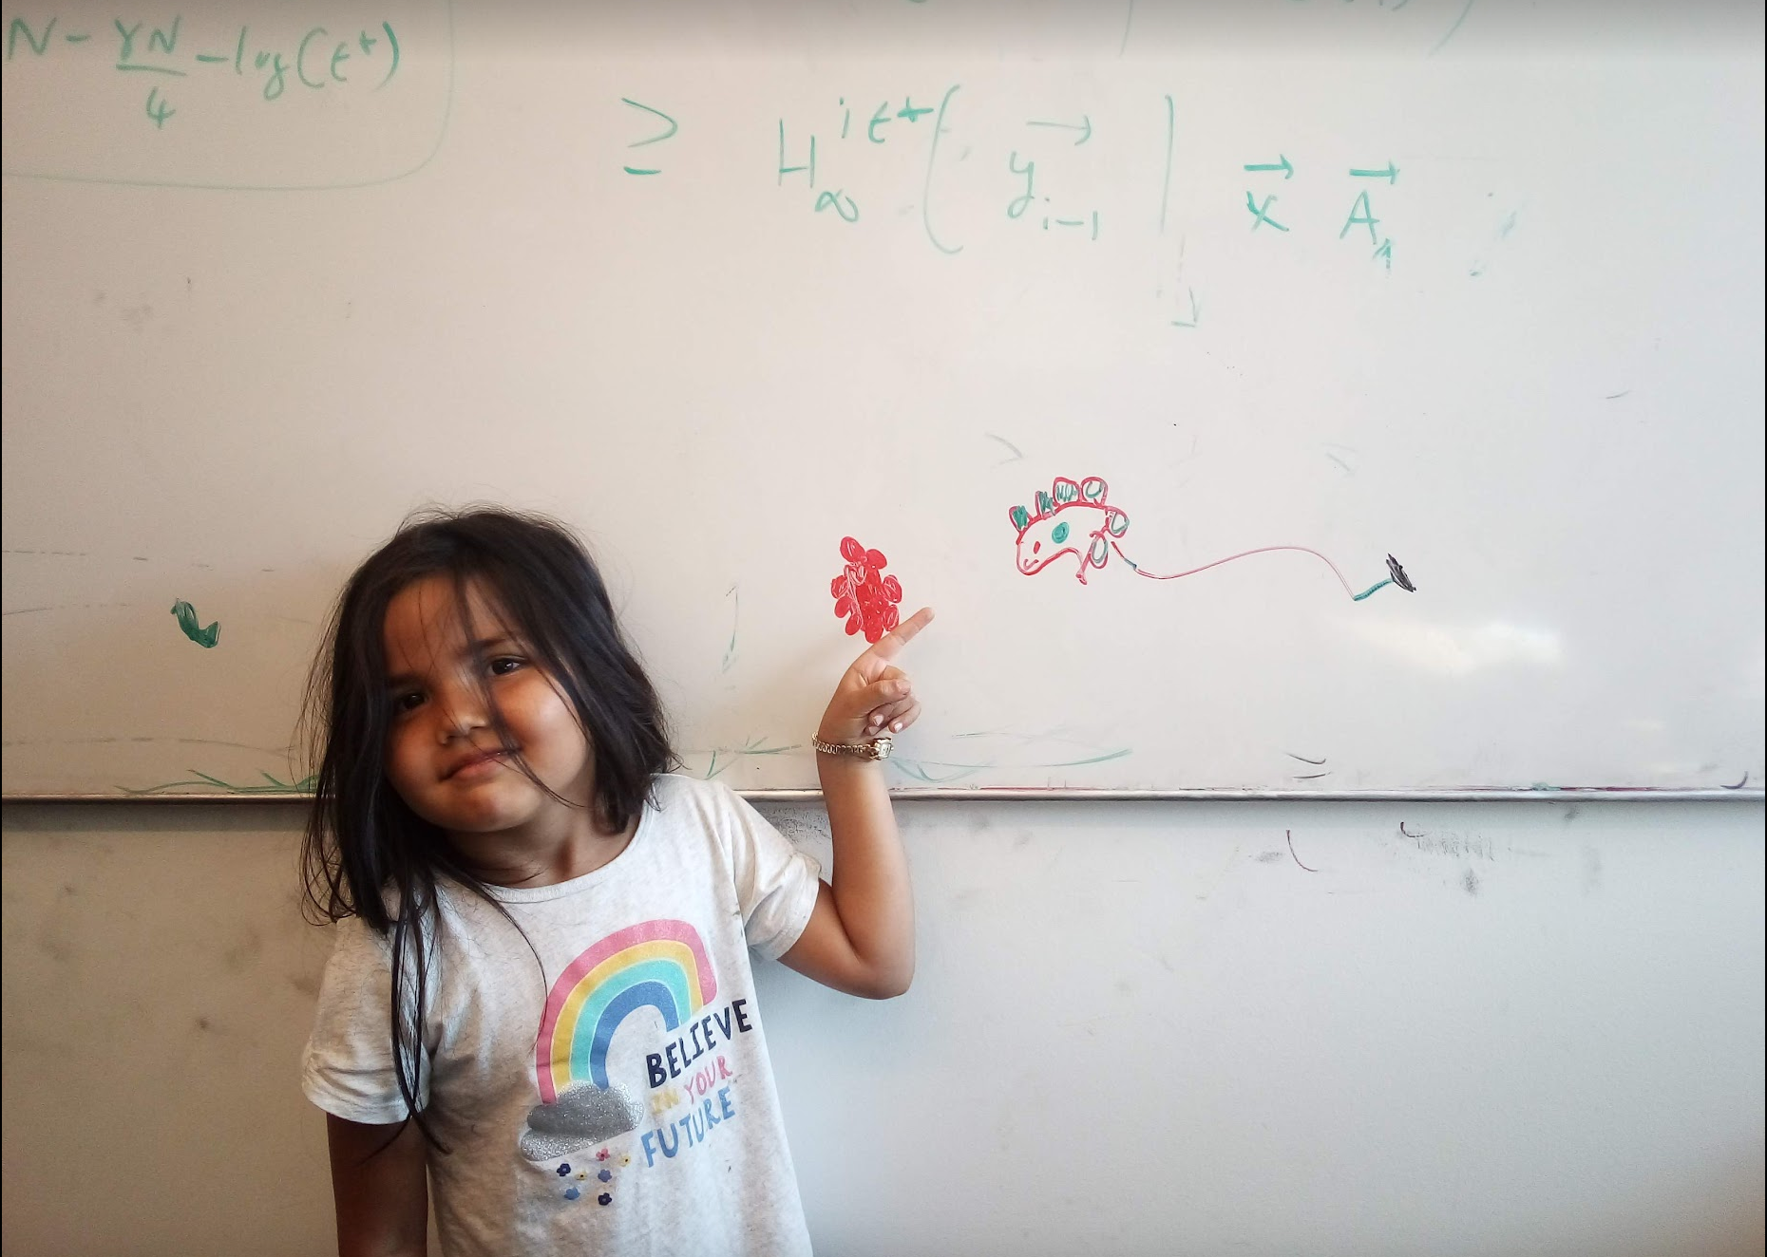
Questions/Comments?

Slide 8
Divide and Conquer
Divide up the problem into at least two sub-problems
Recursively solve the sub-problems
“Patch up” the solutions to the sub-problems for the final solution

Slide 9
Improvements on a smaller scale
Greedy algorithms: exponential → poly time
(Typical) Divide and Conquer: O(n²) → asymptotically smaller running time

Slide 10
Multiplying two numbers
Given two numbers a and b in binary
a=(a_{n-1},..,a₀) and b = (b_{n-1},…,b₀)
Elementary school algorithm is O(n²)
Compute c = a x b

Slide 11
The current algorithm scheme
Shift by O(n) bits
Adding O(n) bit numbers
Mult over n bits
a • b = a¹b¹ •2^{2[n/2]} + (a¹b⁰+a⁰b¹)•2^{[n/2]} + a⁰b⁰
Multiplication over n/2 bit inputs
T(n) is O(n²)
T(n) ≤ 4T(n/2) + cn
T(1) ≤ c

Slide 12
The key identity
a¹b⁰+a⁰b¹= (a¹+a⁰)(b¹+b⁰) - a¹b¹ - a⁰b⁰

Slide 13
Wait, how do you think of that?

Slide 14
The final algorithm
Input: a = (a_{n-1},..,a₀) and b = (b_{n-1},…,b₀)
T(1) ≤ c
Mult (a, b)
If n = 1 return a₀b₀
T(n) ≤ 3T(n/2) + cn
a¹ = a_{n-1},…,a_{[n/2]} and a⁰ = a_{[n/2]-1},…, a₀
O(n^{log}₂ ³) = O(n^{1.59})
run time
Compute b¹ and b⁰ from b
x = a¹ + a⁰ and y = b¹ + b⁰
Let p = Mult (x, y), D = Mult (a¹, b¹), E = Mult (a⁰, b⁰)
All green operations
are O(n) time
F = p - D - E
return D • 2^{2[n/2]} + F • 2^{[n/2]} + E
a • b = a¹b¹ •2^{2[n/2]} +( (a¹+a⁰)(b¹+b⁰) - a¹b¹ - a⁰b⁰ ) •2^{[n/2]} + a⁰b⁰

