Slide 1
Lecture 30
CSE 331
Nov 13, 2023

Slide 2
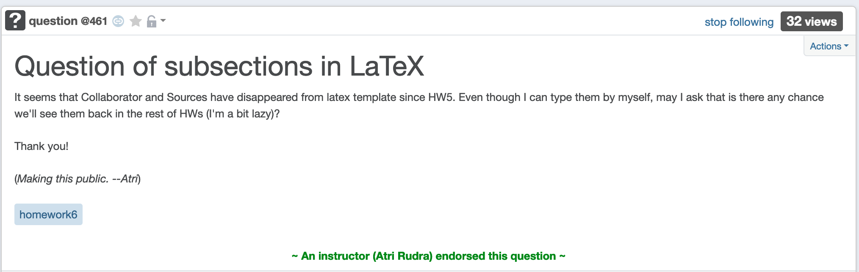
HW 6 Q1+2 templates buggy

Slide 3
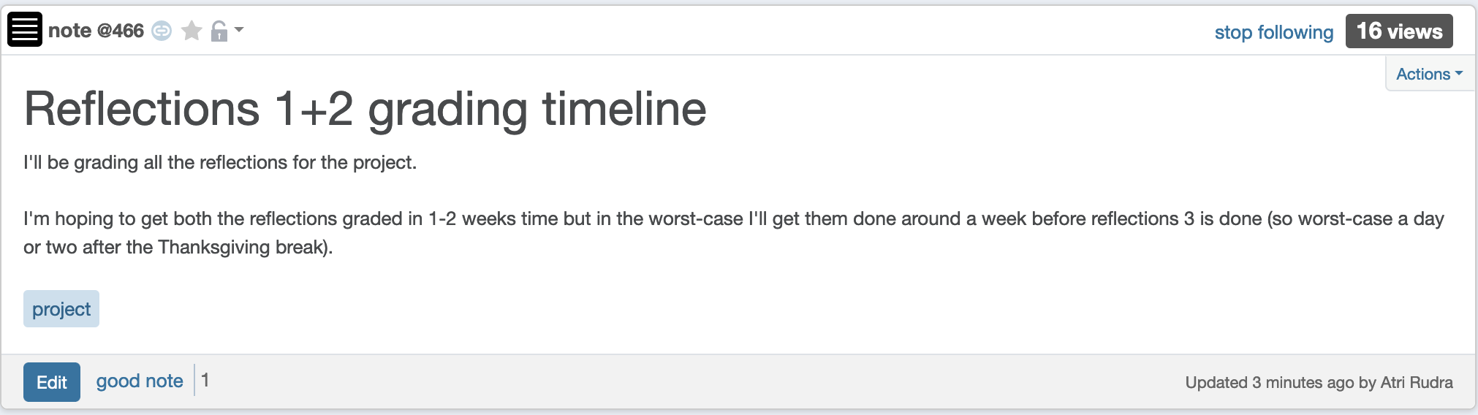
Reflections 1+2 grading

Slide 4
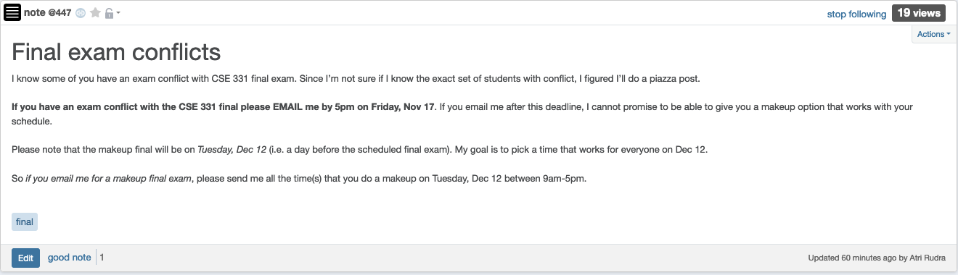
Final exam conflict

Slide 5
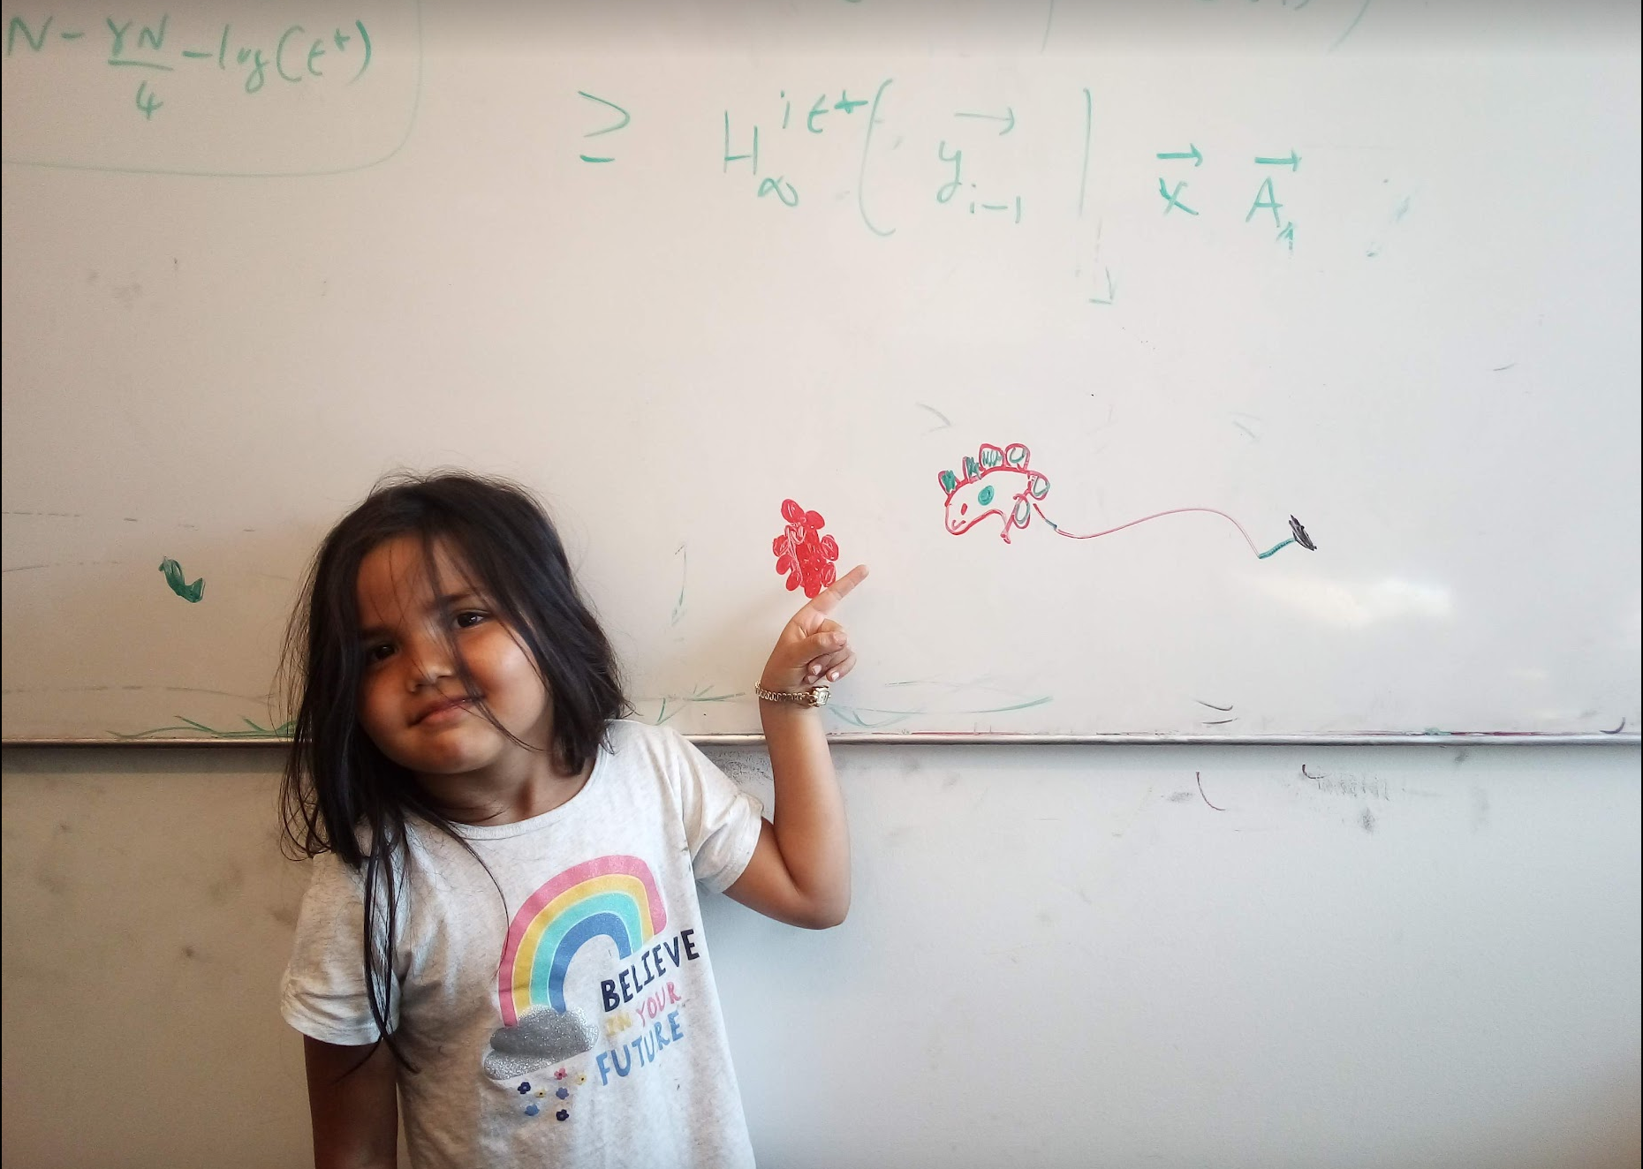
Questions/Comments?

Slide 6

End of Semester blues
Can only do one thing at any day: what is the optimal schedule to obtain maximum value?
Write up a term paper
(10)
Party!
(2)
Exam study
(5)
331 HW
(3)
Project
(30)
Friday
Saturday
Sunday
Monday
Tuesday

Slide 7
Previous Greedy algorithm
Order by end time and pick jobs greedily
Greedy value = 5+2+3= 10
Write up a term paper
(10)
OPT = 30
Party!
(2)
Exam study
(5)
331 HW
(3)
Project
(30)
Friday
Saturday
Sunday
Monday
Tuesday

Slide 8
Weighted Interval Scheduling
Input: n jobs (s_{i},f_{i},v_{i})
Output: A schedule S s.t. no two jobs in S have a conflict
Goal: max Σ_{i in S} v_{j}
Assume: jobs are sorted by their finish time

Slide 9

Today’s agenda
Finish designing a recursive algorithm for the problem

Slide 10
Couple more definitions
p(j) = largest i < j s.t. i does not conflict with j
p(j) < j
= 0 if no such i exists
OPT(j) = optimal value on instance 1,..,j

Slide 11
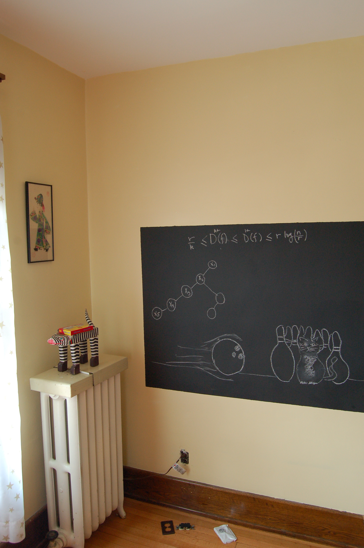
Moving to the board…

Slide 12
Property of OPT
j not in OPT(j)
j in OPT(j)
OPT(j) = max { v_{j} + OPT( p(j) ), OPT(j-1) }
Given OPT(1),…., OPT(j-1), how can one figure out if j in optimal solution or not?

Slide 13


Slide 14
A recursive algorithm
Proof of correctness by induction on j
Correct for j=0
Compute-Opt(j)
If j = 0 then return 0
return max { v_{j} + Compute-Opt( p(j) ), Compute-Opt( j-1 ) }
= OPT( p(j) )
= OPT( j-1 )
OPT(j) = max { v_{j} + OPT( p(j) ), OPT(j-1) }

Slide 15
Exponential Running Time
1
p(j) = j-2
2
3
Only 5 OPT values!
4
5
OPT(5)
Formal proof: Ex.
OPT(3)
OPT(4)
OPT(3)
OPT(1)
OPT(2)
OPT(2)
OPT(1)
OPT(2)
OPT(1)
OPT(1)
OPT(1)

Slide 17
Using Memory to be smarter
Using more space can reduce runtime!

Slide 18
How many distinct OPT values?

Slide 19
A recursive algorithm
M-Compute-Opt(j) = OPT(j)
M-Compute-Opt(j)
If j = 0 then return 0
If M[j] is not null then return M[j]
M[j] = max { v_{j} + M-Compute-Opt( p(j) ), M-Compute-Opt( j-1 ) }
return M[j]
Run time = O(# recursive calls)

