Slide 1
Lecture 32
CSE 331
Nov 17, 2023

Slide 2
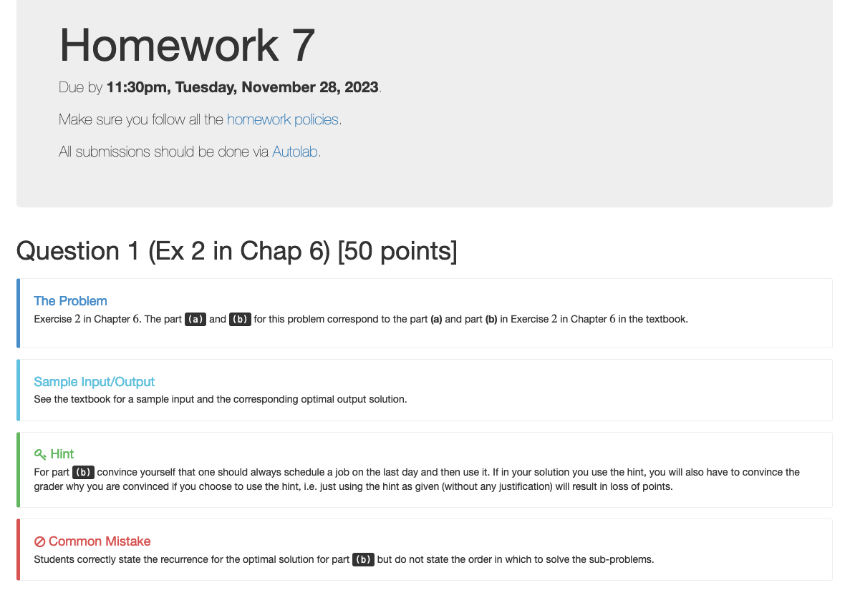
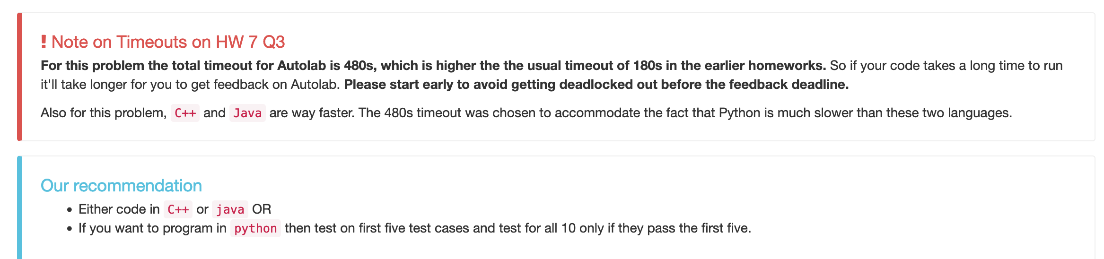
Homework 7 reminders

Slide 3
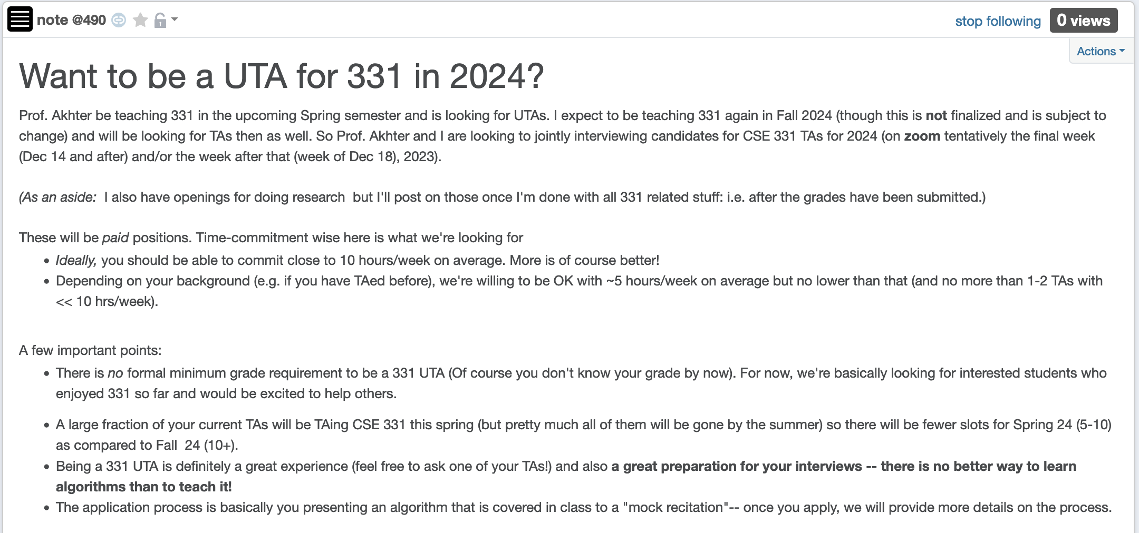
Apply to be a CSE 331 TA in 2024!

Slide 4
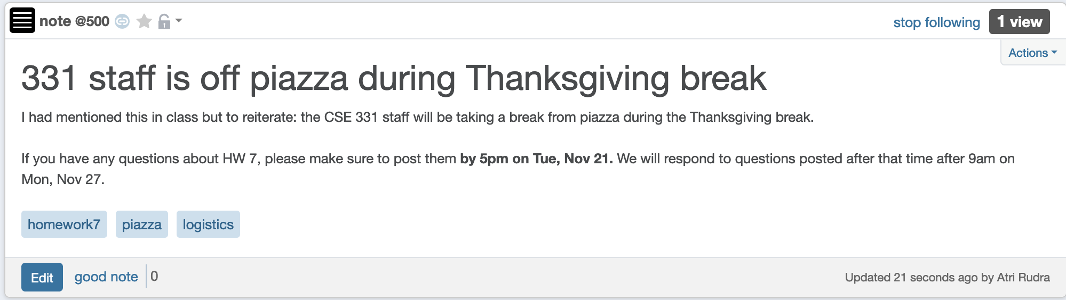
No piazza help during break

Slide 5
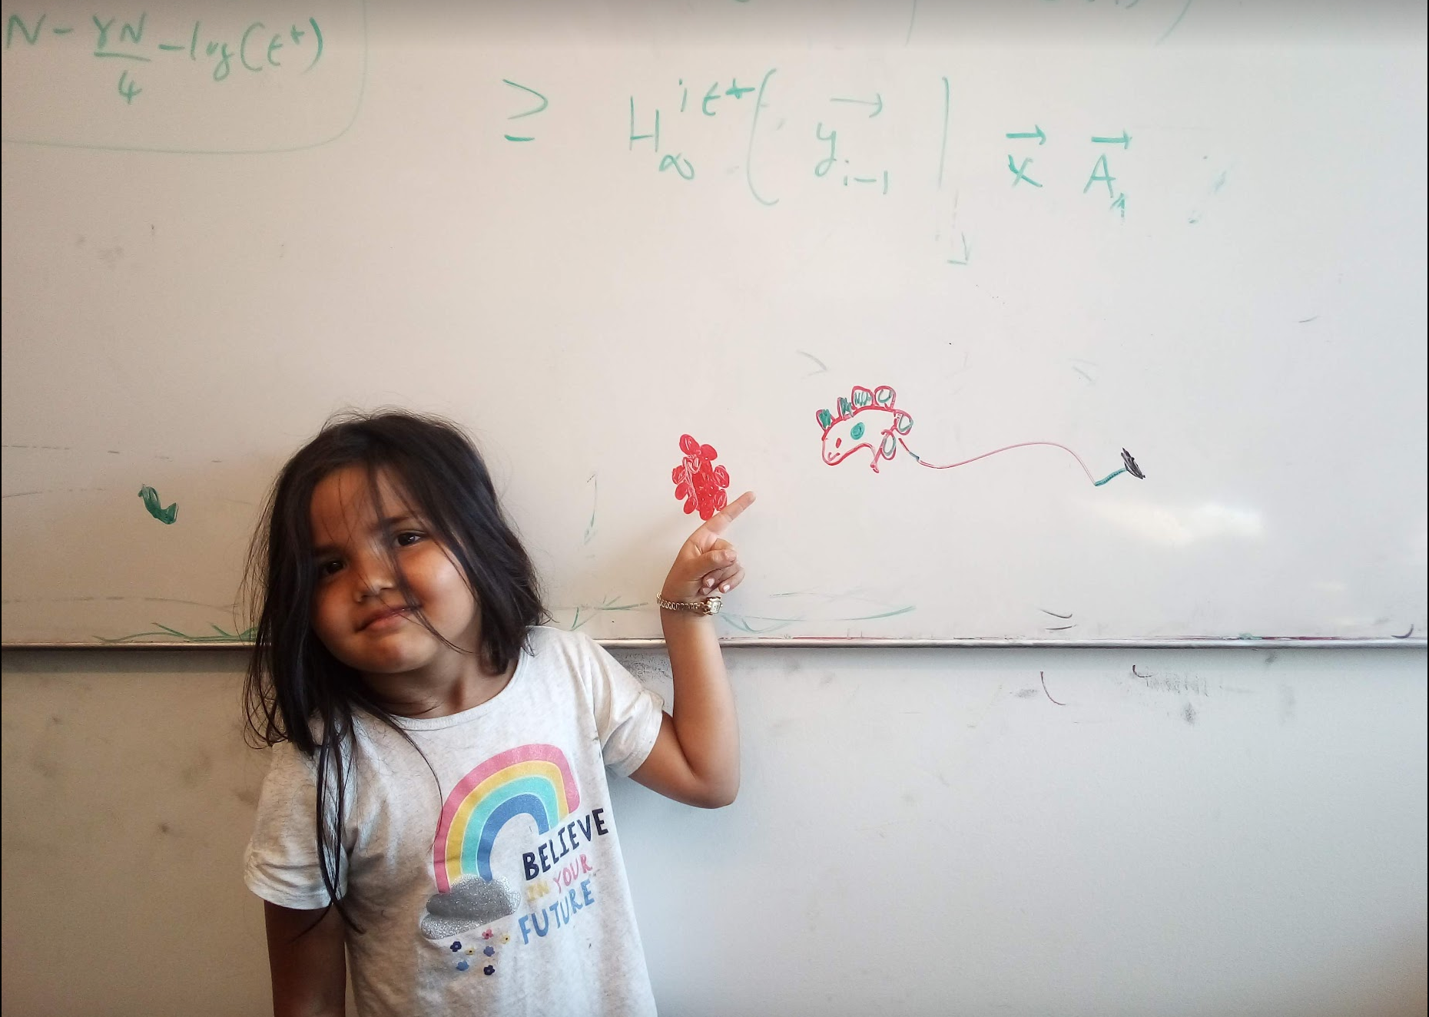
Questions/Comments?

Slide 6
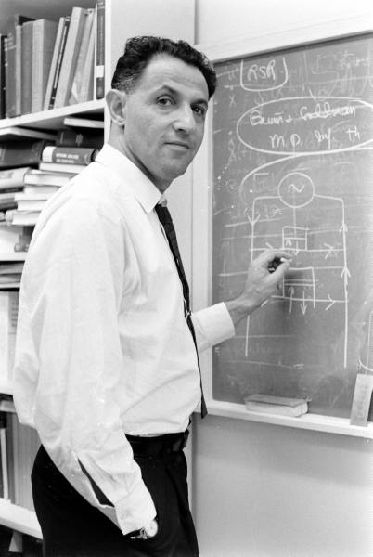
When to use Dynamic Programming
There are polynomially many sub-problems
OPT(1), …, OPT(n)
Richard Bellman
Optimal solution can be computed from solutions to sub-problems
OPT(j) = max { v_{j} + OPT( p(j) ), OPT(j-1) }
There is an ordering among sub-problem that allows for iterative solution
OPT (j) only depends on OPT(j-1), …, OPT(1)

Slide 7

Scheduling to min idle cycles
n jobs, i^{th} job takes w_{i} cycles
You have W cycles on the cloud
What is the maximum number of cycles you can schedule?

Slide 8
Subset sum problem
Input:
n integers w₁, w₂, …, w_{n}
bound W
Output:
subset S of [n] such that
sum of w_{i} for all i in S is at most W
w(S) is maximized

Slide 9

Questions?

Slide 10
Today’s agenda
Dynamic Program for Subset Sum problem

Slide 11
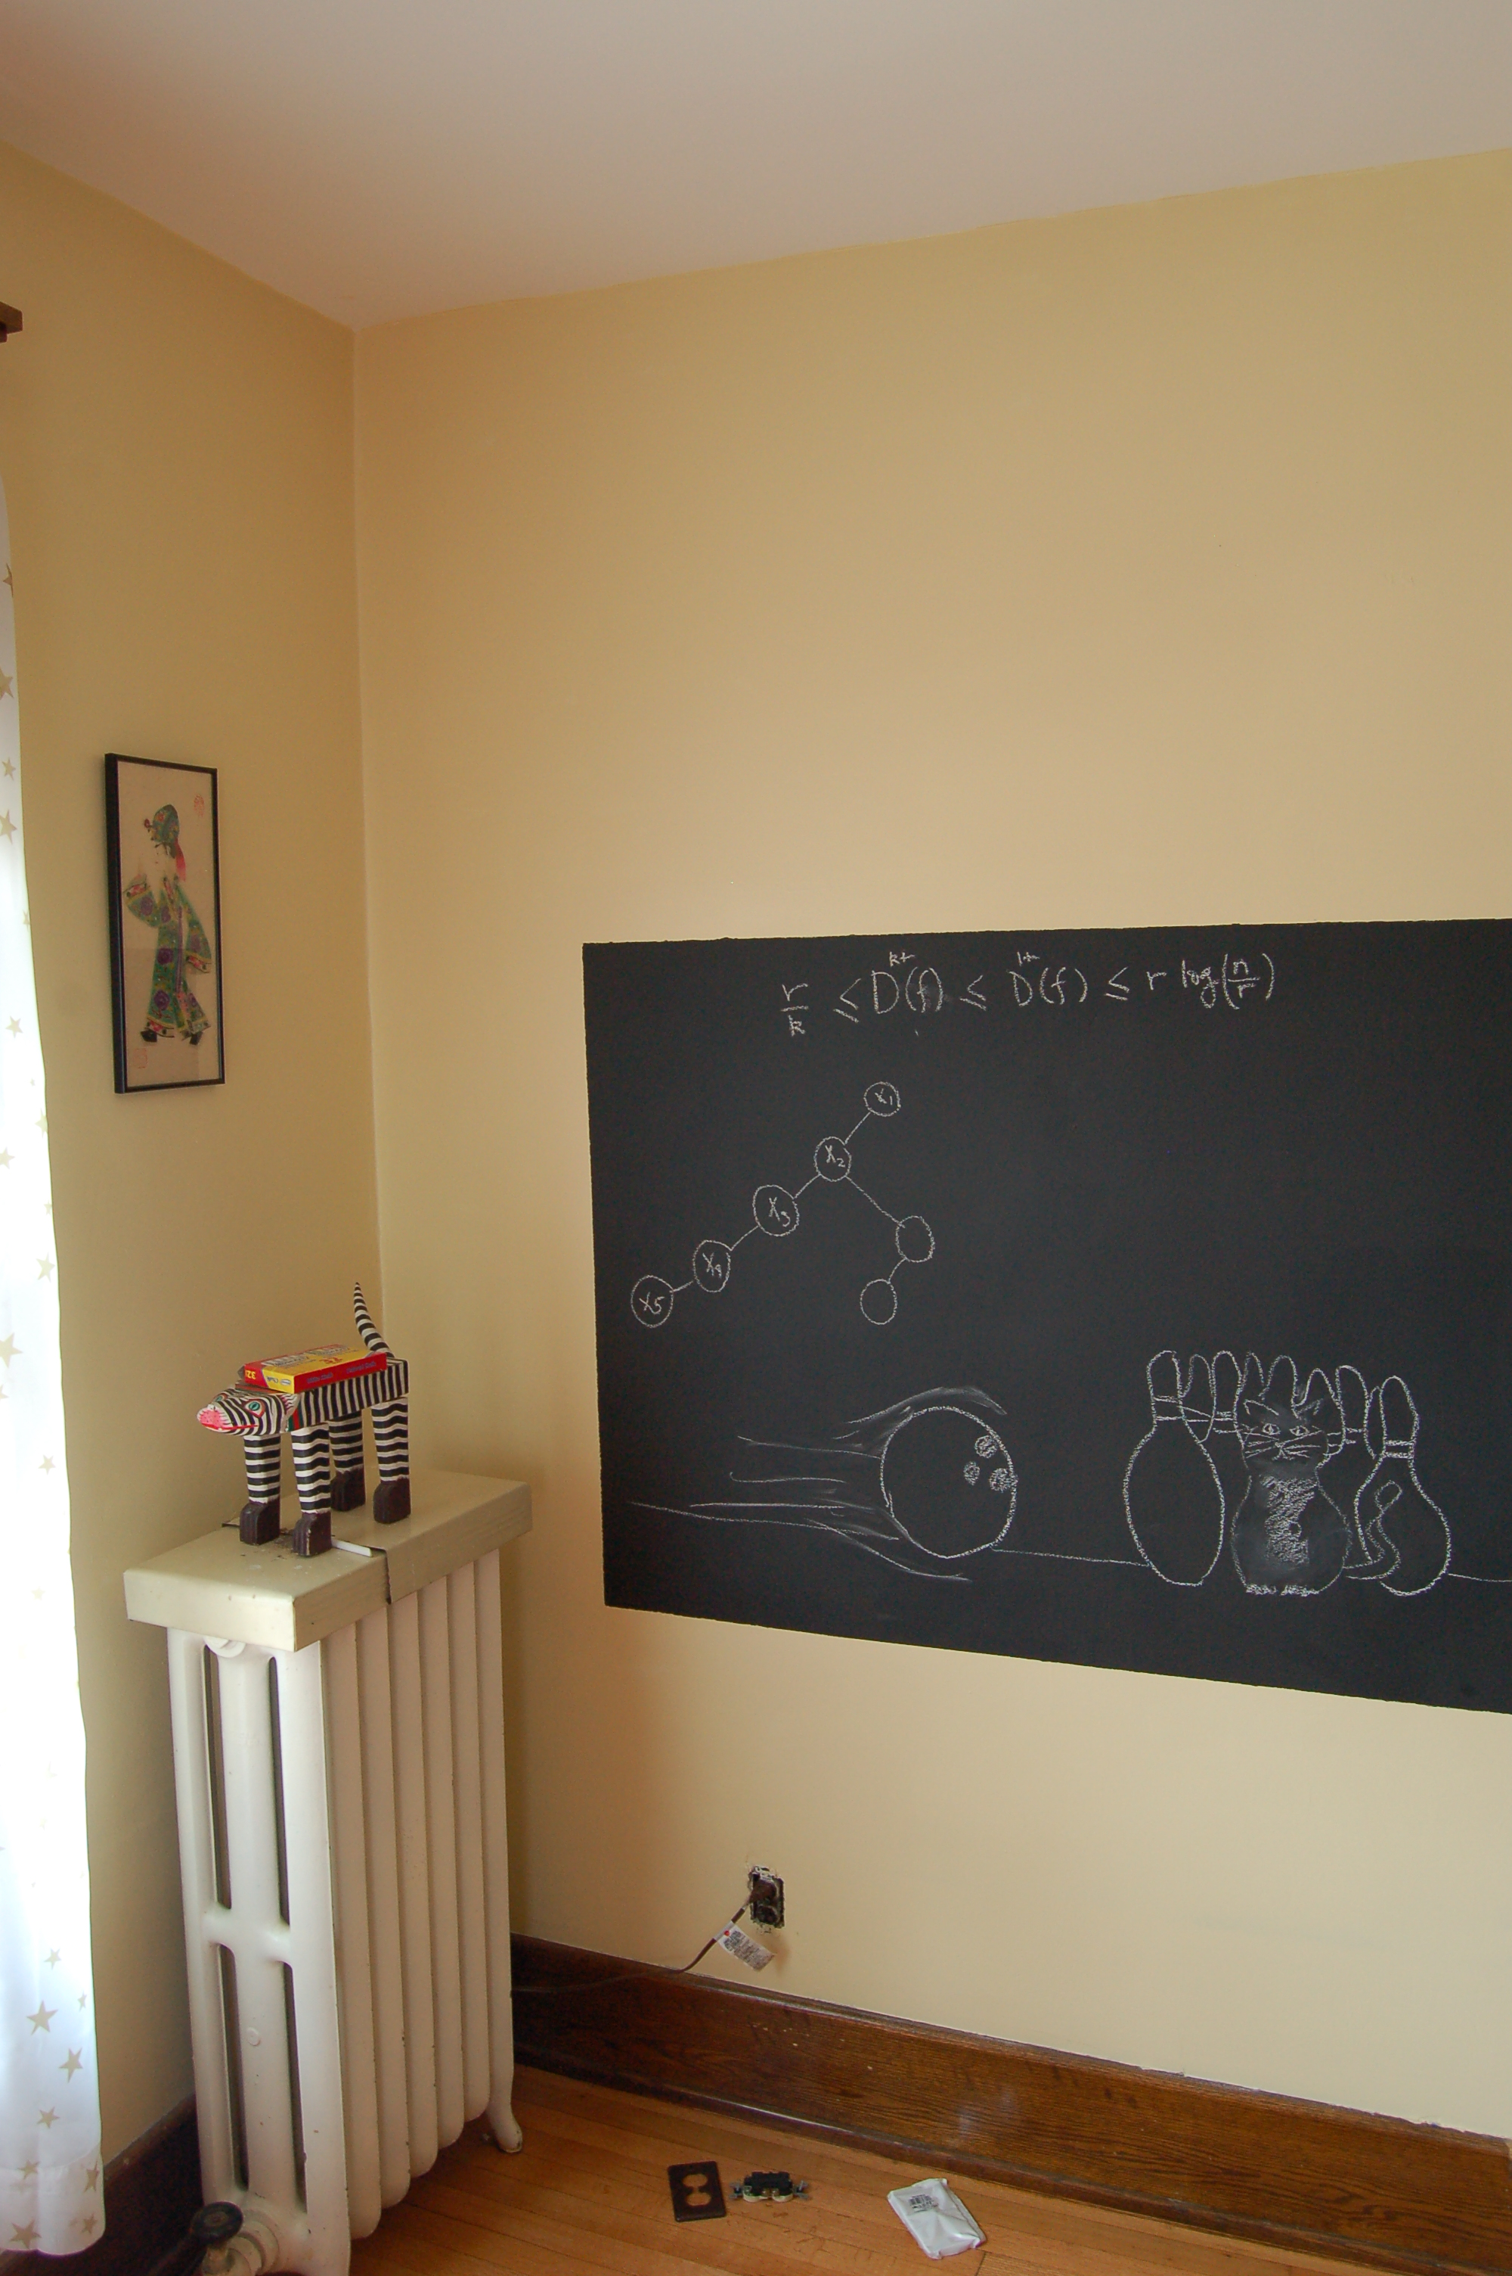
Algo on the board…

