Slide 1
Lecture 35
CSE 331
Nov 29, 2023

Slide 2
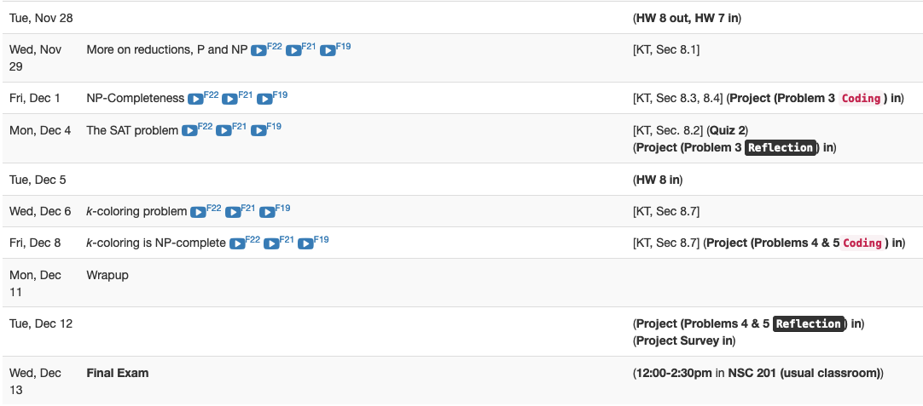
Next 2 weeks are brutal

Slide 3
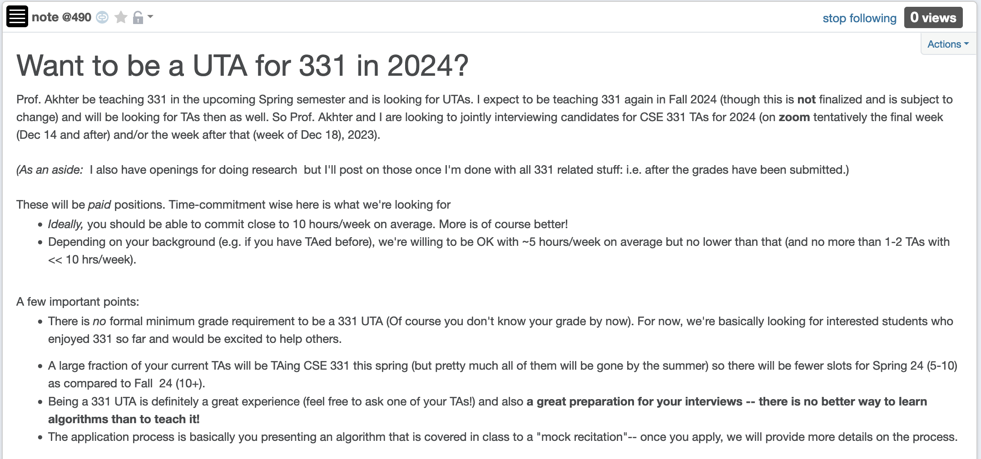
Apply to be a CSE 331 TA in 2024!

Slide 4
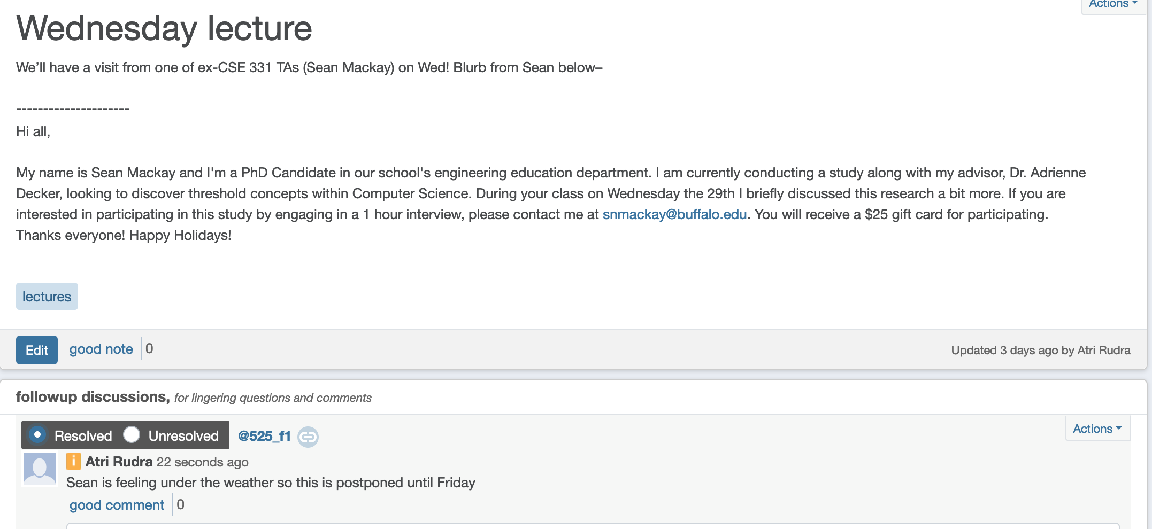
Sean will here Friday

Slide 5
The course so far…
https://www.teepublic.com/sticker/1100935-obama-yes-we-can

Slide 6
The rest of the course…
Under certain assumptions,
https://www.madduckposters.com/products/megamind-no-you-cant?variant=13565168320556

Slide 7
Questions?

Slide 8
No, you can’t– what does it mean?
NO algorithm will be able to solve a problem in polynomial time
Still for worst-case runtime

Slide 9
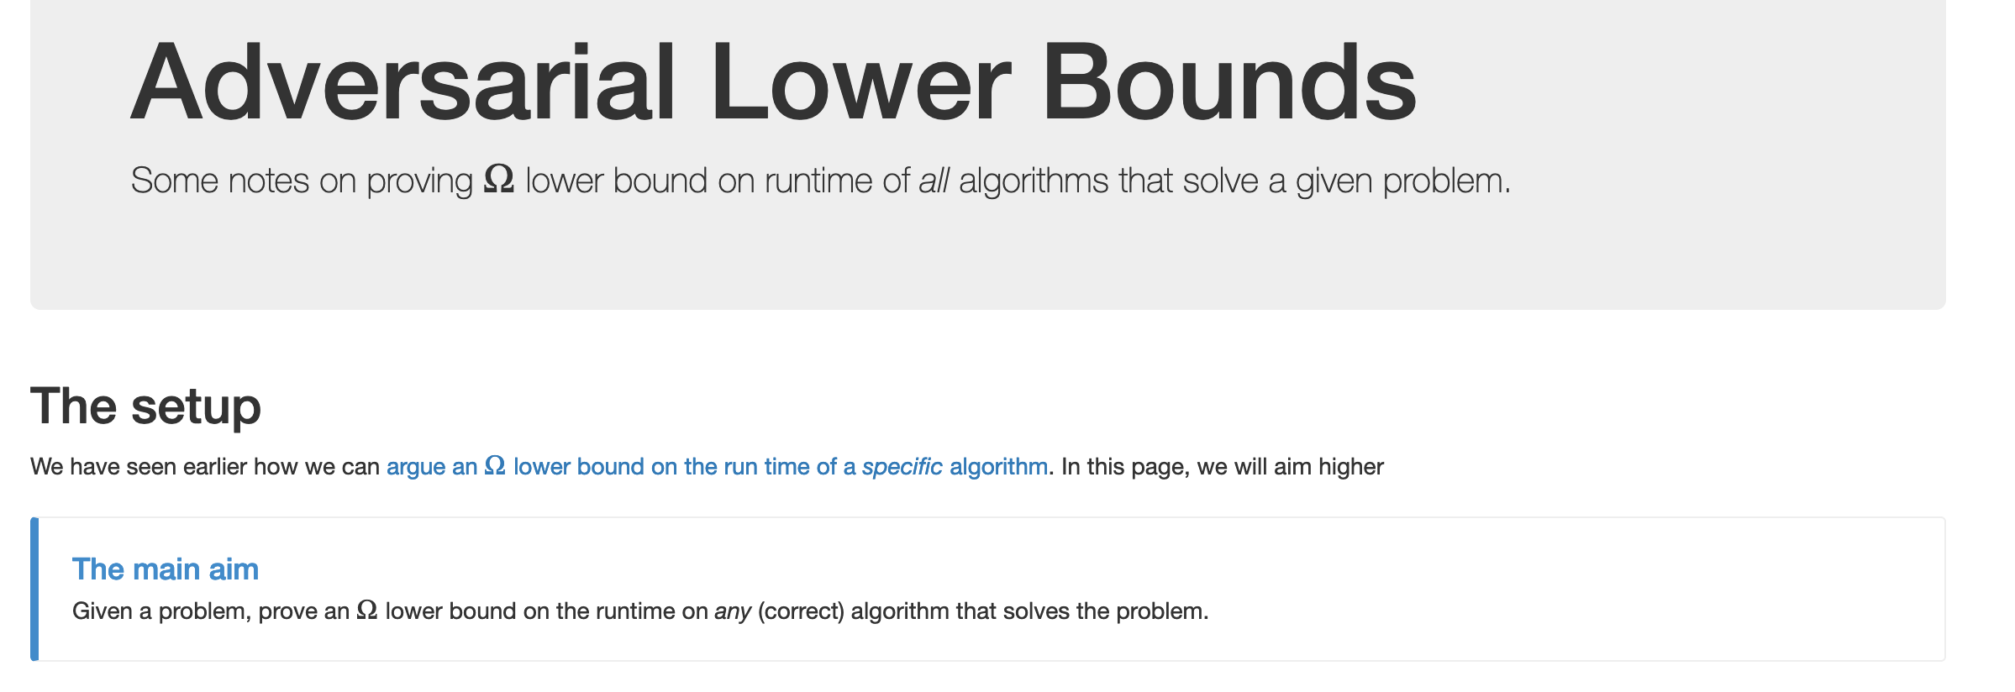
No, you can’t take- 1
What is the best lower bound you can prove?

Slide 10
No, you can’t take- 2
Lower bounds based on output size
Exists graphs with m^{3/2} triangles

Slide 11
No, you can’t take- 2
Lower bounds based on output size
On input n, output 2^{n} many ones
Every algo takes (doubly) exponential time
But at heart problem is “trivial”
From now on, output size is always O(N) and could even be binary.

Slide 12
No, you can’t take -3
Argue that a given problem is AS HARD AS
a “known” hard problem
How can we argue something like this?
Reductions

Slide 13
So far: “Yes, we can” reductions
https://www.teepublic.com/sticker/1100935-obama-yes-we-can

Slide 14
Reduce Y to X where X is “easy”

Slide 15
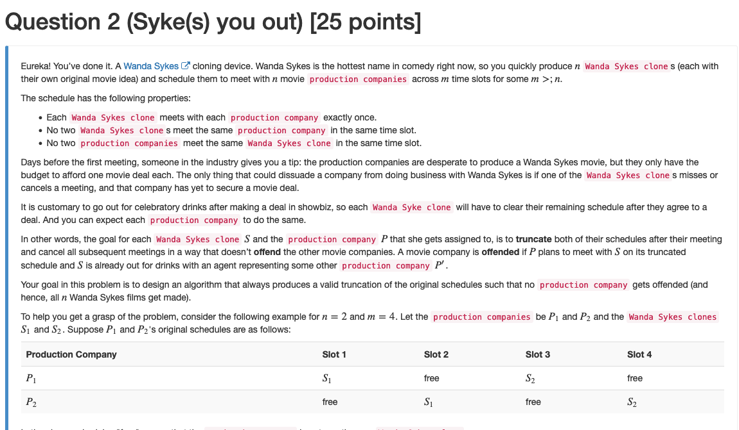
“Yes, we can” reductions (Example)

Slide 16
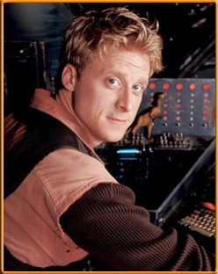
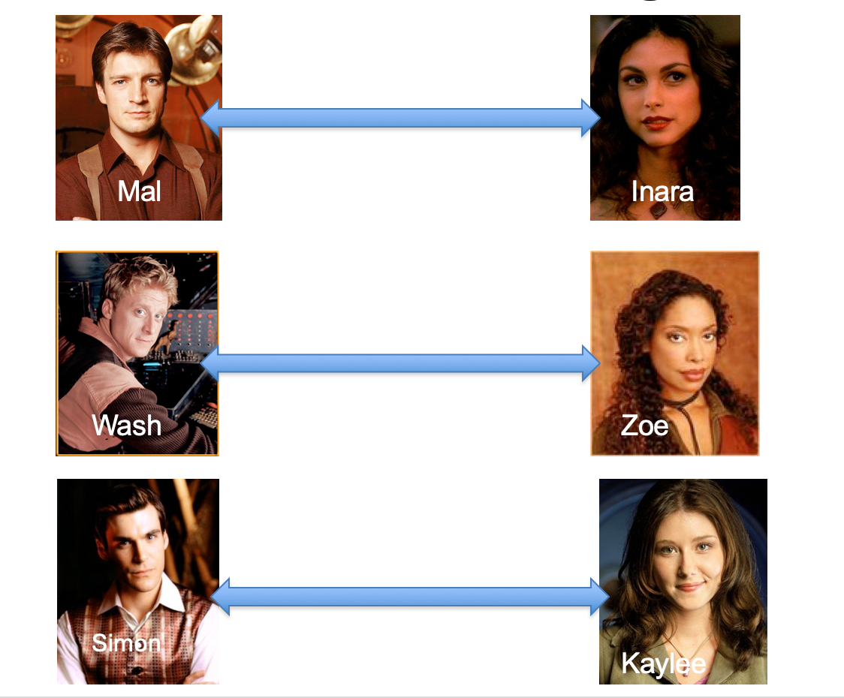
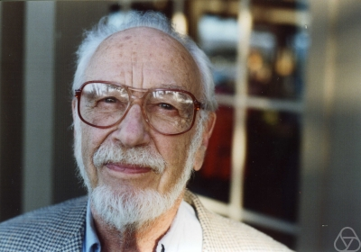
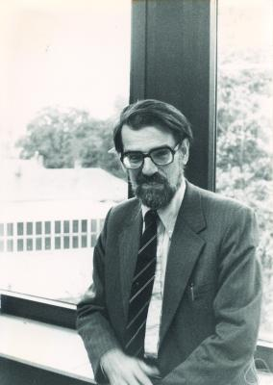
Overview of the reduction

Slide 17
Nothing special about GS algo
ANY algo for stable matching problem works!

Slide 18
Another observation
Poly time steps
ANY algo for stable matching problem works!

Slide 19
Poly time reductions
Poly time steps
ANY algo for stable matching problem works!

Slide 20
Poly time steps
Arbitrary Y instance
ANY algo for stable matching problem works!
Pre-process the input
Output for Y instance
All processing
is poly-time
Algo for X
Post-process the output

Slide 21
Poly time algo for X
Arbitrary Y instance
Poly time algo for Y
Pre-process the input
Output for Y instance
All processing
is poly-time
Algo for X
Post-process the output

Slide 22
!B !A

Slide 23
No poly time algo for Y
Poly time algo for X
Arbitrary Y instance
No poly time algo for X
Poly time algo for Y
Pre-process the input
Output for Y instance
All processing
is poly-time
Algo for X
Post-process the output

Slide 24
Plan for rest of today
More on reductions
(If there is time) Quick definition of P and NP

