Slide 1
Lecture 36
CSE 331
Dec 1, 2023

Slide 2
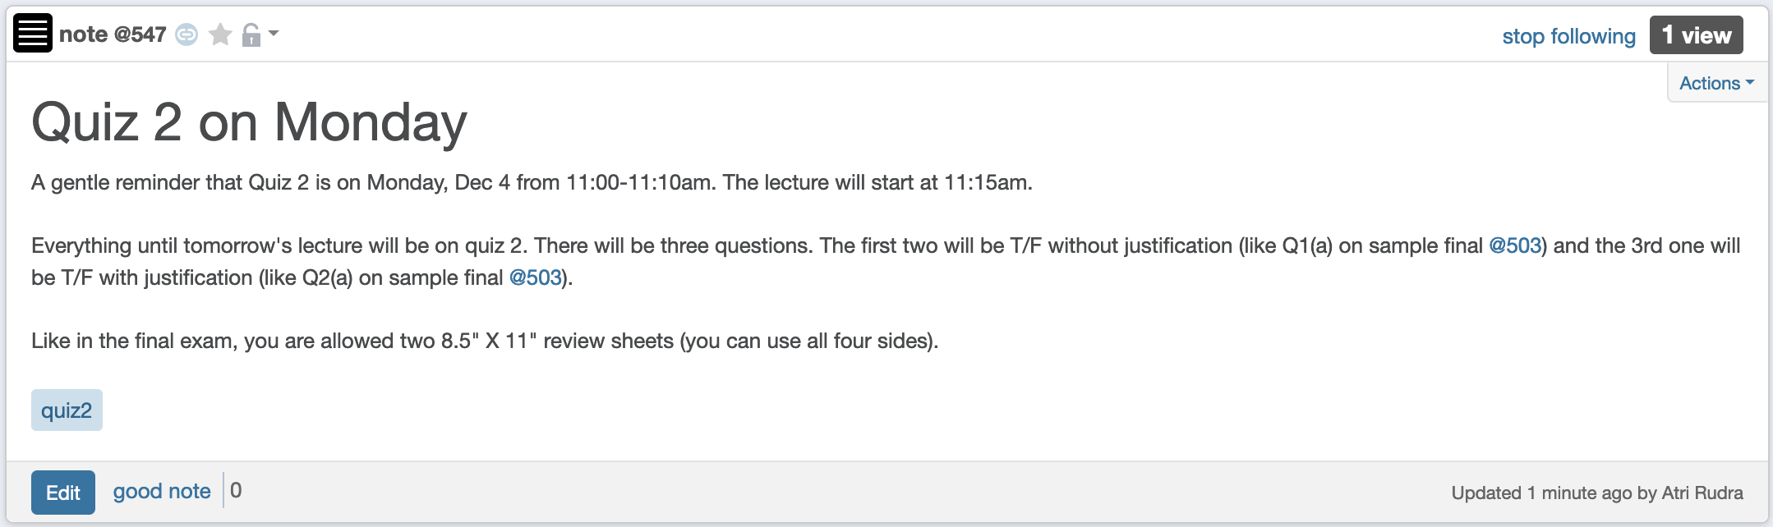
Quiz 2 on Monday

Slide 3
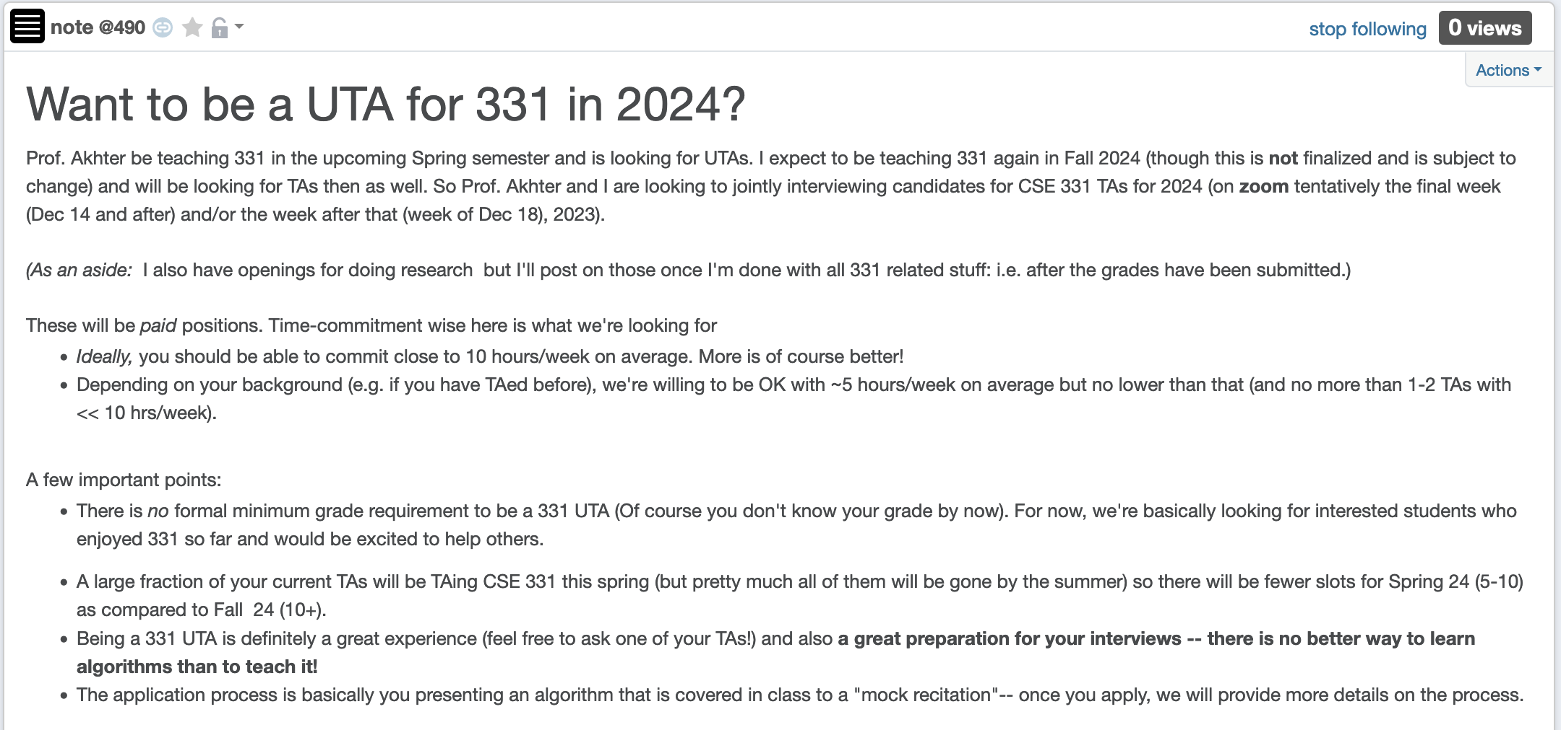
Apply to be a CSE 331 TA in 2024!

Slide 4
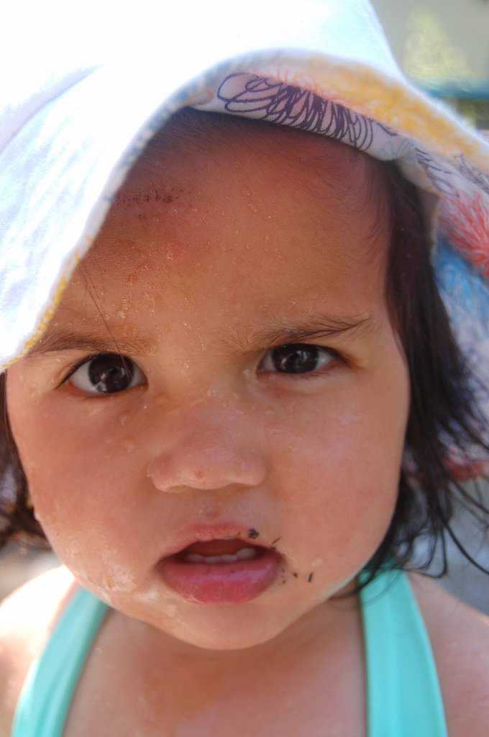
Questions?

Slide 5



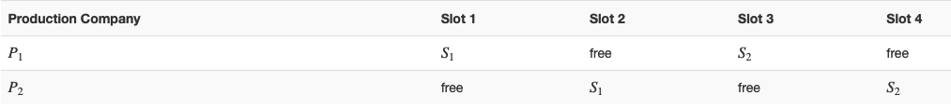
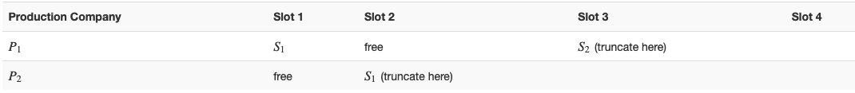






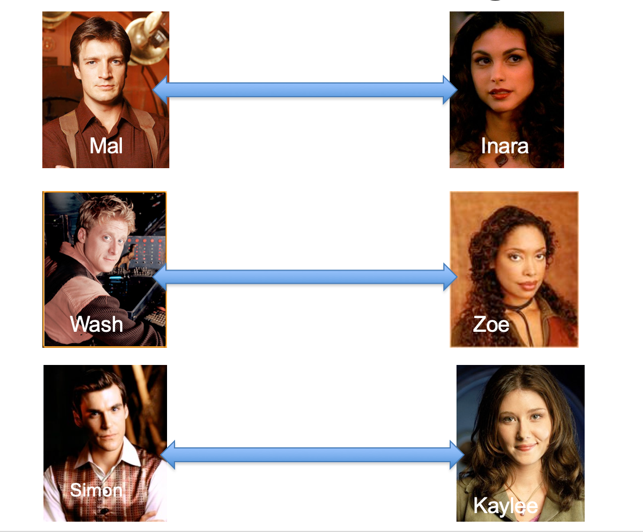
Poly time steps
Arbitrary Y instance
ANY algo for stable matching problem works!
Pre-process the input
Output for Y instance
All processing
is poly-time
Algo for X
Post-process the output

Slide 6



No poly time algo for Y
Poly time algo for X
Arbitrary Y instance
No poly time algo for X
Poly time algo for Y
Pre-process the input
Output for Y instance
All processing
is poly-time
Algo for X
Post-process the output

Slide 7
P vs NP question
P: problems that can be solved by poly time algorithms
Is P=NP?
NP: problems that have polynomial time verifiable witness to optimal solution

Slide 8

Independent Set (IS)
Input: Graph G = (V,E) and number k
Output: Yes iff G has an IS of size $≥$k

Slide 9

Vertex Cover (VC)
Input: Graph G = (V,E) and number k
Output: Yes iff G has a VC of size $≤$k

Slide 10
Questions?

Slide 11

Plan for today
Define P and NP
Define NP-completeness
IS $≤$_{P}VC

