Slide 1
Lecture 5
CSE 331
Sep 8, 2023

Slide 2
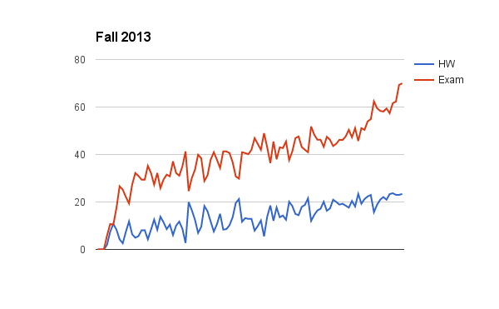
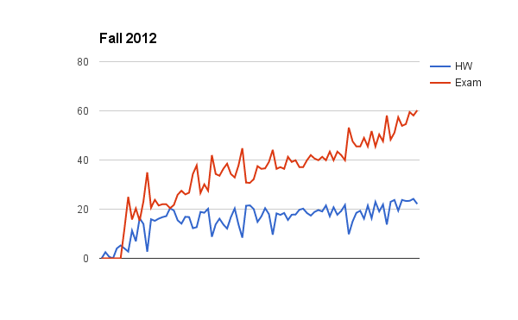
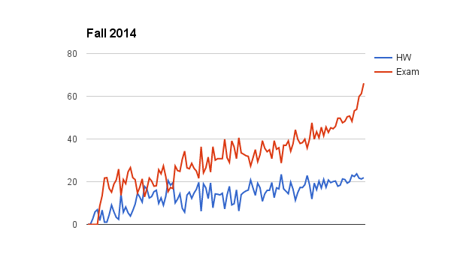
Can you guess the correlation?

Slide 3
Another comment
Discomfort with proofs
I will not cover proof basics in class anymore
Please read support pages and some utilize (next few) Office hours!

Slide 4
Lecture pace (until Fall 18)
Mid-term

Slide 5
Lecture pace
Mid-term

Slide 6
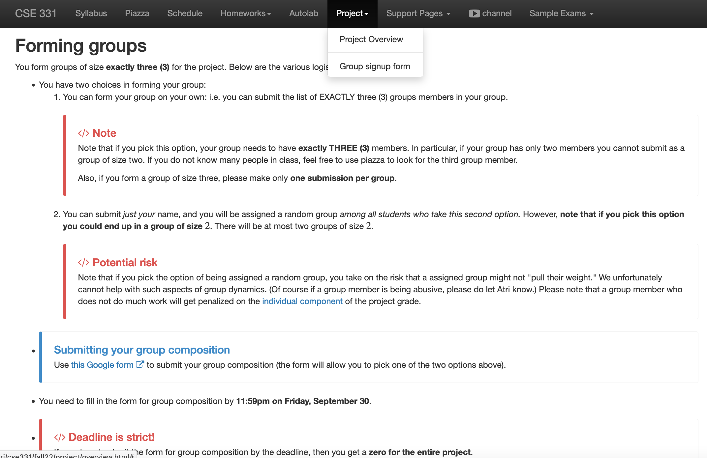
Register your project groups
Deadline: Friday, Sep 29, 11:59pm

Slide 7
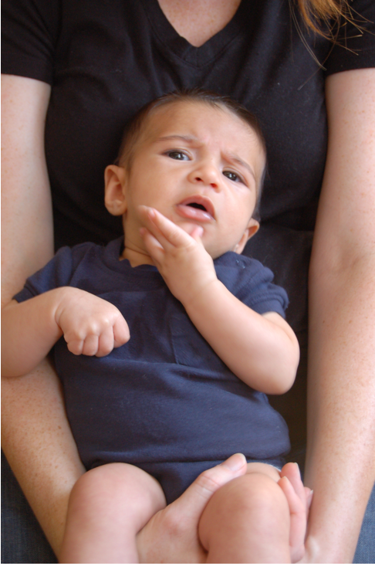
Questions/Comments?

Slide 8
Questions to think about
1) How do we specify preferences?
Preference lists
2) Ratio of applicant vs employers
1:1
3) Formally what is an assignment?
(perfect) matching
4) Can an employer get assigned > 1 applicant?
NO
5) Can an applicant have > 1 job?
NO
6) How many employer/applicants in an applicants/employers preferences?
All of them
7) Can an employer have 0 assigned applicants?
NO
8) Can an applicant have 0 jobs?
NO

Slide 9
(Perfect) Matching
S is a set of pairs (m,w) where m in M and w in W
exactly
(1) For every woman w in W, exist at most one m such that (m,w) in S
exactly
(2) For every man m in M, exist at most one w such that (m,w) in S
Perfect matching

Slide 10
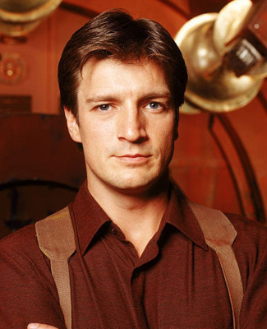


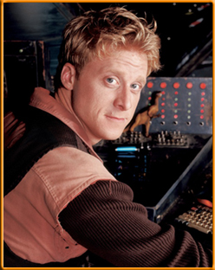
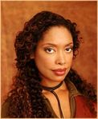

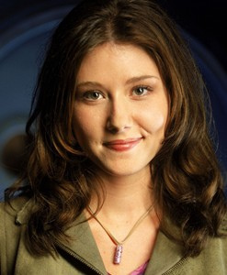
On matchings
Mal
Inara
Wash
Zoe
Simon
Kaylee

Slide 11
A valid matching
Mal
Inara
Wash
Zoe
Simon
Kaylee

Slide 12
Not a matching
Mal
Inara
Wash
Zoe
Simon
Kaylee

Slide 13
Perfect Matching
Mal
Inara
Wash
Zoe
Simon
Kaylee

Slide 14
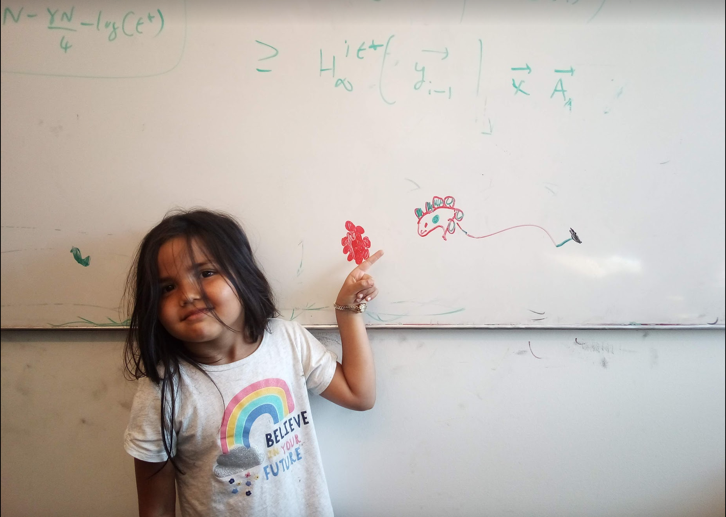
Questions/Comments?

Slide 15
Preferences
Mal
Inara
Wash
Zoe
Simon
Kaylee

Slide 16
Instability
Mal
Inara
Wash
Zoe
Simon
Kaylee

Slide 17
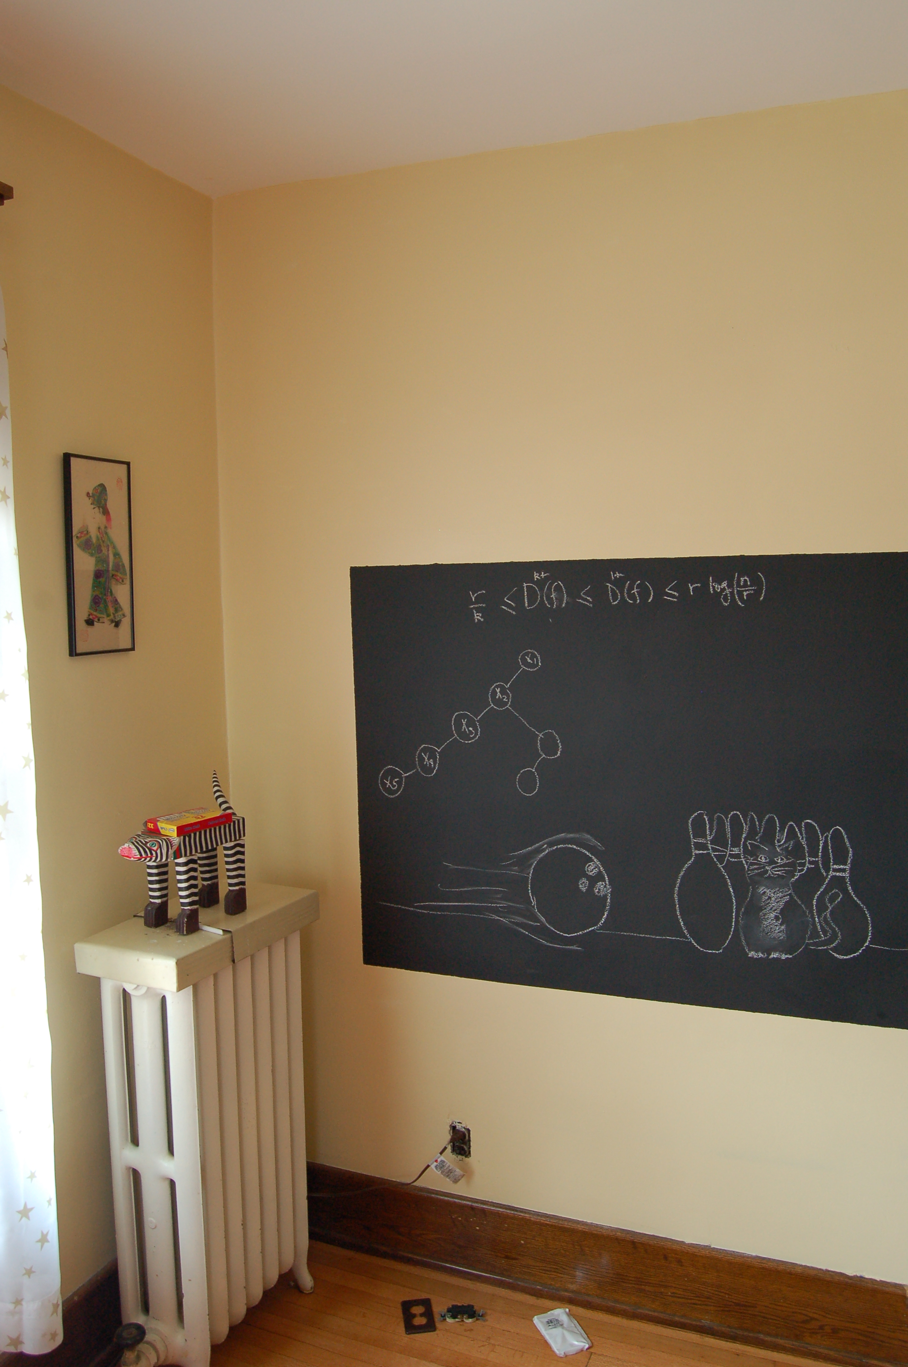
Back to the board…

Slide 18
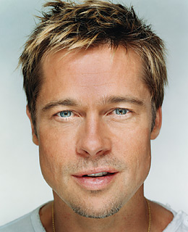
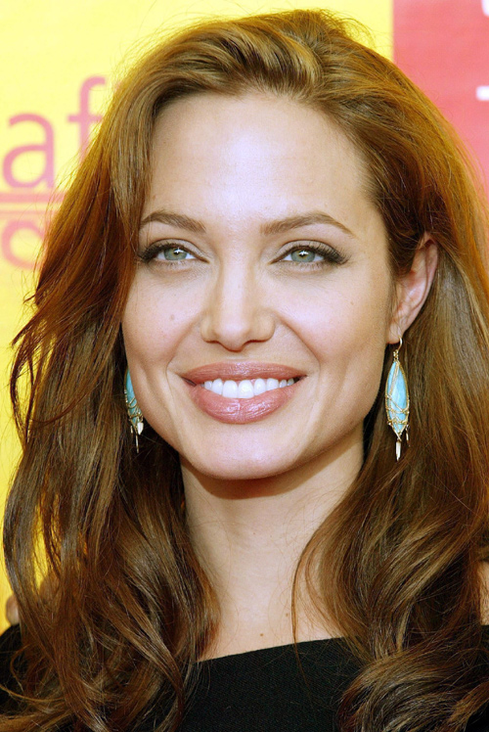
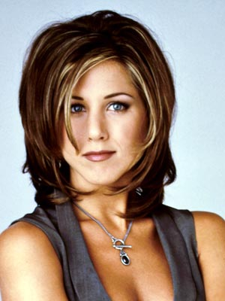
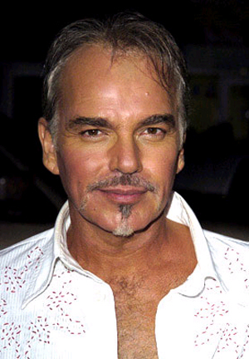
A stable matching
Even though BBT and JA are not very happy
Brad Pitt
Angelina Jolie
Billy Bob Thornton
Jennifer Aniston

Slide 19
Two stable matchings
Brad Pitt
Angelina Jolie
Billy Bob Thornton
Jennifer Aniston

Slide 20
Stable Matching problem
Input: M and W with preferences
Output: Stable Matching
Set of men M and women W
Preferences (ranking of potential spouses)
Matching (no polyandry/gamy in M X W)
Perfect Matching (everyone gets married)
m
w
Instablity
m’
w’
Stable matching = perfect matching+ no instablity

Slide 21
Questions/Comments?

Slide 22
Two Questions
Does a stable marriage always exist?
If one exists, how quickly can we
compute one?

Slide 23
Rest of today’s lecture
Naïve algorithm
Gale-Shapley algorithm for Stable Marriage problem

Slide 24
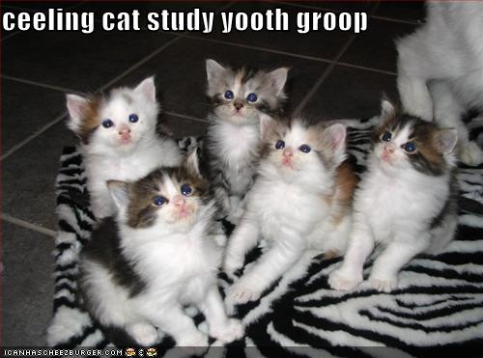
Discuss: Naïve algorithm!

Slide 25
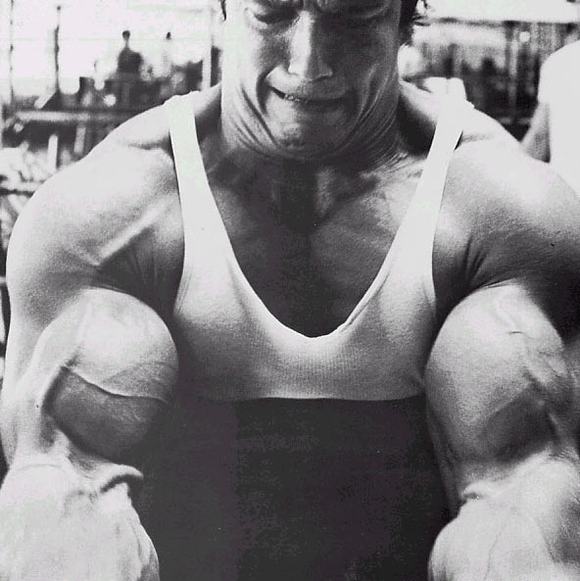
The naïve algorithm
Incremental algorithm to produce all n! prefect matchings?
Go through all possible perfect matchings S
If S is a stable matching
then Stop
n! matchings
Else move to the next perfect matching

Slide 26
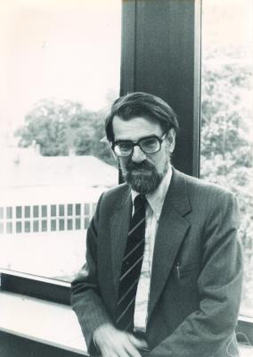
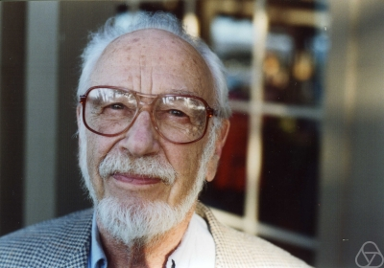
Gale-Shapley Algorithm
David Gale
Lloyd Shapley
O(n²) algorithm

Slide 27
Moral of the story…
>

Slide 28
Questions/Comments?

