Slide 1
Welcome
to
CSE 331

Slide 2
Let’s do some introductions
http://www.zazzle.com/warning_teaching_assistant_bag-149882665435161818

Slide 3
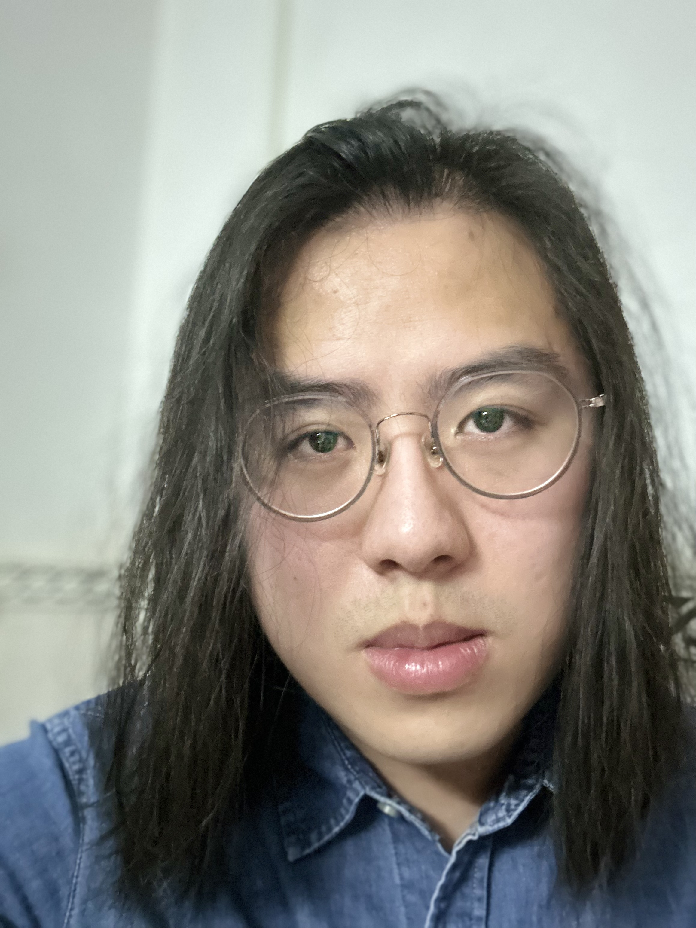
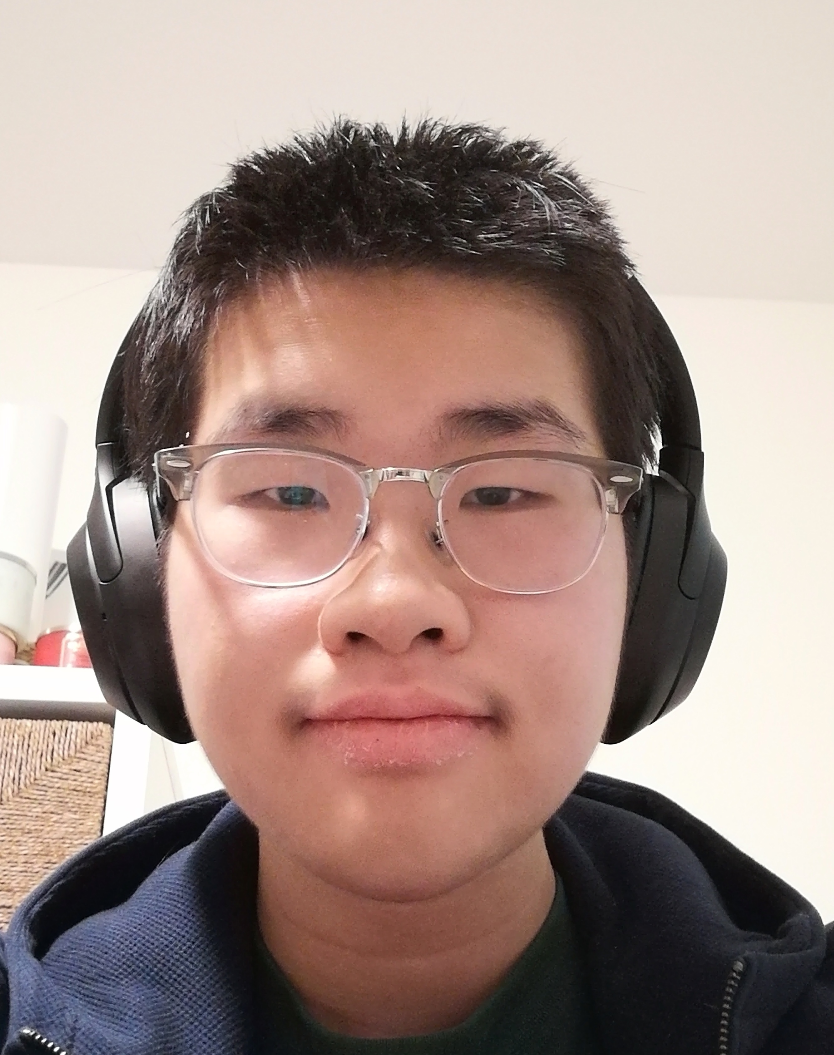
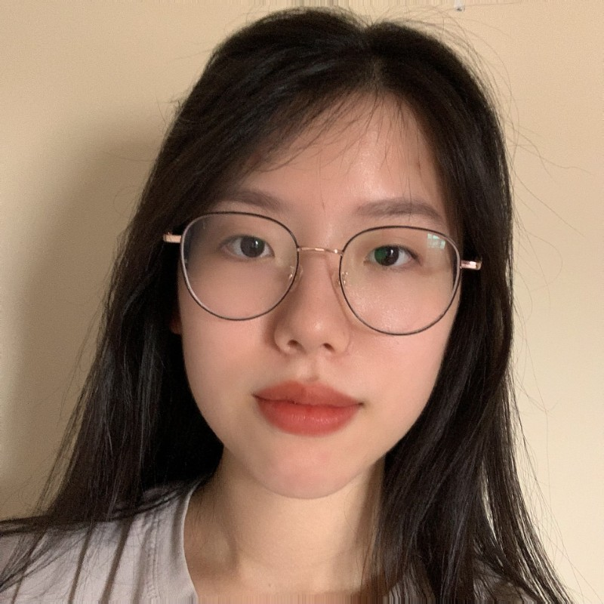
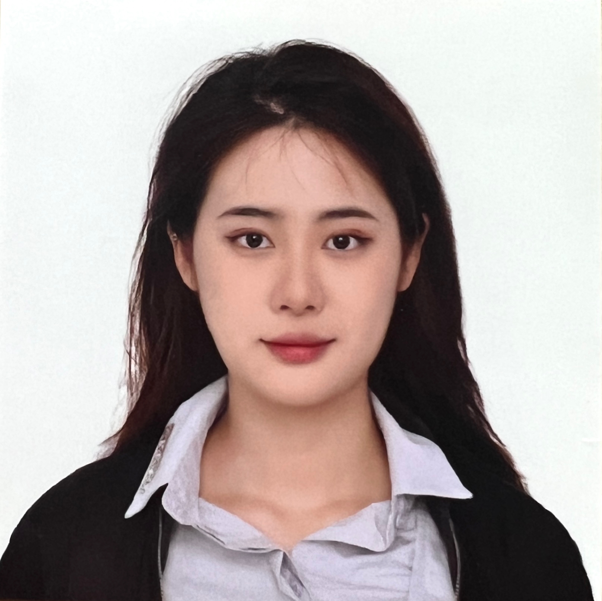
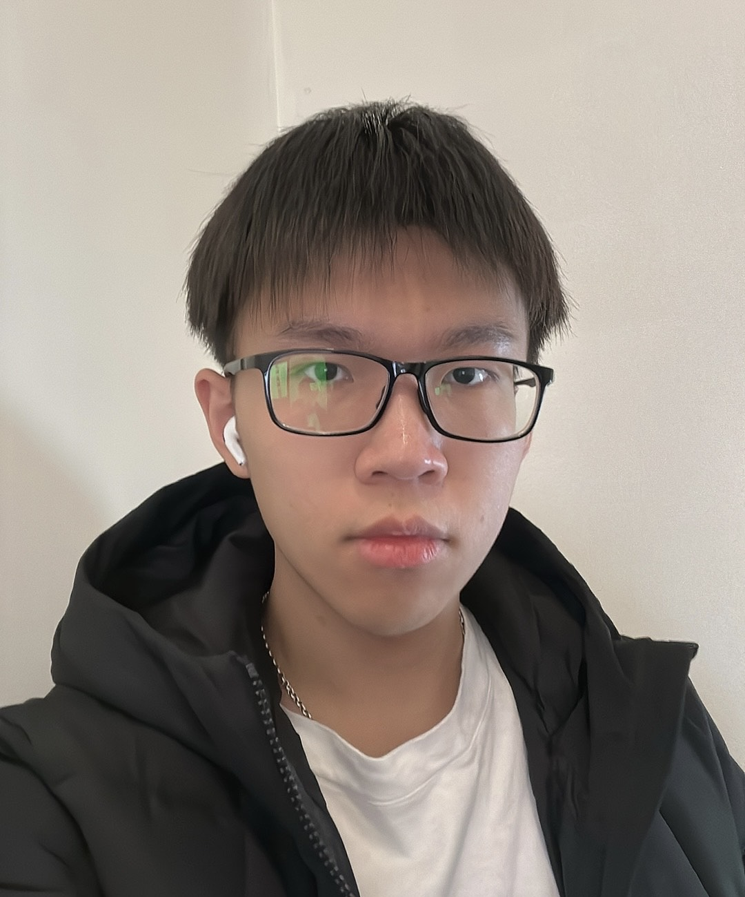
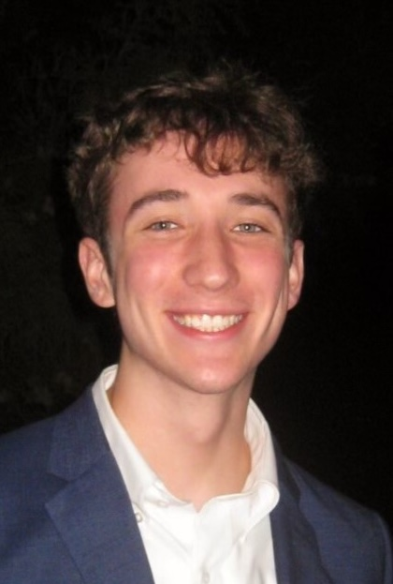
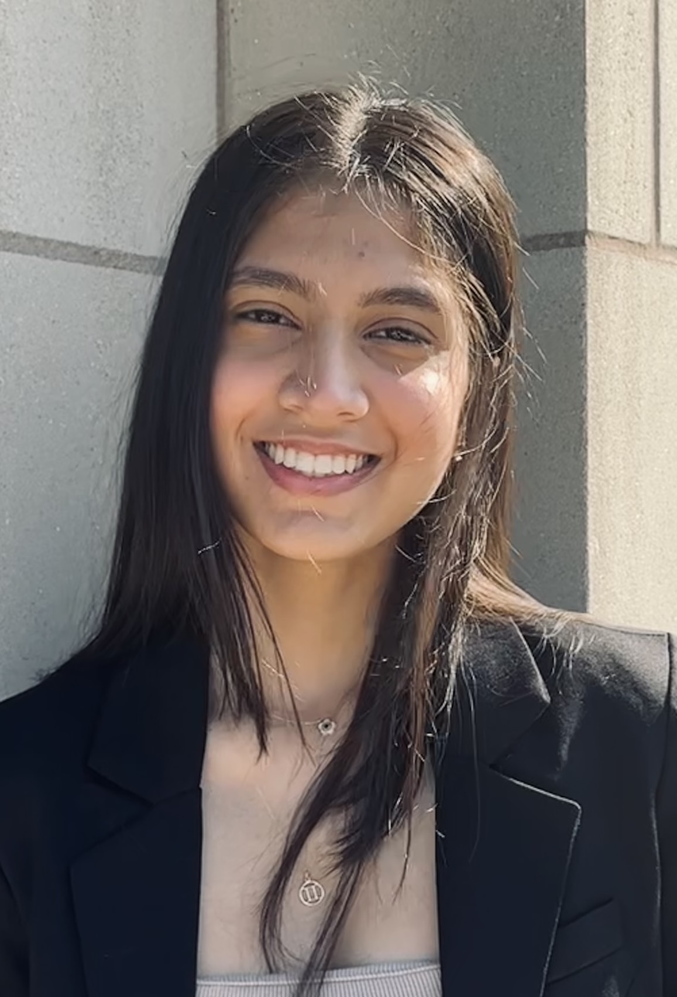
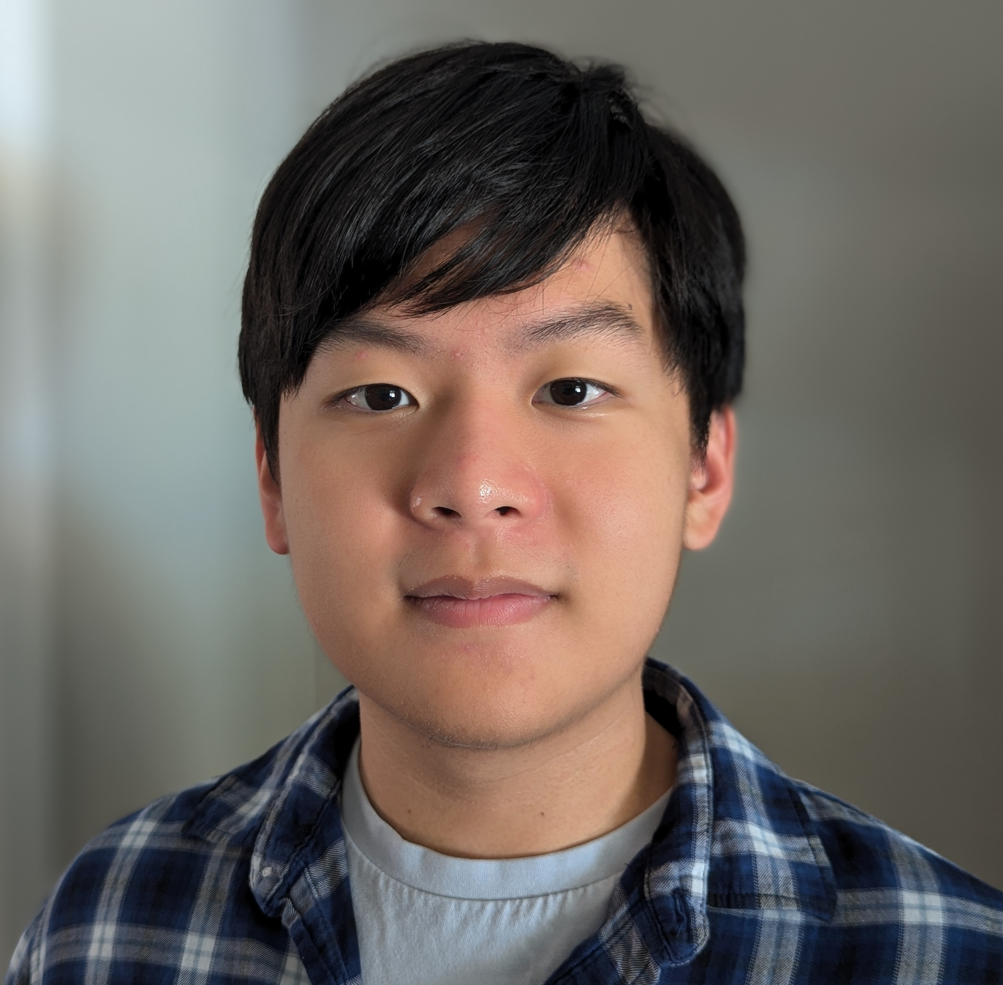
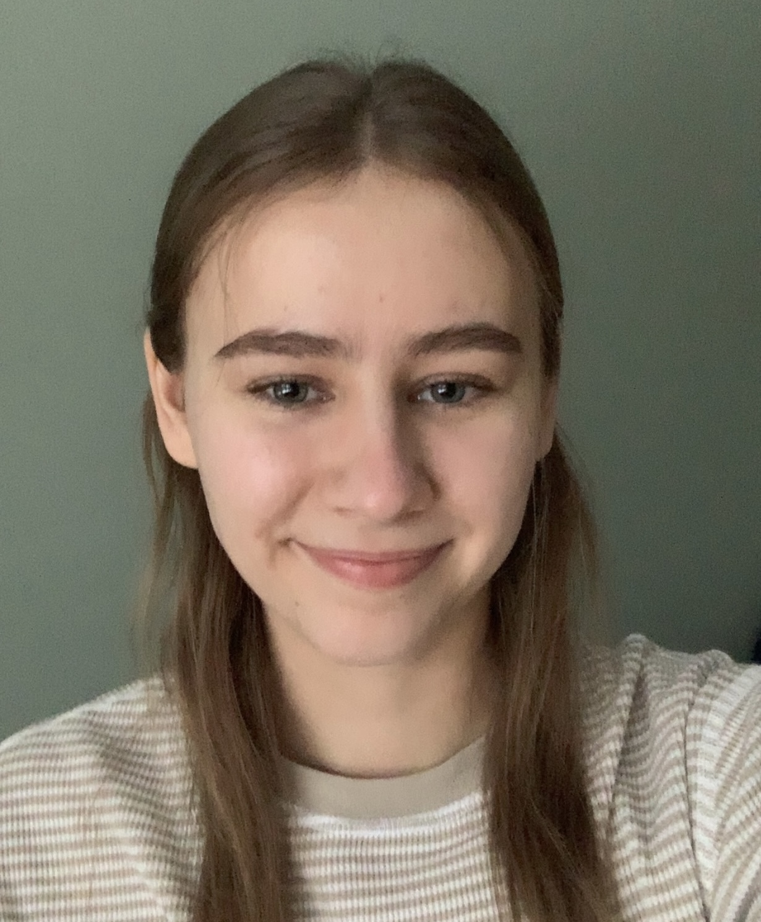
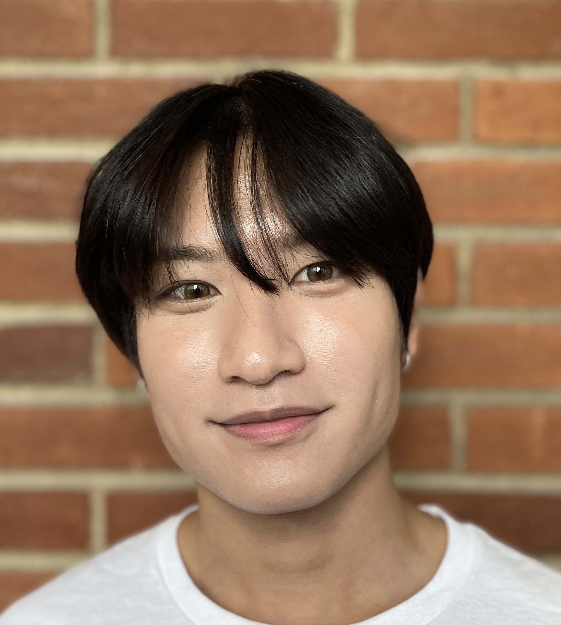
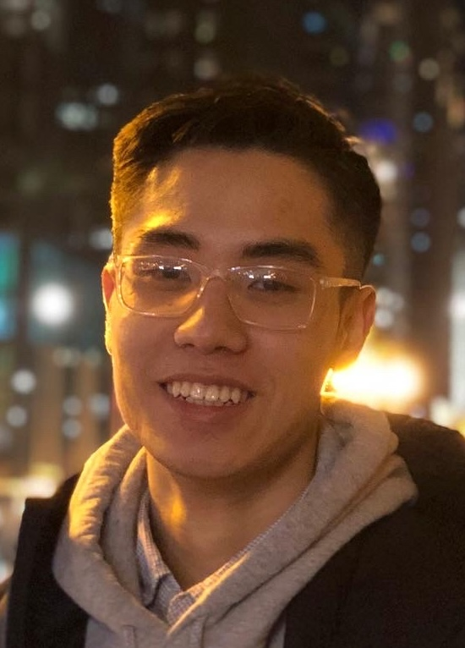
TAs first
Andrew
Vincent
Daniel
Junyan
Mary
Rico
Wei
Jack
Shreya
Mingi
Vipassana
Rachel
John
ester
Arnav
Mark

Slide 4
About Me
Just Atri please!
Atri Rudra
atri@buffalo.edu
Office: See syllabus for location
Office hours: Mon, Fri, 1:00-1:50pm
OH starts today in Clemens 17

Slide 5
Contact us all at
Or use piazza!
cse-331-staff@buffalo.edu
TAs will not respond to individual emails (except for re-grading requests)

Slide 6
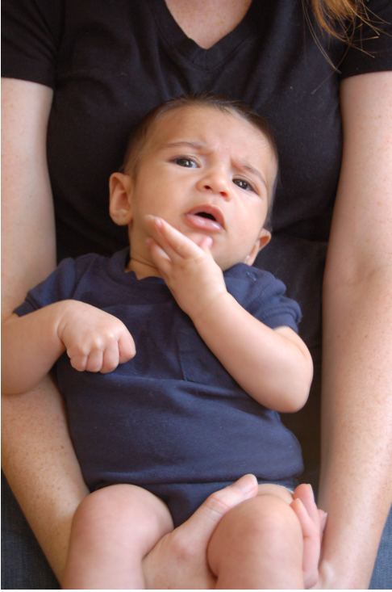
Questions/Comments?

Slide 7
Handouts for today
Syllabus (online)
Syllabus Walkthrough video (online)
Homework Policy document (online)

Slide 8
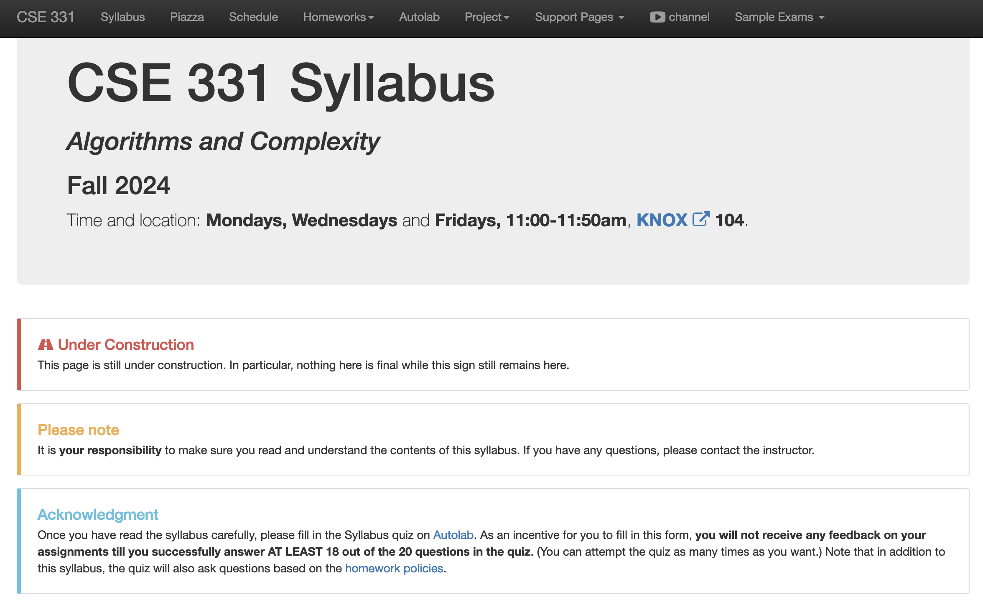
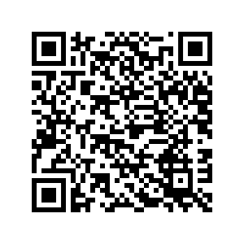
Read the syllabus CAREFULLY!

Slide 9
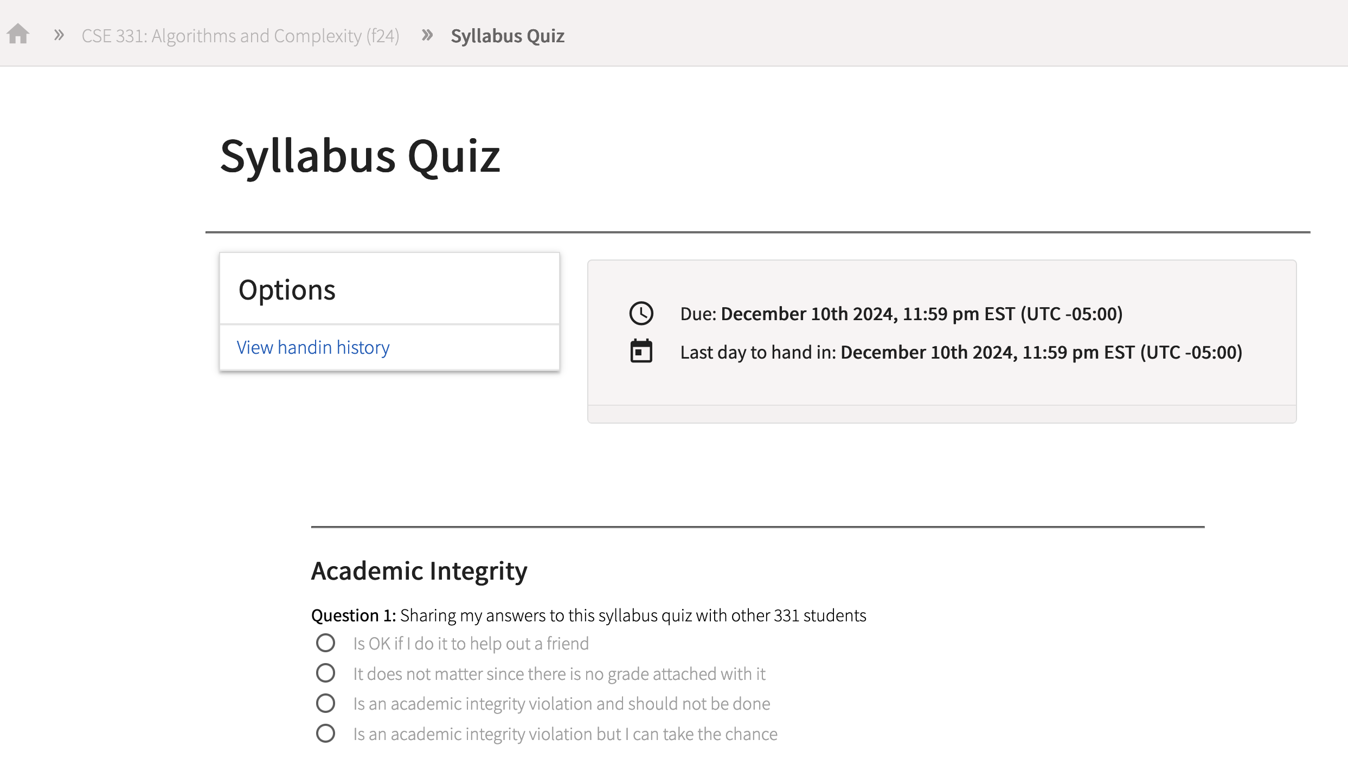
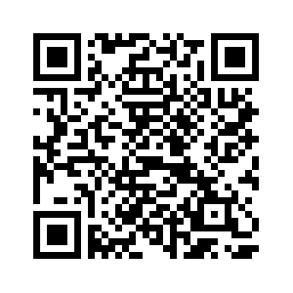
In spirit of trust but verify
No graded material will be handed back until you pass the syllabus quiz!
If you registered by 5pm on Sunday, Aug 25 you will be on Autolab + piazza

Slide 10
Accessibility Resources
Information included in the syllabus
In short, let me know and consult with Accessibility Resources

Slide 11
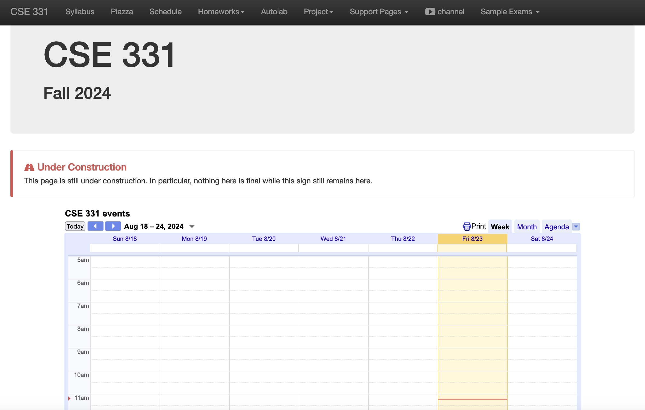
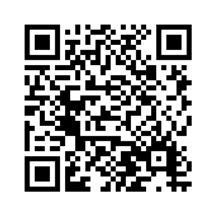
One Stop Shop for the Course
http://www-student.cse.buffalo.edu/~atri/cse331/fall24/index.html

Slide 12
Three things to remember
WORK HARD!
DO NOT CHEAT!
READ CAREFULLY!

Slide 13
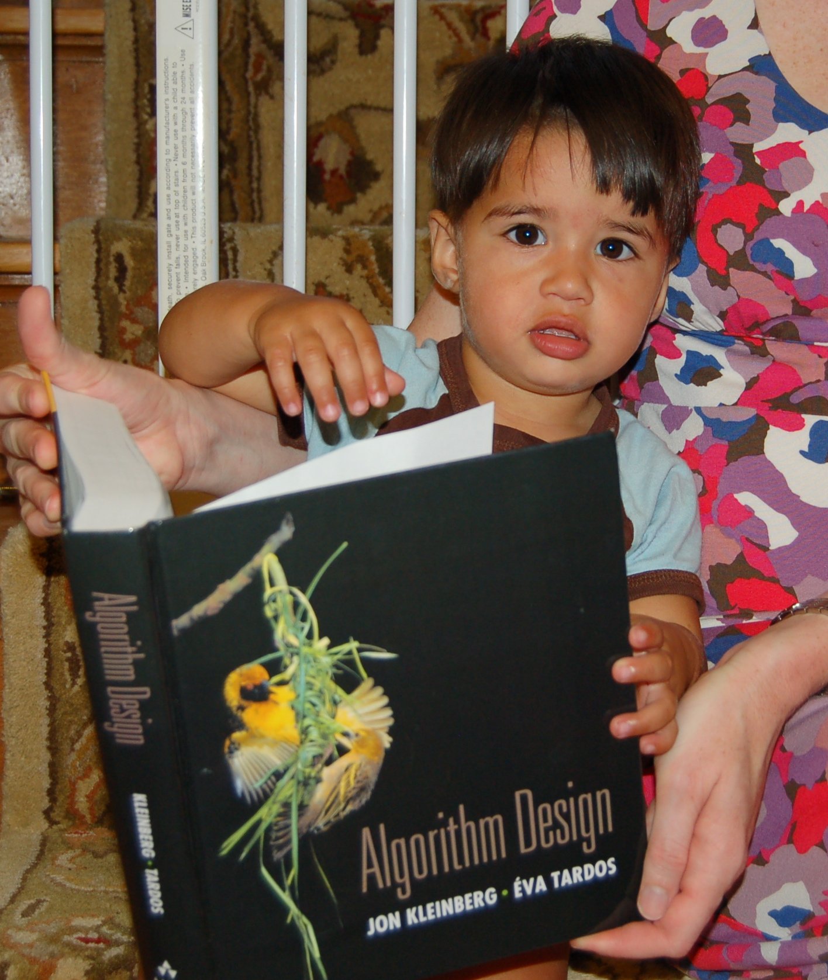
Wait.. What???
Make sure you follow submission
instructions
Two most common ways of losing points
Make sure you read problem
statements carefully

Slide 14
Academic Dishonesty
All your submissions must be your own work
Penalty:
Minimum: A grade reduction in course
Possible: F (or higher penalty) if warranted
YOUR responsibility to know what is cheating, plagiarism etc.
If not sure, come talk to me
Excuses like “I have a job,” “This was OK earlier/in my country,” “This course is hard,” etc. WON’T WORK
I DO NOT HAVE ANY PATIENCE WITH ANY CHEATING :
YOU WILL GET A GRADE REDUCTION IN THE COURSE
FOR YOUR FIRST MISTAKE

Slide 15
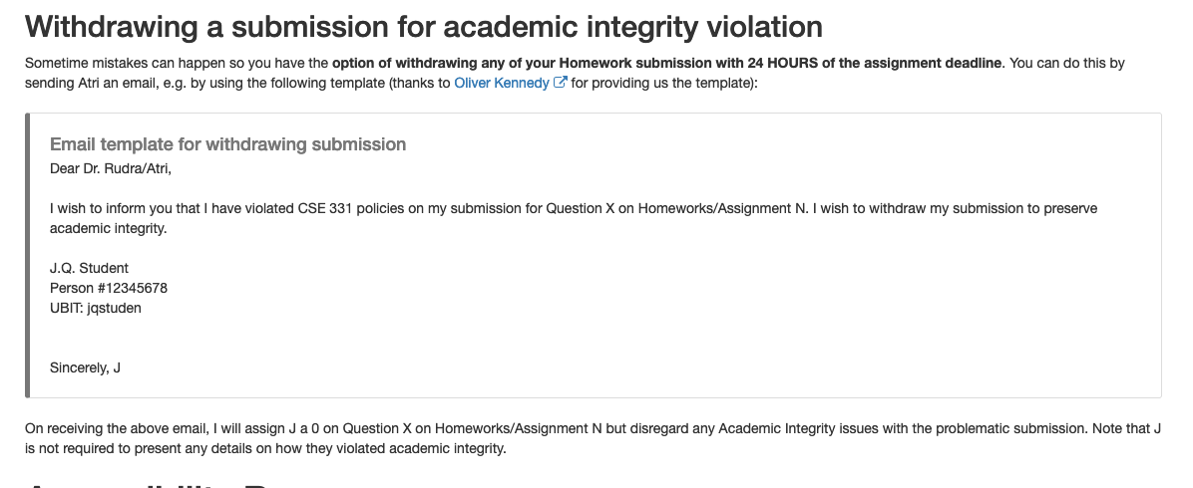
Withdrawing a suspect submission

Slide 16
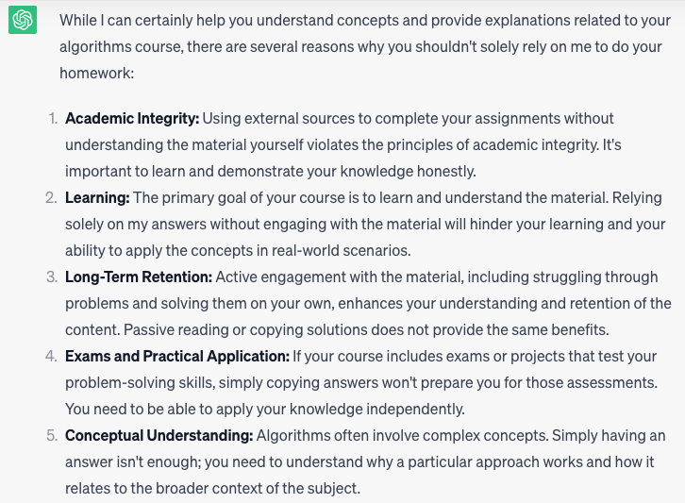
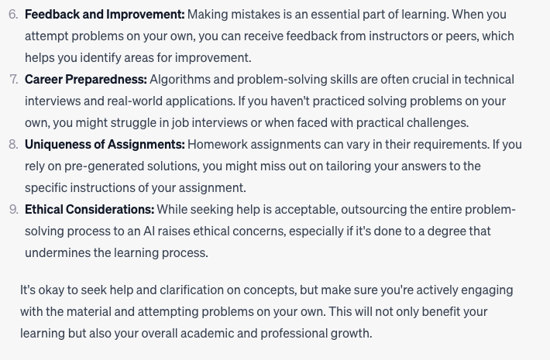
Use of ChatGPT is not allowed

Slide 17
In spirit of trust but verify
TAs will have access to a database of ChatGPT answers to cross check
It’s no fun failing any of you but use of ChatGPT will result in an F

Slide 18
Use of ChatGPT is not allowed

Slide 19
Coding jobs will be done by AI

Slide 20
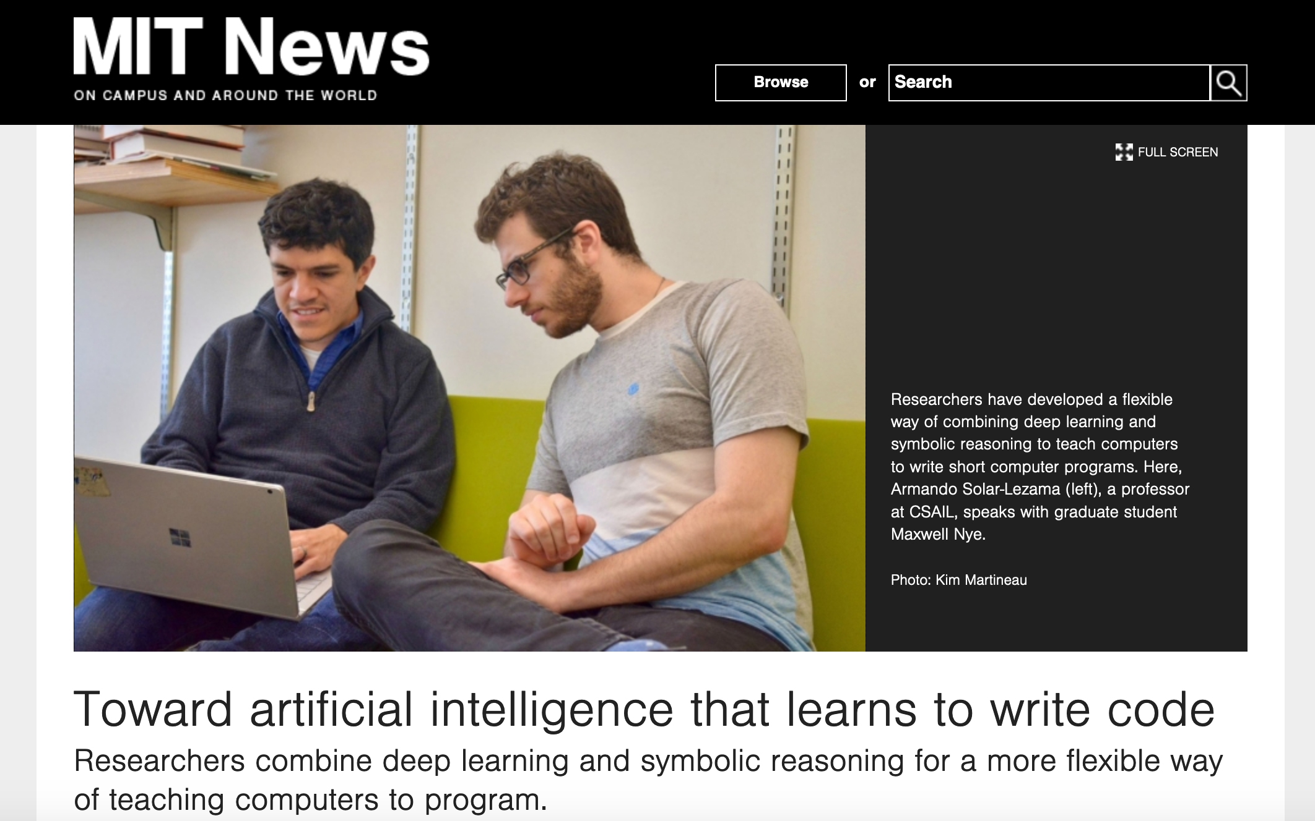
Coding jobs will be done by AI

Slide 21
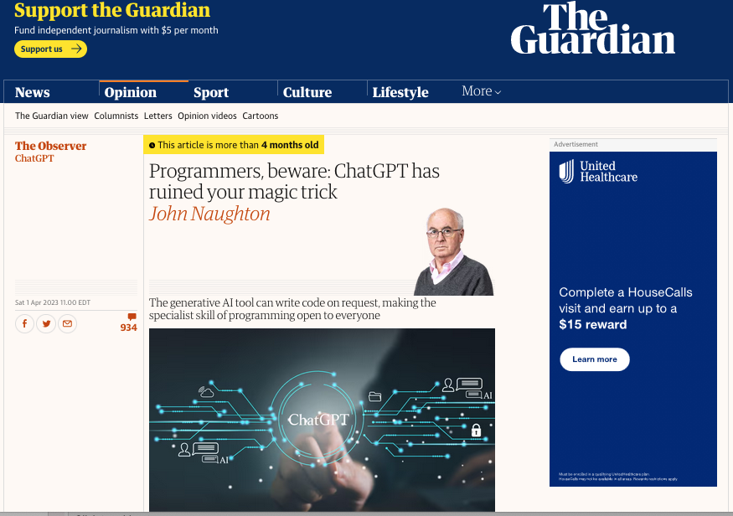
It happened sooner than expected

Slide 22
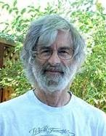
So am I doomed?
There will still be room for high level algorithmic thinking!

Slide 23
Questions/Comments?

Slide 24
Any question on course policies?

Slide 25
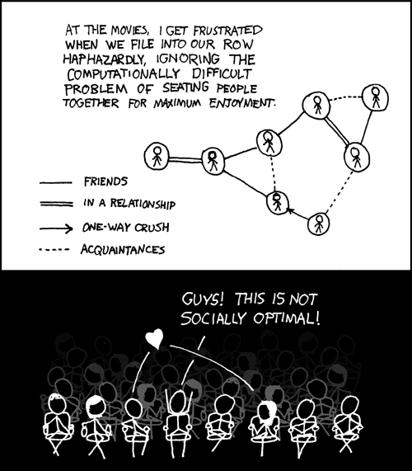
This course: how to solve problems!
http://xkcd.com/173/

Slide 26
Why should I care ?

Slide 27
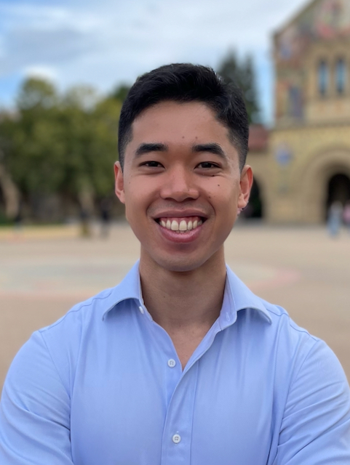
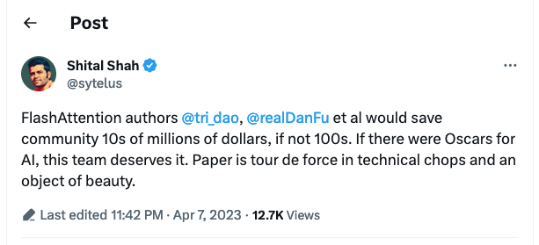
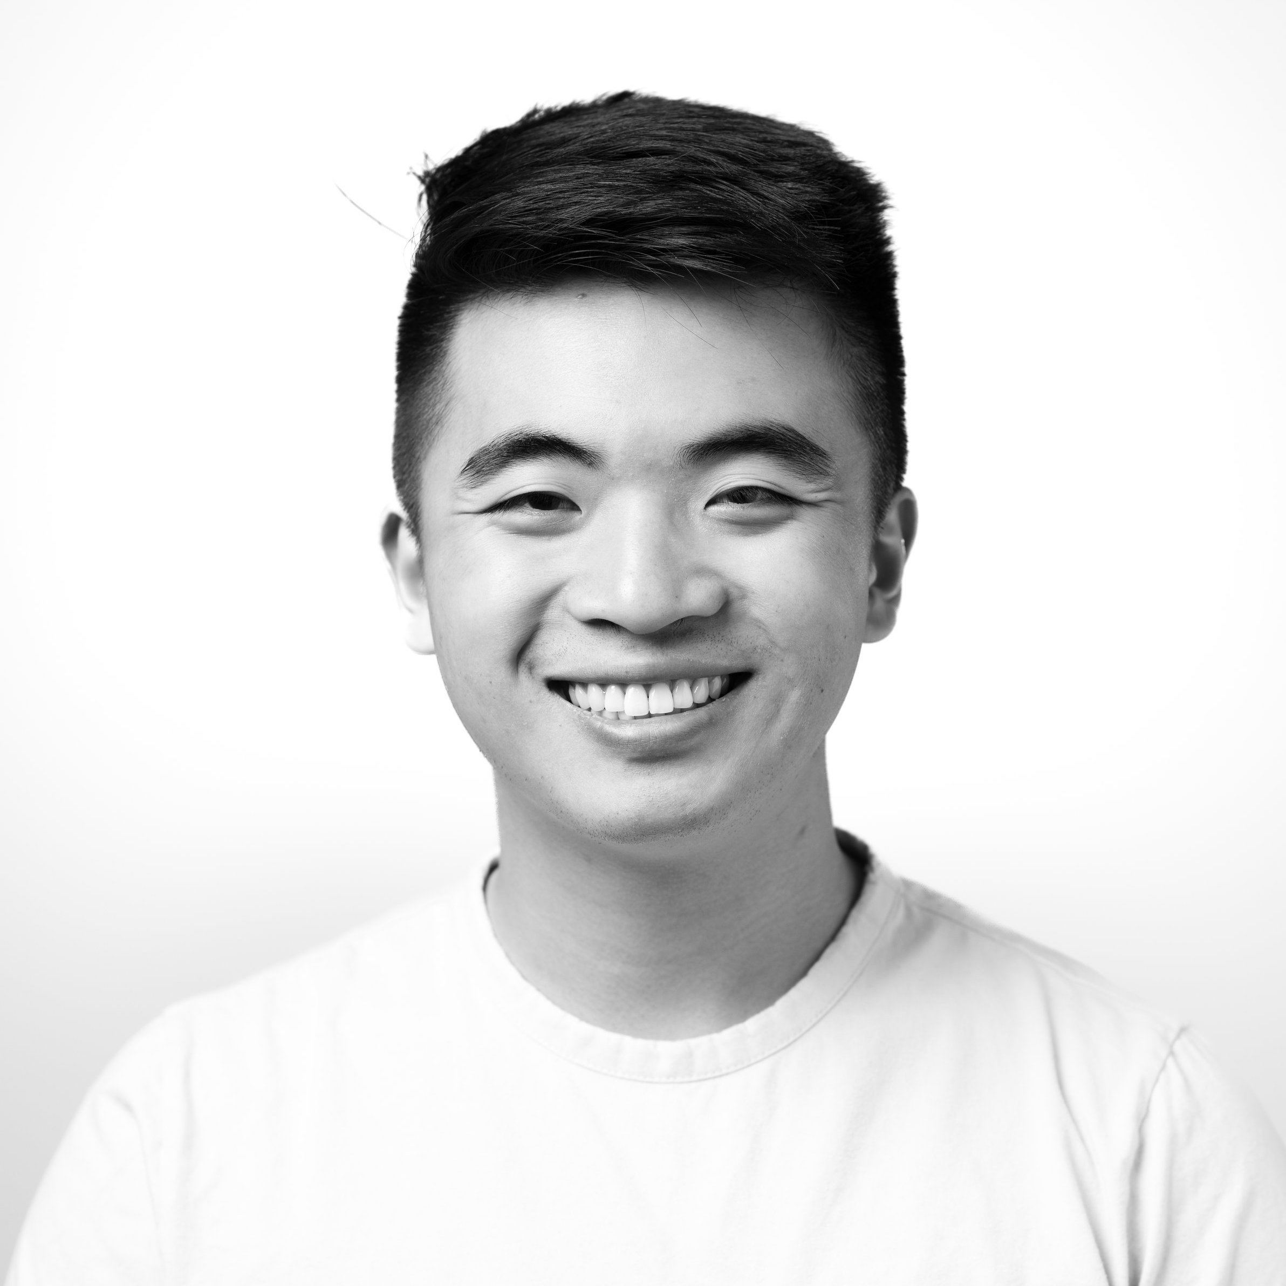
I know twitter ain’t that cool any more but..
I’ll start off with a tweet…
Tri
https://twitter.com/sytelus/status/1644546251302621184
Dan

Slide 28
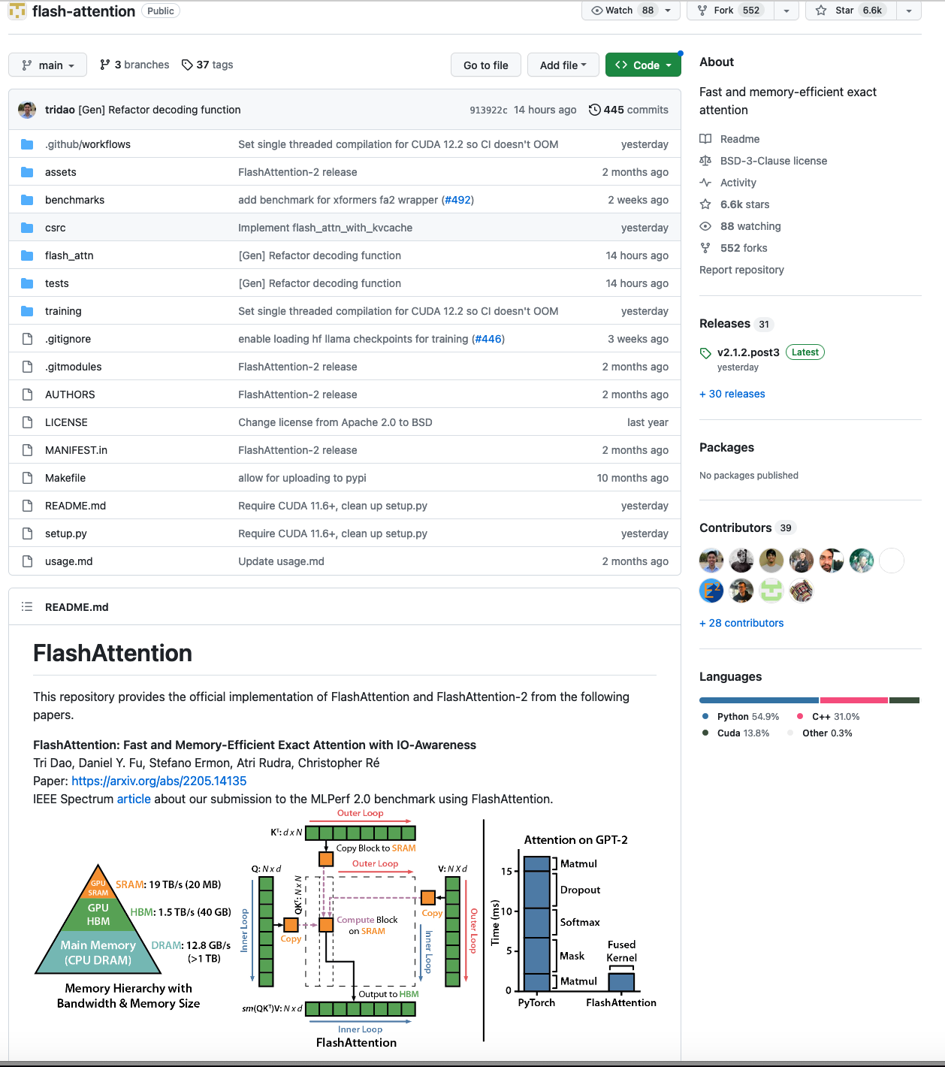
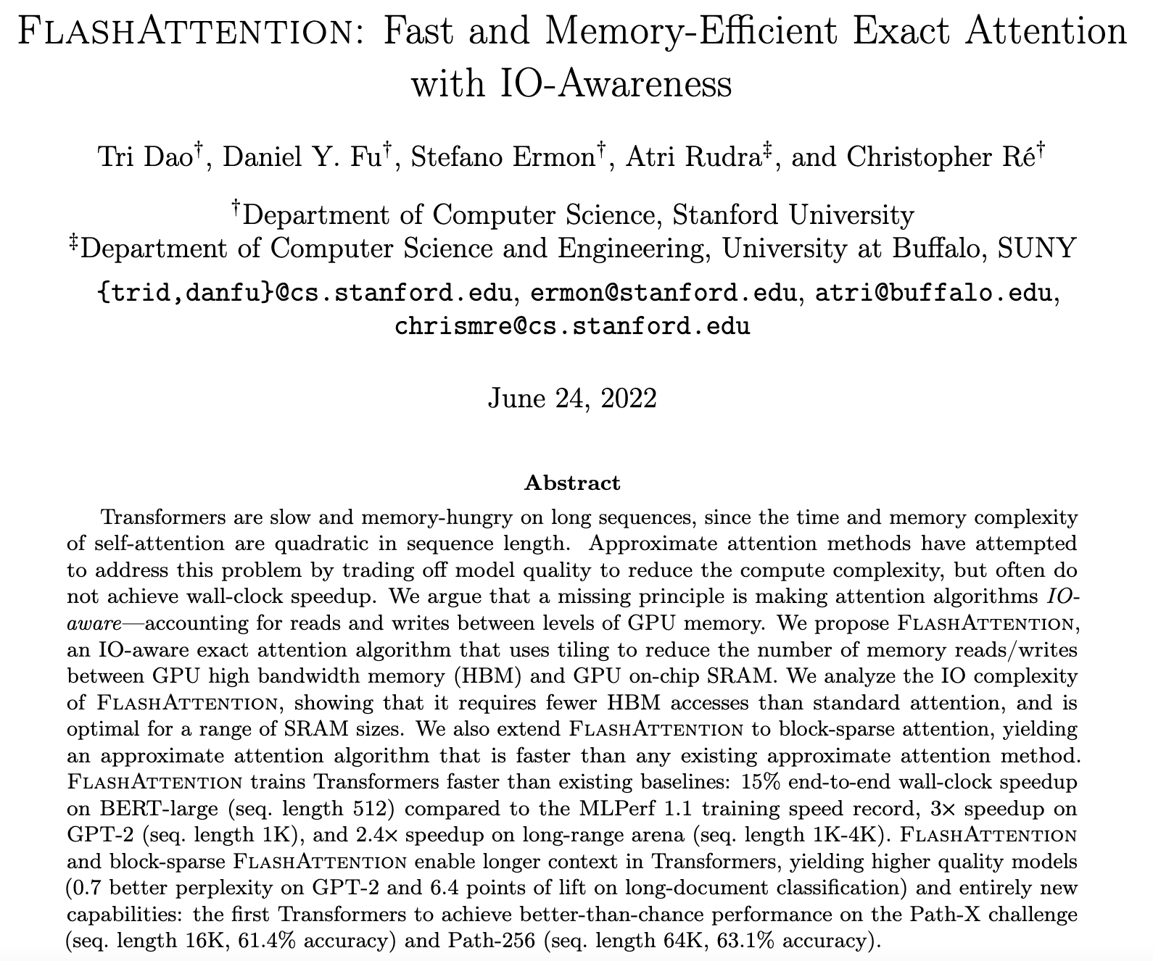
What is FlashAttention?
https://github.com/Dao-AILab/flash-attention

Slide 29
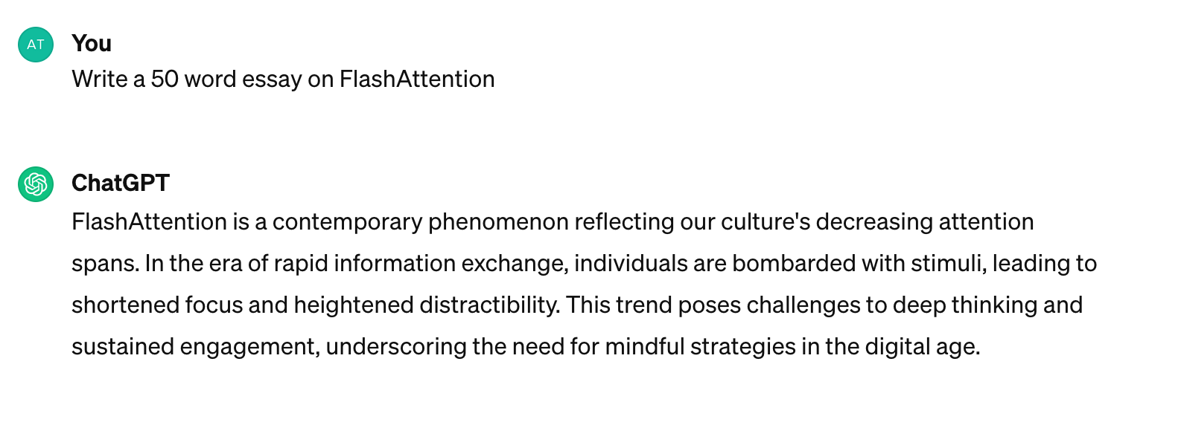
OK, but what does FlashAttention do?
This over simplifying things
and then some more but….
FlashAttention helps ChatGPT (or other similar models) write longer essays!

Slide 30
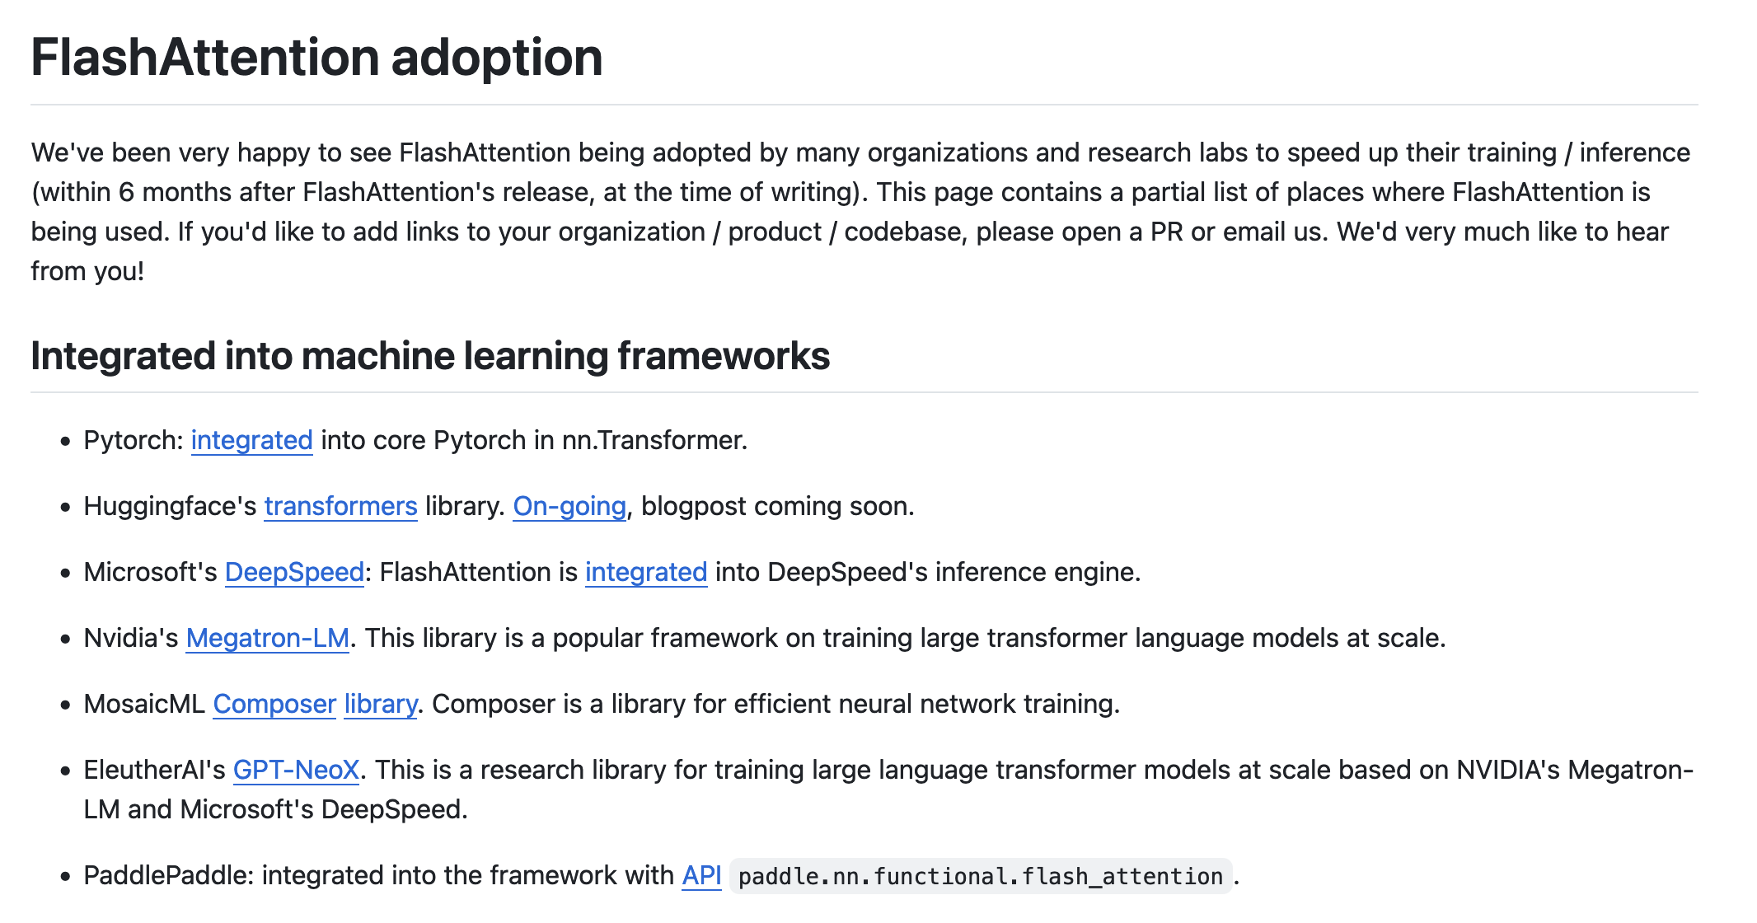
FlashAttention is used everywhere

Slide 31
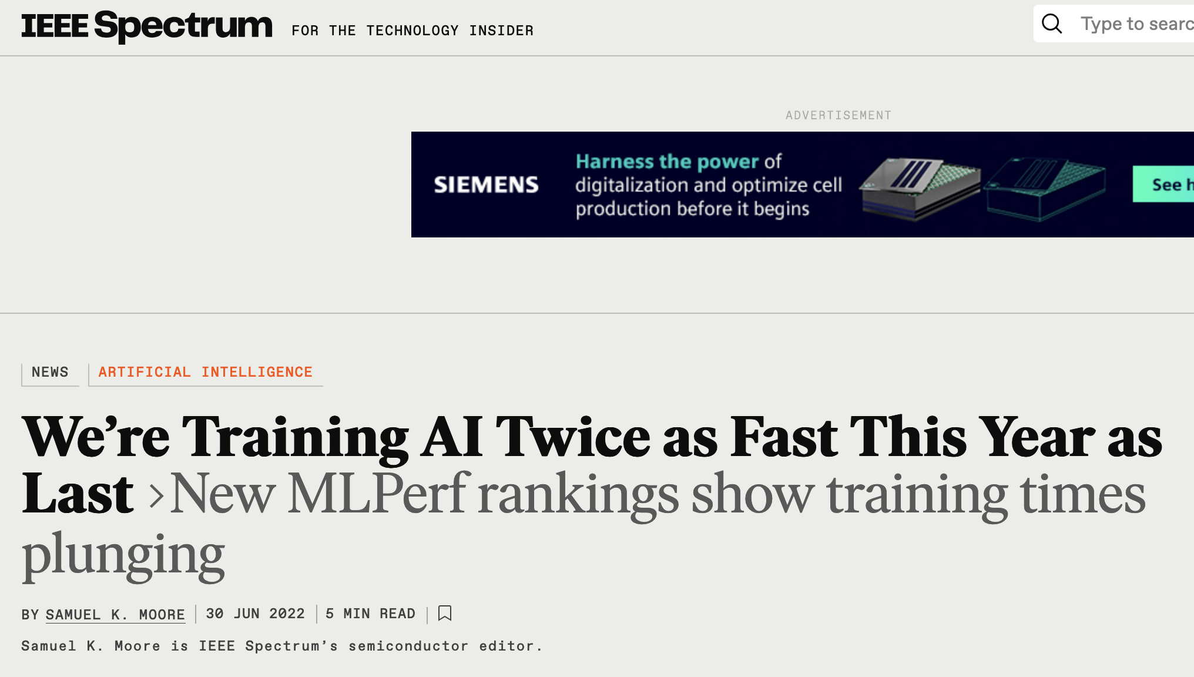
1 Ph.D. student > Multiple Ph.D.s

Slide 32
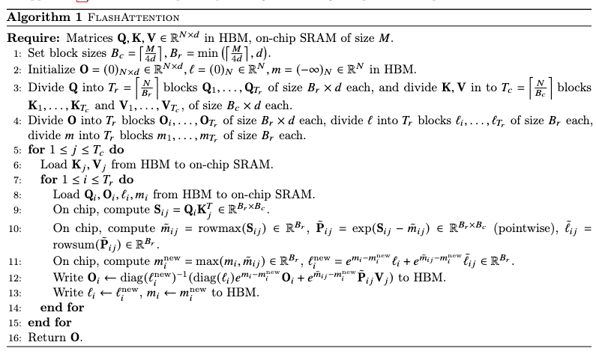
Here’s the entire algorithm

Slide 33
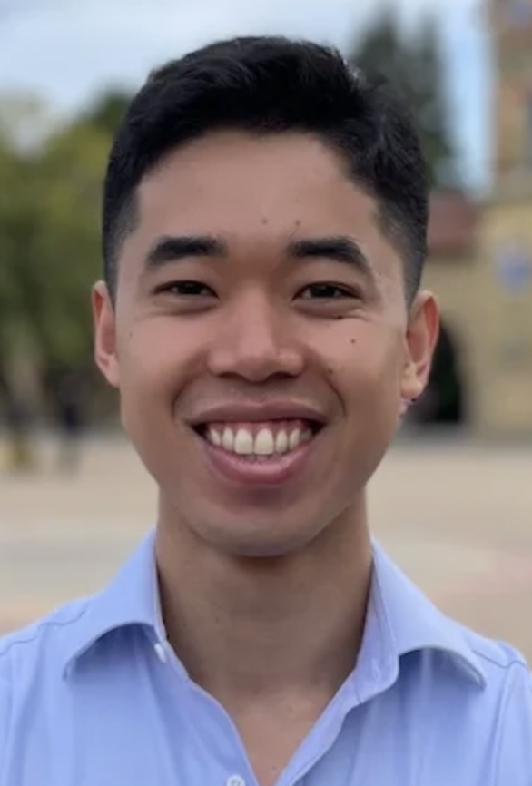
Flash Attention [Dao, Fu et al. 2022]
Q
K^{T}
V
d
$$σ$$
N
N
N
d
d
Want to avoid accessing slow memory
Better algorithm with little hacking will beat a worse algorithm with tons of hacking
Tri
Dan
With apologies to
Flash Attention avoids unnecessary writes to slow memory!
Notes:
[Karan]
What does "sparsity" mean in ML? Replace dense with sparse.
[Neel] You lose steam in the middle, I'm unsure why youre telling me this.
What are things I should try to understand, and what are things I should ignore.
Need to succinctly articulate your research style.
What you're doing: looking at effieincy by understanidng "how computers work" and understanding "foundabmental mathematics for efficinecy".
[Sarah] blurry fig, slide number small.
Title: what's question. The answer is "matmul".
Floating text.
Enough text to help understanding.

Slide 34
Questions/Comments?

Slide 35
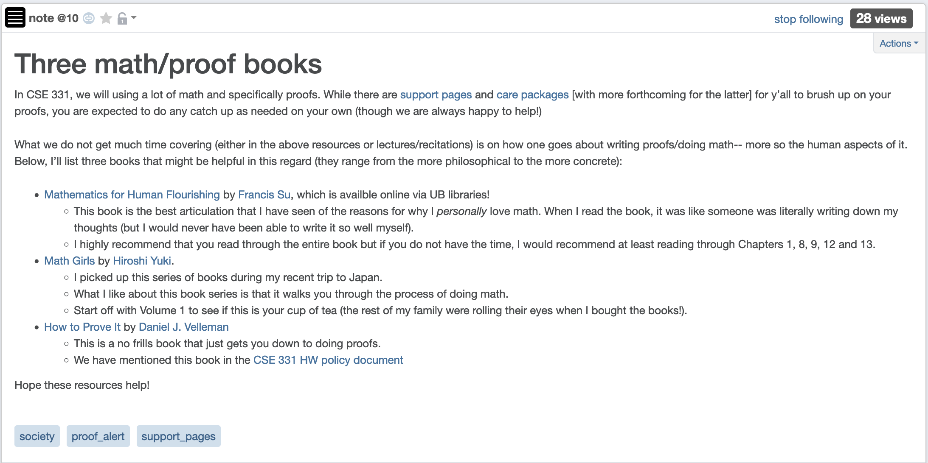
Few words on math/proofs

Slide 36
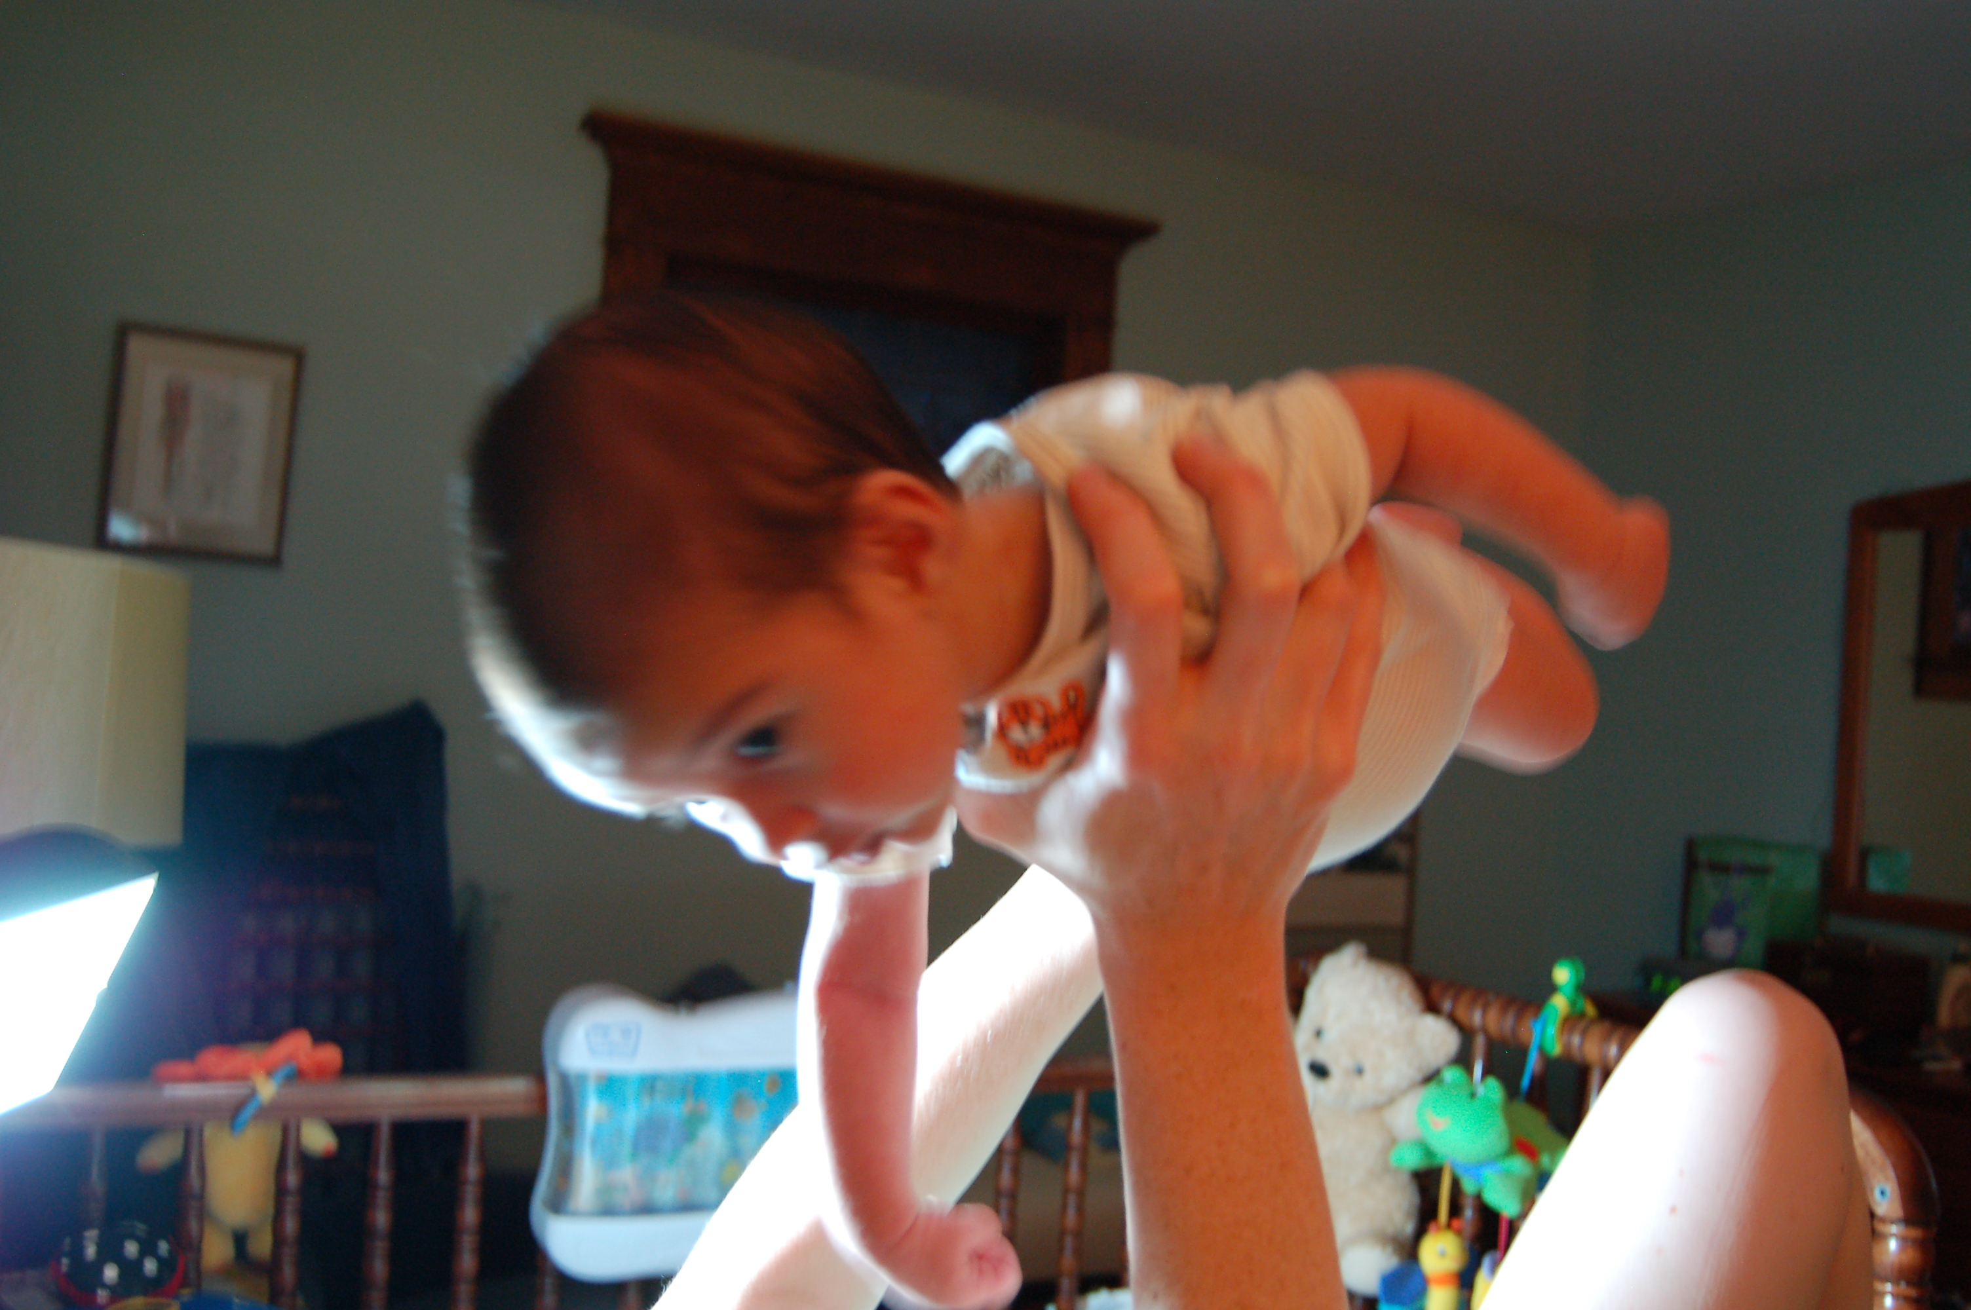
Let the fun begin!

Slide 37
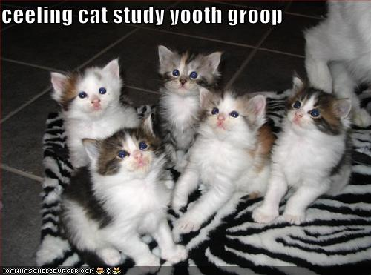
Remember: Stick with your group

Slide 38
Halting Problem
Input: A program P
Output: Yes if P terminates on all possible inputs
No otherwise
Let A be an algorithm/program that solves the Halting problem on all inputs
Yes, if returns some c
on every input (a , b)
def add (a,b):
c = a+b
return c
def add (a,b):
c = a+b
return c
A
No, if doesn’t return any c
on some input (a , b)
def add (a,b):
c = a+b
return c

