Slide 1
Lecture 12
CSE 331
Sep 23, 2024

Slide 2
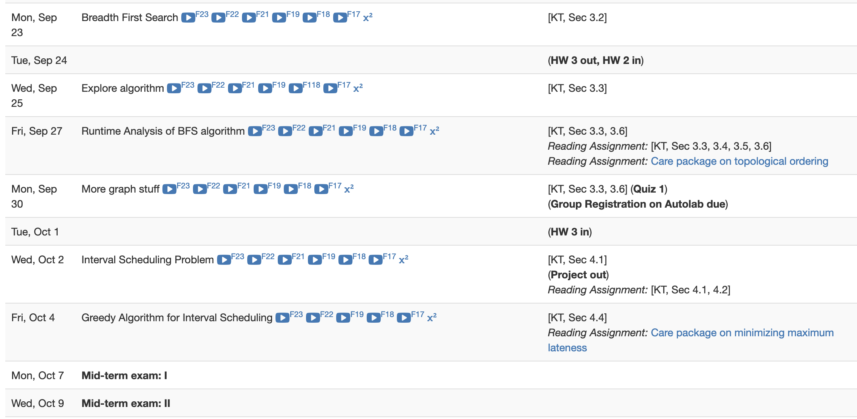
Quiz 1 next Monday

Slide 3
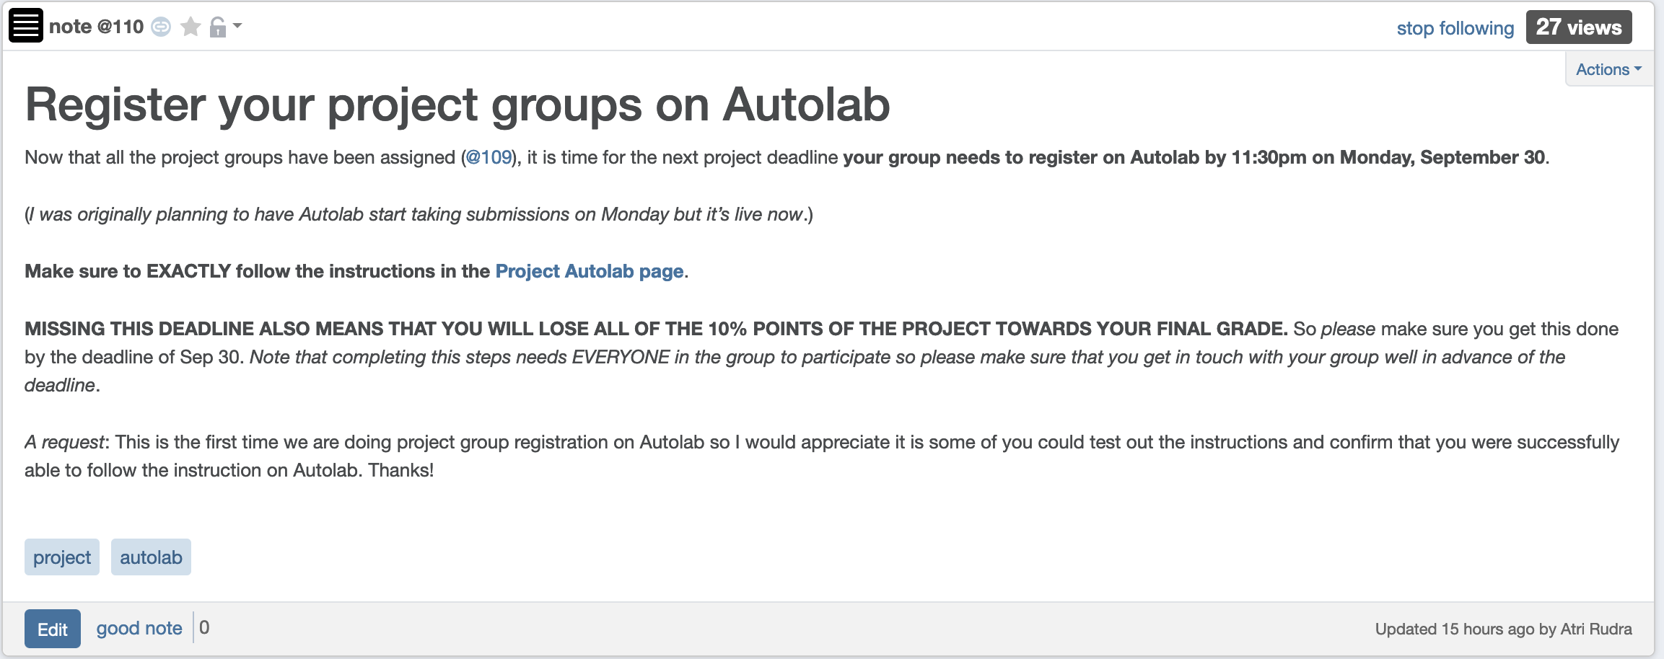
Autolab Project Group Registration
Also due next Monday
If you miss this deadline then you will get a ZERO on the ENTIRE project

Slide 4
Read the instruction carefully

Slide 5
Connectivity
u and w are connected iff there is a path between them
A graph is connected iff all pairs of vertices are connected

Slide 6
Questions/Comments?

Slide 7
Rest of Today’s agenda
Algorithms for checking connectivity

Slide 8
Checking by inspection

Slide 9
What about large graphs?
s
t
Are s and t connected?

Slide 10
Brute-force algorithm?
List all possible vertex sequences between s and t
n^{n} such sequences
Check if any is a path between s and t

Slide 11
Algorithm motivation
all

Slide 12
Questions/Comments?

Slide 13
Breadth First Search (BFS)

Slide 14
Connectivity Problem
Input: Graph G = (V,E) and s in V
Output: All t connected to s in G
Connected component of s

Slide 15
Breadth First Search (BFS)
Build layers of vertices connected to s
L₀ = {s}
Assume L₀,..,L_{j} have been constructed
L_{j+1} set of vertices not chosen yet but are connected by an edge to L_{j}
Stop when new layer is empty

Slide 16
BFS Tree
BFS naturally defines a tree rooted at s
Add non-tree edges
L_{j} forms the jth “level” in the tree
u in L_{j+1} is child of v in L_{j} from which it was “discovered”
1
7
9
1
L₀
2
3
L₁
2
3
8
0
4
5
4
5
7
8
L₂
6
6
L₃

Slide 17
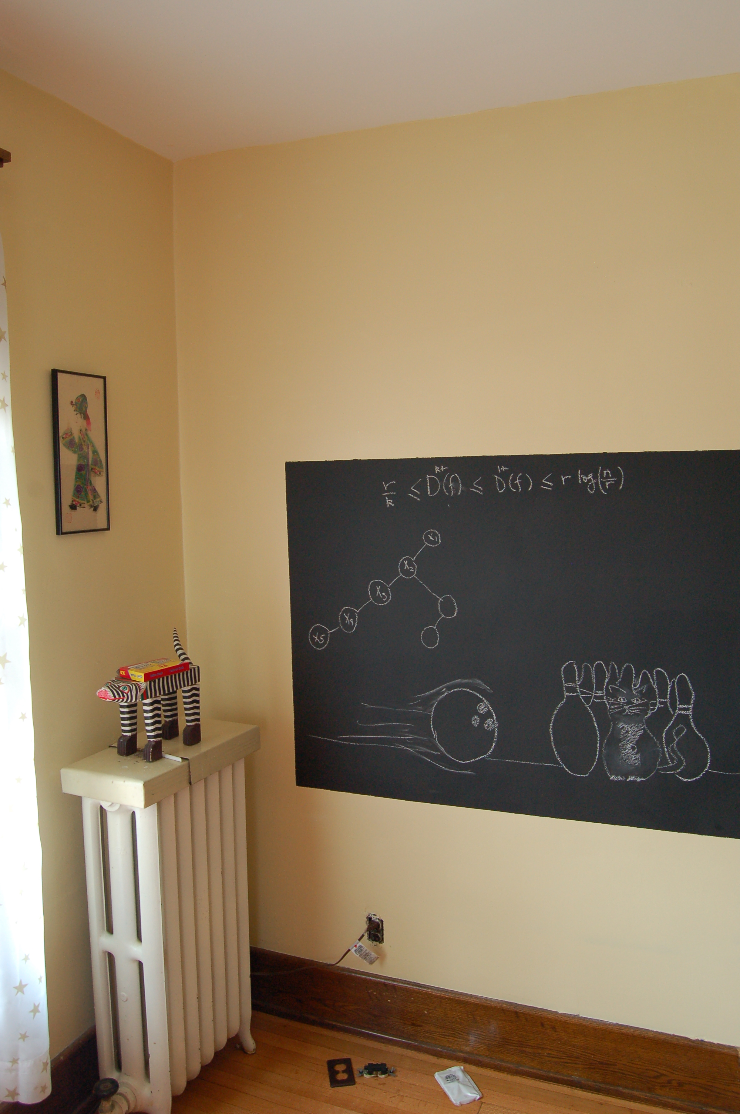
Argue on the board…

Slide 18
Two facts about BFS trees
(1) All non-tree edges are in the same or consecutive layer
(2) If u is in L_{i} then dist(s,u) = i

Slide 19
Rest of today’s agenda
Computing Connected component

Slide 20
Computing Connected Component
Explore(s)
Start with R = {s}
While exists (u,w) edge w not in R and u in R
Add w to R
Output R* = R
BFS (Build layers of vertices)
L₀ = {s}
Assume L₀,..,L_{j} have been constructed
L_{j+1} set of vertices not chosen yet but are connected to L_{j}
Stop when new layer is empty

Slide 21
Argue correctness on the board…

