Slide 1
Lecture 19
CSE 331
Oct 16, 2024

Slide 2

HW 4 out
Overall easiest HW of the semester!

Slide 3
Grading timeline
Mid terms should hopefully be handed back by tomorrow

Slide 4
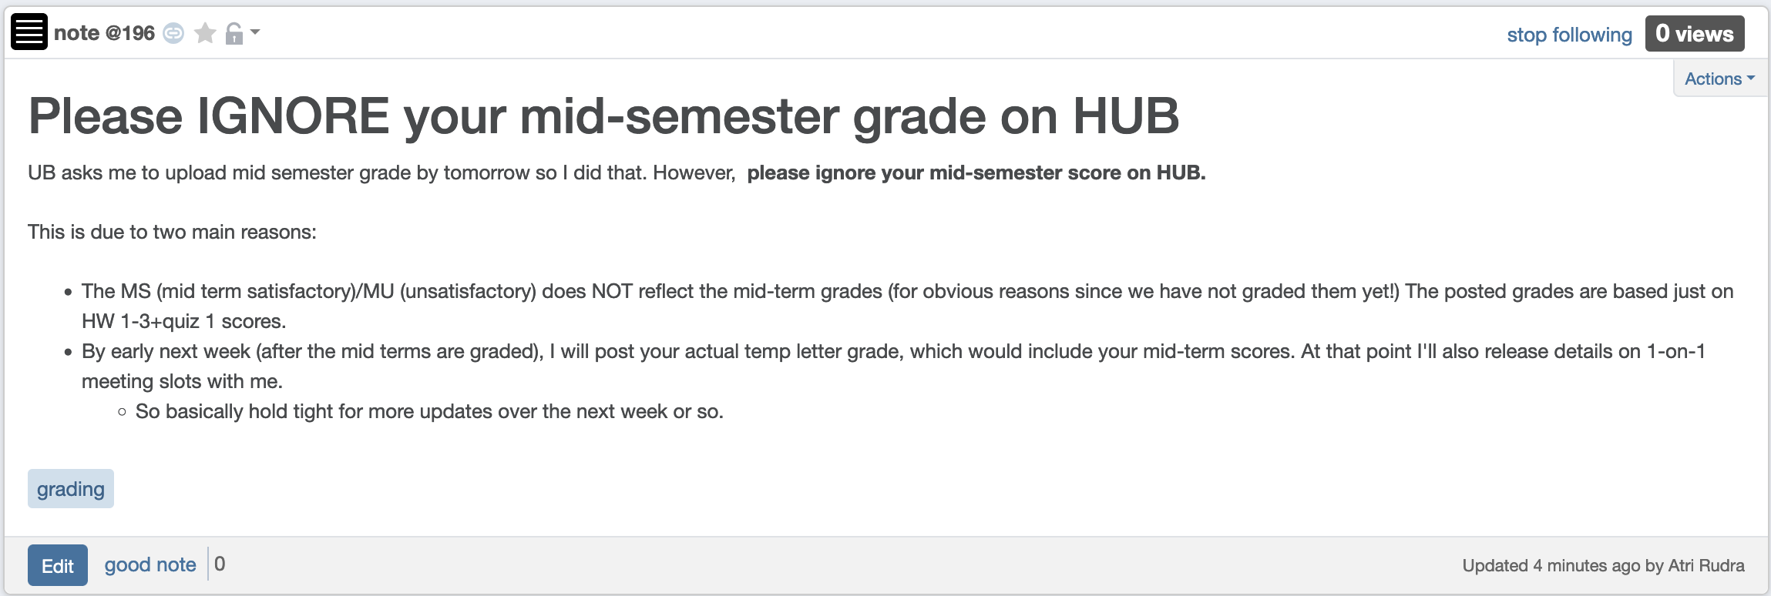
Ignore HUB mid-semester grade

Slide 5

Your actual mid-term letter grade

Slide 6

Questions?

Slide 7
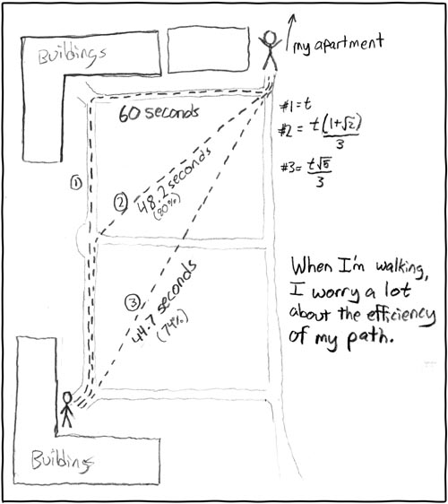
Shortest Path Problem
http://xkcd.com/85/

Slide 8

Another more important application
Is BGP a known acronym for you?
Routing uses shortest path algorithm

Slide 9
Shortest Path problem
s
100
Input: Directed graph G=(V,E)
Edge lengths, l_{e} for e in E
“start” vertex s in V
w
5
15
u
s
s
w
5
5
15
u
u
Output: Length of shortest paths from s to all nodes in V

Slide 10
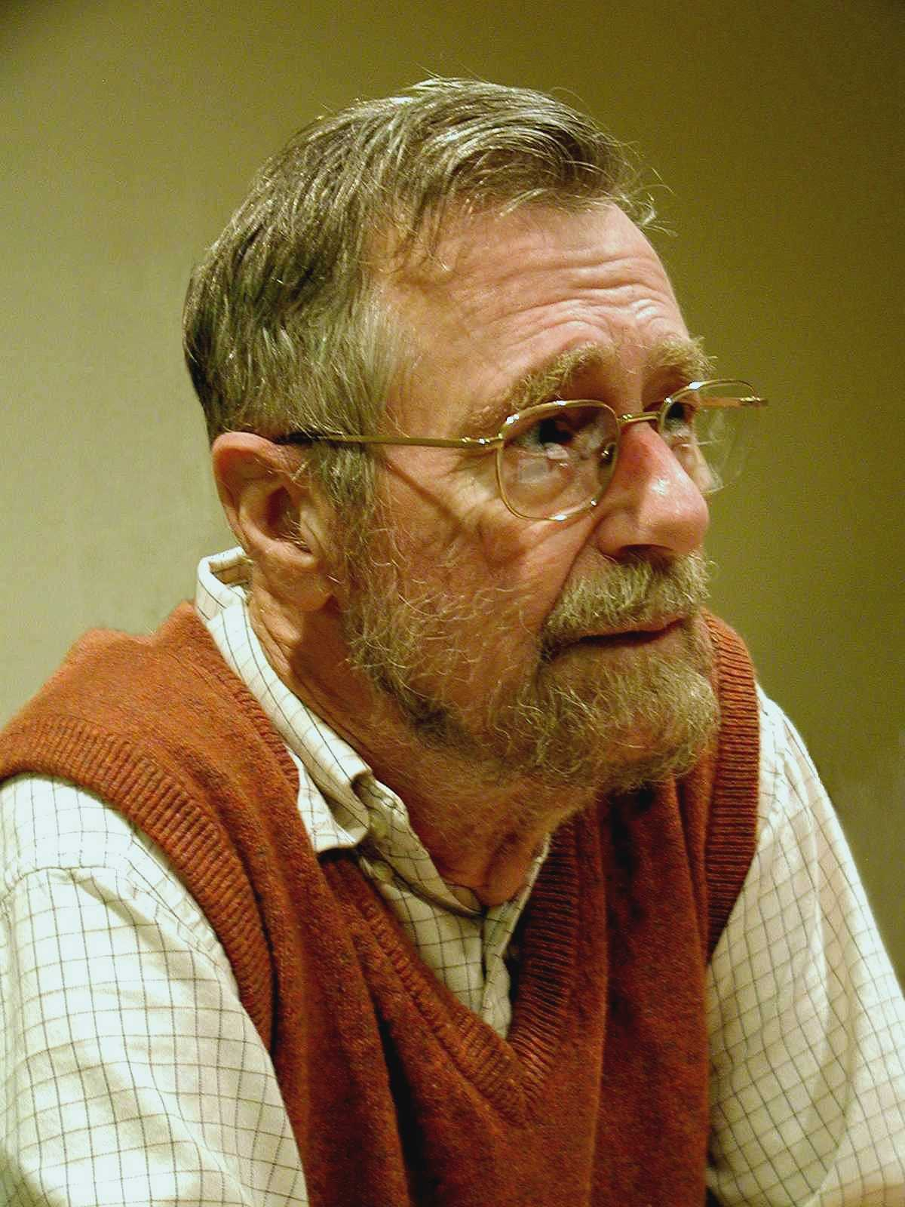
Dijkstra’s shortest path algorithm
E. W. Dijkstra (1930-2002)

Slide 11
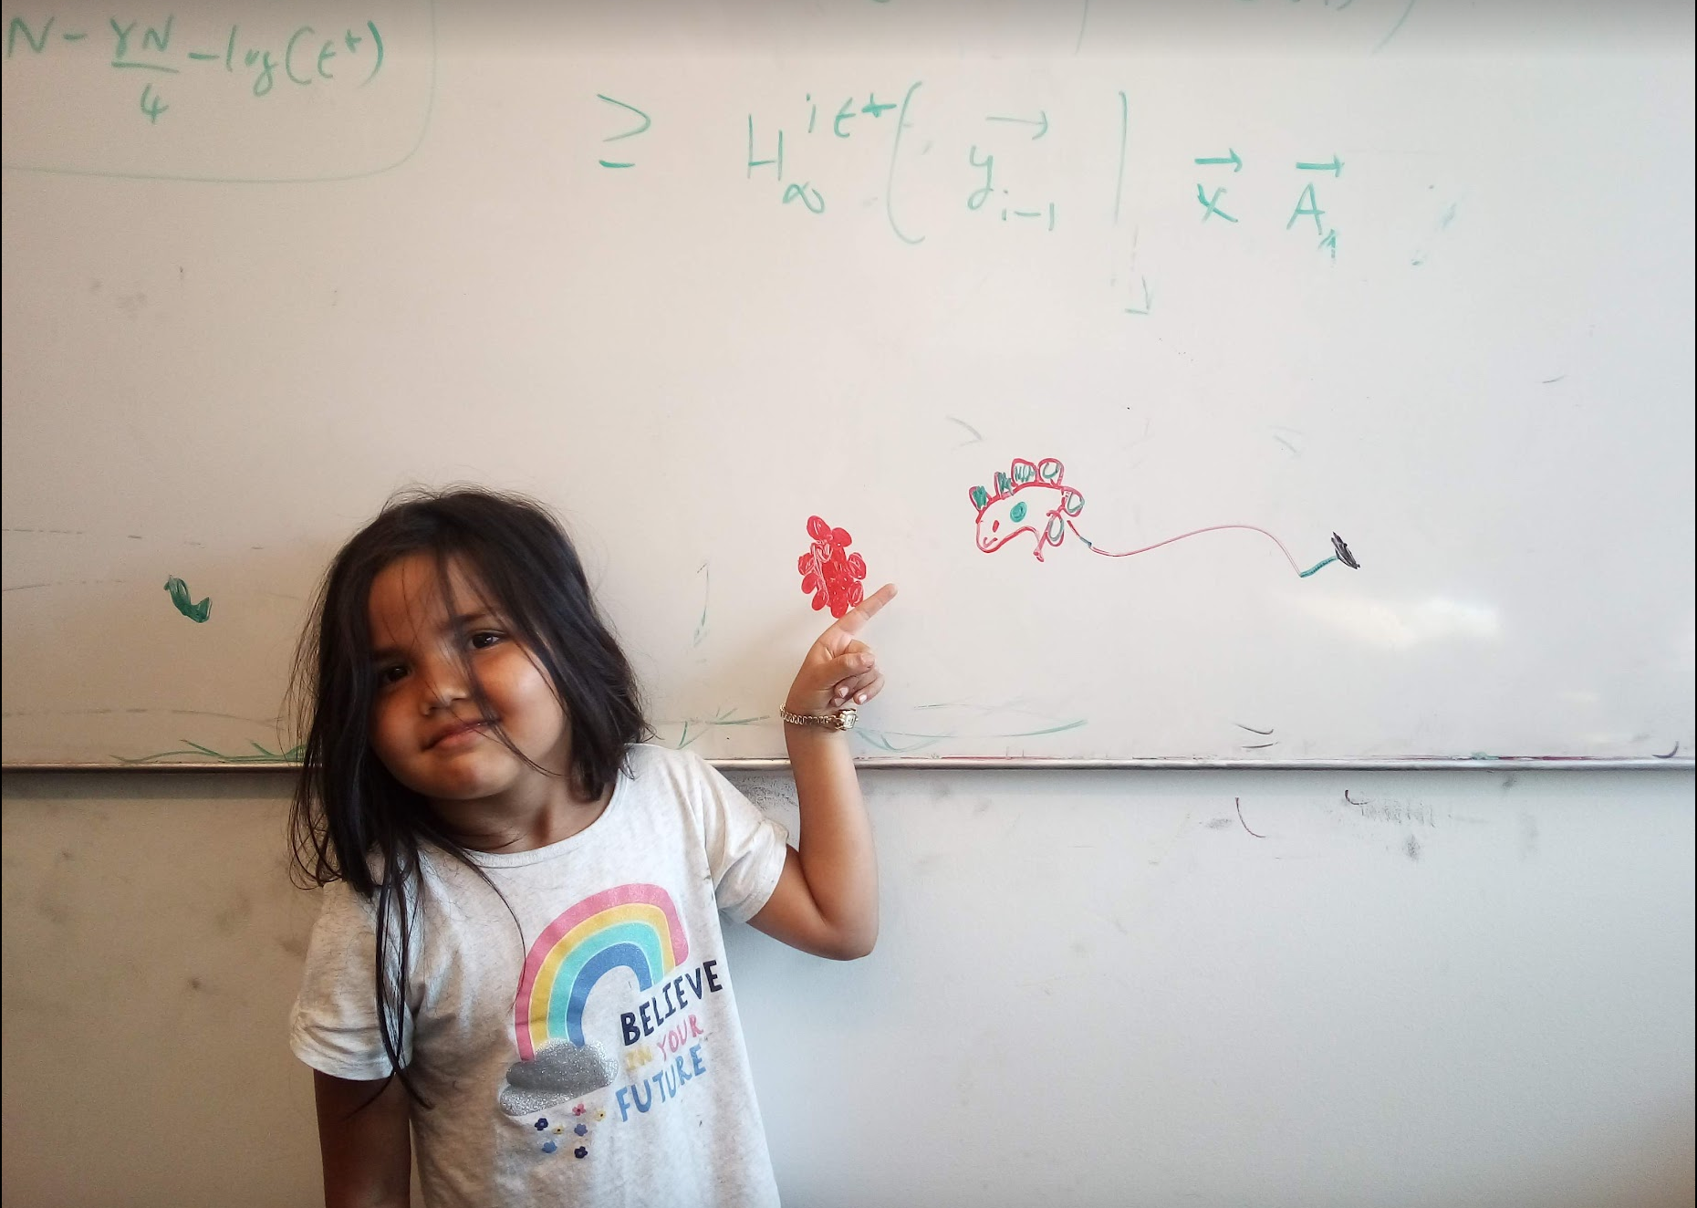
Questions/Comments?

Slide 12
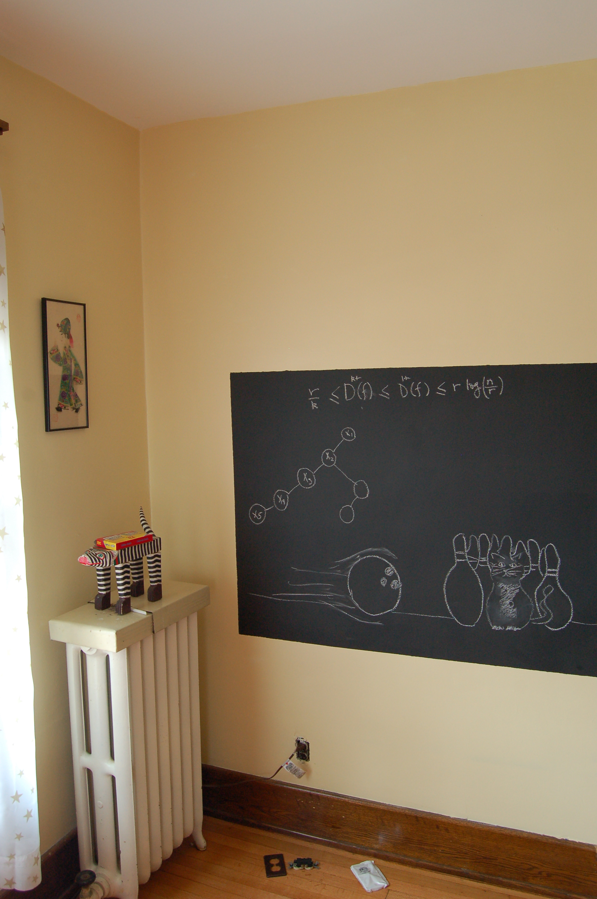
Finish reduction on the board…

Slide 13
Towards Dijkstra’s algo: part ek
Determine d(t) one by one
s
d(s) = 0
u
x
y

Slide 14

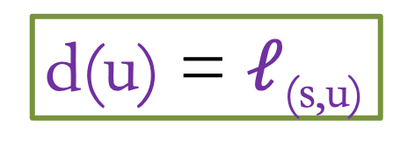
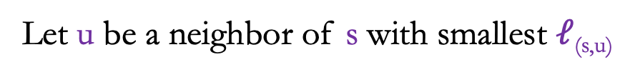
Towards Dijkstra’s algo: part do
Determine d(t) one by one
Let u be a neighbor of s with smallest $ℓ$_{(s,u)}
s
100
3
4
u
x
y
d(u) = $ℓ$_{(s,u)}
Not making any claim on other vertices

Slide 15


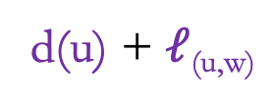
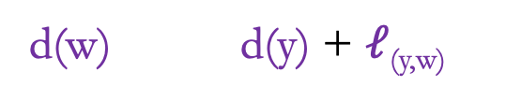
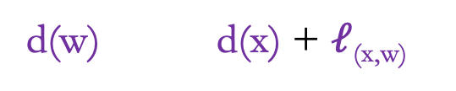
Towards Dijkstra’s algo: part teen
Determine d(t) one by one
R
Assume we know d(v) for every v in R
s
u
x
y
Compute an upper bound d’(w) for every w not in R
d(w)
d(u) + $ℓ$_{(u,w)}
w
d(w) d(x) + $ℓ$_{(x,w)}
d’(w) = min _{e=(u,w) in E, u in R} d(u)+ $ℓ$_{e}
d(w) d(y) + $ℓ$_{(y,w)}

Slide 16
Questions/Comments?

Slide 17


Dijkstra’s shortest path algorithm
1
d’(w) = min _{e=(u,w) in E, u in R} d(u)+ $ℓ$_{e}
3
y
3
u
4
1
1
1
d(s) = 0
d(u) = 1
s
4
x
4
2
d(w) = 2
d(x) = 2
2
2
2
d(y) = 3
d(z) = 4
w
z
5
3
4
2
s
Input: Directed G=(V,E), $ℓ$_{e} ≥ 0, s in V
u
w
R = {s}, d(s) =0
Shortest paths
While there is a x not in R with (u,x) in E, u in R
x
Pick w that minimizes d’(w)
Add w to R
y
z
d(w) = d’(w)

