Slide 1
Lecture 22
CSE 331
Oct 23, 2024

Slide 2

UB Hacking!

Slide 3

Details on 1-on-1 meetings

Slide 4
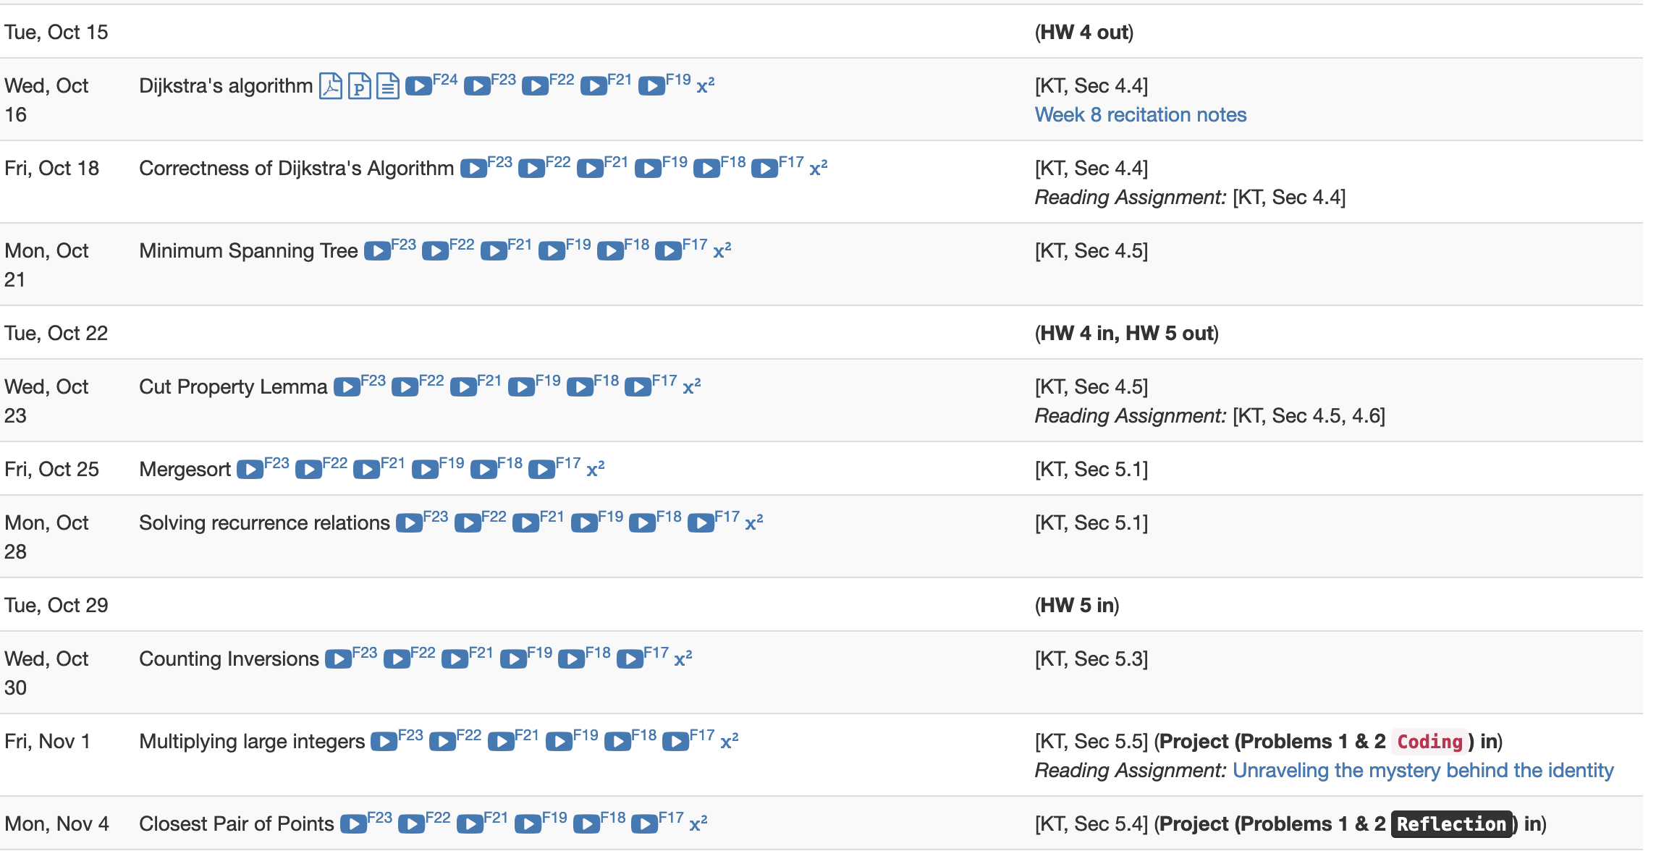
Project deadlines coming up

Slide 5
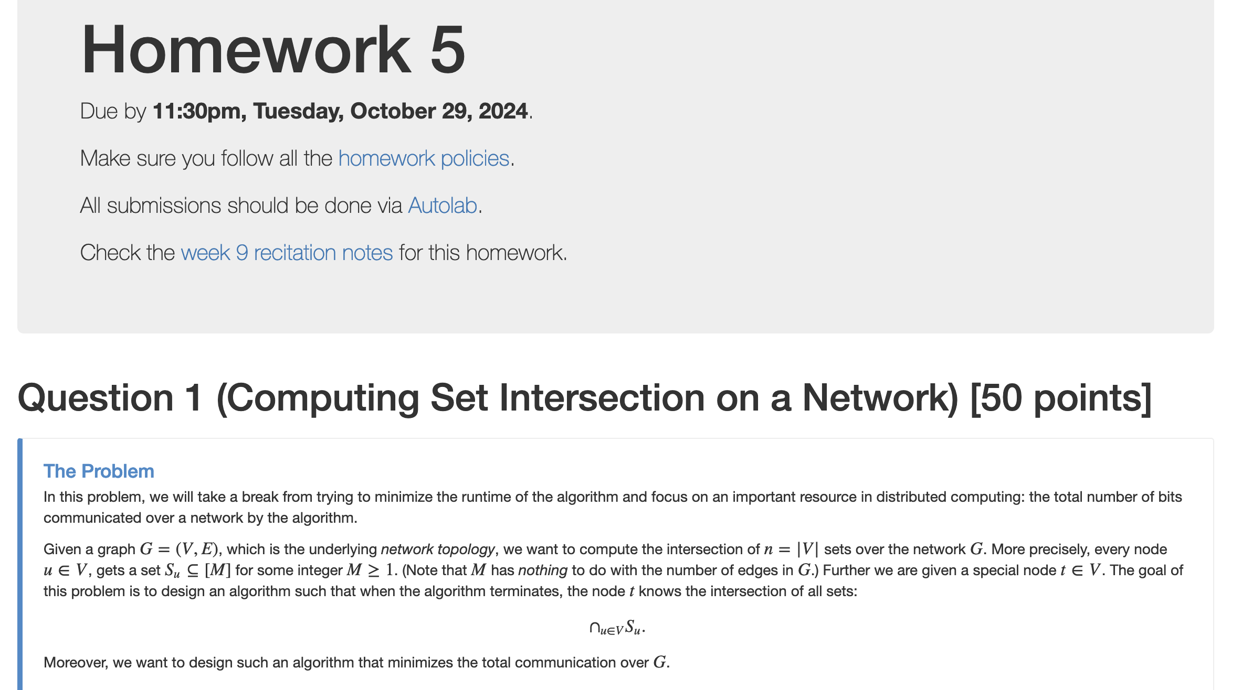
HW 5 out

Slide 6
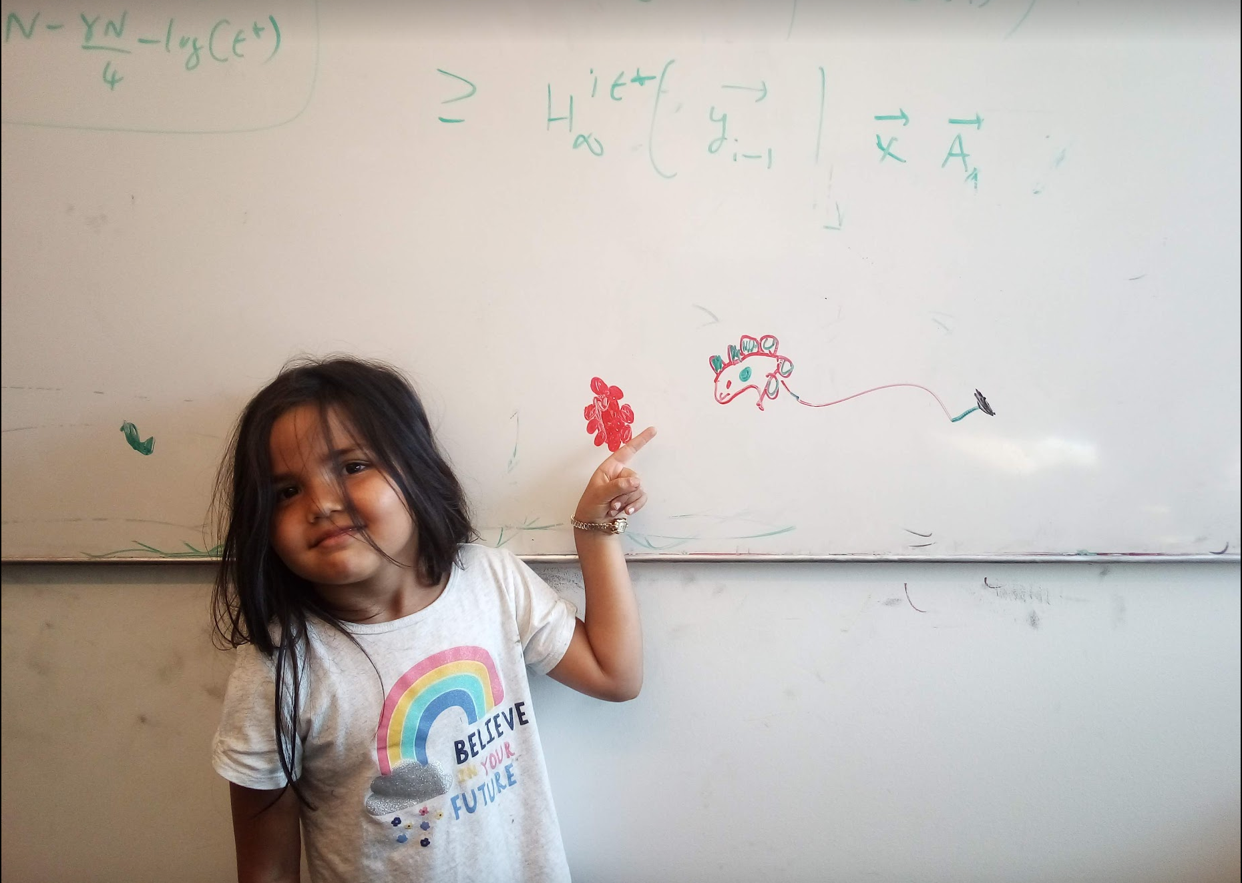
Questions/Comments?

Slide 7
Minimum Spanning Tree Problem
Input: Undirected, connected G = (V,E), edge costs c_{e}
Output: Subset E’ ⊆ E, s.t. T = (V,E’) is connected
C(T) is minimized
If all c_{e} > 0, then T is indeed a tree

Slide 8
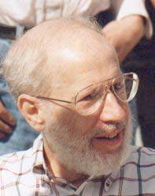
Kruskal’s Algorithm
Input: G=(V,E), c_{e}> 0 for every e in E
T = Ø
Sort edges in increasing order of their cost
Joseph B. Kruskal
Consider edges in sorted order
If an edge can be added to T without adding a cycle then add it to T

Slide 9
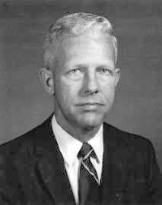
Prim’s algorithm
Similar to Dijkstra’s algorithm
Robert Prim
Input: G=(V,E), c_{e}> 0 for every e in E
S = {s}, T = Ø
While S is not the same as V
Among edges e= (u,w) with u in S and w not in S, pick one with minimum cost
Add w to S, e to T

Slide 10
Cut Property Lemma for MSTs
Condition: S and V\S are non-empty
V \ S
S
Cheapest crossing edge is in all MSTs
Assumption: All edge costs are distinct

Slide 11
Questions/Comments?

Slide 12
Today’s agenda
Optimality of Prim’s algorithm
Prove Cut Property Lemma
Optimality of Kruskal’s algorithm
Remove distinct edge weights assumption

Slide 13
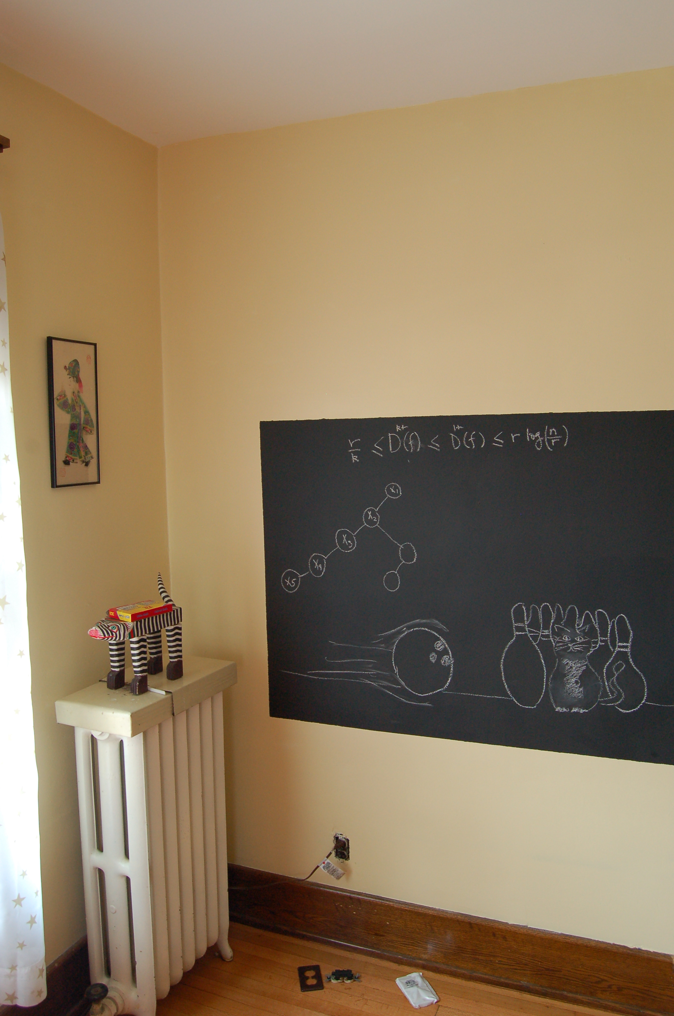
On to the board…

