Slide 1
Lecture 24
CSE 331
Oct 28, 2024

Slide 2
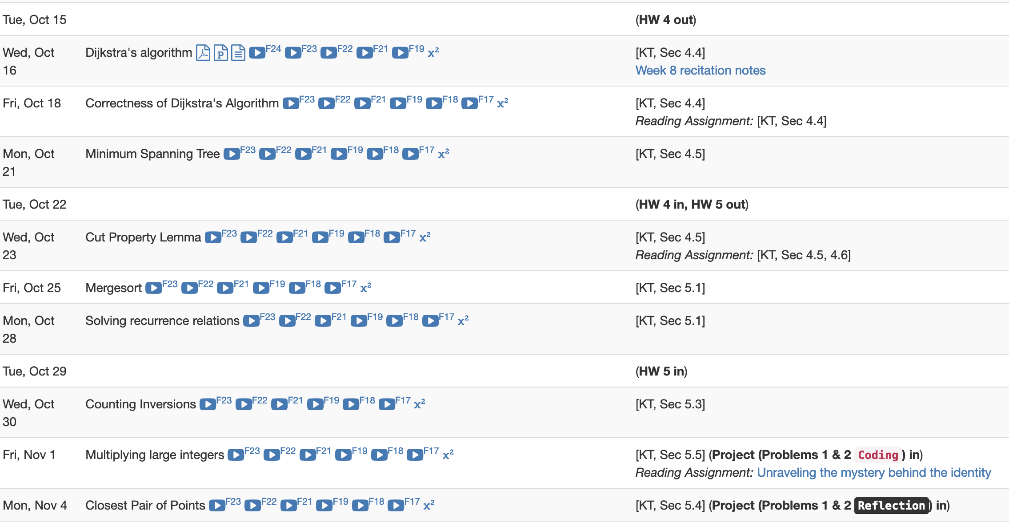
1st project deadline THIS Friday

Slide 3
Questions/Comments?

Slide 4
Mergesort algorithm
Input: a₁, a₂, …, a_{n}
Output: Numbers in sorted order
MergeSort( a, n )
If n = 1 return the order a₁
If n = 2 return the order min(a₁,a₂); max(a₁,a₂)
a_{L} = a₁,…, a_{n/2}
a_{R} = a_{n/2+1},…, a_{n}
return MERGE ( MergeSort(a_{L}, n/2), MergeSort(a_{R}, n/2) )

Slide 5
An example run
51
1
100
19
2
8
4
3
1
51
19
100
2
8
3
4
1
19
51
100
2
3
4
8
1
2
3
4
8
19
51
100
MergeSort( a, n )
If n = 1 return the order a₁
If n = 2 return the order min(a₁,a₂); max(a₁,a₂)
a_{L} = a₁,…, a_{n/2}
a_{R} = a_{n/2+1},…, a_{n}
return MERGE ( MergeSort(a_{L}, n/2), MergeSort(a_{R}, n/2) )

Slide 6
Correctness
Input: a₁, a₂, …, a_{n}
Output: Numbers in sorted order
By induction on n
MergeSort( a, n )
If n = 1 return the order a₁
If n = 2 return the order min(a₁,a₂); max(a₁,a₂)
a_{L} = a₁,…, a_{n/2}
a_{R} = a_{n/2+1},…, a_{n}
return MERGE ( MergeSort(a_{L}, n/2), MergeSort(a_{R}, n/2) )
Inductive step follows from correctness of MERGE

Slide 7
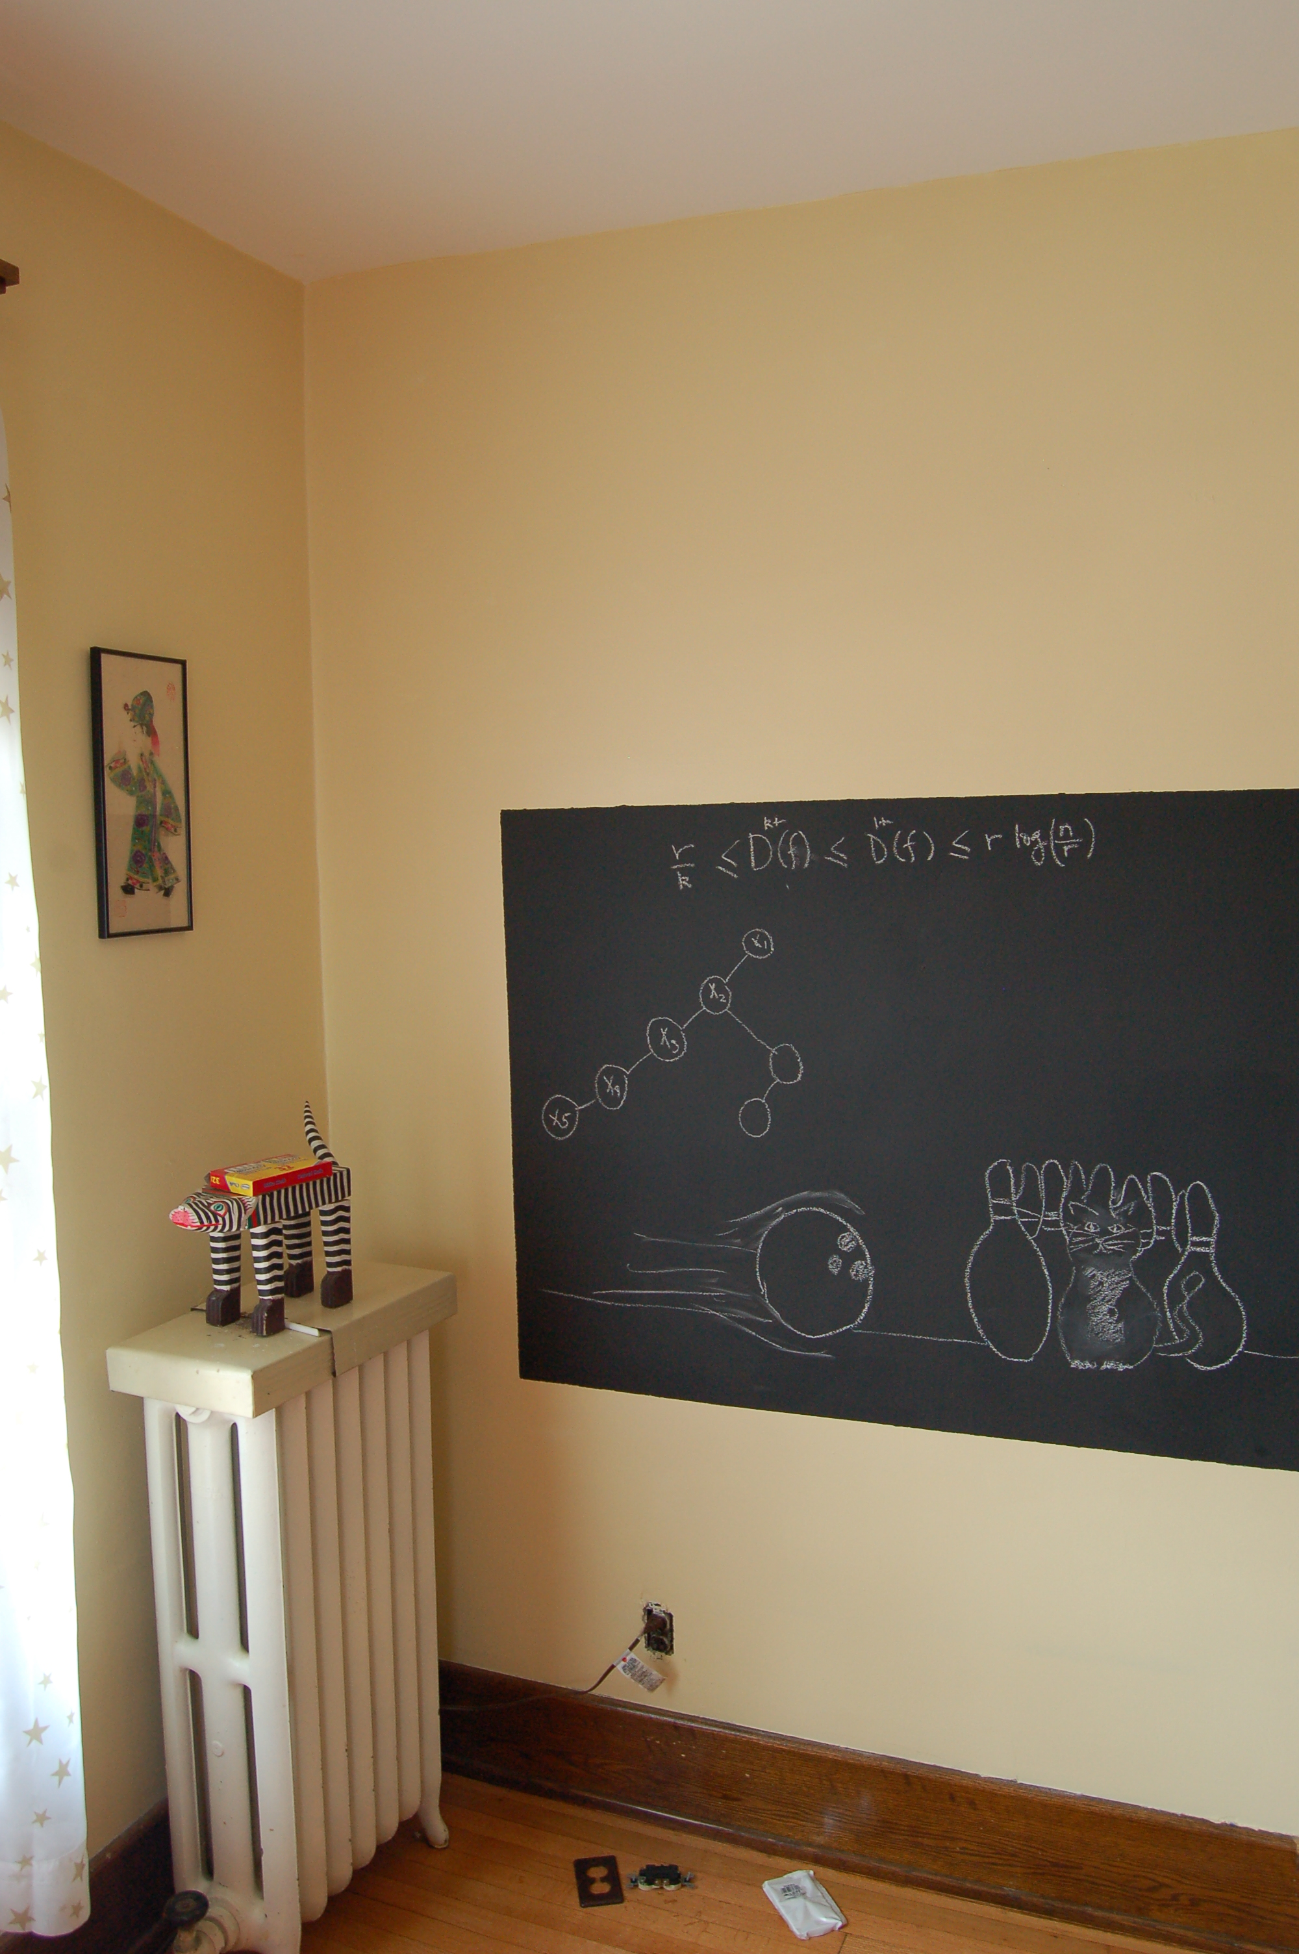
Runtime analysis on the board…

