Slide 1
Lecture 29
CSE 331
Nov 8, 2024

Slide 2
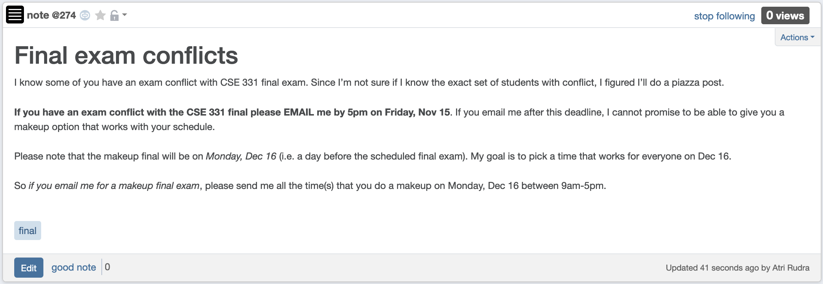
Final exam conflict

Slide 3
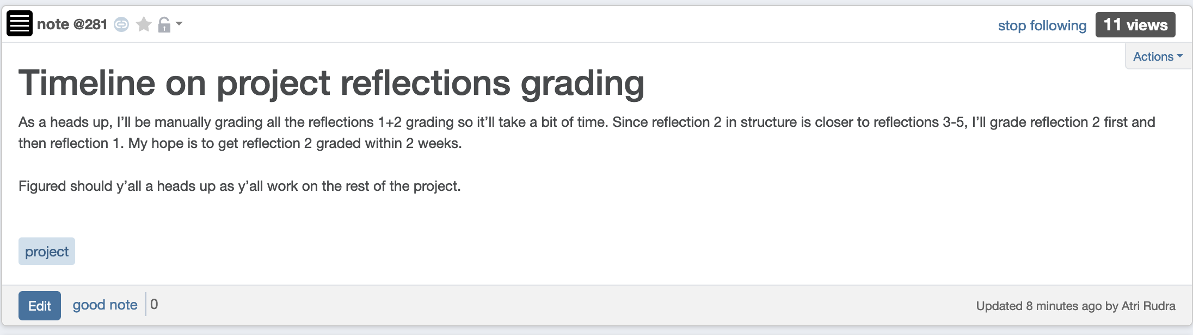
Reflections 2+1 grading timeline

Slide 4
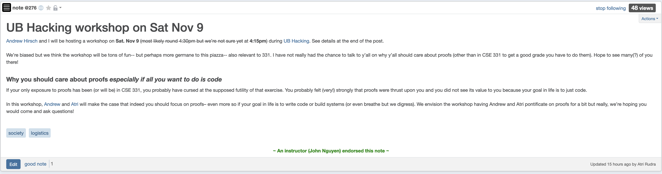
UB Hacking Workshop on Sat

Slide 5
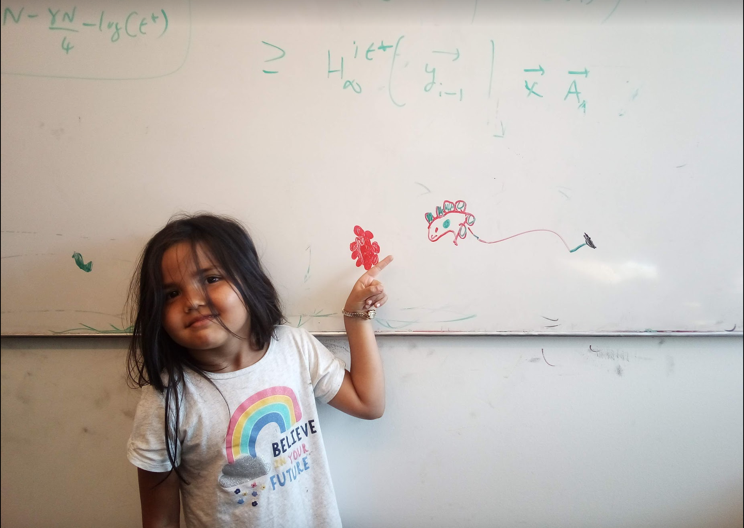
Questions/Comments?

Slide 6
High level view of CSE 331
Problem Statement
Problem Definition
Three general techniques
Algorithm
“Implementation”
Data Structures
Analysis
Correctness+Runtime Analysis

Slide 7


Greedy Algorithms
Natural algorithms
Reduced exponential running time to polynomial

Slide 8

Divide and Conquer
Recursive algorithmic paradigm
Reduced large polynomial time to smaller polynomial time

Slide 9
A new algorithmic technique
Dynamic Programming

Slide 10

Dynamic programming vs. Divide & Conquer

Slide 11
Same same because
Both design recursive algorithms

Slide 12
Different because
Dynamic programming is smarter about solving recursive sub-problems

Slide 13

End of Semester blues
Can only do one thing at any day: what is the optimal schedule to obtain maximum value?
Write up a term paper
(10)
Party!
(2)
Exam study
(5)
331 HW
(3)
Project
(30)
Friday
Saturday
Sunday
Monday
Tuesday

Slide 14
Previous Greedy algorithm
Order by end time and pick jobs greedily
Greedy value = 5+2+3= 10
Write up a term paper
(10)
OPT = 30
Party!
(2)
Exam study
(5)
331 HW
(3)
Project
(30)
Friday
Saturday
Sunday
Monday
Tuesday

Slide 15
Questions/Comments?

Slide 16
Today’s agenda
Formal definition of the problem
Start designing a recursive algorithm for the problem

Slide 17
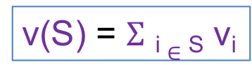
Weighted Interval Scheduling
Input: n jobs/intervals. Interval i is triple (s_{i}, f_{i}, v_{i})
start time
value
finish time
v₃ = 2
v₂ = 4
v₄ = 3
v₁ = 30
0
1
2
3

Slide 18
Questions/Comments?

Slide 19

Previous Greedy Algorithm
R = original set of jobs
While R is not empty
Choose i in R where f_{i} is the smallest
Add i to S
Remove all requests that conflict with i from R
Return S* = S
v₃ = 2
v₂ = 4
v₄ = 3
v₁ = 30
0
1
2
3

Slide 20
Perhaps be greedy differently?
R = original set of jobs
While R is not empty
Choose i in R where v_{i}/(f_{i} – s_{i}) is the largest
Add i to S
Remove all requests that conflict with i from R
Return S* = S
v₃ = 2
v₂ = 4
v₄ = 3
v₁ = 30
0
1
2
3

Slide 21
Can this work?
R = original set of jobs
While R is not empty
Choose i in R where v_{i}/(f_{i} – s_{i}) is the largest
Add i to S
Remove all requests that conflict with i from R
Return S* = S
v₃ = 2
v₂ = 6
v₄ = 3
v₁ = 12
0
1
2
3

Slide 22

Avoiding the greedy rabbit hole
Provably IMPOSSIBLE for a large class of greedy algos
https://www.writerightwords.com/down-the-rabbit-hole/
There are no known greedy algorithm to solve this problem

Slide 23
Questions/Comments?

Slide 24
Perhaps a divide & conquer algo?
Divide the problem in 2 or more many EQUAL SIZED
INDEPENDENT problems
Recursively solve the sub-problems
Patchup the SOLUTIONS to the sub-problems

Slide 25
Perhaps a divide & conquer algo?
RecurWeightedInt([n])
if n = 1 return the only interval
Would this general scheme work?
L = first n/2 intervals
R = last n/2 intervals
S_{L} = RecurWeightedInt(L)
S_{R} = RecurWeightedInt(R)
PatchUp(S_{L}, S_{R})
Divide the problem in 2 or more many EQUAL SIZED
INDEPENDENT problems

Slide 26
Sub-problems NOT independent!
v₆ = 20
v₃ = 10
v₁ = 1
v₂ = 2
v₄ = 4
v₅ = 5
0
1
2
3

Slide 27
Perhaps patchup can help?
Patchup the SOLUTIONS to the sub-problems
v₆ = 20
v₃ = 10
v₁ = 1
v₂ = 2
0
1
2
3

Slide 28
Sometimes patchup NOT needed!
v₆ = 0
v₃ = 10
v₁ = 1
v₂ = 2
v₄ = 4
v₅ = 5
0
1
2
3

Slide 29
Check for two cases?
6 is in the optimal solution
v₆ = 20
v₃ = 10
v₁ = 1
v₂ = 2
v₄ = 4
v₅ = 5
0
1
2
3
6 is NOT in the optimal solution
v₆ = 0
v₃ = 10
v₁ = 1
v₂ = 2
v₄ = 4
v₅ = 5
0
1
2
3

Slide 30
Check if v₆ is the largest value?
6 is in the optimal solution
v₆ = 20
Cannot decide this greedily. Need to have a global view!
v₃ = 10
v₁ = 1
v₂ = 2
v₄ = 4
v₅ = 5
0
1
2
3
6 is NOT in the optimal solution
v₆ = 0
v₆ = 20
v₃ = 10
v₁ = 1
v₂ = 2
v₄= 14
v₅ =15
0
1
2
3

Slide 31
Check out both options!
v₆ = 20
v₃ = 10
v₁ = 1
v₂ = 2
v₄ = 4
v₅ = 5
0
1
2
3
Case 1: 6 is in the optimal solution

Slide 32
6 is not in optimal solution
v₆ = 20
v₃ = 10
v₁ = 1
v₂ = 2
v₄= 14
v₅ =15
0
1
2
3

Slide 33


Slide 34
So what sub-problems?
Divide the problem in 2 or more many EQUAL SIZED
INDEPENDENT problems
Sub problem 3
Original problem
Sub-problem 2
Sub-problem 5
Sub problem 1
Sub problem 4

