Slide 1
Introduction to Xinu and Kernel Programming
Bina Ramamurthy
bina@buffalo.edu

Slide 2
Topics
Processor architecture
What is Xinu? And Embedded Xinu?
What is CFE?
Modifying WRT54GL to host Xinu: or port Xinu to MIPS platform
Connecting, compiling and deploying
Embedded Xinu Code reverse engineering

Slide 3
Processor Architecture
WRT54Gl uses Broadcom MIPS (Microprocessor without Interlocked Pipelines Stages) processor, common to embedded devices and game consoles.
Model: BCM5352
Based on Reduced Instruction Set Architecture (RISC)
The BCM5532 family of processors is a next generation SoC architecture that combines the CPU, Wireless MAC (media access controller), Ethernet MAC onto one chip
In this respect it qualifies to be an embedded system: dedicated functionality

Slide 4
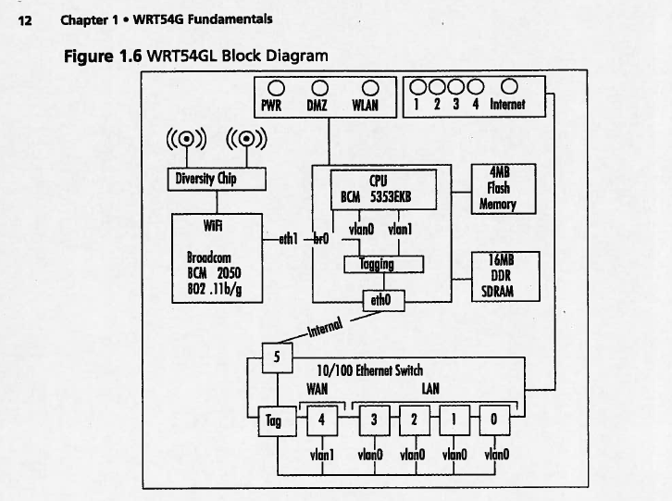

Slide 5
Storage
On board storage is indeed a limitation when using WRT54GL in situation other than for which it is meant for.
WRT54GL has a flash memory (4 MB), a form of non-volatile storage commonly used in small devices, such as digital camera.
It also use SDRAM (Synchronous Dynamic Random Access Memory) soldered directly into the printed board. DIMM (Dual In-line Memory Module)

Slide 6
Wireless and Ethernet networking
WRT54GL has a powerful networking architecture
It provides 5 port Ethernet switch that is broken down into two virtual LANs VLAN0 and VLAN1 (default)
Wireless interface is bridged by default to the Ethernet switch.
WiFi component is BCM2050, a 802.11b/g radio chipset.
It uses a diversity chip to balance signals between two built-in antenna.
WiFi radio connects to the CPU Wireless MAC on eth1 which is bridged to VLAN0 via br0 interface.
Ethernet switch controls EthernetLAN and Internet lights, whereas Power, DMZ, WLAN are controlled by GPIO port on the CPU
WAN port: plug in cable modem into this port,
  it will pull a DHCP (Dynamic Host Configuration Protocol) address from your ISP (Internet Service Provider).
  Since it belongs to VLAN1 it is separate from VLAN0 and the two are linked by WRT54Gl’s routing capabilities.
  Firewall prevents traffic from flowing from WAN to LAN network, traffic initiated by LAN to exit via WAN.

Slide 7
What does WRT54GL do?
Creates a network between the wireless interface and the LAN ports known as br0.
Router address is 192.168.1.1 by default.
WLAN port (port 4).
Typically you will plug your cable modem into this port; this will pull the DHCP address from your ISP.
WAN and LAN are separate network linked by WRT54GL

Slide 8
Xinu
Unix spelled backward
Developed by Dr. Douglas E. Comer (Purdue University)
ANSI-compliant C
Meant for educational purposes

Slide 9
Embedded Xinu
To port Xinu to embedded MIPS/other platforms

Slide 10
Embedded XINU
http://xinu.mscs.mu.edu/Main_Page
XINU ("XINU Is Not Unix", a recursive acronym) is a Unix-like operating system originally developed by Douglas Comer for instructional purposes at Purdue University in the 1980s.
Embedded XINU is a reimplementation of the original XINU operating system on the MIPS processor which is able to run on inexpensive wireless routers and is suitable for courses and research in the areas of Operating Systems, Hardware Systems, Embedded Systems, and Compilers.

Slide 11
Embedded XINU
http://xinu.mscs.mu.edu/Memory
ls xinu_mips-1.0
AUTHORS README include loader system tty
LICENSE compile lib shell test uart
Above is the xinu kernel directory organization
See attached XINU directory structure and class diagram
We will develop programs into XINU kernel on linux server called nexos.cse.buffalo.edu
We will cross compile this kernel and load the firmware into WRT54GL (“upload”) and test it

Slide 12
Common Firmware Environment (CFE)
The Common Firmware Environment (CFE) is the firmware developed by Broadcom for the BCM947xx SoC platform (among others). It is the first code that runs when the router boots and performs functions similar to Apple's Open Firmware:
Initializes the system
Sets up a basic environment in which code can run
Optionally provides a command line interface non-standard usage
Loads and executes a kernel image
So, in normal operation, a user will not see CFE working at all; it will load the Linksys kernel and send it on its merry way without hesitation. For us, however, CFE is crucial, because it provides us with the ability to load an image over the network using TFTP.

Slide 13
CFE: http://melbourne.wireless.org.au/files/wrt54/cfe.pdf
On startup, CFE performs the following low-level initialization:
  Reset and ROM trap handler vectors
  CPU and FPU initialization
  L1 and L2 Cache initialization
  Multiprocessor initialization
  Memory controller initialization
  PCI and LDT bus configuration
  Environment variables
  Console device initialization
  Bootstrap device initialization
Certain information, such as the physical memory layout and other critical information, are stored by CFE and are made available to boot loaders and operating systems via CFE’s external API.
Once initialization has completed, CFE is ready to load programs from the bootstrap device (UART, Flash, ports etc.)

Slide 14
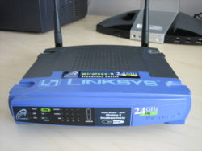
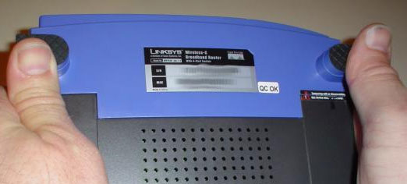
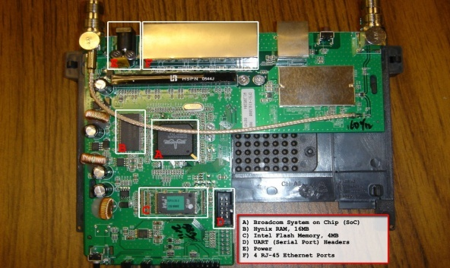
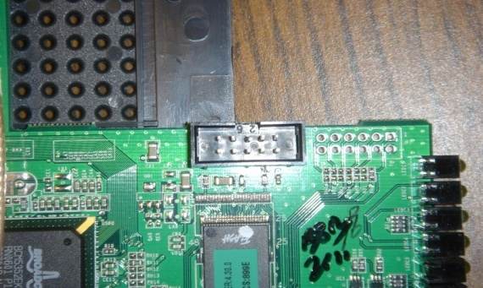
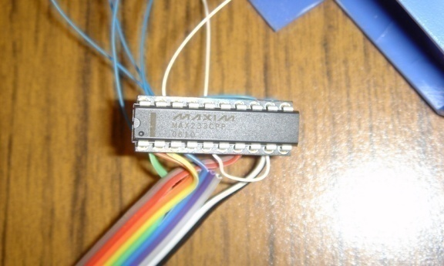
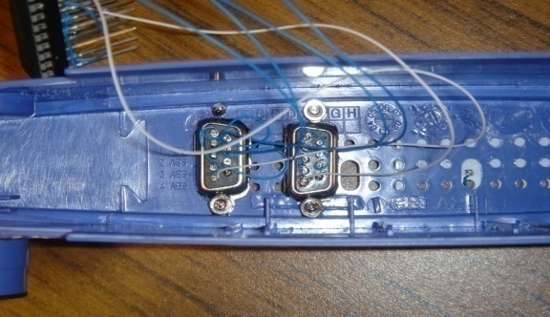
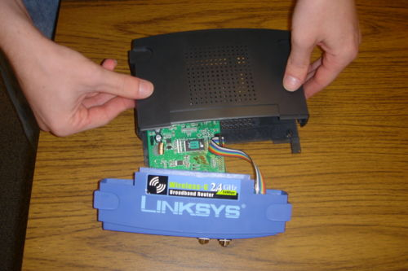
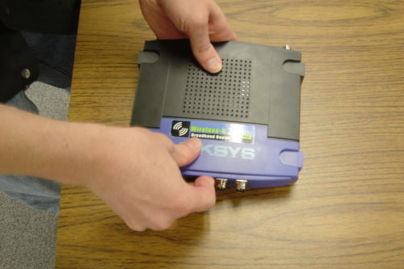
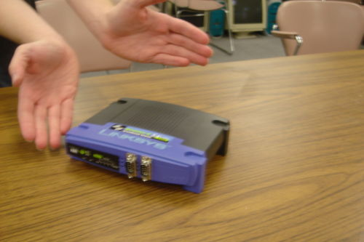
The Basic Hardware modifications

Slide 15
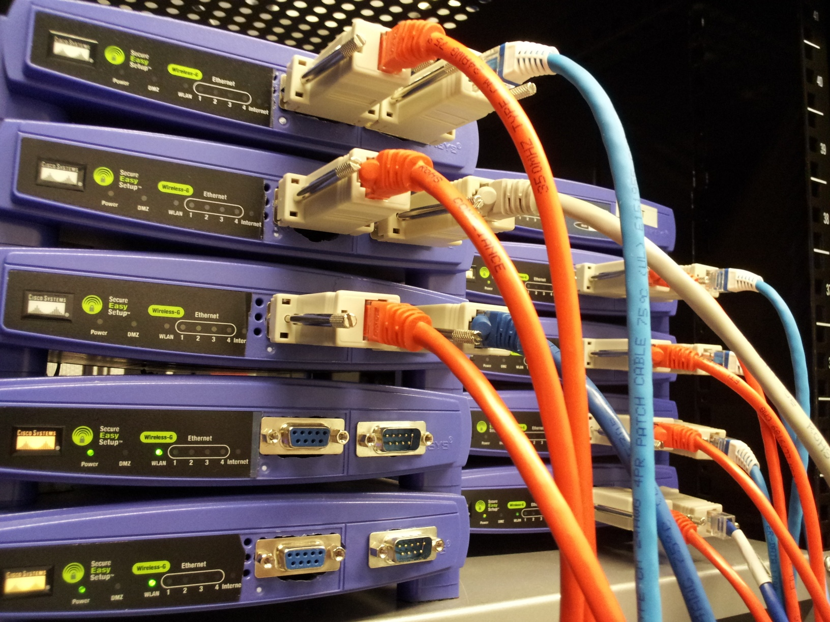

Slide 16
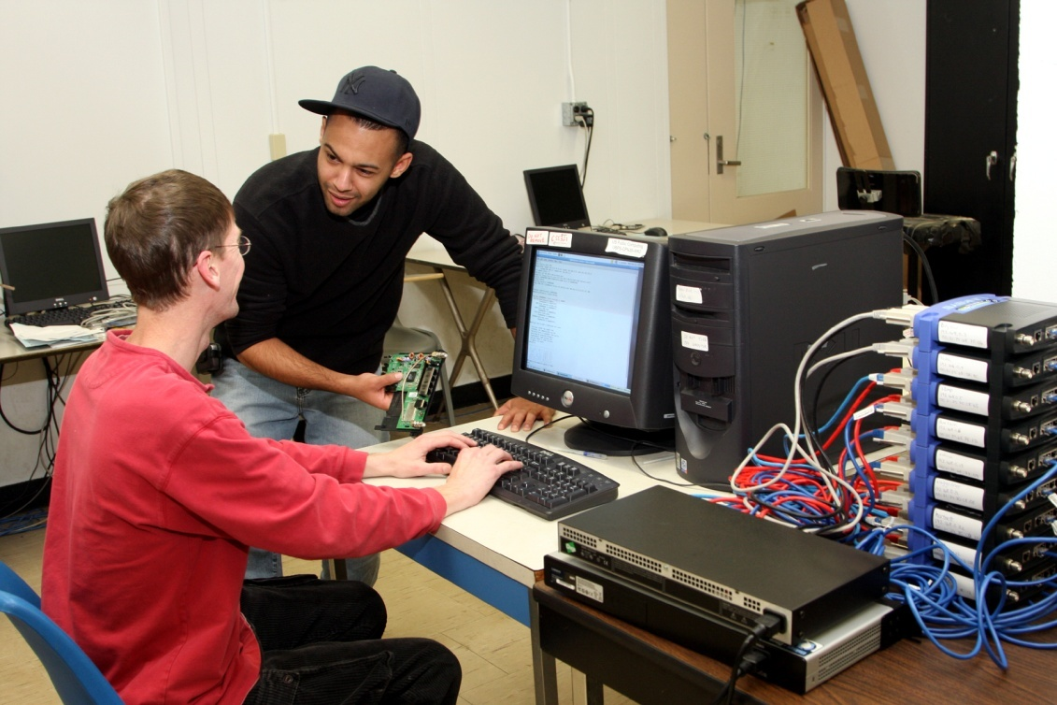
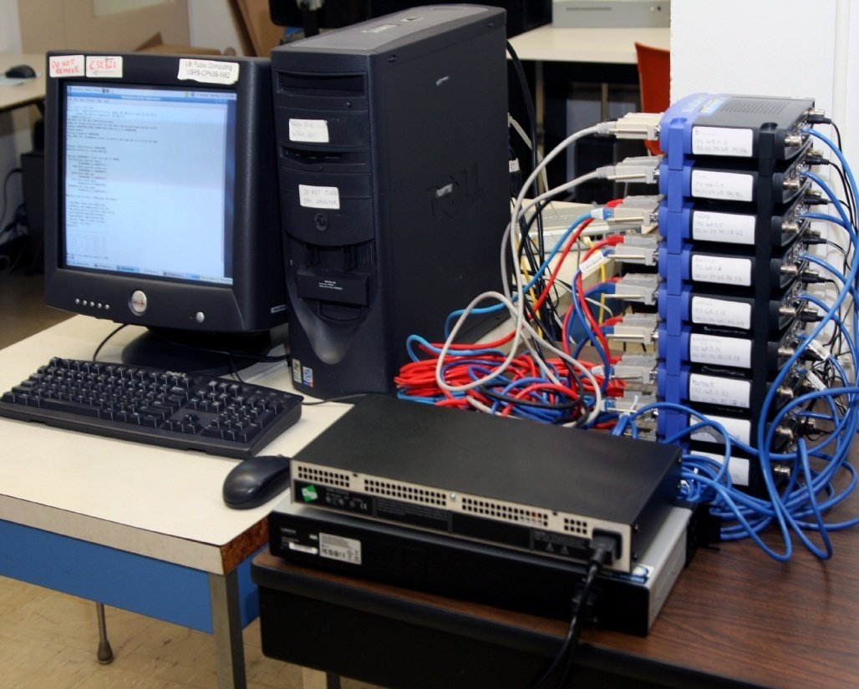
The NSF-Supported Facility at UB

Slide 19
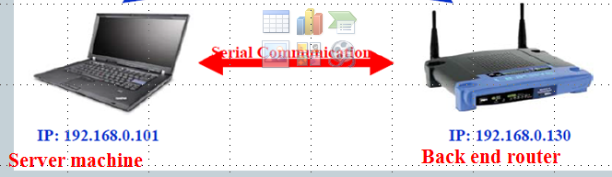
Connecting WRT54GL
You have modified the connections, connected the server to wrt54gl
using serial cable. How will you make bacn end recognize the server machine?

Slide 20
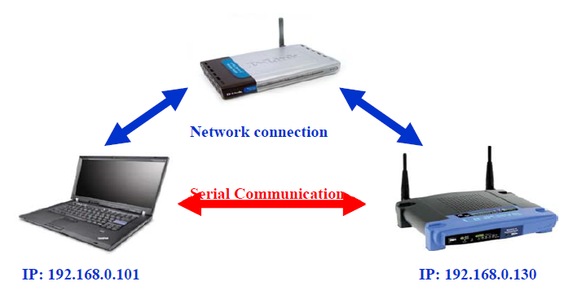
Basic Xinu Environment
Front end router
Server machine
Back end router

Slide 21
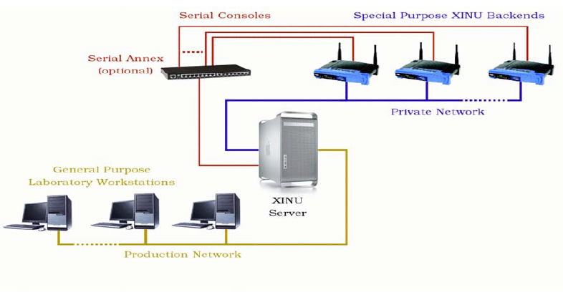
Extended Xinu Environment

Slide 22
WRT54GL
Detailed instruction: http://xinu.mscs.mu.edu/HOWTO:Modify_the_Linksys_hardware
You DO NOT have to do this. We already did it for you.
Our goal is to get you familiar with working in the Embedded Xinu environment
Some of the following slides are by a long-time teaching assistant Panya Chanawangsu

Slide 23
Introduction to NEXOS Lab
Log on to timberlake
Connect to the NEXOS server:
ssh nexos.cse.buffalo.edu
Change your password:
passwd

Slide 24
Some Technical Terms
Cross Compiler
Shell
Kernel

Slide 25
Cross Compiler
General idea:
  Compile a program on machine A
  Run it on machine B where an OS is not supported
In our case, we build the XINU system on a local machine and upload the executable to the routers.

Slide 26
Shell
User interface for the operating system
Access to the kernel
Other programs are called through shell
CLI (Command Line Interface)
GUI (Graphical User Interface) – not available in our system

Slide 27
Kernel
Lowest level but the most important part of an operating system
Resource management
Bridge between software and hardware

Slide 28
xinu_mips-1.0.2.tar.gz
Obtain the tarball from home directory
cd /home
Copy the tarball to your directory
cp xinu_mips-1.0.2.tar.gz ~
Go to your directory and untar the package
cd ~
tar zxf xinu_mips-1.0.2.tar.gz

Slide 29
Compiling
Go to xinu_mips-1.0.2
cd xinu_mips-1.0.2
View all the files and folders
ls
Go to the compile folder
cd compile
Compile all the source files
make

Slide 30
Connecting to a router
View available routers
xinu-status
You need the file xinu.boot so stay in the compile folder
mips-console router_name
For example,
mips-console moiz

Slide 31
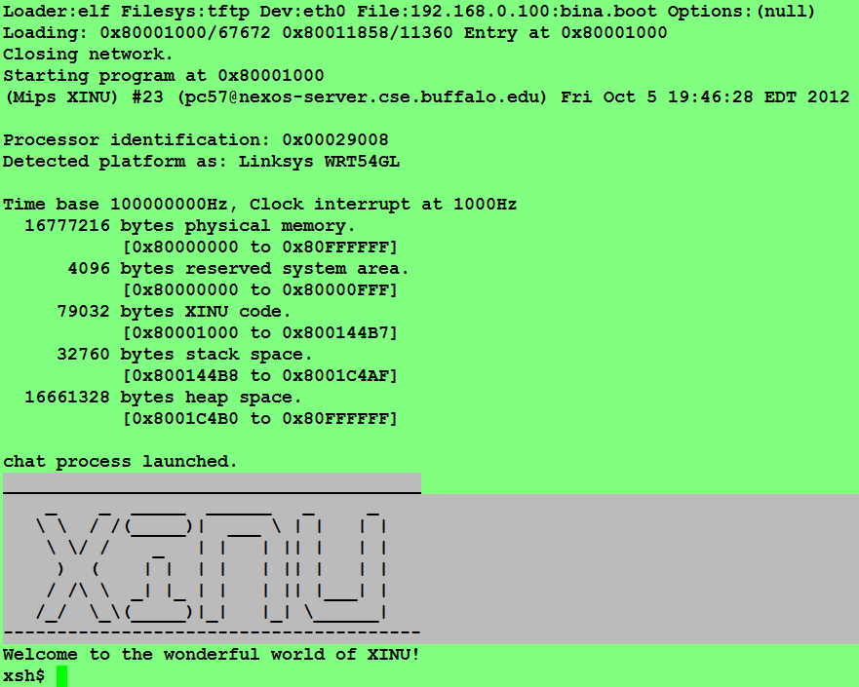

Slide 32
Disconnecting from a router
You have to release the router once you are done using it.
Press ctrl + spacebar
And then q
Other students have the right to ask me to kill your connection if you are logged on to the same router for more than 15 minutes.

Slide 33
Working with Xinu/Nexos
Lets look at the code and update the shell functions to get started with Xinu
Lets reverse engineer and understand the current xinu code.

Slide 34
Using in XINU
To view all available commands
help
To call a function
function_name arg1 arg2 …

Slide 35
Adding your own commands
Write and save your source file in the shell directory
Follow the naming convention:
xsh_commandName.c
For example,
xsh_myTest.c
Hint: use xsh_test.c in the shell directory as a template.

Slide 36
Parameters explained
ushort = unsigned short (0 to 65,535)
nargs holds the number of arguments
arg[0] is the command itself
arg[1] is the first argument, arg[2] is the second argument, etc.

Slide 37
Adding your own commands
(cont’d)
Update the command table in shell/shell.c
{ “myTest”, FALSE, xsh_myTest }
Update include/shell.h
command xsh_myTest(ushort, ushort, ushort, ushort, char *[]);
Update compile/Makefile. Look for ”SHL =” and add your source file to the list
xsh_myTest.c

Slide 38
Some basic C commands
To print something in standard output,
fprintf(stdout, “CSE524\n”);
fprintf(stdout, “%s”, args[1]);
To convert a string to its integer equivalent,
int x = atoi(args[1]);

Slide 39
Adding your own commands
(cont’d)
Now you are ready to compile your command. Change your directory to compile and type
make
Connect to a router and try running your command.
mips-console router_name
Now when you type help, you should see your command added to the list.

Slide 40
Resources
XINU reference page:
http://www.cse.buffalo.edu/~bina/amrita/RTOS/xinudocs/files.html
XINU main page: how to deploy XINU
http://xinu.mscs.mu.edu/Main_Page

