Slide 1
Review of HTML
Ch. 1

Slide 2
Review of tags covered
<html> </html>
<body></body>
<title></title>
<p> </p>
<table></table> <table border =“1”>
<tr></tr> <td></td><caption></caption>
<ol>
<li>
<ul>
<h2> various header tags
Img tag
Style, attributes and values
alt

Slide 3
Digitizing Data
Chapter 7

Slide 4
Digitizing Discrete Information
The dictionary definition of digitize is to represent information with digits.
Digit means the ten Arabic numerals 0 through 9.
Digitizing uses whole numbers to stand for things.

Slide 5
The PandA Representation
PandA is the name used for two fundamental patterns of digital information:
Presence
Absence
PandA is the mnemonic for “Presence and Absence”
A key property of PandA is that the phenomenon is either present or not

Slide 6
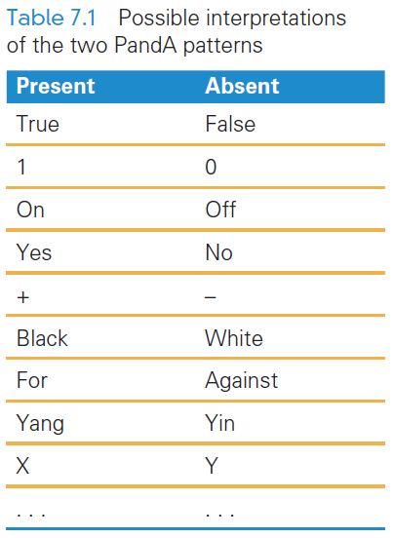
A Binary System
The PandA encoding has two patterns: present and absent
Two patterns make it a binary system
There is no law that says on means “present” or off means “absent”

Slide 7
Bits Form Symbols
In the PandA representation, the unit is a specific place (in space and time), where the presence or absence of the phenomenon can be set and detected.
The PandA unit is known as a bit
Bit is a contraction for “binary digit”
Bit sequences can be interpreted as binary numbers
Groups of bits form symbols

Slide 8
Bits in Computer Memory
Memory is arranged inside a computer in a very long sequence of bits
Going back to the definition of bits (previous slide), this means that places where the physical phenomenon encoding the information can be set and detected

Slide 9
Hex Explained
Hex digits, short for hexadecimal digits, are base-16 numbers
A bit sequence might be given in 0’s and 1’s:
1111111110011000111000101010
Writing so many 0’s and 1’s is tedious and error prone
There needed to be a better way to write bit sequences…hexadecimal digits

Slide 10
The 16 Hex Digits
The digits of the hexadecimal numbering system are 0, 1, ... , 9, A, B, C, D, E, F
Because there are 16 digits (hexits), they can be represented perfectly by the 16 symbols of 4-bit sequences:
The bit sequence 0000 is hex 0
Bit sequence 0001 is hex 1
Bit sequence 1111, is hex F

Slide 11
Hex to Bits and Back Again
Because each hex digit corresponds to a 4-bit sequence, easily translate between hex and binary
0010 1011 1010 1101 2 B A D
F A B 4 1111 1010 1011 0100

Slide 12
Digitizing Numbers in Binary
The two earliest uses of PandA were to:
Encode numbers
Encode keyboard characters
Representations for sound, images, video, and other types of information are also important

Slide 13
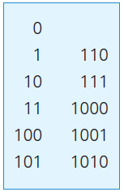
Counting in Binary
Binary numbers are limited to two digits, 0 and 1
Digital numbers are ten digits, 0 through 9
The number of digits is the base of the numbering system
Counting to ten

Slide 14
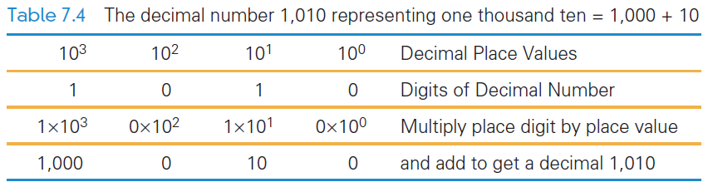
Counting in Binary
With decimal numbers, we use a place value representation where each “place” represents the next higher power of 10
With binary numbers, it is the same idea, but with higher powers of 2

Slide 15
Place Value in a Decimal Number
Recall that To find the quantity expressed by a decimal number:
The digit in a place is multiplied by the place value and the results are added
Example, 1010 (base 10) is:
Digit in the 1’s place is multiplied by its place
Digit in the 10’s place is multiplied by its place
and so on: (0 × 1) + (1 × 10) + (0 × 100) + (1 × 1000)

Slide 16
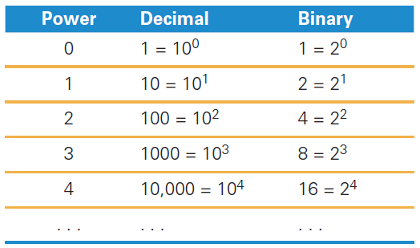
Place Value in a Binary Number
Binary works the same way
The base is not 10 but 2
Instead of the decimal place values: 1, 10, 100, 1000, . . . , the binary place values are: 1, 2, 4, 8, 16, . . . ,

Slide 17
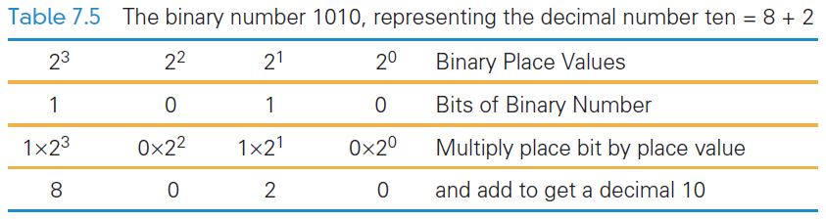
Place Value in a Binary Number
1010 in binary:
(1 × 8) + (0 × 4) + (1 × 2) + (0 × 1)

Slide 18
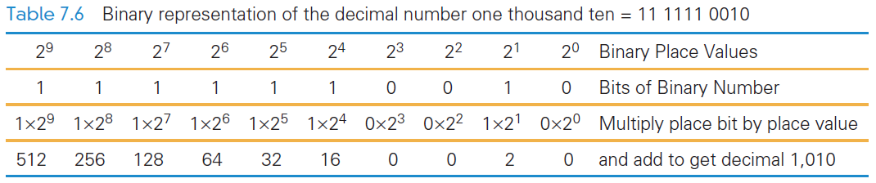

Slide 19
Digitizing Text
The number of bits determines the number of symbols available for representing values:
n bits in sequence yield 2n symbols
The more characters you want encoded, the more symbols you need

Slide 20
Digitizing Text
Roman letters, Arabic numerals, and about a dozen punctuation characters are about the minimum needed to digitize English text
What about:
Basic arithmetic symbols like +, −, *, /, =?
Characters not required for English ö, é, ñ, ø?
Punctuation? « », ¿, π, ∀)? What about business symbols: ¢, £, ¥, ©, and ®?
And so on.

Slide 21
Assigning Symbols
We need to represent:
26 uppercase,
26 lowercase letters,
10 numerals,
20 punctuation characters,
10 useful arithmetic characters,
3 other characters (new line, tab, and backspace)
95 symbols…enough for English

Slide 22
Assigning Symbols
To represent 95 distinct symbols, we need 7 bits
6 bits gives only 2⁶ = 64 symbols
7 bits give 2⁷ = 128 symbols
128 symbols is ample for the 95 different characters needed for English characters
Some additional characters must also be represented

Slide 23
Assigning Symbols
ASCII stands for American Standard Code for Information Interchange
ASCII is a widely used 7-bit (2⁷) code
The advantages of a “standard” are many:
Computer parts built by different manufacturers can be connected
Programs can create data and store it so that other programs can process it later, and so forth

Slide 24
Extended ASCII: An 8-Bit Code
7-bit ASCII is not enough, it cannot represent text from other languages
IBM decided to use the next larger set of symbols, the 8-bit symbols (2⁸)
Eight bits produce 2⁸ = 256 symbols
The 7-bit ASCII is the 8-bit ASCII representation with the leftmost bit set to 0
Handles many languages that derived from the Latin alphabet

Slide 25
NATO Broadcast Alphabet
The code for the letters used in radio communication is purposely inefficient
The code is distinctive when spoken amid noise
The alphabet encodes letters as words
Words are the symbols
“Mike” and “November” replace “em” and “en”
The longer encoding improves the chance that letters will be recognized
Digits keep their usual names, except nine, which is known as niner

Slide 26
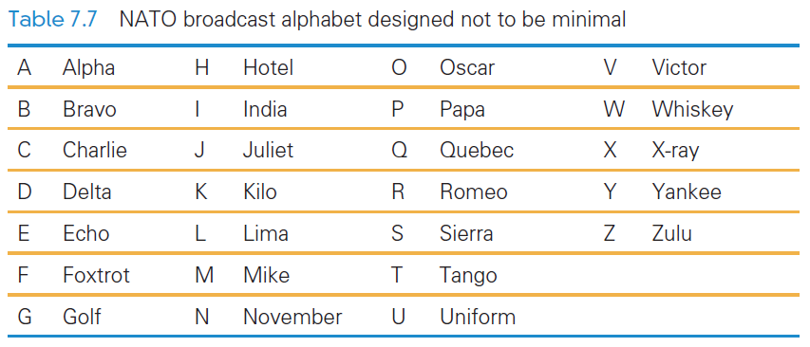
NATO Broadcast Alphabet

Slide 27
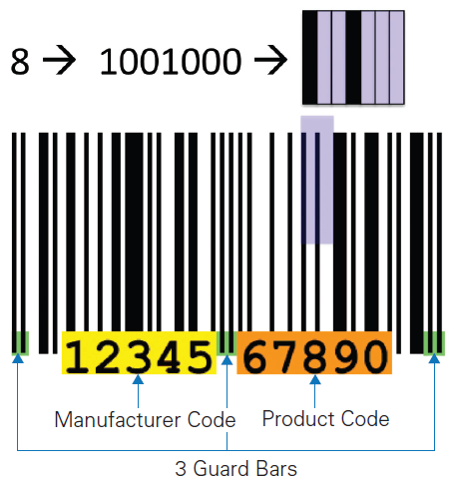
Bar Codes
Universal Product Codes (UPC) also use more than the minimum number of bits to encode information
In the UPC-A encoding, 7 bits are used to encode the digits 0 – 9

Slide 28
Bar Codes
UPC encodes the manufacturer (left side) and the product (right side)
Different bit combinations are used for each side
One side is the complement of the other side
The bit patterns were chosen to appear as different as possible from each other

Slide 29
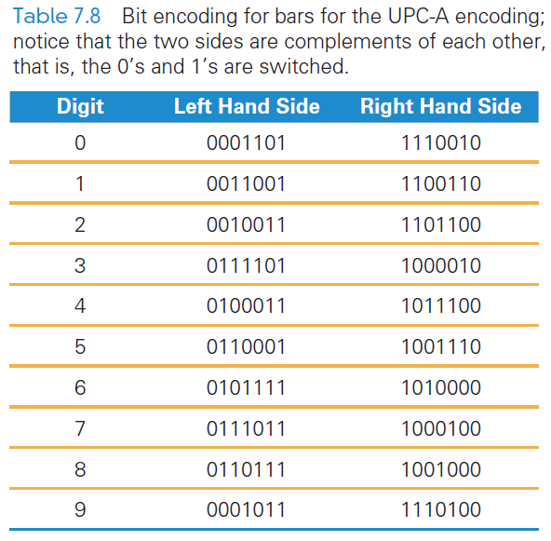
Bar Codes
Different encodings for each side make it possible to recognize whether the code is right side up or upside down

Slide 30
Why “Byte”?
Computer memory is subject to errors
An extra bit is added to the memory to help detect errors
A ninth bit per byte can detect errors using parity
Parity refers to whether a number is even or odd
Count the number of 1’s in the byte. If there is an even number of 1’s we set the ninth bit to 0

Slide 31
Why “Byte”?
All 9-bit groups have even parity:
Any single bit error in a group causes its parity to become odd
This allows hardware to detect that an error has occurred
It cannot detect which bit is wrong, however

Slide 32
Why “Byte”?
IBM was building a supercomputer, called Stretch
They needed a word for a quantity of memory between a bit and a word”
A word of computer memory is typically the amount required to represent computer instructions (currently a word is 32 bits)

Slide 33
Why “Byte”?
Then, why not bite?
The ‘i’ to a ‘y’ was done so that someone couldn’t accidentally change ‘byte’ to ‘bit’ by the dropping the ‘e’ ”
bite bit (the meaning changes)
byte byt (what’s a byt?)

Slide 34
Summary
We began the chapter by learning that digitizing doesn’t require digits—any symbols will do
We explored the following:
PandA encoding, which is based on the presence and absence of a physical phenomenon. Their patterns are discrete; they form the basic unit of a bit. Their names (most often 1 and 0) can be any pair of opposite terms.

Slide 35
Summary
We explored the following:
7-bit ASCII, an early assignment of bit sequences (symbols) to keyboard characters. Extended or 8-bit ASCII is the standard.
The need to use more than the minimum number of bits to encode information.
The mystery of the y in byte.

