Slide 1
Realizing Concurrency using the thread model
B. Ramamurthy

Slide 2
Introduction
A thread refers to a thread of control flow: an independent sequence of execution of program code.
Threads are powerful. As with most powerful tools, if they are not used appropriately thread programming may be inefficient.
Thread programming has become viable solution for many problems with the advent of multi-core processors
Typically these problems are expected to handle many requests simultaneously. Example: multi-media, games, automotive embedded systems
Especially relevant to embedded system with the proliferation of multi-core processors

Slide 3
Topics to be Covered
Objectives
What are Threads?
Thread implementation models
POSIX threads
Creating threads
Using threads
Summary

Slide 4
Objectives
To understand the thread model for realizing concurrency
To study POSIX standard for threads called the Pthreads.
To study thread control primitives for creation, termination, join, synchronization, concurrency, and scheduling.
To learn to design multi-threaded applications.

Slide 5
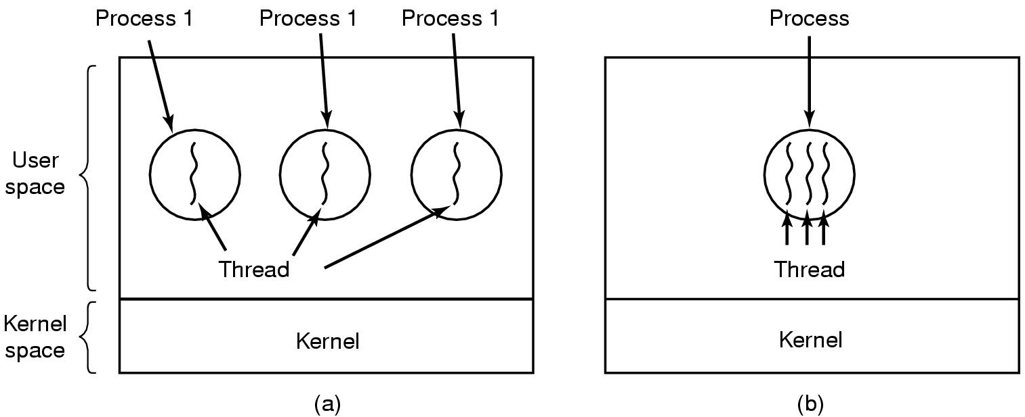
The Thread Model
(a) Three processes each with one thread
(b) One process with three threads

Slide 6
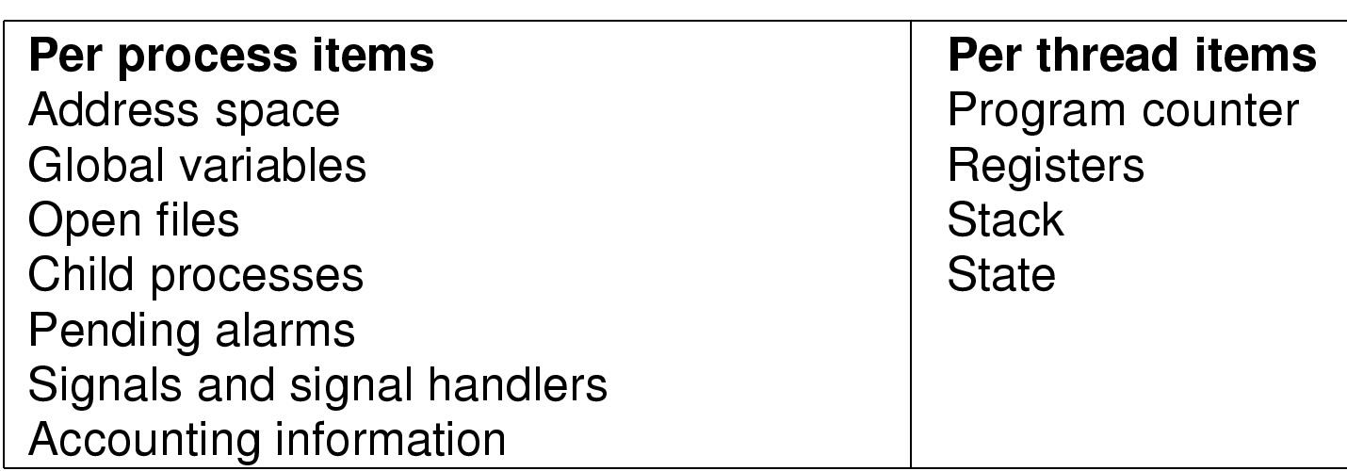
Per process vs per thread items
Items shared by all threads in a process
Items private to each thread

Slide 7
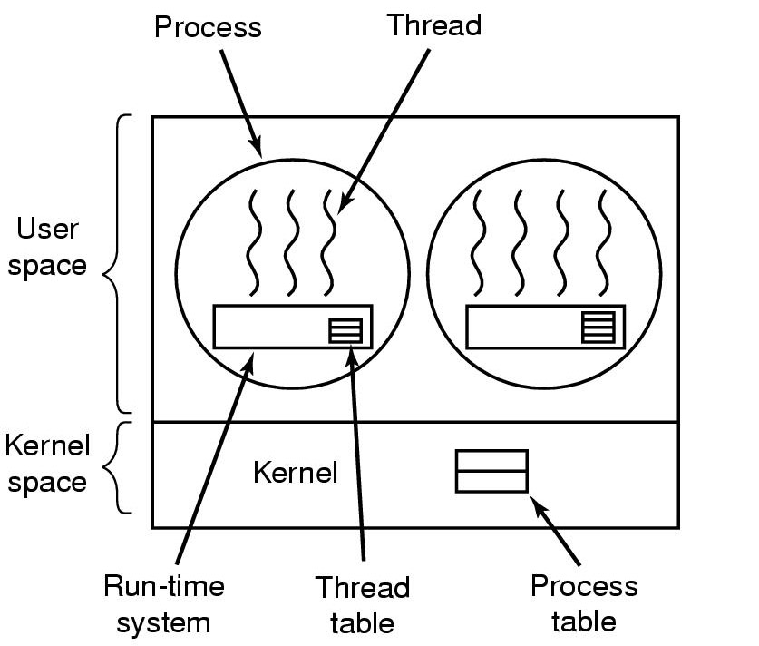
Implementing Threads in User Space
A user-level threads package

Slide 8
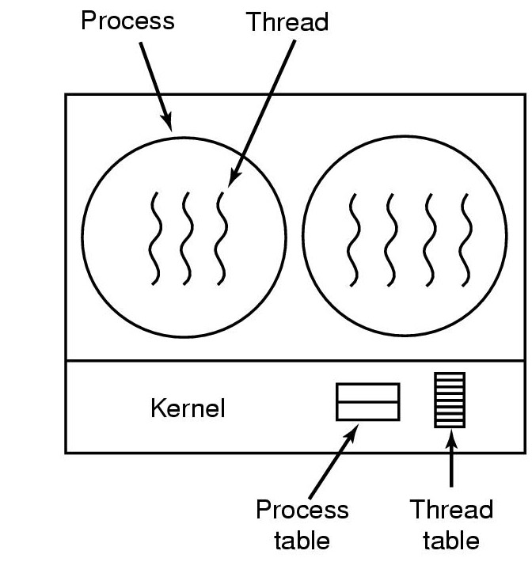
Implementing Threads in the Kernel
A threads package managed by the kernel

Slide 9
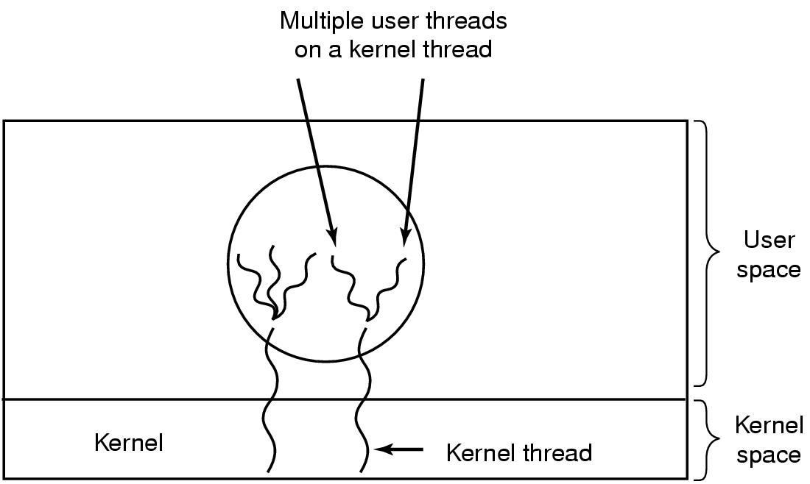
Hybrid Implementations
Multiplexing user-level threads onto kernel- level threads

Slide 10
Scheduler Activations
Goal – mimic functionality of kernel threads
  gain performance of user space threads
Avoids unnecessary user/kernel transitions
Kernel assigns virtual processors to each process
  lets runtime system allocate threads to processors
Problem:
Fundamental reliance on kernel (lower layer)
calling procedures in user space (higher layer)

Slide 11
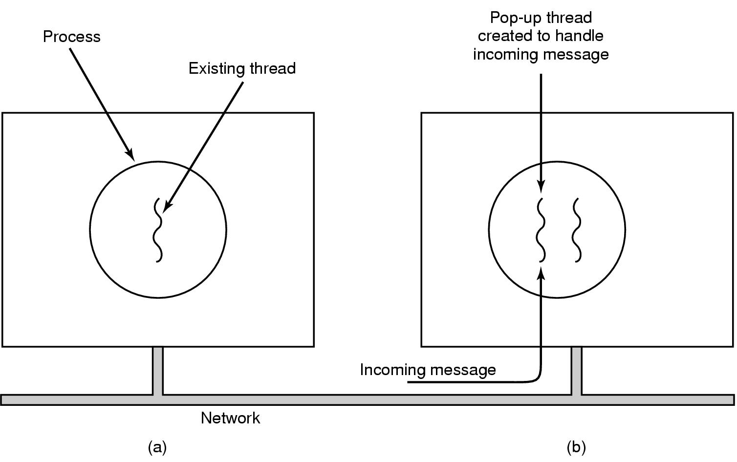
Pop-Up Threads
Creation of a new thread when message arrives
  (a) before message arrives
  (b) after message arrives
Thread pools

Slide 12
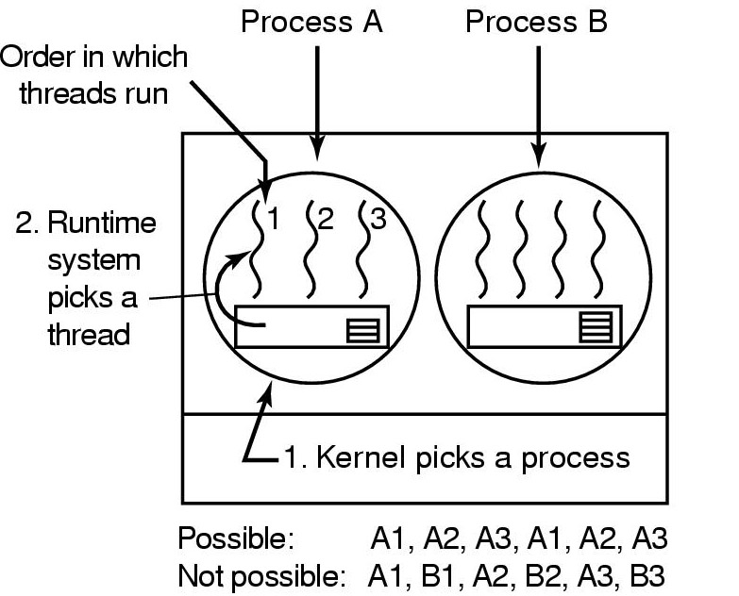
Thread Scheduling (1)
B1, B2, B3
Possible scheduling of user-level threads
50-msec process quantum
threads run 5 msec/CPU burst

Slide 13
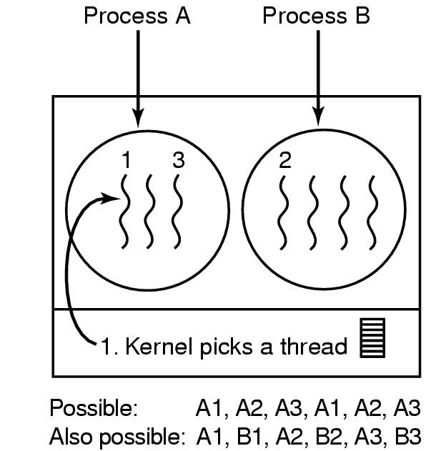
Thread Scheduling (2)
B1, B2, B3
Possible scheduling of kernel-level threads
50-msec process quantum
threads run 5 msec/CPU burst

Slide 14
Thread as a unit of work
A thread is a unit of work to a CPU. It is strand of control flow.
A traditional UNIX process has a single thread that has sole possession of the process’s memory and resources.
Threads within a process are scheduled and execute independently.
Many threads may share the same address space.
Each thread has its own private attributes: stack, program counter and register context.

Slide 15
Pthread Library
Many thread models emerged: Solaris threads, win-32 threads
A POSIX standard (IEEE 1003.1c) API for thread creation and synchronization.
API specifies behavior of the thread library, implementation is up to development of the library.
Simply a collection of C functions.

Slide 16
Posix Library Implementation in F. Mueller’s Paper
Language Application
Language Interface
C Language Application
Posix thread library
Unix libraries
User Level
Unix Kernel
Kernel Level

Slide 17
Creating threads
Always include pthread library:
#include <pthread.h>
int pthread_create (pthread_t *tp, const pthread_attr_t * attr, void *(* start_routine)(void *), void *arg);
This creates a new thread of control that calls the function start_routine.
It returns a zero if the creation is successful, and thread id in tp (first parameter).
attr is to modify the attributes of the new thread. If it is NULL default attributes are used.
The arg is passing arguments to the thread function.

Slide 18
Using threads
1. Declare a variable of type pthread_t
2. Define a function to be executed by the thread.
3. Create the thread using pthread_create
Make sure creation is successful by checking the return value.
4. Pass any arguments need through’ arg (packing and unpacking arg list necessary.)
5. #include <pthread.h> at the top of your header.
6. Compile:
g++ -o executable file.cc -lpthread

Slide 19
Thread’s local data
Variables declared within a thread (function) are called local data.
Local (automatic) data associated with a thread are allocated on the stack. So these may be deallocated when a thread returns.
So don’t plan on using locally declared variables for returning arguments. Plan to pass the arguments thru argument list passed from the caller or initiator of the thread.

Slide 20
Thread termination (destruction)
Implicit : Simply returning from the function executed by the thread terminates the thread. In this case thread’s completion status is set to the return value.
Explicit : Use thread_exit.
Prototype: void thread_exit(void *status);
The single pointer value in status is available to the threads waiting for this thread.

Slide 21
Waiting for thread exit
int pthread_join (pthread_t tid, void * *statusp);
A call to this function makes a thread wait for another thread whose thread id is specified by tid in the above prototype.
When the thread specified by tid exits its completion status is stored and returned in statusp.

Slide 22
Summary
We looked at
  Implementation of threads.
  thread-based concurrency.
  Pthread programming
We will look at a pthread programming demo
See
https://computing.llnl.gov/tutorials/pthreads/

