Slide 1
From Smart contract to Dapps(Ch04) – Part 2 updated
B. RAMAMURTHY
©2019, ALL RIGHTS RESERVED
BINA@BUFFALO.EDU
HTTP://WW.CSE.BUFFALO.EDU/FACULTY/BINA
TEACHING PROFESSOR
COMPUTER SCIENCE AND ENGINEERING
DIRECTOR, BLOCKCHAIN THINKLAB
PROGRAM DIRECTOR, DATA-INTENSIVE COMPUTING PROGRAM

Slide 2
Topics for discussion
Read chapter 4 of the text book
The architectural model of a Dapp
Using the Truffle IDE for developing Dapps
Connecting the front end to the smart contract
The MetaMask browser plugin
Deploying and testing an end-to-end Dapp
Summary

Slide 3
READ READ READ
Fiction or non-fiction
Poetry or prose
Technical or non-technical
Always have a book next to you
Read to learn how to program
Test your SC: positive and negative test
Now develop the <Dapp-app>
--Bina

Slide 4

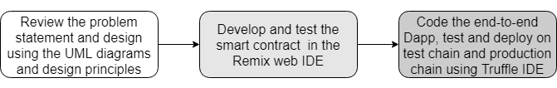
How to develop a Dapp?
You must understand Dapp programming is not your traditional programming. There are many new concepts that you must understand before you start coding.

Slide 5
Dapp web application development
You’ll need these elements for the web application part of the Dapp
HTML, JavaScript, and CSS for rendering the server contents for user interaction
A server to host the base entry script defined in index.js
Server code (app.js) linking the web server and web client
Additional wrappers and plugins for any frameworks such as Bootstrap and the web3 API
Package configuration files such as package.json

Slide 6
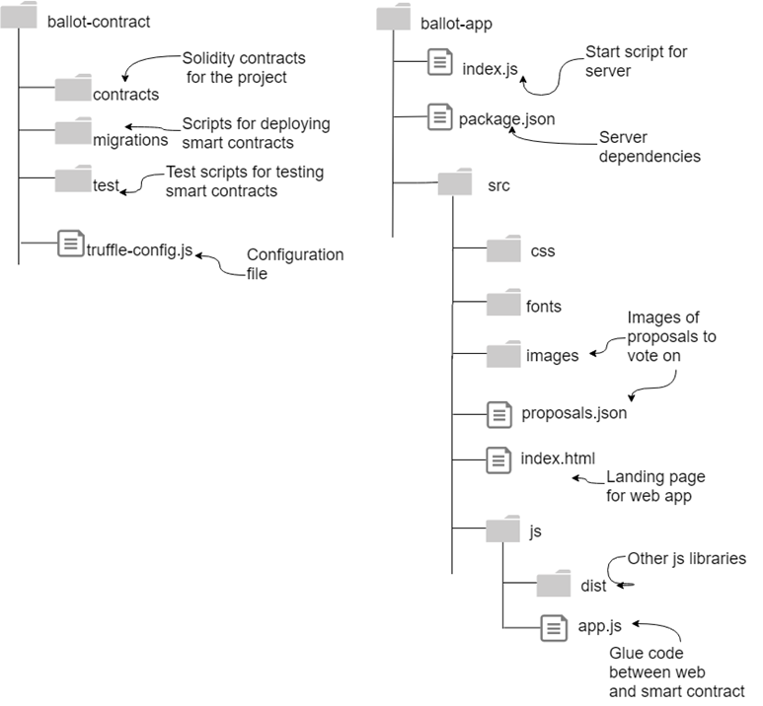
Ballot -Dapp
Part 1:
ballot-contract

Slide 7
You’ll need these tools
Operating system—Linux Ubuntu 18.04
Web server for the web client interface—Node.js
Package manager—npm
IDE—Truffle
Smart contract language toolchain—Solidity (comes with Truffle suite)
Browser/web client—Chrome and the MetaMask (LTS) plugin
Editor—Atom, gedit, or any other of your choice

Slide 8
Install required software
STOP
Truffle: v5.0.27
latest is 5.0.36
https://www.npmjs.com/package/truffle
Node: v10.15.3
latest : v10.16.3.
https://nodejs.org/en/
Solidity : 0.5.8 (latest is 0.5.12)
npm: 6.4.1
latest is 6.11.3
https://www.npmjs.com/get-npm
ganache v2.1.1
https://www.trufflesuite.com/ganache

Slide 9
Dapp-contract : ballot-contract
So far you used Remix IDE: that is for learning the smart contract features
Now let’s move onto Truffle IDE (or suite of tools)
How do you create the Dapp-contract directory structure? Truffle uses a standard structure
mkdir ballot
cd ballot
mkdir ballot-app
mkdir ballot-contract
cd ballot-contract
truffle init
ls
And truffle init automatically creates the folder and files and you’ll see this:
contracts migrations test truffle-config.js

Slide 10
Contents ballot-contract folder
contracts/—Contains the Solidity source files for your smart contracts. There is an important contract in here called Migrations.sol; this is the smart contract facilitating deployment.
migrations/—Truffle uses a migration system to handle smart contract deployments. A migration is an additional script (in JavaScript) that keeps track of changes in the contracts under development.
test/—Contains both JavaScript and Solidity tests for your smart contracts.
truffle-config.js—Truffle configuration file, containing for example configuration for the blockchain network ID, IP, and RPC port number.

Slide 11
Adding the smart contract (s) and configuring
Now add the Ballot.sol you have tested in Remix IDE into the contracts directory
Confguring testchain and rpc port in truffle-config.js
module.exports = {
// See <http://truffleframework.com/docs/advanced/configuration>
// to customize your Truffle configuration for the RPC port
networks: {
development: {
host: "localhost",
port: 7545,
network_id: "5777"
}
}
};

Slide 12
Adding the smart contract (s) and configuring
In the migrations directory, add a file 2_deploy_contracts.js that specifies the SC to deploy and provides any parameters to be sent to the constructor.
var Ballot = artifacts.require("Ballot");
module.exports = function(deployer) {
deployer.deploy(Ballot,4);
};
Now you are ready to deploy the SC; assuming that you’ve addressed any compile errors in your Remix env, you can directly use truffle migrate command as shown below:
truffle migrate --reset
The reset option deletes any earlier deployment of the same contract – used only during testing and prototyping and not in production
You can test it using truffle console (CLI) : see Chapter 4 for detailed instructions.

Slide 13
Dapp-app : ballot-app
Now your SC (s), ballot.sol in this case is deployed and ready.
Next step is to get the web UI ready and link it to the deployed contract. For this you’ll need these skills:
HTML, JavaScript, and CSS for rendering the server contents for user interaction
A server to host the base entry script defined in index.js
Server code (app.js) linking the SC via web server and web client
Additional wrappers and plugins for any frameworks such as Bootstrap and the web3 API
Package configuration files such as package.json

Slide 14
Dapp-app: ballot –app : more details
Part 2:
ballot-app

Slide 15
ballot-app
Navigate to Ballot-Dapp
cd ballot-app
npm init
This command will ask you a series of question to configure your application including a index.js for the Node.js server; accept all of the default options.
Then edit the package.json created by the above command to add two items:
The filename of the script for starting the Node.js server (index.js)
A dependency on the express module for defining the web application
package.json file will look like this:
{
"name": "ballot-app",
"version": "1.0.0",
"description": "",
"main": "index.js",
"scripts": {
"start": "node index.js"
},
"author": "",
"license": "ISC",
"dependencies": {
"express": "^4.16.4"
}
}

Slide 16
package.json
{
"name": "ballot-app",
"version": "1.0.0",
"description": "",
"main": "index.js",
"scripts": {
"start": "node index.js"
},
"author": "",
"license": "ISC",
"dependencies": {
"express": "^4.16.4"
}
}
Note: Express is the web application framework for the Node.js server; you’ll use the express module to specify the script for the entry point of the server. I’ll refer to the web server as the Node.js server instead of the Node server to distinguish it from the blockchain node.

Slide 17
index.js: express framework based web application base
Create the rest of the directory shown in slide 14:index.js, src, and the rest.
Now let’s examine the index.js file that defines the web application.
It defines the request and response functions and the port number for the Node.js server.
For this initial deployment you used nom init; for subsequent deployments you can use npm install (instead of npm init) to deploy all the required Node.js modules.
var express = require('express');
var app = express();
app.use(express.static('src'));
app.use(express.static('../ballot-contract/build/contracts'));
app.get('/', function (req, res) {
res.render('index.html');
});
app.listen(3000, function () {
console.log('Example app listening on port 3000!');
});

Slide 18
src directory and the all important app.js
The only other directory in ballot-app is the src directory, which contains:
The usual artifacts for a web page (CSS, fonts, images, JavaScript)
The landing page for the web application (index.html)
proposals.json, which holds details about the proposals being voted on (images for the proposals are in the images subdirectory)
app.js, the glue code connecting the web server layer and the contract layer

Slide 19
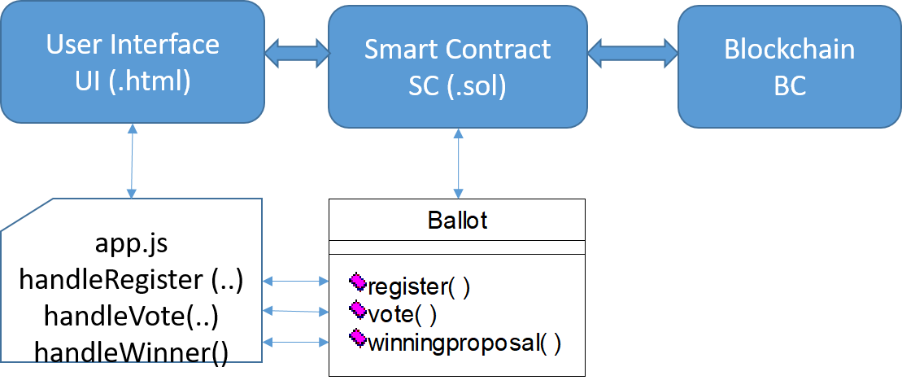
Positioning app.js (role of app.js)
You have to write a specific (app.js) for your Dapp.
This function is reqWinner()

Slide 20
Ballot.zip exploration
Ballot.zip has all these items discussed
Now let’s work with the ballot.zip and interact with ballot.sol
npm install
npm start
Review managing the accounts and interaction with with Metamask
Right-click the MetaMask icon (a fox) and connect to the custom RPC at http://127.0.0.1:7545.
Type your Ganache seed words in the response screen that appears.
Choose a password and type it in; later on you’ll be able to use this password to unlock MetaMask without entering the seed words; (use a password that’s easy to remember during the testing phase).
Now you are ready to interact with ballot Dapp; open the application at localhost:3000 and interact.

Slide 21
Part 2: Focus on app.js for your Dapp
App.js connects to the sc using ballot ABI and address.
It has minimally a handler for each of the public function of the SC; these handlers route the web interaction to access SC functions as Txs.
Examine app.js, learn how it is written and use it as guideline to write the app.js for your Dapp. This will require some effort.
Also web UI, just mimick the Remix UI and add images. Images are defined in proposals.json
If your application is not significant enough, you will have no work in the web app development. You know what that means…
Good luck and get working on part 2 of lab1.
Also look around for an idea for Lab2.

