Slide 1
Exam 1 Review

Slide 2
Reading material and topics
Chapter 1, 2,3,
Chapter 4 only up to smart contract
Class notes
Solidity Read the Docs
Topics:
Blockchain architecture; structure, stack and operations
Problem solving : write a SC
Problem solving: write and use modifiers
4. Problem solving: design representation: use case and contract diagram

Slide 3
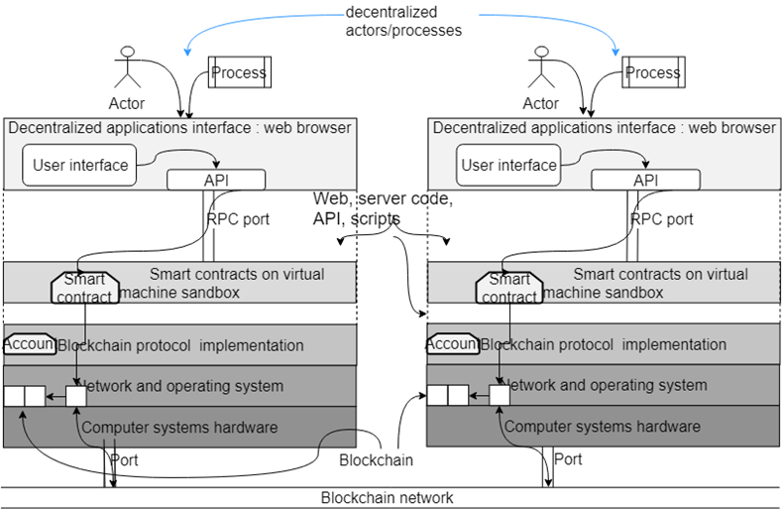
1. Blockchain structure: Dapp stack model

Slide 4
2. Writing an SC
Basic structure of SC
Uint, struct, array, mapping, address data types
Functions syntax ( msg.sender, msg.value etc., simple arithmetic)
Simple if statement, for loop
No modifiers in this question
View function, public function, use of payable

Slide 5
Here is an example
pragma solidity ^0.5.2;
contract SampleSC{
//data
mapping (address=>uint) public donation;
uint public deposit;
constructor() public payable
{
deposit = msg.value;
donation[msg.sender] = msg.value;
}
function sendEther() public payable
{
deposit = address(this).balance;
donation[msg.sender] = msg.value;
} }

Slide 6
3. Write and use modifiers, require etc.
Define a modifier
Modifier with messages
Use a modifier
Example from Counter.sol
modifier checkIfGreaterThanZero(uint n){
require(value >= n, 'Counter can not become negative.');
_;
}
Usage:
function decrement (uint n) public checkIfGreaterThanZero(n) {
value = value - n;
}

Slide 7
4. Design representations: UML diagrams
Use case diagram : plan, requirements
Contract diagram : static design
Sequence diagram : captures dynamics

