Slide 1
Explore Txs, block, blockchain in Bitcoin
Bina Ramamurthy

Slide 2
The Concept of a UTXO
UTXO: Unspent Transaction Output is a fundamental concept of a bitcoin network.
The set of all the UTXO’s the Bitcoin network collectively define the state of the Blockchain.
The structure of a UTXO is very simple: the amount, address (or public key) of the recipient and a signature (script).
UTXOs are referenced as inputs in a transaction (Tx)
UTXOs are also outputs generated by the Tx.
All the UTXOs in the system are stored by the full nodes.

Slide 3
The Transaction (Tx)
A Tx uses the amount specified by 1 or more input UTXOs and transfers them to 1 or more newly created UTXOs according to the request initiated by the sender.
Reference Number
Input
UTXO1
UTXO2
…
UTXOn
Output
UTXO1
UTXO2
…
UTXOm
Other data

Slide 4
Sample Actual Transaction
In a actual Bitcoin Blockchain transaction you will see next, we will identify
Reference number of the current transaction
Reference(s) to one or more UTXOs
References to one or more newly created UTXOs generated by the current Tx
Total input amount and output amount
Participants can & do validate the transaction contents: Is the UTXOs referenced in the input exist in the network state?

Slide 5
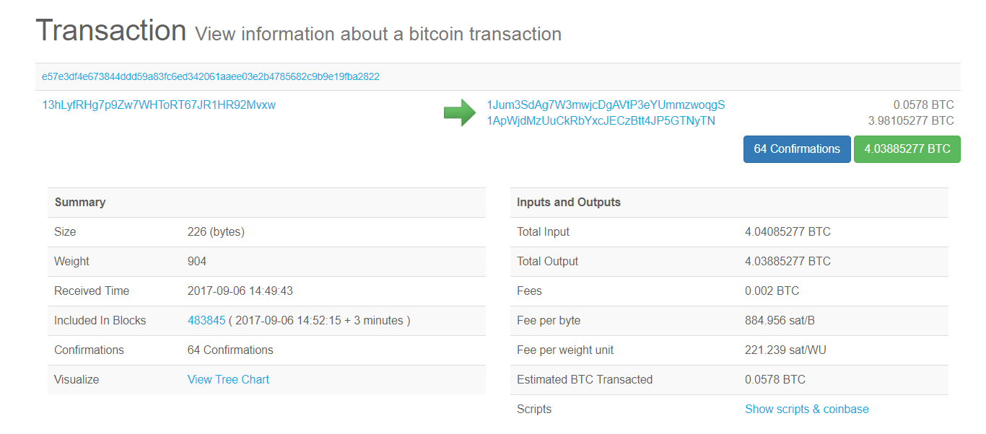
Sample Transaction
1
2
3
4

Slide 6
Blockchain: The Block
Transactions
Eve
Candidate
Block
Validate &
Gather,
Broadcast
Transactions
Consensus &
Verify &
Confirm
Block
Block
Block

Slide 7
Block structure
Block Header
Transactions

Slide 8
Genesis Block where it all began.
https://blockchain.info/block/000000000019d6689c085ae165831e934ff763ae46a2a6c172b3f1b60a8ce26f
Satoshi Nakamoto initiated the Bitcoin Blockchain with one transaction of 50BTC.
This one transaction created a UTXO for Hal Finney address.
Let's briefly explore this Block#0 for posterity sake. (We did that last class!)

Slide 9
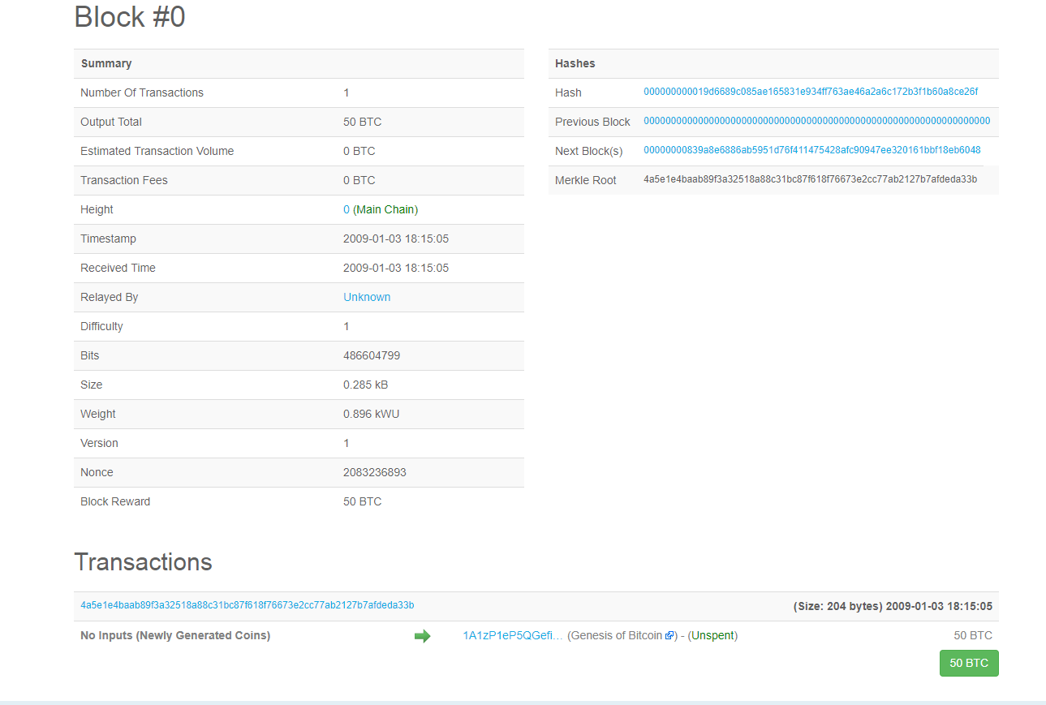
Genesis Block

Slide 10
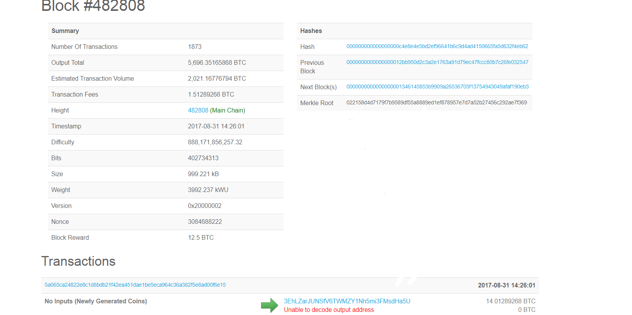
Sample Block (#482808 on Bitcoin Blockchain)
Current block’s hash
hash(1,2,3)
2
Hash of previous
block header
Hash of transactions
1
Nonce 3
Transactions

Slide 11
Blockchain: Chain of Blocks
Transactions
Candidate
Block
Validate &
Gather,
Broadcast
Transactions
Consensus &
Verify &
Confirm
Block
Block
Block

Slide 12
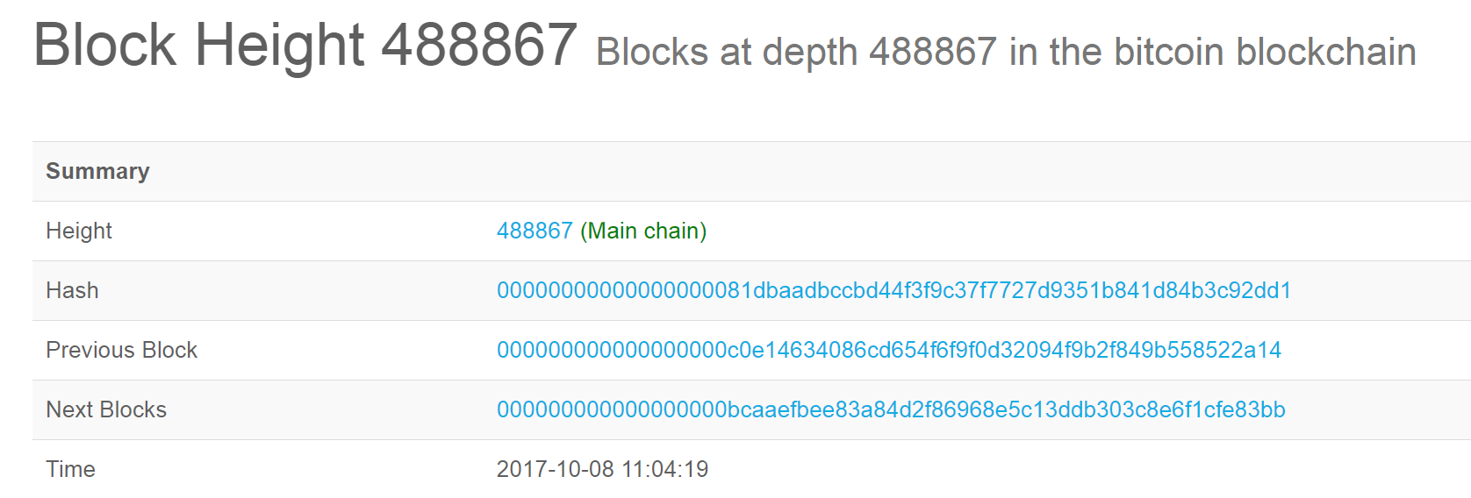
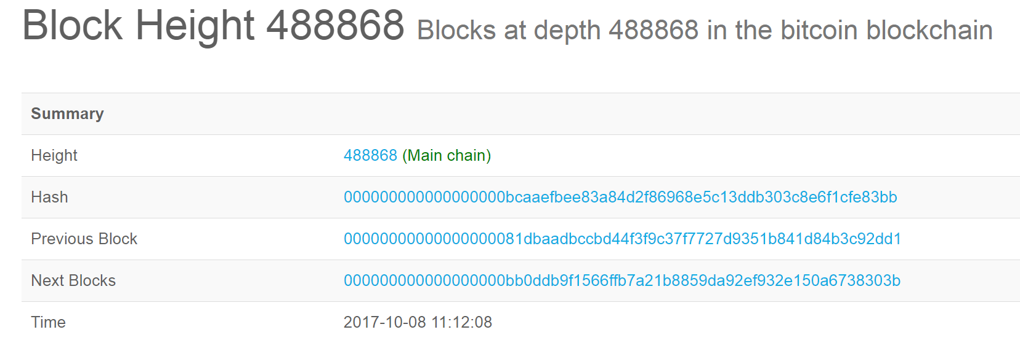
Chain of Three Blocks: 488867--488868--488869
Let's consider three blocks and see how they are chained together without going into technical details.

Slide 13
Overview
Operations in the decentralized network are the responsibility of the peer participants and their respective computational nodes (e.g. laptop, desktop, server racks).
These operations include: validation of transactions, gathering the transactions for a block, broadcasting valid transactions and blocks, consensus on the next block creation, rejecting double spending of value, and chaining the blocks to form a immutable record.
In this lesson we will explore some of the fundamental operations of the Bitcoin Blockchain.

Slide 14
Roles of Participants (convert to figure)
Two major roles:
Participants that only initiate transfer of value (digital currency) by creating a transaction. $$$
Participants called miners who take on added work (computation) to verify transactions, broadcast transactions, compete to claim the right to create a block, work on reaching consensus by validating the block, broadcasting the newly created block and confirming transactions.
Miners are incentivized with bitcoins for their efforts in managing the Blockchain.

Slide 15
Transaction Verification (convert to fig)
Transaction Validation
Tx validation is independently carried out by the all miners.
The process involves validation of more than 20 criteria including the size, syntax, etc. Some of these are:
Referenced input UTXOs are valid.
Referenced output UTXOs are correct
Referenced input amount and output amount match sufficiently
Input UTXO referenced has not already been used (double spending)
Invalid Txs are rejected and will not be broadcast.

Slide 16
Adding a New Block to the Chain
Miners aggregate a sequence of validated transactions to create a block.
Challenge: If everyone of them adds their block to the chain, there will be many branches to the chain resulting in an inconsistent states. (Recall that the Blockchain is a single linked chain of blocks.) We need a system.
Solution: Miners compete by solving a puzzle to determine who will earn the right to create the next block. In the case of the Bitcoin Blockchain this puzzle is a computational puzzle and is CPU-intensive. (We will learn the details later in lesson 4).

Slide 17
Consensus Protocol
Once a miner solves this puzzle, the announcement is broadcast to the network, and the block is also broadcast to the network.
Other participants verify the new block.
Participants reach consensus (or agreement) to add a new block to the chain. This new block is added to their local copy of the Blockchain; thus a new set of transactions are recorded and confirmed.
This algorithm for consensus is called Proof-of-Work (PoW) protocol since it involves “work” or computational power to solve the puzzle and to claim the right to form the next block.

Slide 18
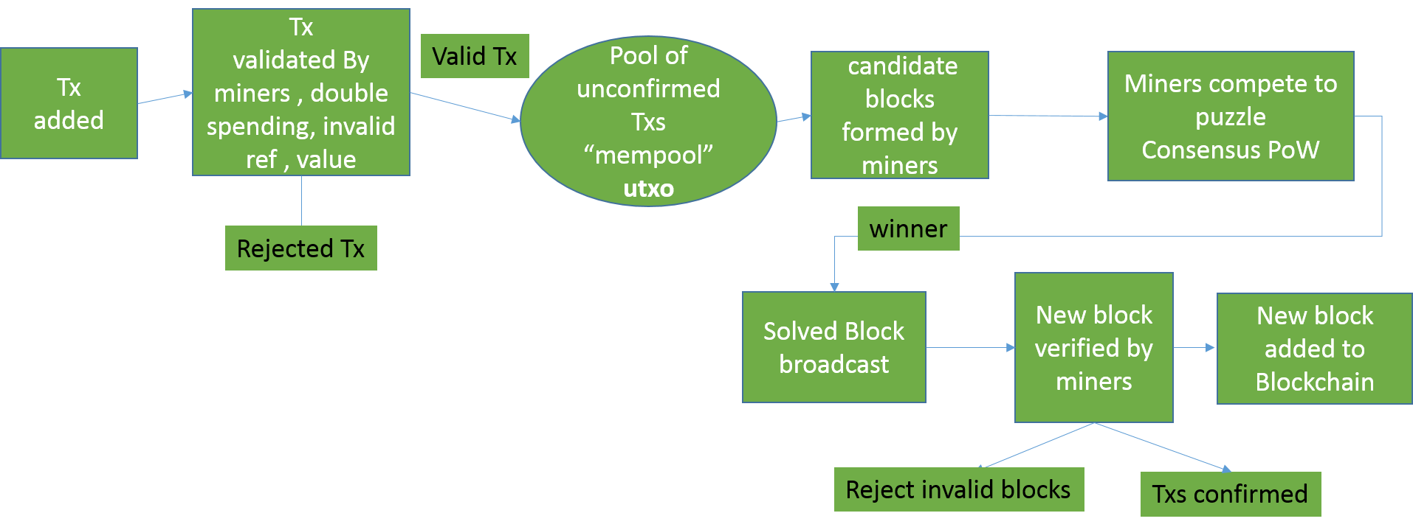
Block Creation Process

Slide 19
Beyond Bitcoin
Bitcoin Blockchain is open source and the entire code base is available on github: https://github.com/bitcoin/bitcoin
During the initial years, this open source code was extended to release different cryptocurrencies. About 300+ cryptocurrencies were introduced.
Bitcoin supports an optional and special feature called “scripts” for conditional transfer of values.
Ethereum Blockchain extended this scripting feature into a full blown code execution framework called “smart contract”. A smart contract provides the very powerful capability of “code execution” for embedding business logic on the Blockchain.

Slide 20
Summary
Hundreds of different digital currencies have emerged since the advent of the Bitcoin.
Significant innovations such as smart contract has opened up broader applications for the Blockchain technology.
Private and permissioned Blockchain allow for controlled access to the Blockchain enabling many business models.

