Slide 1
Our Blockchain Roadmap
Blockchain concepts: Tx, block, consensus process
Smart contract: Design and programming in Solidity
Decentralized application: BC, SC, UI (stack)and the glue code in web3
Security and privacy
Events and notification
On-chain and off-chain data access
Dapp models and standards

Slide 2
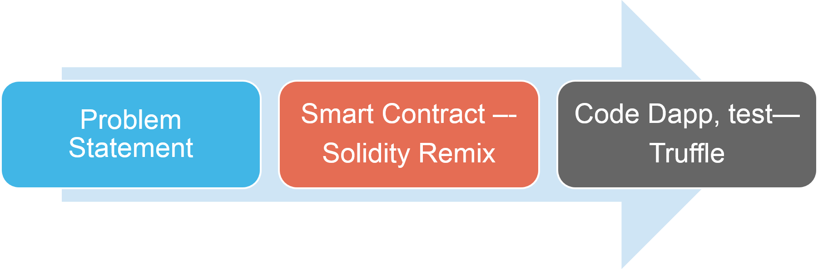
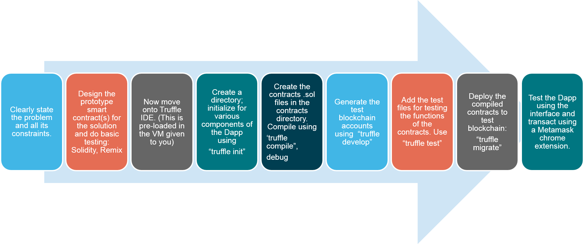
Blockchain programming (Ethereum)

Slide 3
Topics for questions
Ethereum blockchain
Smart contract coding
Solidity concepts: address, struct, mapping, account, value, modifiers, msg.sender, transfer, etc.
Dapp design given a problem: concept only
Web3 API
Security and privacy : Keccak256
256 address space

Slide 4
Questions (tentative list)
Design: contract diagram, finite state machine, sequence diagram : given a problem statement, provide these design representation of the solution
Smart contract coding using all the Solidity concepts discussed
Dapp design and Web3 details , stack, interface like :Lab1 Part2
Events; define, emit and use events
On-chain and off-chain data

Slide 5
How to study?
Classnotes on the web page for the course
Read the docs for solidity
Examples: counter, ballot, Ask, blindAuction
Run it on Remix and test your understanding and comprehension
Web3 class notes and read the docs
Dapp development directory structure
Models and standards (ERC)

Slide 6
Date, Time and Place
December 9, 2019, Monday
8.00AM – 11AM
NSC 215
Please bring
  Pencils, pens and erasers.
  Any form of ID with photograph
  Closed book exam

Slide 7
Exam format
4 questions covering the concepts discussed:
Design
Smart contract code
Event management
Dapp development

Slide 8
How to study?
Chapters 1-6 --READ
Review videos from class

