Slide 1
On-chain and off-chain Data (Chapter 6)
B. RAMAMURTHY
©2019, ALL RIGHTS RESERVED
BINA@BUFFALO.EDU
HTTP://WW.CSE.BUFFALO.EDU/FACULTY/BINA
TEACHING PROFESSOR
COMPUTER SCIENCE AND ENGINEERING
DIRECTOR, BLOCKCHAIN THINKLAB
PROGRAM DIRECTOR, DATA-INTENSIVE COMPUTING PROGRAM

Slide 2
Topics for discussion
This chapter covers
Types of data stored on-chain: Transactions, receipts, and state
Defining, activating, and logging on-chain events
Accessing event logs from transaction receipts to support Dapp operations
Designing Dapps with on-chain and off-chain data
Tools and methodology for end-to-end Dapp design and development

Slide 3
On-chain Data
This is what distinguishes blockchain application development from that of non-blockchain applications: on-chain data.
Did you wonder about where the data generated by a Dapp is stored?
Some of it is stored on the blockchain (on-chain), and some of the data is stored in traditional data stores like a database (off-chain).
In this lesson, you’ll first learn about the concept of on-chain data introduced by the inclusion of blockchain infrastructure in an application.
Then you’ll learn to design and develop Dapps that deal with on-chain and off-chain data.
So what exactly are these two types of data in the context of blockchain programming?

Slide 4
What is on-chain data?
In general, any data stored on the blockchain is called on-chain data, and anything else is off-chain.
Let’s analyze this concept further.
In a traditional system, the results of function executions in an application are persisted in a local filesystem or a central database.
In a blockchain application, transactions (Txs), smart contract function execution results, state changes (changes in variable values), and event logs are all stored on the blockchain node (on-chain), in specific storage allocated for each purpose, and propagated to all the stakeholder nodes through the consensus process specified in the blockchain protocol.
Most of the on-chain data is generated by Dapps using the blockchain.

Slide 5
On-chain data definition
Definition On-chain data is a set of interrelated information generated by a transaction invocation by an application, and the data used and generated during blockchain materialization. Most of this data is stored in a block and its header.

Slide 6
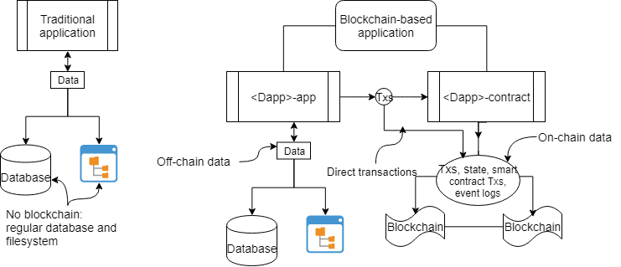
Traditional vs blockchain Dapp data

Slide 7
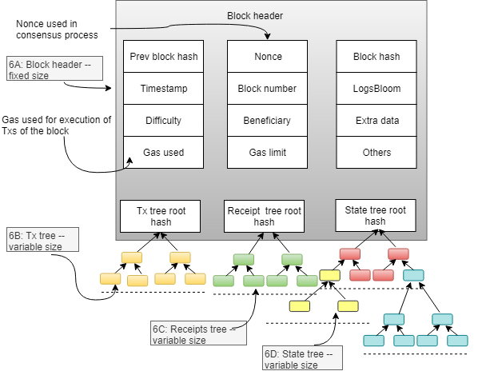
Block header

Slide 8
Events – on-chain data
The block header, Txs, receipts, and state storage—form the majority of the on-chain data.
They play a vital role in ensuring the robustness and security of the blockchain and in providing proof of existence of a Tx and of the events that happened during the execution of the Txs.
You can access the information stored in the blockchain to support operations at the application level.

Slide 9
More on events
Events are notifications that can be emitted from functions to indicate the presence of a condition or flag during a smart contract function’s execution.
Solidity provides features to define and emit an event with and without parameters.
Events are logged on-chain, in the receipt tree and can be accessed using their names.

Slide 10
Event definition and example from BA
Here is the syntax for an event definition:
event NameOfEvent (parameters);
Here’s an example of an event definition from the blind auction smart contract of blind auction:
event AuctionEnded(address winner, uint highestBid);
Emitting an event involves calling it by its name and specifying any actual parameter values. Here’s an example for triggering the AuctionEnded event:
emit AuctionEnded(highestBidder, highestbid);
Now examine the smart contract and check all the events that are added to the blind auction smart contract. Here are some more:
You can also define events without any parameters by specifying them for the different phases of the blind auction—here, Bidding and Reveal:
event BiddingStarted():
event RevealStarted();
The emit call triggers an event:
emit BiddingStarted();
emit RevealStarted();

Slide 11
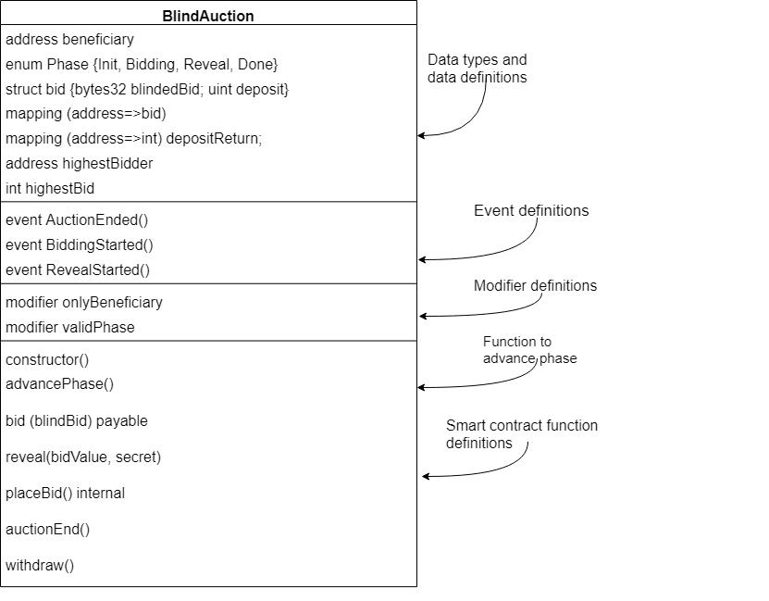
Contract diagram with events

Slide 12
Code: Let’s look at the new and improved code for blind auction

