Slide 1
On-chain and off-chain Data (Chapter 6)
B. RAMAMURTHY
©2019, ALL RIGHTS RESERVED
BINA@BUFFALO.EDU
HTTP://WW.CSE.BUFFALO.EDU/FACULTY/BINA
TEACHING PROFESSOR
COMPUTER SCIENCE AND ENGINEERING
DIRECTOR, BLOCKCHAIN THINKLAB
PROGRAM DIRECTOR, DATA-INTENSIVE COMPUTING PROGRAM

Slide 2
Topics for discussion
This chapter covers
Types of data stored on-chain: Transactions, receipts, and state
Defining, activating, and logging on-chain events
Accessing event logs from transaction receipts to support Dapp operations
Designing Dapps with on-chain and off-chain data
Tools and methodology for end-to-end Dapp design and development

Slide 3
On-chain Data
This is what distinguishes blockchain application development from that of non-blockchain applications: on-chain data.
Did you wonder about where the data generated by a Dapp is stored?
Some of it is stored on the blockchain (on-chain), and some of the data is stored in traditional data stores like a database (off-chain).
In this lesson, you’ll first learn about the concept of on-chain data introduced by the inclusion of blockchain infrastructure in an application.
Then you’ll learn to design and develop Dapps that deal with on-chain and off-chain data.
So what exactly are these two types of data in the context of blockchain programming?

Slide 4
What is on-chain data?
In general, any data stored on the blockchain is called on-chain data, and anything else is off-chain.
Let’s analyze this concept further.
In a traditional system, the results of function executions in an application are persisted in a local filesystem or a central database.
In a blockchain application, transactions (Txs), smart contract function execution results, state changes (changes in variable values), and event logs are all stored on the blockchain node (on-chain), in specific storage allocated for each purpose, and propagated to all the stakeholder nodes through the consensus process specified in the blockchain protocol.
Most of the on-chain data is generated by Dapps using the blockchain.

Slide 5
On-chain data definition
Definition On-chain data is a set of interrelated information generated by a transaction invocation by an application, and the data used and generated during blockchain materialization. Most of this data is stored in a block and its header.

Slide 6
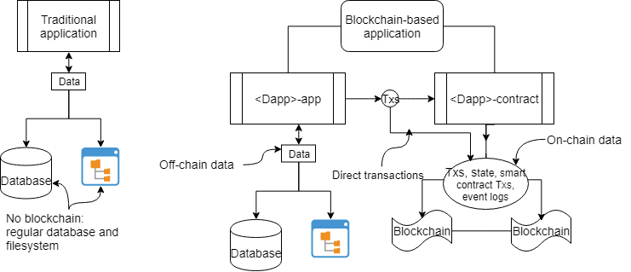
Traditional vs blockchain Dapp data

Slide 7
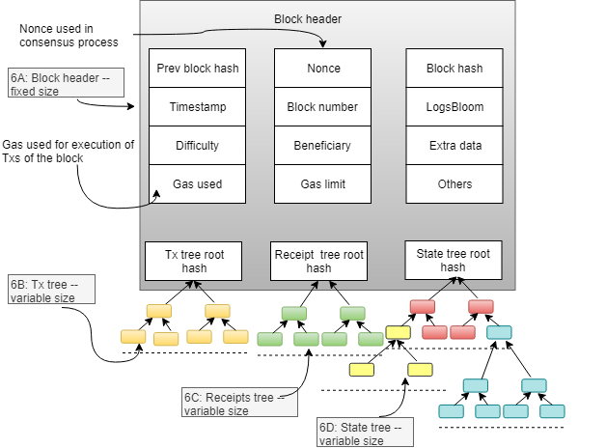
Block header

Slide 8
Events – on-chain data
The block header, Txs, receipts, and state storage—form the majority of the on-chain data.
They play a vital role in ensuring the robustness and security of the blockchain and in providing proof of existence of a Tx and of the events that happened during the execution of the Txs.
You can access the information stored in the blockchain to support operations at the application level.

Slide 9
More on events
Events are notifications that can be emitted from functions to indicate the presence of a condition or flag during a smart contract function’s execution.
Solidity provides features to define and emit an event with and without parameters.
Events are logged on-chain, in the receipt tree and can be accessed using their names.

Slide 10
Event definition and example from BA
Here is the syntax for an event definition:
event NameOfEvent (parameters);
Here’s an example of an event definition from the blind auction smart contract of blind auction:
event AuctionEnded(address winner, uint highestBid);
Emitting an event involves calling it by its name and specifying any actual parameter values. Here’s an example for triggering the AuctionEnded event:
emit AuctionEnded(highestBidder, highestbid);
Now examine the smart contract and check all the events that are added to the blind auction smart contract. Here are some more:
You can also define events without any parameters by specifying them for the different phases of the blind auction—here, Bidding and Reveal:
event BiddingStarted():
event RevealStarted();
The emit call triggers an event:
emit BiddingStarted();
emit RevealStarted();

Slide 11
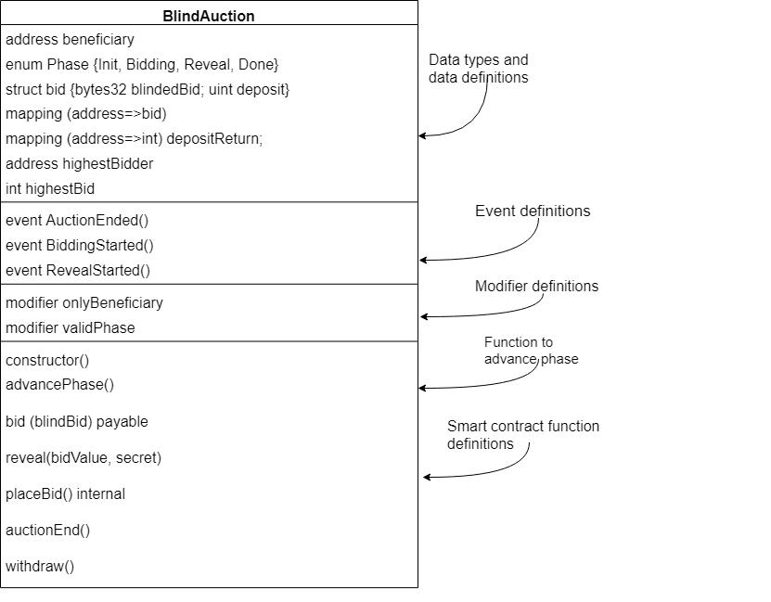
Contract diagram with events

Slide 12
Code: Let’s look at the new and improved code for blind auction

Slide 13
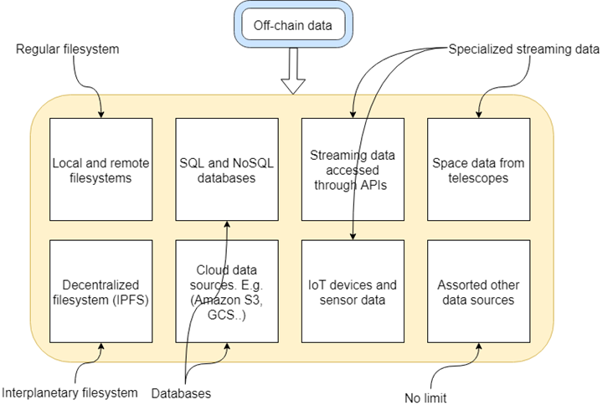
Off-chain data

Slide 14
Design Principle 8
DESIGN PRINCIPLE 8: Design smart contracts with only the functions and data needed for enforcing rules, compliance, regulation, provenance, logs for real-time notifications, and timestamped footprints and messages about offline operations.

Slide 15
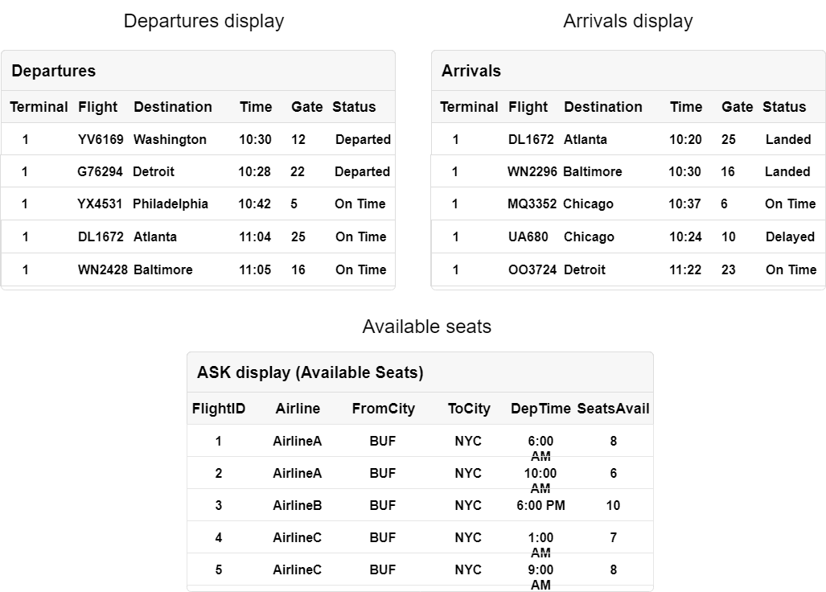
ASK Airline Consortium

Slide 16
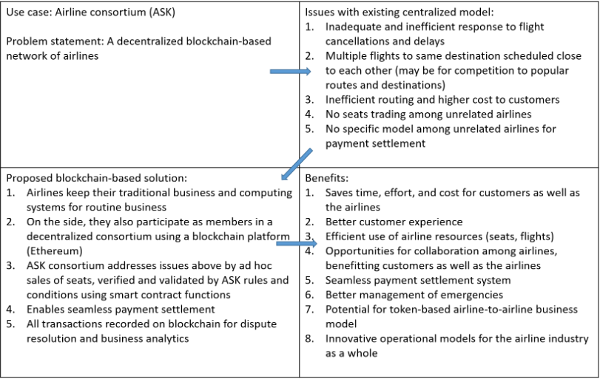
Quad chart ASK

Slide 17
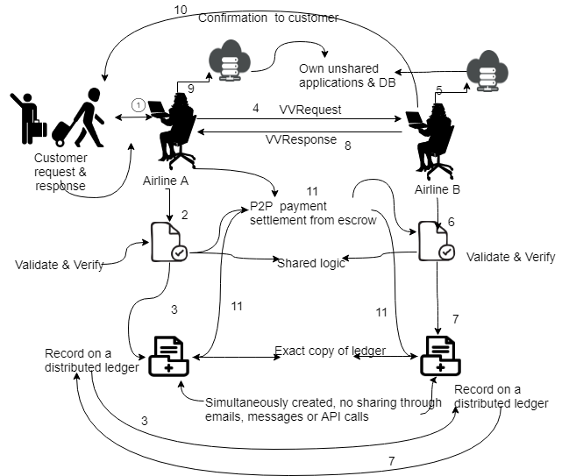
ASK concept diagram

Slide 18
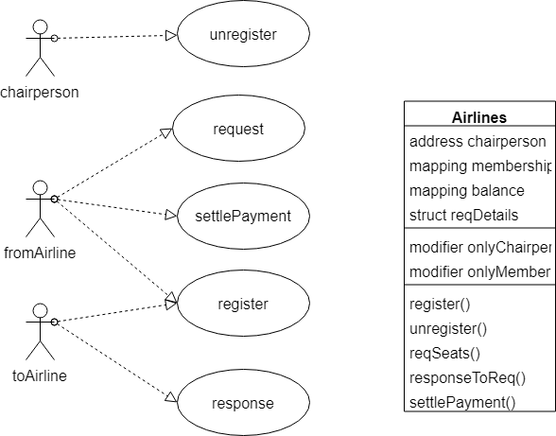
ASK Use case diagram

Slide 19
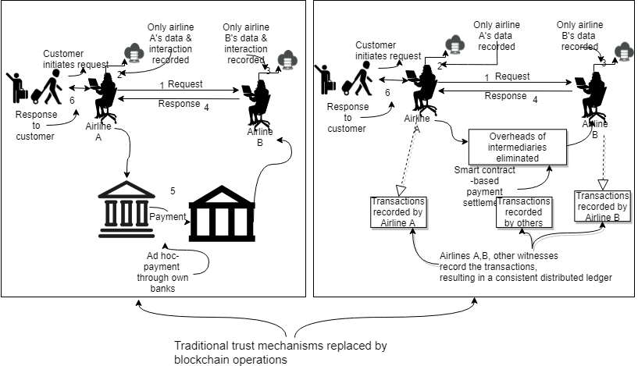
ASK Use case diagram

Slide 20
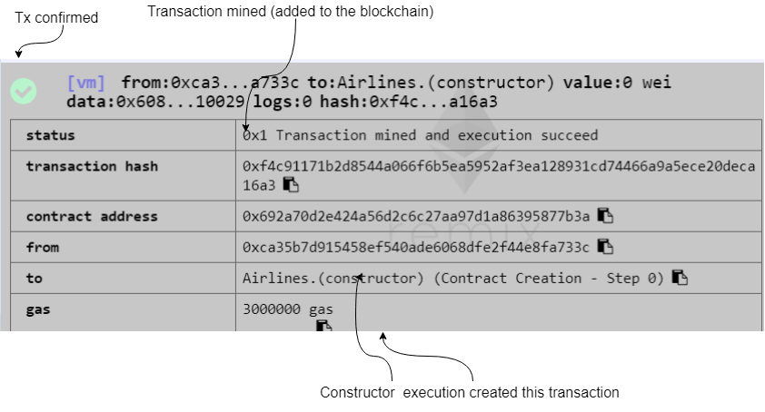
ASK Remix confirmation

