Slide 1
On-chain and off-chain Data (Chapter 6)
B. RAMAMURTHY
©2019, ALL RIGHTS RESERVED
BINA@BUFFALO.EDU
HTTP://WW.CSE.BUFFALO.EDU/FACULTY/BINA
TEACHING PROFESSOR
COMPUTER SCIENCE AND ENGINEERING
DIRECTOR, BLOCKCHAIN THINKLAB
PROGRAM DIRECTOR, DATA-INTENSIVE COMPUTING PROGRAM

Slide 2
Topics for discussion
This chapter covers
Types of data stored on-chain: Transactions, receipts, and state
Defining, activating, and logging on-chain events
Accessing event logs from transaction receipts to support Dapp operations
Designing Dapps with on-chain and off-chain data
Tools and methodology for end-to-end Dapp design and development

Slide 3
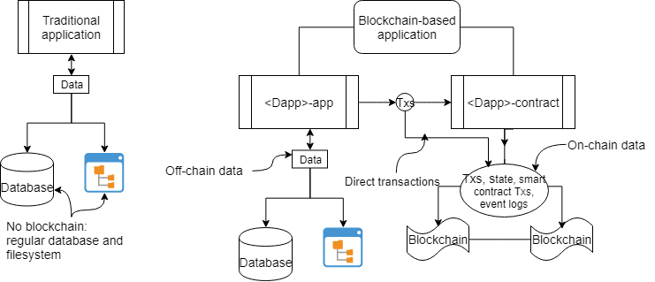
Traditional vs blockchain Dapp data

Slide 4
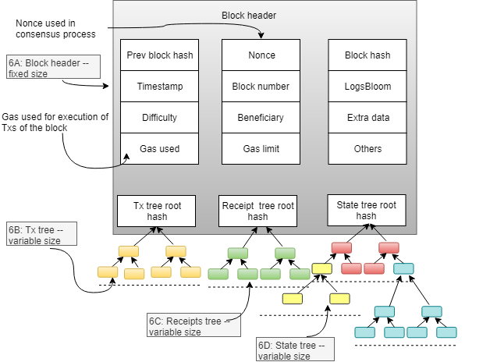
Block header

Slide 5
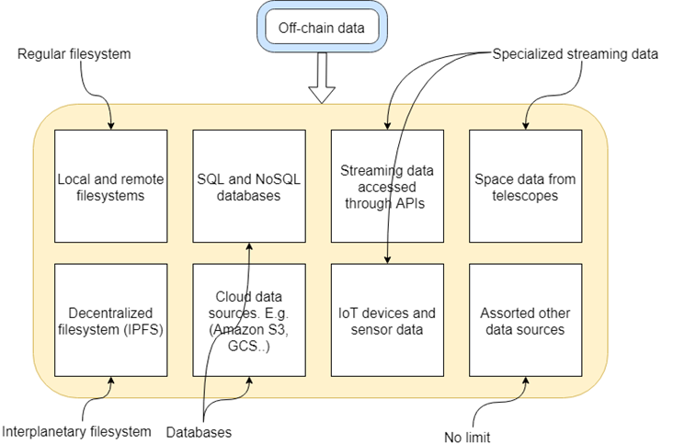
Off-chain data

Slide 6
Design Principle 8
DESIGN PRINCIPLE 8: Design smart contracts with only the functions and data needed for enforcing rules, compliance, regulation, provenance, logs for real-time notifications, and timestamped footprints and messages about offline operations.

Slide 7
ASK details
ASK illustrates many blockchain concepts, including:
Coexistence of a traditional centralized system and a decentralized blockchain system as parts of a larger system
Off-chain and on-chain data (the topic of this chapter)
Use of cryptocurrency (tokens) while keeping your fiat currency for regular operations
End-to-end Dapp development using the Truffle IDE

Slide 8
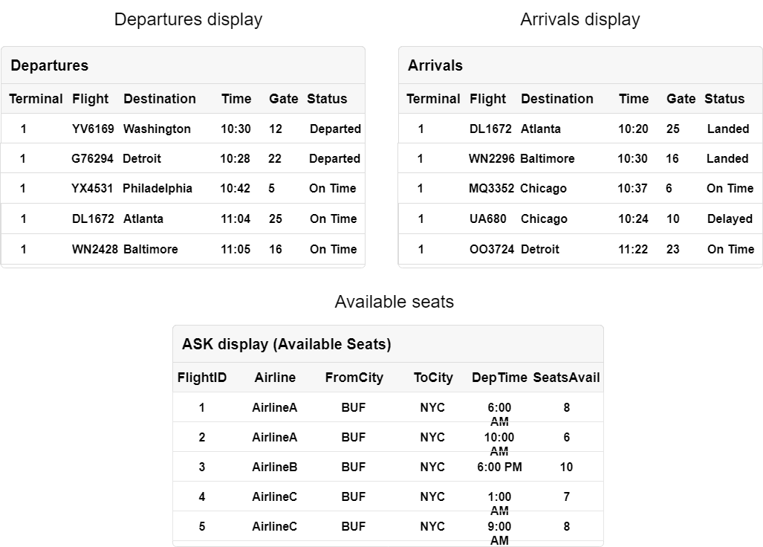
ASK Airline Consortium

Slide 9
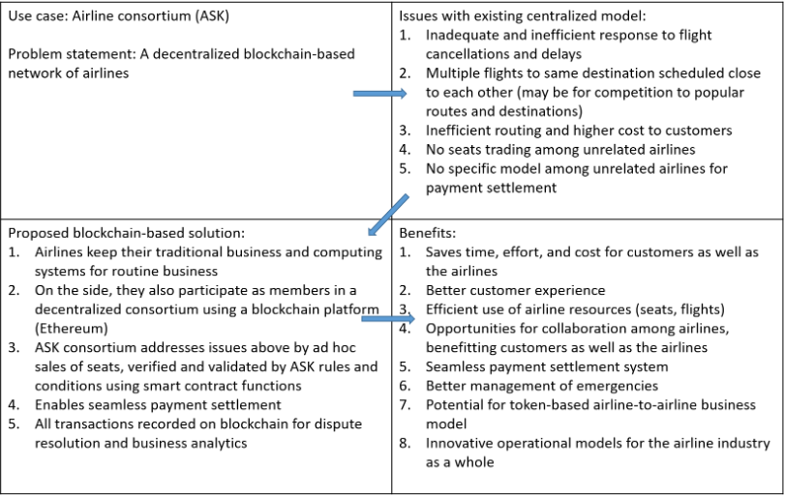
Quad chart ASK

Slide 10
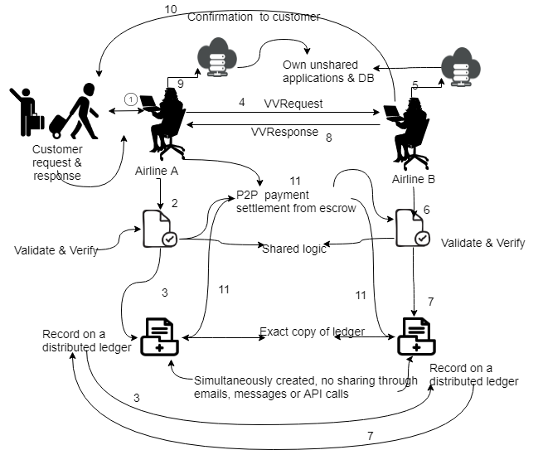
ASK concept diagram

Slide 11
Operations 1-11 : ASK
1. A customer initiates a change of flight seat on airline A.
2. An agent or application at airline A verifies and validates the request through application logic shared among the ASK consortium members.
3. Once verified, the request Tx is confirmed and recorded in a distributed immutable ledger. Now everyone in the consortium knows that a legitimate request has been made.
4. In the simplest design, an agent at airline A sends the verified and validated request (VVRequest) to airline B. (Alternatively, we could use a broadcast model where many airlines get the request, and any one of them could respond.)
5. An agent or application at airline B checks the airline’s database to check for availability.
6. An agent at airline B responds through shared logic that verifies and validates the common interests and shared rules of the consortium.
7. Once verified, the response Tx is confirmed and recorded in a distributed immutable ledger. Now everyone in the consortium knows that a response has been sent.
8. Airline B sends the response (indicated by VVResponse) to the agent at airline A.
9. Airline A updates its database.
10. An agent at airline B now sends the customer the information for the flight seats and other details. (Note that airline B holds its own digital assets and does not transfer them to airline A but directly to the customer.)
11. Payments are settled through peer-to-peer Txs using the escrow or deposit that participating airlines hold in their shared logic. The payment settlement can be embedded into other suitable operations in the system, but will be handled by the shared logic and recorded in the ledger.

Slide 12
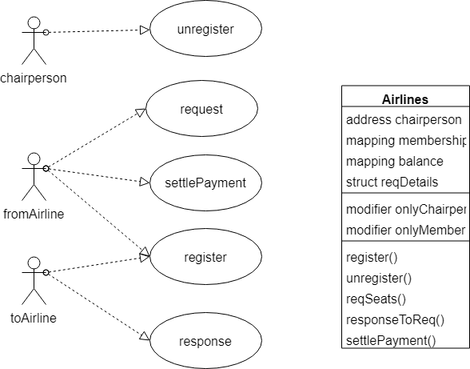
ASK Use case diagram

Slide 13
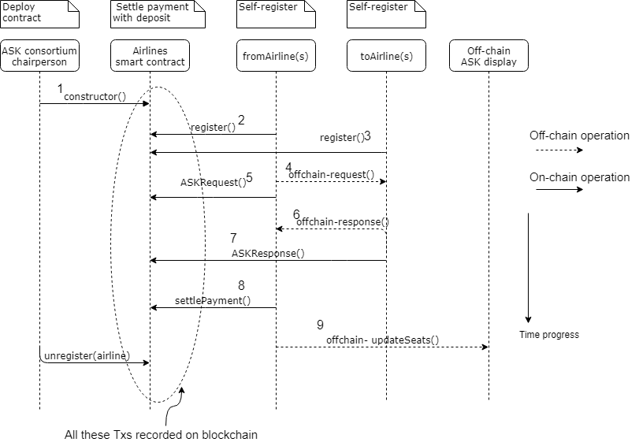
Sequence diagram

Slide 14
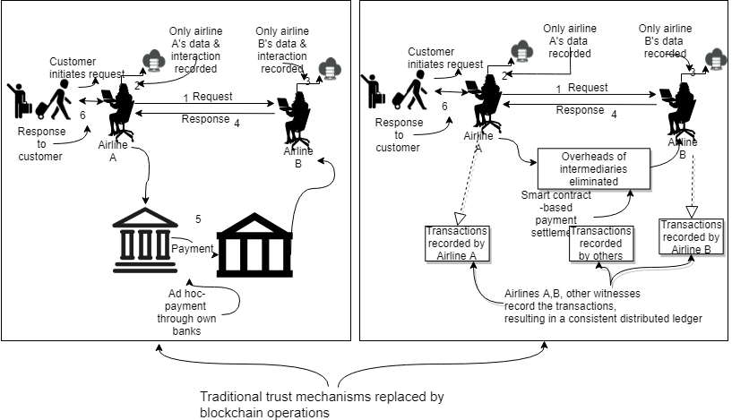
ASK Use case diagram

Slide 15
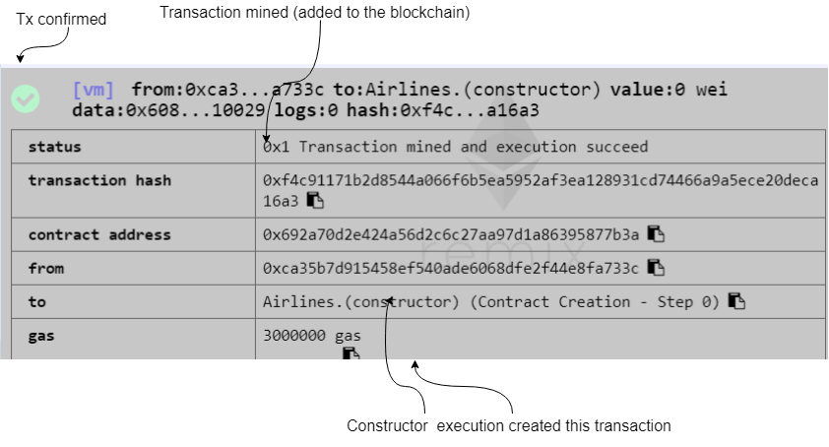
ASK Remix confirmation

Slide 16
ASK smart code
ASK.sol

Slide 17
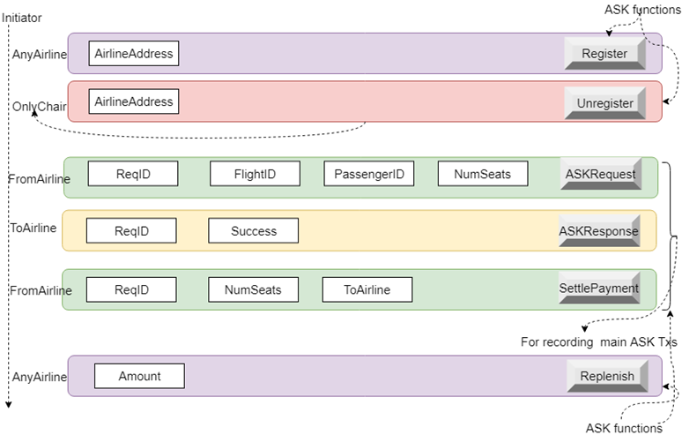
ASK UI

