Slide 1
From Smart contract to Dapps(Ch04)
B. RAMAMURTHY
©2019, ALL RIGHTS RESERVED
BINA@BUFFALO.EDU
HTTP://WW.CSE.BUFFALO.EDU/FACULTY/BINA
TEACHING PROFESSOR
COMPUTER SCIENCE AND ENGINEERING
DIRECTOR, BLOCKCHAIN THINKLAB
PROGRAM DIRECTOR, DATA-INTENSIVE COMPUTING PROGRAM

Slide 2
Topics for discussion
Read chapter 4 of the text book
The architectural model of a Dapp
Using the Truffle IDE for developing Dapps
Connecting the front end to the smart contract
The MetaMask browser plugin
Deploying and testing an end-to-end Dapp
Summary

Slide 3
READ READ READ
Fiction or non-fiction
Poetry or prose
Technical or non-technical
Always have a book next to you
Read to learn how to program
--Bina

Slide 4
Status of Lab1 Part1
Title
Problem statement
Use case diagram
Contract diagram
Make a list of what functions and what modifiers, what data
Incrementally develop SC

Slide 5

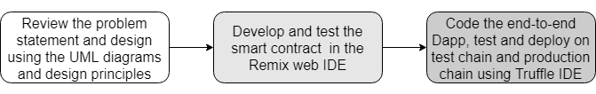
How to develop a Dapp?
You must understand Dapp programming is not your traditional programming. There are many new concepts that you must understand before you start coding.

Slide 6
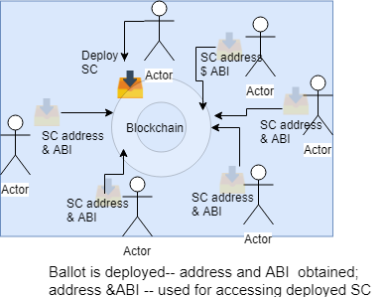
SC compile, deploy and invoke
SC compile generates ABI (Abstract binary interface: json version of the SC)
SC deploy generates the address of the SC
An application working on behalf of a peer participant will use the SC address and ABI to access the functions of the SC.
From last lecture..

Slide 7
From SC to Dapp
But the logic coded in a smart contract cannot act alone. You need applications that will expose the smart contract’s functions and data to users.
Applications invoke smart contract functions that in turn verify, validate, and may record the resulting transactions and data alterations on the blockchain.
In that case, you’ll have to learn about the structure of this larger system, called a decentralized application (Dapp), and explore the methods and tools for developing Dapps.

Slide 8
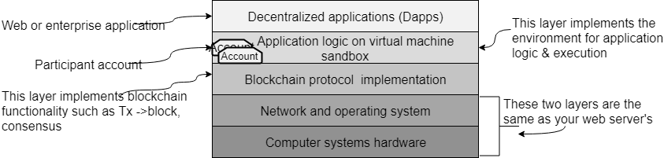
Dapp Stack

Slide 9
What are Dapps?
Definition Dapps are web or enterprise applications that include decentralized application logic to invoke blockchain functions.
Understand that SCs are part of larger system that may be a non-blockchain system.

Slide 10
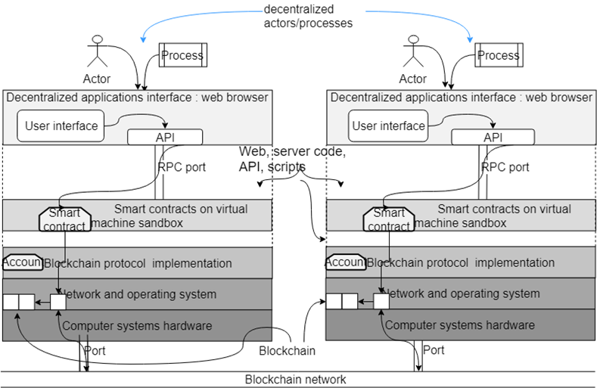
Architectural model

Slide 11
Blockchain network: Ex: Ropsten network, mainnet
The architectural model shows just two nodes.
In practice, many such nodes with same blockchain configuration—the same network ID number and the same genesis block, for example—are connected together to make up the blockchain network of a decentralized system.

Slide 12
What do you need to develop a Dapp?
A web server and package manager (E.g. Node.js and the Node Package Manager, npm)
A blockchain provider (for example, Ganache)
<project>-app for the web user interface and <project>-contract for smart contracts
The Truffle IDE, for command-line instructions
The MetaMask browser plugin

Slide 13
Preliminary concepts: Identifying participants
Every entity in blockchain world is identified by a 256 bit number (address)
Lets compile this code and understand the concept of accounts and identifiers
pragma solidity ^0.5.0;
contract Accounts {
address public myAccount;
uint public myDeposit;
function whatIsMyAccount() public payable
{
myAccount = msg.sender;
myDeposit = msg.value;
}
}

Slide 14
Cost of Tx execution
Read about gas points
Tx cost
Execution cost
Read about it in Ethereum yellow paper or
Here:
https://vomtom.at/what-exactly-is-the-gas-limit-and-the-gas-price-in-ethereum/

Slide 15
Dapp development using Truffle IDE (or Truffle suite of tools)
Initializing a template or base directory structure for a Dapp (truffle init)
Smart contract compilation and deployment (truffle compile)
Launching a personal blockchain for testing with a console (truffle develop)
Running migration scripts for deploying smart contracts (truffle migrate)
Opening a command-line interface to Truffle for testing without the Dapp UI (truffle console)
Testing the deployed contract (truffle test)
These steps (the first 4 steps) will be needed for your Lab1-Part2
Step 5 is optional but cool
We’ll explore step 6 later on in the semester

Slide 16
How to develop a Dapp?
You must understand Dapp programming is not your traditional programming. There are many new concepts that you must understand before you start coding.

Slide 17
Software and tools you’ll need for Dapp development
We started with this 6 months ago:
Operating system—Linux Ubuntu 18.04
Web server for the web client interface—Node.js 10.15
Package manager—npm 6.4
IDE—Truffle 0.5.0
Smart contract language toolchain—Solidity 0.5.0 (comes with the Truffle suite)
Browser/web client—Chrome and the MetaMask (LTS) plugin
Editor—Atom, gedit, or any other of your choice
We are here now:

Slide 18
Ballot Dapp overall structure (Lets use standard directory structure)
After you install all the required software and tools;
Ballot-Dapp
ballot-contract
ballot-app

Slide 19
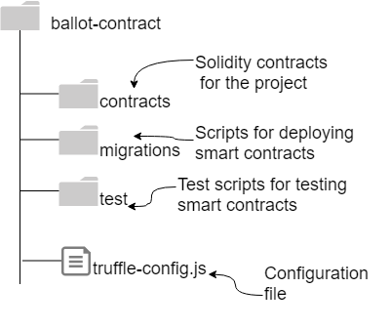
Lets focus on ballot-contract
Truffle can create template structure for ballot-contract
truffle init

Slide 20
On to the demo
Make sure your installs are good.
Please seek TAs help and get it done now
mkdir ballot-Dapp
cd ballot-Dapp
mkdir ballot-contract
cd ballot-contract
truffle init
// move ballot.sol into contracts directory
//Quickstart Ganache
truffle migrate –reset
// the contracts in contract directory are deployed.. That is it

