Slide 1
From Smart contract to Dapps(Ch04) – Part 2
B. RAMAMURTHY
©2019, ALL RIGHTS RESERVED
BINA@BUFFALO.EDU
HTTP://WW.CSE.BUFFALO.EDU/FACULTY/BINA
TEACHING PROFESSOR
COMPUTER SCIENCE AND ENGINEERING
DIRECTOR, BLOCKCHAIN THINKLAB
PROGRAM DIRECTOR, DATA-INTENSIVE COMPUTING PROGRAM

Slide 2
Topics for discussion
Read chapter 4 of the text book
The architectural model of a Dapp
Using the Truffle IDE for developing Dapps
Connecting the front end to the smart contract
The MetaMask browser plugin
Deploying and testing an end-to-end Dapp
Summary

Slide 3
READ READ READ
Fiction or non-fiction
Poetry or prose
Technical or non-technical
Always have a book next to you
Read to learn how to program
Test your SC: positive and negative test
--Bina

Slide 4
Status of Lab1 Part1
Title
Problem statement
Use case diagram
Contract diagram
Sequence diagram
Make a list of what functions and what modifiers, what data
Incrementally develop SC
Test it: positive and negative tests

Slide 5

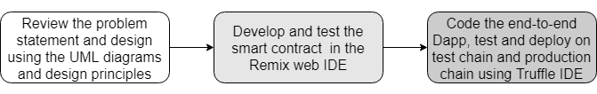
How to develop a Dapp?
You must understand Dapp programming is not your traditional programming. There are many new concepts that you must understand before you start coding.

Slide 6
Dapp development using Truffle IDE (or Truffle suite of tools)
Initializing a template or base directory structure for a Dapp (truffle init)
Smart contract compilation and deployment (truffle compile)
Launching a personal blockchain for testing with a console (truffle develop)
Running migration scripts for deploying smart contracts (truffle migrate)
Opening a command-line interface to Truffle for testing without the Dapp UI (truffle console)
Testing the deployed contract (truffle test)
These steps (the first 4 steps) will be needed for your Lab1-Part2
Step 5 is optional but cool
We’ll explore step 6 later on in the semester

Slide 7
How to develop a Dapp?
You must understand Dapp programming is not your traditional programming. There are many new concepts that you must understand before you start coding.

Slide 8
Software and tools you’ll need for Dapp development
We started with this 6 months ago:
Operating system—Linux Ubuntu 18.04
Web server for the web client interface—Node.js 10.15
Package manager—npm 6.4
IDE—Truffle 0.5.0
Smart contract language toolchain—Solidity 0.5.0 (comes with the Truffle suite)
Browser/web client—Chrome and the MetaMask (LTS) plugin
Editor—Atom, gedit, or any other of your choice
We are here now:
Truffle: v5.0.27 https://www.npmjs.com/package/truffle
Node: v10.15.3 https://nodejs.org/en/
Solidity : 0.5.8
npm: 6.4.1 https://www.npmjs.com/get-npm
ganache v2.1.1 https://www.trufflesuite.com/ganache

Slide 9
Ballot Dapp overall structure (Lets use standard directory structure)
After you install all the required software and tools;
Ballot-Dapp
ballot-contract
ballot-app

Slide 10
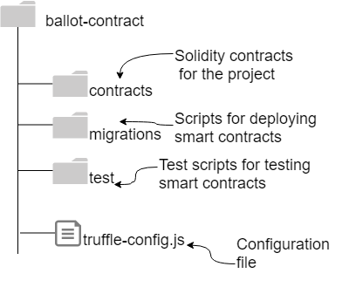
Lets focus on ballot-contract
Truffle can create template structure for ballot-contract
truffle init

Slide 11
Configuring RPC port
An application communicates with the underlying blockchain using an RPC port. This one is for Ganche. As we progress we’ll learn about more configurations: external providers.
The configuration of this port is specified in the truffle-config.js
module.exports = {
// See <http://truffleframework.com/docs/advanced/configuration>
// to customize your Truffle configuration for the RPC port
networks: {
development: {
host: "localhost",
port: 7545,
network_id: "5777"
}
} };

Slide 12
2_deploy_contracts.js
var Ballot = artifacts.require("Ballot");
module.exports = function(deployer) {
deployer.deploy(Ballot, 4);
};

Slide 13
On to the demo
Make sure your installs are good.
Please seek TAs help and get it done now
mkdir ballot-Dapp
cd ballot-Dapp
mkdir ballot-contract
cd ballot-contract
truffle init
// move ballot.sol into contracts directory
//Quickstart Ganache
truffle migrate –reset
// the contracts in contract directory are deployed.. That is it

Slide 14
Command line interface (CLI)
You can use Remix, you can also use truffle console “truffle console”
let instance = await Ballot.deployed()
let accounts = await web3.eth.getAccounts()
instance.register(accounts[1])
instance.register(accounts[2])
instance.register(accounts[3])
instance.vote(1, {from: accounts[0]})
instance.vote(2, {from: accounts[1]})
instance.vote(2, {from: accounts[2]})
instance.vote(2, {from: accounts[3]})
instance.reqWinner()

Slide 15
Explanation for Txs
Proposal 2 is the winner because three participants with weight=1 voted for 2, and only the chairperson (accounts[0], with weight=2) voted for proposal 1.
For fun, you can also try transferring ether from one account to another. You can use the web3.eth API directly to invoke the methods getBalance() and sendTransaction().

Slide 16
Simple cryptocurrency Txs
web3.eth.getBalance(accounts[0])
web3.eth.getBalance(accounts[1])
web3.eth.sendTransaction({from: accounts[0], to:accounts[1], value:99})
web3.eth.getBalance(accounts[0])
web3.eth.getBalance(accounts[1])

Slide 17
Dapp web application development
You’ll need these elements for the web application part of the Dapp
HTML, JavaScript, and CSS for rendering the server contents for user interaction
A server to host the base entry script defined in index.js
Server code (app.js) linking the web server and web client
Additional wrappers and plugins for any frameworks such as Bootstrap and the web3 API
Package configuration files such as package.json

Slide 18
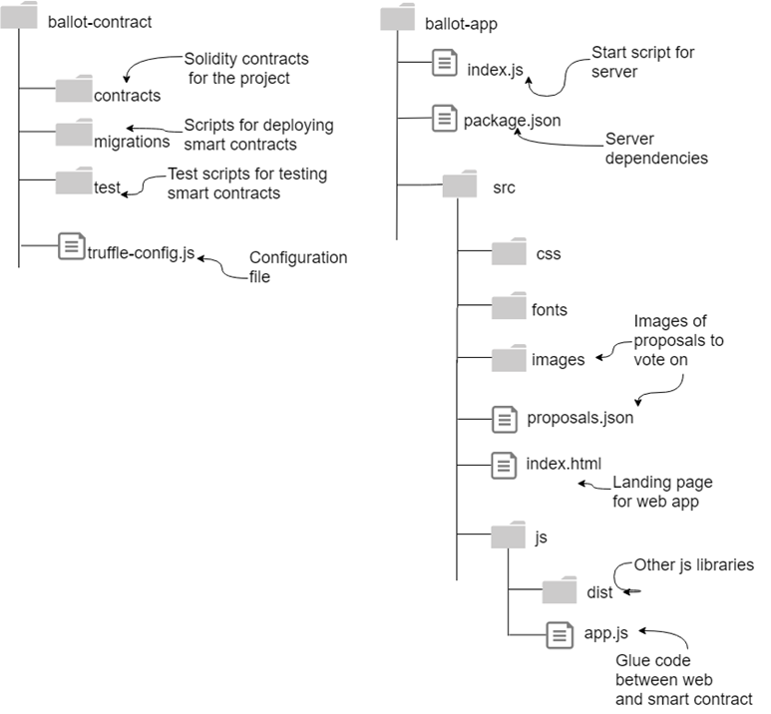
Ballot -Dapp

