Slide 1
Security and privacy (Chapter 5)
B. RAMAMURTHY
©2019, ALL RIGHTS RESERVED
BINA@BUFFALO.EDU
HTTP://WW.CSE.BUFFALO.EDU/FACULTY/BINA
TEACHING PROFESSOR
COMPUTER SCIENCE AND ENGINEERING
DIRECTOR, BLOCKCHAIN THINKLAB
PROGRAM DIRECTOR, DATA-INTENSIVE COMPUTING PROGRAM

Slide 2
Discussed and demoed: Blind auction
Problmem statement: A blind auction is planned by a beneficiary for a piece of artwork. There may be many pieces to be auctioned off, but for this problem you’ll consider only one; you can always add others once this piece is sold. The beneficiary controls the various stages of the auction, {Init, Bidding, Reveal, Done}. After initiation by the beneficiary, the bidders bid one bid at a time during the Bidding phase, providing their bids securely and privately. Others, including the beneficiary, cannot see what each bid is. After a while, the beneficiary advances the stage to the Reveal phase. Now bidders openly send their bids, and the beneficiary opens the bids and identifies the highest bidder and highest bid. The beneficiary brings the auction to a close by advancing the stage to Done, at which time auction ends. Beneficiary is transferred the highest bid value. Non-winner bidders can withdraw their deposits, and the winning bidder is returned the balance of their deposit, if any.

Slide 3
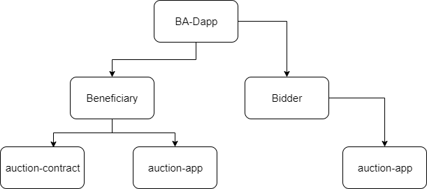
Design of decentralized BA??
Retrospection: Lets look at the structure of the Blind auction as I deployed it.

Slide 4
Things to note
In the blind auction problem, the parameters (auction bid details) need to be kept private and secure in one of the phases but can be revealed to the public in another phase. Privacy and security are achieved during the Bidding phase by secure hashing the parameters; when the parameters are revealed during the Reveal phase, the bid is verified by computing the hash from the revealed parameters and matching the hash sent during Bidding phase.
Other problems that have similar hide and reveal phases include online quizzes and exams, requests for proposals (RFPs) in business contract bidding, and games such as poker (which has play, bet, and reveal phases). Notice that the approach used in the blind auction is not implementing security and privacy in the traditional sense of encrypting data using a private key, then decrypting it using a public key.
Also notice that the hashes and identities in the blockchain context involve a 256-bit address space and 256-bit computations. This large address space aids in ensuring both the uniqueness of decentralized identities and an extremely low probability of collisions for hash values.

Slide 5
Best practices
Migrate to a public chain only after thoroughly testing your smart contract in the Remix IDE or on Ganache’s local test chain.
Make sure you keep the mnemonic that you generated for your private key safe. This is your identity for the network where you created the accounts using the mnemonic.
Private-public key cryptography plays an indispensable role in uniquely identifying an account. Similar to how you secure and protect a credit card, you need to protect the private key for the security of your assets on the blockchain.
Pay attention to the hashing technique used in achieving privacy and security of data (parameters) transmitted in a decentralized blockchain-based system.

Slide 6
Summary
This chapter demonstrated onboarding a smart contract on the Ropsten public chain and interacting with it, with truly decentralized access.
Cryptographic algorithms and techniques are used in the implementation of self-managed decentralized identity, with a unique 256-bit account number derived from a private key.
Transactions generated by an account are digitally signed using the account’s private key; for the examples in this chapter MetaMask facilitated this process, so you didn’t observe it openly, except when MetaMask is asked for confirmation.
Using secure Keccak hashing, as was done for the blind auction problem, is a technique for privacy and security that is suitable for decentralized applications.
Using a secret code in the parameter list of the blind bid helps ensure the privacy and security of the data by obfuscating the bid value.

