Slide 1
Fundamental concepts
B. RAMAMURTHY
©2019, ALL RIGHTS RESERVED
BINA@BUFFALO.EDU
HTTP://WW.CSE.BUFFALO.EDU/FACULTY/BINA
TEACHING PROFESSOR
COMPUTER SCIENCE AND ENGINEERING
DIRECTOR, BLOCKCHAIN THINKLAB
PROGRAM DIRECTOR, DATA-INTENSIVE COMPUTING PROGRAM

Slide 2
Topics for discussion
Read chapter 2 of the text book
A blockchain system within a larger system (from Chapter 1)
Summary

Slide 3
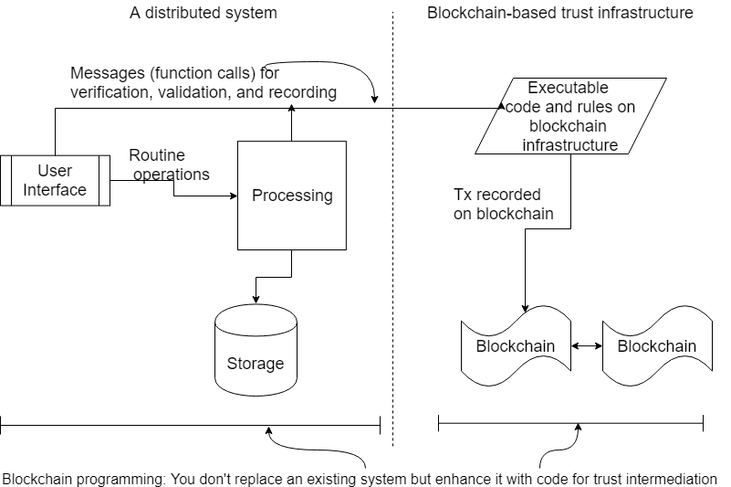
Blockchain application is a part of a larger system
Copyright: B. Ramamurthy,
Blockchain in Action, Manning, 2020,
ISBN: 9781617296338
Figure 1.3

Slide 4
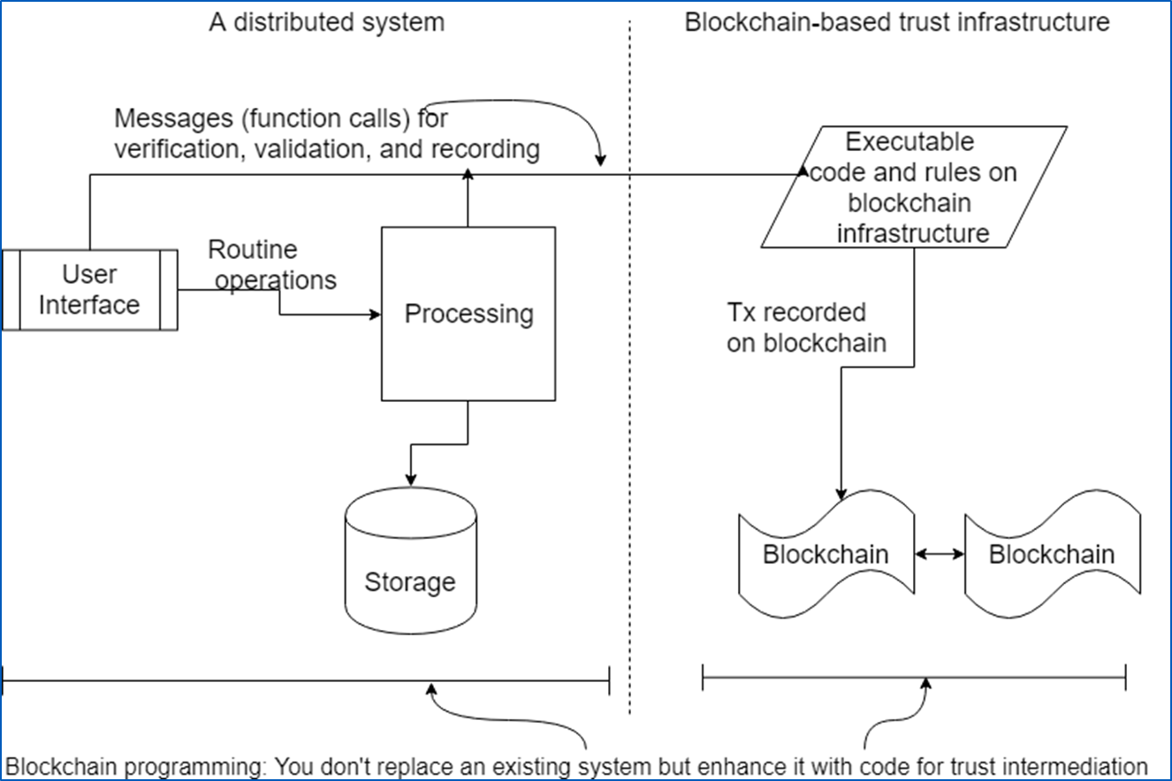
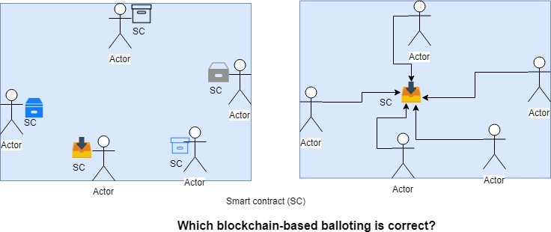
What blockchain is not?
Blockchain is NOT your compute engine: You cannot do linear programming or run optimization algorithms inside a smart contract! Don’t call you random number generator from inside a smart contract.
Blockchain is NOT your regular SQL NoSQL database: Don’t use blockchain for storage. You store the data outside the chain and only provenance (hash, metadata) on the chain. See figure 1.3
Blockchain is NOT for creating an instance of a smart contract for each
participant, rather a unified single SC governing and recording
Tx of all participants

Slide 5
What is blockchain, then? Where can I use it?
Logs, logs, logs: When you want to record or log things happening this is a good choice. Once again you don’t record huge docs but its essence, or data about data or meta data.
Messages: think of blockchain as a message queue; outside system can respond to these messages.
Rules, rules, rules: you can codify rules for a problem into the smart contract to verify and validate things.
Events and notifications: Certain significant milestones can be captured as events (pre-defined) and notified to the user real-time; or an application can search for these events that are stored (indexed) on the blockchain.
Build timelines using Txs that are recorded timestamped in a sequence of many blocks.
Decentralized market place, auction, balloting models where participants hold their assets and directly interact with peers without any formal intermediaries.
…. Many more

Slide 6
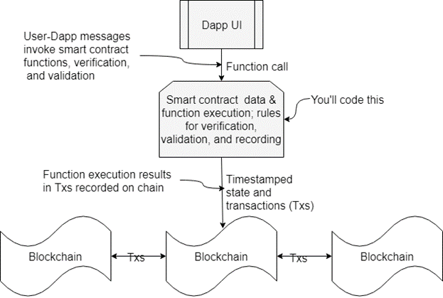
From applications to Txs on a block©

Slide 7
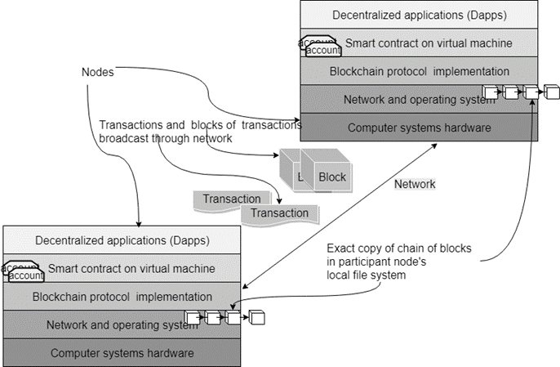
From Tx → Block → Blockchain©

Slide 8
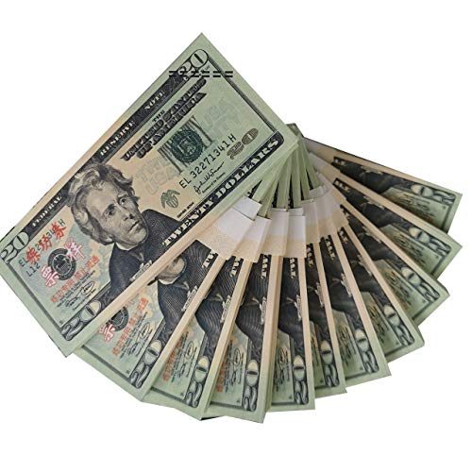
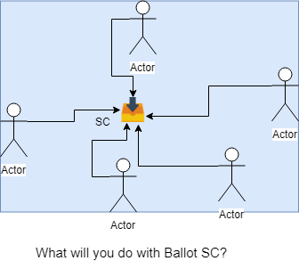
What is your use case for Ballot?
Consider that you are given a sum of $2000? Give me some use cases for this?
Next consider the basic ballot Dapp, and explore, research for some cool use cases?

Slide 9
Girts idea or use case based on Ballot Dapp
My idea is to implement Smart contract for Voting for European Car of the Year (ECOTY) https://en.wikipedia.org/wiki/European_Car_of_the_Year.
Every year some number of journalists from all Europe votes for European Car of the Year. List of voters is known in advance. They can vote for any car Sold in Europe in previous Year. (List of cars are also known.)
In first round seven finalists are chosen by simple voting.
In second round vote for finalists only.
Each voter has 25 points.
Each voter must divide votes to at least 5 cars.
Max number of points voter can give to one car is 10.
No joint top marks allowed.
I would like to implement second round only.

Slide 10
How to develop a Dapp?
This is what we’ll do today.

Slide 11
Chapter 2 Smart contracts
Smart contracts are the brain of a blockchain system: the cerebellum of the brain, to be more specific.
In this chapter, you’ll learn:
Smart contracts as executable code on the blockchain
Design principles for smart contract design
Solidity, a language for writing smart contracts
Remix, an environment for deployment and execution of a smart contract
Designing, developing, deploying, and testing smart contracts with two use cases

Slide 12
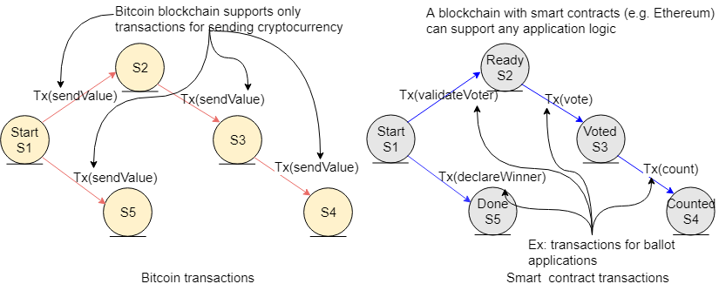
Bitcoin Tx Ethereum Tx
Figure 2.2

Slide 13
What can a smart contract do?
It represents a business logic layer for verification and validation of application-specific conditions.
It acts as the software-based intermediator for decentralized blockchain-based applications.
It allows specification of rules for operations on the blockchain.
It facilitates the implementation of policies for transfer of assets in a decentralized network.
It embeds functions that can be invoked by “messages” or function calls from participant accounts or other smart contract accounts. These messages and their input parameters, along with other metadata such as the sender address and timestamp, result in transactions recorded in the distributed ledger of the blockchain.
It adds programmability and intelligence to the blockchain through specification of the parameters of its functions.

Slide 14
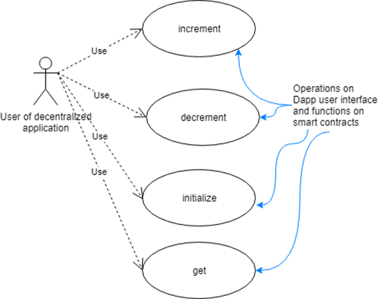
Counter Dapp : end-to-end development
Design first: After you come up with your idea, draw the UML use case diagram to represent the idea. Here is an example:

Slide 15
Assets, peer participants, roles, rules, & transactions
For the counter (we have chosen a somewhat trivial problem so that we can develop the ideas and blockchain concepts):
Digital assets to track: the value of the counter
Peer participants: the applications that update the counter value
Roles of these participants: updating the counter value, view the value
Rules to be verified and validated, to be applied to data and functions: none in this use case
Transactions to be recorded in the digital ledger: initialize(), increment(), and decrement()

Slide 16
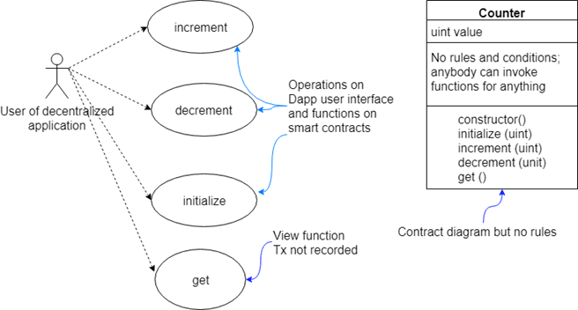
Counter contract diagram

Slide 17
Solidity
Solidity is an object-oriented, high-level language for implementing smart contracts, influenced by C++, Python, and JavaScript.
Solidity is statically typed and supports inheritance, libraries, and complex user-defined types as well as providing many useful features for developing blockchain applications.
Because its syntax and semantics are similar to those of languages you may know, I will not explicitly discuss the language elements of Solidity
But rather will introduce and explain them as we go using code snippets.

Slide 18
Solidity SC code for Counter (basic)
pragma solidity ^0.5.2;
// imagine a big integer counter that the whole world could share
contract Counter {
uint value; #A
function initialize (uint x) public {
value = x; }
function get() view public returns (uint) {
return value; }
function increment (uint n) public {
value = value + n;
// return (optional)
}
function decrement (uint n) public {
value = value - n; }
}

Slide 19
Deploy and test it on Remix
Lets deploy and test it om Remix IDE
And also do a demo of end-to-end Dapp using truffle CLI

Slide 20
Summary: Introspection
When smart contract code is deployed on a blockchain, it is accessible to anybody with a defined identity on that blockchain.
They could be in Albany, NY, or Bali, Indonesia; it is equally accessible as long as they have an account number and are connected to the same blockchain network.
You may argue that this is like any web application, a distributed system. But a distributed web application does not maintain a distributed immutable ledger.
The blockchain does, and as a result every participant records the same copy of the list of transactions that happened on the blockchain for this particular smart contract.
The information in this immutable ledger can then be used to trace the provenance and the who, when, and what of the transactions.
This information is automatically recorded with agreement (consensus) of all the stakeholders on the network.
This distributed immutable ledger of the blockchain enables trust among unknown decentralized participant nodes, thus opening up a whole world of opportunities for innovative Dapps.
Read the second Dapp discussed in the chapter about Airline consortium marketplace

