Slide 1
Developing a Dapp – Part 4 (Rules)
B. RAMAMURTHY
©2019, ALL RIGHTS RESERVED
BINA@BUFFALO.EDU
HTTP://WW.CSE.BUFFALO.EDU/FACULTY/BINA
TEACHING PROFESSOR
COMPUTER SCIENCE AND ENGINEERING
DIRECTOR, BLOCKCHAIN THINKLAB
PROGRAM DIRECTOR, DATA-INTENSIVE COMPUTING PROGRAM

Slide 2
Announcements
Lab1 : due date: 3/8: Only Part 1 and Part 2
Lab 2: Part 1, Part 2, Part 3: into Dapp Due date 3/14 by midnight
Lab 3: Airline Consortium, will discuss detail in the week of March 4: You have all semester to complete and deploy on a public blockchain network; You will also launch Lab1,2 on public blockchain
TA Shi Yan has a nice handout for Web-node.js-MySQL- may want to attend recitation and use the handout for Lab2
Is that agreeable? Yes or No?
Other than that your work involves attending lectures, recitation and take two exams:
Midterm : 3/27, lecture time
Final exam: 5/13, Cooke 121, 7.15-10.15PM

Slide 3
Topics for discussion
Preview of problem we discussed last class (slides 4-9)
Rules, conditions, criteria: for validation and verification
Blockchain node and blockchain server (slides 4-12)
Structure and working of a Dapp (slides 13-17)
APIs (slides 18-20)
Ethereum blockchain web3 API (slides 22-24)
Dapp request-response (slides 25-26)
Summary

Slide 4
Problem Statement: Ballot
Voting or Ballot represents the universal problem of choosing a winner or a leader using the democratic process of voting.
It is representative of a wide variety of scenarios from reviews for a product and its purchase based on good reviews it received, to passing a law or a budget in a governing body.
Recall the design process we discussed earlier that is repeated here:

Slide 5
Design steps
Problem statement: Counters are very versatile and useful device. It could be a part of a decentralized application. For example: population counter; birth and death entry. You cannot get any more decentralized than this.
Step 1: Use case (Unified Modeling Language) diagram. Identify user and operations and supporting operations.
Step 2: Using the use case and the problem statement as guidance, identify, user, digital assets and transactions.
Step 3: Design the “contract” diagram (derivative of “class” diagram)
Step 5: Implement the contract in a blockchain-specific language. In our case, we will use Solidity and Ethereum blockchain. Ethereum Metropolis—Constantinople to be exact.
Step 6: Test it using a web-IDE call Remix.

Slide 6
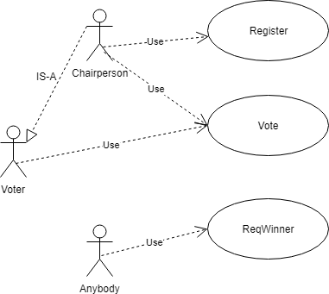
Design step 1 : use case diagram

Slide 7
Design step 2 : Identify users, digital assets, transactions, roles
Users: voters, chairperson
Digital assets: identity of users, vote, whether voted or not, list of voters, list of ballots, what else?
Transactions: register, vote, (need to recorded), count (no need?)
Roles: chairperson and voter
Rules: Chairperson organizes the voting. Voters are identified by their “account” addresses. Here is the logic or the rules to implement:
Only chairperson can register other voters.
Voter can be registered only once.
Only registered voters can vote.
Voters can vote only once.
There is no “write in”. That is, voters can vote only for the items presented
Chairperson’s vote has double (2) the weightage of the regular voter (1).

Slide 8
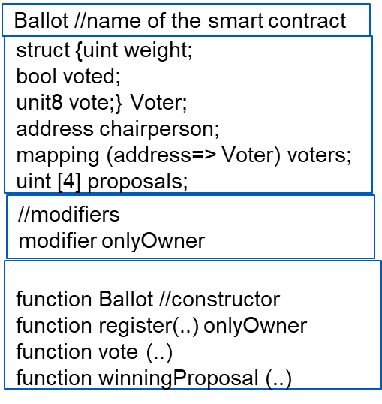
Design step 3 : Design Contract diagram
We skip step 4 , pseudo code
and move onto step 5 and step 6.

Slide 9
Design steps : 5 and 6
Problem statement: Counters are very versatile and useful device. It could be a part of a decentralized application. For example: population counter; birth and death entry. You cannot get any more decentralized than this.
Step 1: Use case (Unified Modeling Language) diagram. Identify user and operations and supporting operations.
Step 2: Using the use case and the problem statement as guidance, identify, user, digital assets and transactions.
Step 3: Design the “contract” diagram (derivative of “class” diagram)
Step 5: Implement the contract in a blockchain-specific language. In our case, we will use Solidity and Ethereum blockchain. Ethereum Metropolis—Constantinople to be exact.
Step 6: Test it using a web-IDE call Remix.
This problem is from Solidity read the docs: https://solidity.readthedocs.io/en/v0.5.3/solidity-by-example.html?highlight=ballot

Slide 10
Motivation
The main intent of a smart contract transaction is to execute a function. However, consider these:
Smart contracts often require control over who/what can execute the function, at what time a function needs to be executed, and what are the pre-conditions to be met before accessing the function.
It is a good practice to validate input values to the function to avoid unnecessary execution and waste of gas. If there are any errors found during input validation, these have to be handled appropriately.
At the end of function execution you may want to assert that certain conditions are met to ensure the integrity of a smart contract.

Slide 11
Modifiers
Modifiers can change the behavior of a function: that is why this feature is referred to as a “modifier”
It is also known as a function modifier since it is specified at the entry to a function and executed before the execution of a function begins.
You can think of a modifier as a screen/filter protecting a function.
A modifier is typically checks a condition using a “require” and if the condition failed, the transaction that called function can be reverted using revert function. This will completely reject the transaction and revert all its state changes. There will no recording on the blockchain.

Slide 12
Modifier and Require
Let us understand modifier and require using the Ballot smart contract functions:
We will add a modifier “onlyBy (chairperson)” to the register function. We will do this by these steps:
Define a modifier for the clause “onlyBy(chiarperson)”
Adding the special notation ( _; ) to the modifier definition that includes the function
Using the modifier clause in the function header

Slide 13
//step 1
modifier onlyBy(address _account) { require(msg.sender == _account); _; /*Note this step 2*/ }
//Ste 3: use the modifier clause in the function header
function register(address toVoter) public onlyBy(chairperson) {
if ( voters[toVoter].voted) return;
voters[toVoter].weight = 1;
voters[toVoter].voted = false;
}
Notes:
Step 1 is the definition of the modifier onlyBy, we allow only the Chairperson who created the smart contract Ballot to register any new voters.
Step 2 shows how to make the modifier include a placeholder for any function.
Step 3 use the modifer clause in the header of the function definition.

Slide 14
Now lets change if statement such that it reverts the transaction on input validation inside the function. We don’t need to waste blockchain resources for a failed transaction!
function register(address toVoter) public onlyBy(chairperson) {
if ( voters[toVoter].voted) revert();
voters[toVoter].weight = 1;
voters[toVoter].voted = false;
}

Slide 15
Now we will illustrate “assert” using a function payOff that computes and pays off bets:
function payoff (address better) public
{
/*compute & payoff all the betters */
assert (bank.balance >10000);
/* revert the call and any state transitions if bank balance falls below a reserve of 10000 */
}
It is preferable that assert not fail and that requires checking the balance after every payoff in this case. We are making sure bank has its reserve of 10000 dollars after all the payoffs. Under normal circumstances assert should not fail! This is more for handling an anomalous, faulty or malicious condition. In this case, it is that the bank balance somehow dipped below the reserves.

Slide 16
Rules, laws, policies, governance
coded as modifiers
Function:
Function header
Input arguments validation using require (Tx revertible)
Function conditions
Modifiers (Tx revertible) referenced in the function header
Function code
Should never fail for normal
function execution
Assertion (Tx revertible)
Execution order
Notes:
This picture summarizes all the features we discussed: modifiers and error handlers and where they are typically used.
The rules, laws, policies, and governance conditions are coded as modifiers. You can use the modifiers as gatekeepers for the functions. If your transaction to invoke the function is does not meet the conditions specified at the header of the function, your transaction will be reverted, will not be recorded on the blockchain.
Modifiers can be used to validate rules outside the function, such as described in the opening of this lesson: who has access to function, at what time, under what conditions, etc.
Once these screening conditions are satisfied, input validation can be carried out inside the function using “require” declarative statement, and in this case also the transaction will be reverted on failed validation. This is done before execution of the function.
There are anomalous, faulty, or malicious code that may result in unexpected situations or exceptions. That can be caught usually at the end of the function or sometimes within a function using “assert” declarative statement and the entire Tx, including the function execution, and state changes will be reverted.

Slide 17
Rule: at least 5 sellers have registered
function buy(..) payable atleast5Sellers ..returns(..)
Enough value to buy selected item?
modifier atlLeast5Sellers {
require( numSellers >= 5);
._; }
Function code: collect value and transfer online item
Should never fail for normal
function execution
Assertion (itemTransferred);
Execution order
Example: Online Digital Media Bazaar
Notes:
Here is an example of an online digital media bazaar: Input condition is as specified by a modifier is alLeast5Sellers that enforces the condition that there should be at 5 sellers with their products before a buyer initiates a “buy” message through a transaction.
This is a global condition for all buyers. So it is appropriate to install it using a “modifier” declarative statement.
Once there are enough sellers, inside the function we validate if the buyer has enough money to specific item requested. If not, the transaction is reverted.
When that validation is satisfied, the money is transferred to seller, and item is transferred to a buyer.
We have simple assert declaration at the end that the bought Item should have been transferred, afterall it is digital item. This will be reached only if the item has not been transferred or could not be transferred due to exceptional reasons.

Slide 18
Summary
Function modifiers along with the state-reverting functions of revert(), require() and assert() collectively support a robust error handling approach for a smart contract.
These declarative features can be be used to perform formal verification and static analysis of a smart contract to make sure it implements the intent of a smart contract.
Modifers are for rules, conditions, criteria in your application that are required for compliane, governance, provenance.
For trust: verification and validation

