Slide 1
Developing Dapps with Truffle
B. Ramamurthy
Reference
https://medium.com/heartbankacademy/how-truffle-works-under-the-hood-f1ff6add416c

Slide 2
Introduction to Truffle
Integrated development environment for creating, developing, compiling, and deploying Dapps on Ethereum blockchain
Beyond that you need to link it to an actual user interface
It is written in Javascript (JS)
Creativity and innovation comes with good understanding of the inner working of the blockchain

Slide 3
Truffle init
Read the reference given
What does truffle init do?
It prepares your directory structure and creates the files for compile.js, deploy.js, test.js that contain commands
Lets just do a “truflle init” and study the directory structure it provides
It gives you guideline to
  structure your smart contract code
  deploy scripts and
  blockchain connection port to other applications

Slide 4
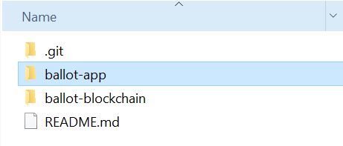
Ballot Base directory

Slide 5
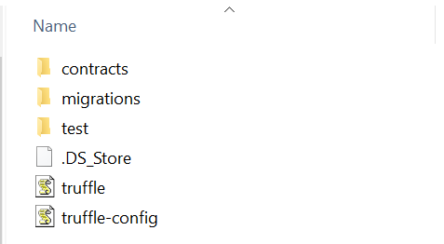
Ballot-blockchain Directory

Slide 6
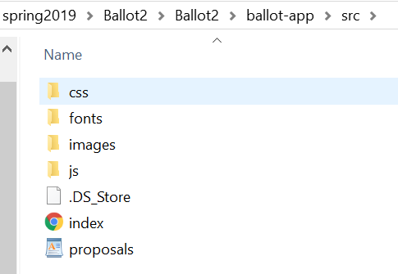
Ballot-app directory
js directory has app.js that is application dependent
And is the entry point for your server

Slide 7
Truffle commands
truffle init
Truffle compile
Truffle test (optional)
After you start the blockchain (Ganache)
Truffle migrate –reset (during testing)
----
Develop web-app part.
npm start or npm run dev
Will start node server with configuration you have provided
I want to see interaction with Metamask before you move to web3 object, ABI instance, and .json embedded code

