Slide 1
What is A blockchain?
B. RAMAMURTHY
©2019, ALL RIGHTS RESERVED
BINA@BUFFALO.EDU
HTTP://WW.CSE.BUFFALO.EDU/FACULTY/BINA
TEACHING PROFESSOR
COMPUTER SCIENCE AND ENGINEERING
DIRECTOR, BLOCKCHAIN THINKLAB
PROGRAM DIRECTOR, DATA-INTENSIVE COMPUTING PROGRAM

Slide 2
Decentralized Systems
Let’s define decentralized systems.
Is a type of distributed system.
Then what is special about this system: it allows peer-to-peer transactions of digital assets among unknown participants.
These participants operate beyond the boundaries of trust.
Example: traditional trusted system: the university, you are all known participants.
How did become known? Your credentials were verified and validated and you were admitted into the system.
Participants can join and leave as they wish. Can you do that in an university system? You may but it is not common, or is not intended.
Distributed system
Decentralized System

Slide 3
What is a blockchain? What does it do?
Blockchain helps implement a decentralized system.
Blockchain is a
Distributed immutable ledger (record)
Infrastructure for transactions → block →blockchain (what and how it is recorded)
Protocol for the network (rules for operation and recording)
What does it accomplish with these?
It implements a trust layer enabling peer-to-peer operation of participants
Shifts trust intermediation from major organizations to software methods
Addresses gaps and issues with existing distributed systems

Slide 4
So you want to develop BC applications?
Lets do that.
For any type of application development look at the stack. This is indeed an unconventional preparatory step.
For web application web stack (LAMP, MEAN etc.)
For enterprise application enterprise stack
For mobile application mobile stack
For BC application BC stack or Dapp stack
Got the idea.
This is enable you to gather the right team, technologies, and tools.
That’s what we will do.

Slide 5
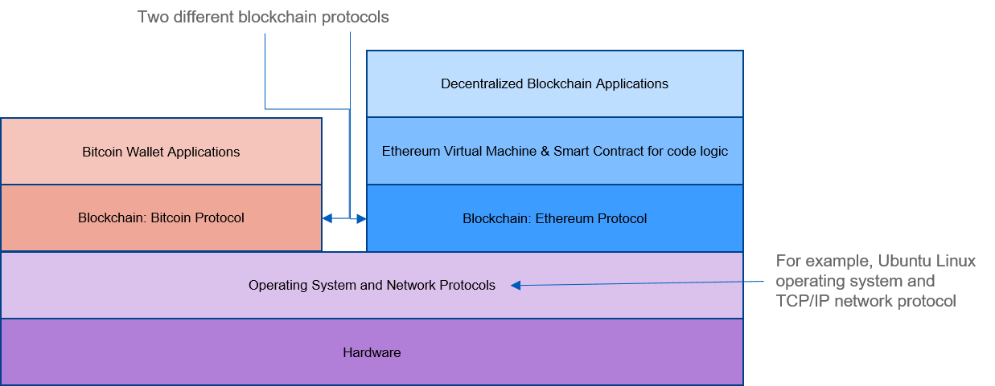
Bitcoin vs Ethereum Stack
User interface of a
larger system;
BC is the decentralized part

Slide 6
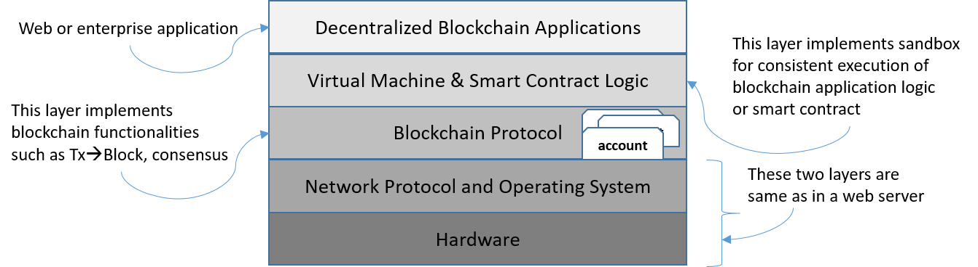
Ethereum stack
Note: In recitation we are covering user interface stack; Today
during lecture we will look at smart contract design.

Slide 7
Lets solve a problem: simple counter
Problem statement: Counters are very versatile and useful device. It could be a part of a decentralized application. For example: population counter; birth and death entry. You cannot get any more decentralized than this.
Step 1: Use case (Unified Modeling Language) diagram. Identify user and operations and supporting operations.
Step 2: Using the use case and the problem statement as guidance, identify, user, digital assets and transactions.
Step 3: Design the “contract” diagram (derivative of “class” diagram)
Step 4: (Optional) Obtain the pseudo code. At this point you can decide to implement it for Ethereum blockchain or for some other blockchain. That is the reason for this step, platform independent step.
Step 5: Implement the contract in a blockchain-specific language. In our case, we will use Solidity and Ethereum blockchain. Ethereum Metropolis—Constantinople to be exact.
Step 6: Test it using a web-IDE call Remix.

Slide 8
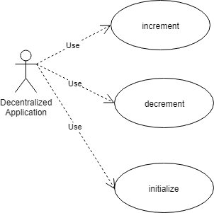
Step 1: Use case diagram
Use draw.io or starML or other
tools to creat a similar one for
your lab1. Can you do it for your
documentation?

Slide 9
Step 2: Identify user, assets and transactions
Users: Actors in any Dapp
Digital or other assets: counter value (type depends on the value: if it is student score: 8-bit, it is world population 256-bit, yes BC works on a 256-bit integer processor.)
Transactions: create, initialize (set), increment, decrement, get (to view)

Slide 10
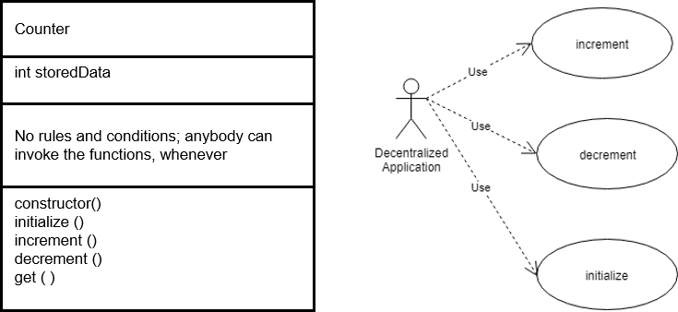
Step 3: Obtain contract diagram

Slide 11
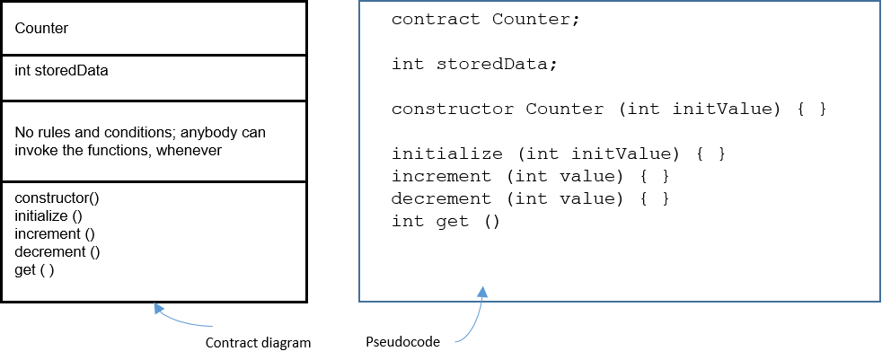
Step 4: Obtain the pseudo code

Slide 12
Step 5: Code it in Solidity
pragma solidity ^0.5.2; // imagine a big integer counter that the whole world could share
contract Counter {
uint storedData;
function initialize (uint x) public {
storedData = x;
}
function get() view public returns (uint) {
return storedData;
}
function increment (uint n) public {
storedData = storedData + n;
return;
}
function decrement (uint n) public {
storedData = storedData - n;
return;
} }

Slide 13
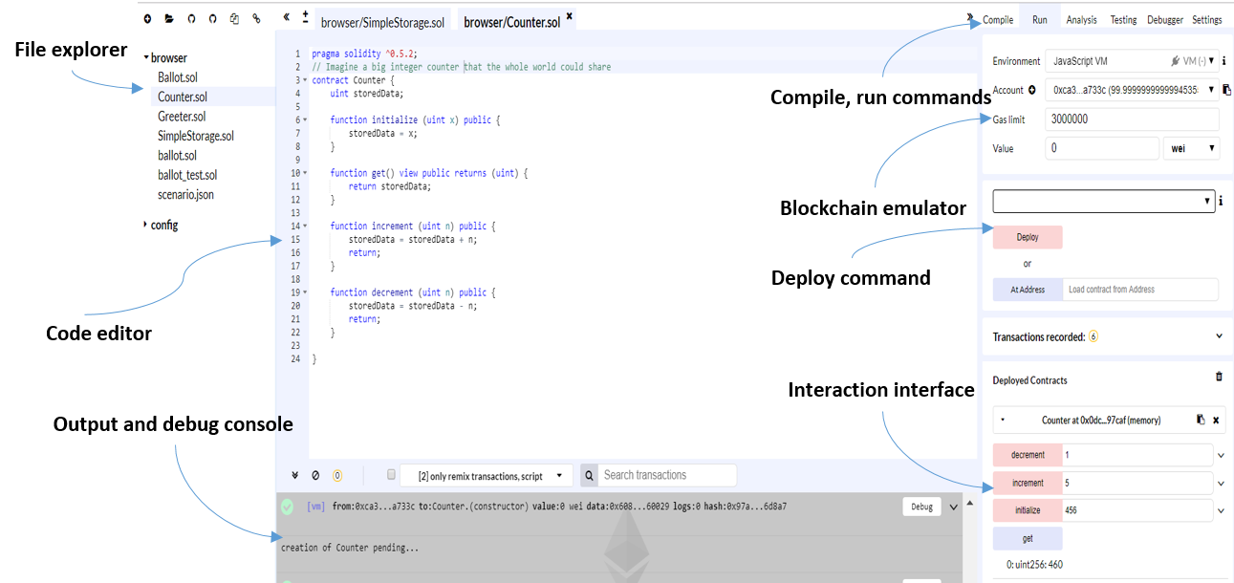
Step 6: Test it in Remix IDE

Slide 14
On to Remix Ide to test our smart contract
On to Remix Ide to test our smart contract

Slide 15
Summary
We learned an approach to design, implement and test a smart contract.
This is just a start.
This is to show an approach that you can use for all your labs in this course and others.
There are many more elements to this, we will add throughout the semester.
This is the base: make sure it is 100% strong, no cracks: that is, you understand it well.
Lets apply these concepts to Lab1.

