Slide 1
Our Blockchain Roadmap
Blockchain concepts: Tx, block, consensus process
Smart contract: Design and programming in Solidity
Decentralized application: BC, SC, IU, and the glue code in web3
Security and privacy
Events and notification
On-chain and off-chain data access
Dapp models and standards

Slide 2
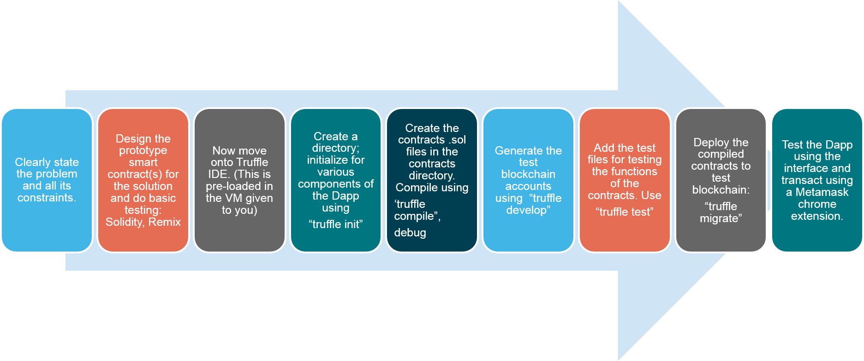
Blockchain programming (Ethereum)

Slide 3
Topics for questions
Ethereum blockchain
Smart contract coding
Solidity concepts: address, struct, mapping, account, value, modifiers, msg.sender, transfer, etc.
Dapp design given a problem: concept only
Web3 API
Security and privacy : Keccak256
256 address space

Slide 4
Questions (tentative list)
Will have subsections
Blockchain concepts: header details, tx, block, consensus
Smart contract coding using all the Solidity concepts discussed
Dapp design and Web3 details (lab2), Models and standards (ERC tokens)
Security, privacy, standards, off-chain data, events

Slide 5
How to study?
Classnotes on the web page for the course
Read the docs for solidity
Examples: counter, ballot, Ask, blindAuction
Run it on Remix and test your understanding and comprehension
Web3 class notes and read the docs
Dapp development directory structure
Models and standards (ERC)

