Slide 1
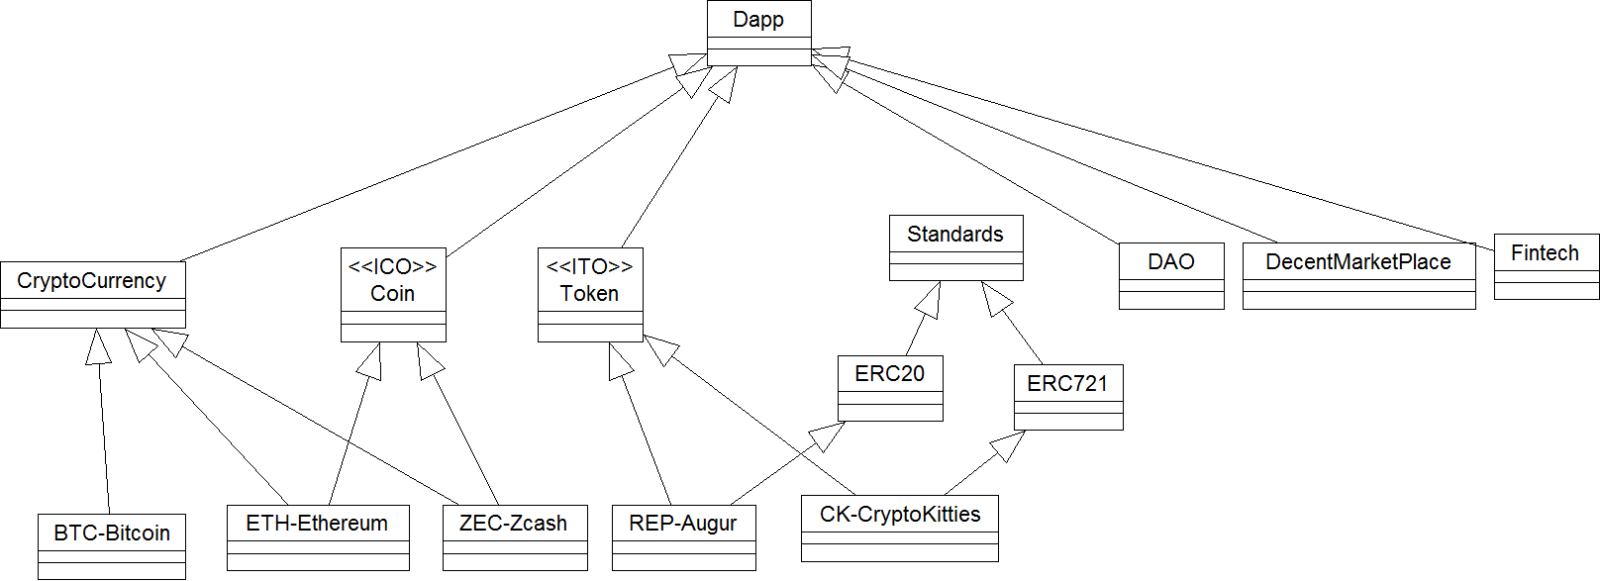
Dapp Models
Notes:
This hierarchy diagram gives a high level view of various Dapp models starting from the genesis of Bitcoin.
In this lesson we will review each of these models listed here. We do acknowledge there are many others we have repesented in the hierarchy diagram. The diagram by no means complete. We encourage learners to add to this diagram other models they can think of.
Bitcoin is the pure cryptocurrency, every Bitcoin was minted by the protocol (except for the genesis transaction from Satoshi to Hal Finney). Innovation of Bitcoin is in the decentralized payment system that is still running, though facing issues with scalability and wild price speculation. https://www.nuskool.com/learn/lesson/bitcoin-future-digital-currency/

Slide 2
Coin and Initial Coin Offering
Bitcoin codebase is open source and initial response to Bitcoin was release of many new cryptocurrencies.
Then came the innovation of Ethereum smart contract that helped automate the crowd fundraising for startups using a virtual instrument called Coin and the process of Initial Coin Offering (similar to Initial Public Offering: IPO of company stocks).
Coin and ICO use a blockchain to record the distribution of the Coin, receive funds, and specify rules and enforce any preconditions and policies. For example, a policy of some of the Chinese ICOs is that they would not receive funds from the USA. This is at the time of our recording. (Need Reference)
In the Dapp hierarchy we have included as Dapps, Ethereum and Zcash, however there are hundreds of ICOs and Coin offerings. It has become a popular mode for crowdfunding. Both Ethereum and Zcash used ICO process for their initial funding. By the way Zcash focuses heavily on privacy and uses closed code.
We classify any cryptocurrency that raised funds through ICOs in this category.

Slide 3
Tokens and Initial Token Offering
Sometimes, token and coins are used synonymously, however we distinguish between these in our model.
Token again is like a Dapp Coin but its offering associated with an asset or utility. For example, in the highly popular cryptokitties, a token is used to represent a kitty, all the rules for the creation, lifecycle, breeding etc. are written into the immutable (ethereum) blockchain smart contract. At predetermined times, certain number of new tokens are released and auctioned off for raising new funds. Assets (kitties) in this case also appreciate (or depreciate) in price based on demand. So these tokens are “fungible”, or intrinsic value of a token can change during its lifetime. We discuss this aspect in the next lesson.
Augur is prediction Dapp that depends on wisdom of crowd and their reports on reputation to predict markets. Decentralized participants (crowd) get paid in REP tokens. These tokens represent fraction of the fees if a transaction goes through based on their report.
Once again there are so many token Dapps in play, we covered only two of the many.
In the hierarchy diagram, You will also notice that both Augur and Cryptokitties inherit from standard tokens.
Notes:
https://www.walkersglobal.com/index.php/publications/100-article/987-initial-token-offerings-five-things-that-you-need-to-know-about-them?utm_source=Mondaq&utm_medium=syndication&utm_campaign=View-Original

Slide 4
DAO
Decentralized Autonomous Organization (DAO) is an early innovation in Dapp that was deployed a smart contract-based investment instrument. Autonomous venture capital Dapp, to be exact. The idea was to showcase an autonomous organization without traditional corporate governance structure (autonomous) for fundraising and automatic investing.
It was deployed prematurely without extensive testing. But the idea itself was well received and DAO raised funds beyond expectation. However a vulnerability in the code was exploited by hackers and resultant digital heist drained the significant portion of the collected funds.
You can read about it all in the references we have provided. Actual events do indeed read like a thriller, nice plot for a movie.
To make the long story short, this DAO heist and the solution to fix it, resulted in one of the unexpected hard fork of Ethereum in July 2016. The hard fork split one Ethereum into ETH (Ethereum core, as we use it now) and ETC (Ethereum Classic that still has the DAO bug in it).
In spite of all the negative publicity, we feel that decentralized autonomous organization is indeed an innovative Dapp if done right.
Notes:
https://www.coindesk.com/information/what-is-a-dao-ethereum/
https://www.cryptocompare.com/coins/guides/the-dao-the-hack-the-soft-fork-and-the-hard-fork/

Slide 5
Decentralized Marketplace
This is an easy low hanging fruit of a Dapp. we define marketplace very broadly. It could anything from selling goods to education credentials. Remember a marketplace facilitates meeting of sellers and buyers of anything.
A Dapp like Bitcoin have a well established payment system with a global immutable ledger.
Dapp can build a marketplace platform where decentralized unknown (trustless) buyers and sellers can meet and exchange items with the payment and transaction recorded on any of the established blockchain technology such as Bitcoin or Ethereum.
Hmm.. is there a sample smart contract code for supporting buying/selling? Yes there is.
An example smart contract code is Safe Remote Purchase in Purchase.sol in the Solidity documentation.
Notes:
https://www.openbazaar.org/
http://solidity.readthedocs.io/en/develop/solidity-by-example.html
Reference for Solidity documentation

Slide 6
Fintech
Fintech has great potential for innovative Dapps, ranging from decentralized investment instruments to micropayment channels.
Challenging issue for FinTech area applications is the high confirmation times of transactions compared to the centralized technologies currently in use. At the time of this recording Dapps cannot meet the subsecond trade confirmation that centralized systems deliver for stock trading. In this case scalability is a dominant issue. Privacy is another issue to be considered in this context.
Also regulations and policies of US Securities Exchange Commission (SEC) and the counterpart organizations in many countries have an effect of the FinTech Dapps and their development. In this case security, privacy, safety and fraud prevention are major issues.
In fact, tokens (Coins, ICO) provide a backdoor entry for many investors into the cryptocurrency markets. (need reference)
Notes:
0X: A decentralized Exchange https://0xproject.com/

Slide 7
Summarizing,
We looked a few of the Dapp models. We have not covered them all. Many innovative models are yet to be created. Uber and AirBnB (sharing apps) came into existence 30 years after the advent of the Internet.
Use these models as inspirations and guidelines to create a Dapp for your application domain. Apply the method and knowledge we developed in the last lessons.

Slide 8
Standards
Any time a growth of a technology explodes exponentially in many directions, and that too with deep and broad impact on all walks of life, from politics to pet shop, we need pay attention to some order.
This is not unusual. Let's take look back at the history of computing, when operating systems became a big deal, POSIX standards was introduced for interoperability among them. (need reference);
IETF (The Internet Engineering Task Force) for the internet related establishing standards through their RFCs for the Internet.
NIST covering whole range of issues from ride hailing (sharing) to stem cells.
Flights can land in any compliant airport in any country because of ISO aviation standards.
Standards bring order, safety, and many more qualitative attributes to a field, in a way, ensuring and bringing clarity to any emerging technology. This is especially an imperative for a nascent and high interest technology such as a blockchain.
Notes:
https://www.ietf.org/

Slide 9
What is EIP? Ethereum Improvement Proposal
EIP is an approach to process improvement in Ethereum ecosystem.
EIP or Ethereum Improvement Protocol is a means to manage the protocol specification, improvements, updates, client APIs and contract standards.
Improvements can be made to the
Core: core ethereum protocol
Network: network level improvement
Interface: Interfaces such as ABI, RPC
ERC: Application level convention and standards
In this lesson on Dapps, we discuss Ethereuem EIPs application level standards in ERCs: ERC20, ERC 721 and upcoming ERC 725.
proposals can be referred to as ERC<n> where n refers to the issue number
final EIP numbers are allocated when an ERC is accepted
Notes:
https://github.com/ethereum/EIPs
https://github.com/ethereum/EIPs/blob/master/EIPS/eip-1.md

Slide 10
ERC Ethereum Request for Comments
ERC proposal for application level issues are given a proposal id number, thus becomes
ERC <n>
ERC 20
ERC 721 etc.
The solution proposed by the ERC document is discussed in the community, and result could be Accepted, Rejected, Withdrawn or Deferred. The ERCs, and EIPs are available on the github and discussed on gitter and sub-reddits.
Accepted ERC is finalized, and is allocated a EIP number.
We will discuss two of many ERCs that are making a splash in the Dapp realm.
Notes:
See this diagram: check if you can make one.
https://github.com/ethereum/EIPs/blob/master/EIPS/eip-1/process.png

Slide 11
Coins and Tokens: anybody can
You experience how easy it is to issue a Coin on your own and transact. You can name your Coin something fancy and deploy it on the main chain and issue this digital currency to the whole decentralized world to buy. Anybody with an internet connection and details of your network can connect and trans your Coin.
On the other hand, the concept of Token was used as a decentralized (venture) capital raising mechanism.
A token has become an instrument to quickly monetize an idea, utility or services offered by a business.
Finally, an important note; standards can be for many other aspects of Blockchain such as identity, security, governance, ..that are still under development!
Given this context, let consider the issues.

Slide 12
Tokens
During the initial years since the advent of the Bitcoin and the smart contracts, many standalone Coins and Tokens emerged. Along with it many issues: Given a token,
What does it represent? What is the value of this token? Or How do value this token?
What can I do with it?
Is it investment or utility token?
Can I exchange it for another type of token? ( Can I exchange it for any fiat currency?)
Is it fungible or non-fungible? Hmm what is fungible?
It is limited in number?
And many more…

Slide 13
ERC 20
These and many issues are addressed and ERC 20 is specified as an interface.
ERC 20 specifies set of rules that allows a token to interact with each other, exchanged with each other, and transact on the Ethereum network.
The interface looks likes this:
Notes:
https://theethereum.wiki/w/index.php/ERC20_Token_Standard

Slide 14
ERC 20 Interface
contract ERC20Interface { 6 function totalSupply() public constant returns (uint); 7 function balanceOf(address tokenOwner) public constant returns (uint balance); 8 function allowance(address tokenOwner, address spender) public constant returns (uint remaining); 9 function transfer(address to, uint tokens) public returns (bool success); 10 function approve(address spender, uint tokens) public returns (bool success); 11 function transferFrom(address from, address to, uint tokens) public returns (bool success); 12 13 event Transfer(address indexed from, address indexed to, uint tokens); 14 event Approval(address indexed tokenOwner, address indexed spender, uint tokens); 15 }

Slide 15
How do you make your Token ERC20 compliant?
Of course, implement the functions required by the ERC interface. Recall our discussion of interface in the last module.
contract MyToken is ERC20Interface {
// implement the function required by ERC20Interface standard
// other functions..
}
Hmm..can you list some ERC20 compliant tokens? Augur REP we discussed earlier is ERC20 compliant. You can see many more in Ethscan

Slide 16
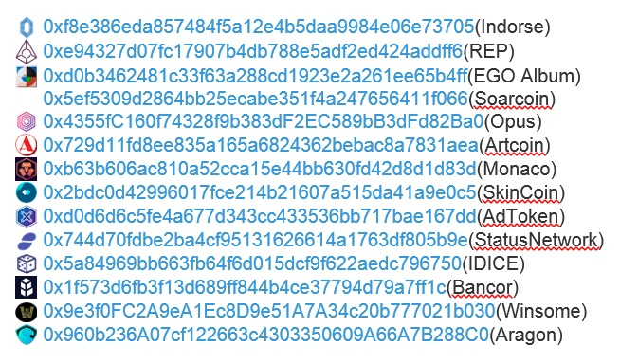
Token Watch: https://etherscan.io/token-search
Notes:
Here are some ERC20, they all piggyback on ethereum network, and can operate with the same address as your Ethereum node.
More importantly, theoretically 1 ERC20 token can be exchanged for any other ERC20 token. On the crypto-exchanges,
You can trade one REP token for 1 Bancor token. This opens up a whole new world Dapps!

Slide 17
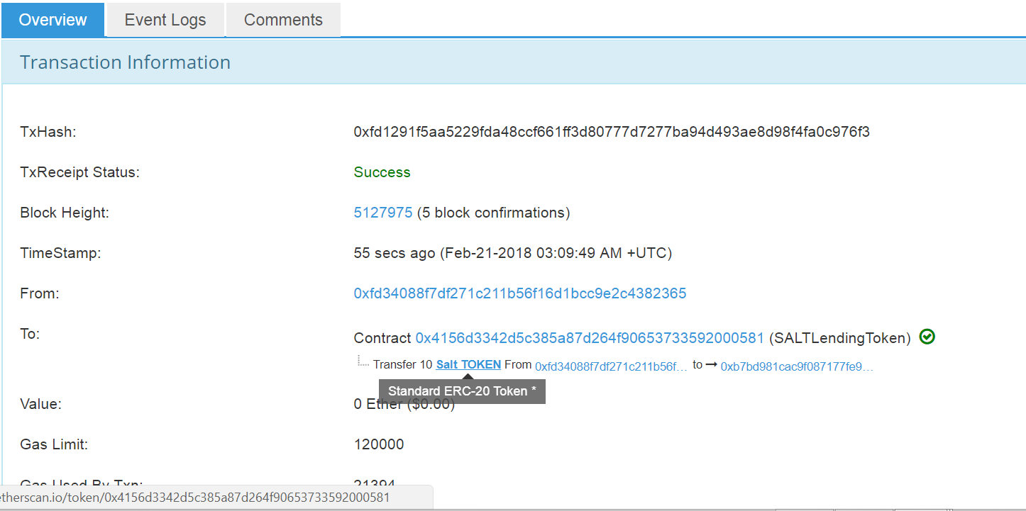
Notes:
https://etherscan.io/tx/0xfd1291f5aa5229fda48ccf661ff3d80777d7277ba94d493ae8d98f4fa0c976f3

Slide 18
Fungible Token vs non-fungible
ERC20 is a fungible token.
Dictionary definition of fungible says: “able to replace or be replaced by another identical item; mutually interchangeable.”
A dollar bill can be exchanged with another dollar bill, it is fungible.
On the other hand when a token represents an asset or a pet, like a real world puppy, and it grows out to be a fine dog that wins a world competition, this token value has appreciated enormously.
Another example is the pokemon cards; How about baseball cards?
How about real estate?
In these cases and in many more practical examples, a given token value may appreciate or depreciate depending on many factors. This culminates in what is known as the non-fungible token. Tokens that cannot be exchanged one to one!

Slide 19
Compare fungible vs non-fungible
1 ordinary dollar bill EQUAL IN VALUE any other ordinary dollar bill
1 bitcoin == (EQUAL IN VALUE) any other bitcoin
1 Ether == any other Ether
===========That is concept of fungible=======> value of this token is intrinsic
Now consider a Puppy A identified by one Token A
Puppy B identified by one Token B
Of course,
Token A is not equal in value to Token B; they cannot be exchanged one to one!
That is the concept of non-fungible.
Compare an ordinary penny with a collectible penny. They are 1 Token or 1 penny each physically. But their values are NOT the same.

Slide 20
ERC 721: CryptoKitties
The non-fungible token concept was brought to prominence by a Dapp Cryptokitties.
It is an Ethereum ERC 721.
It became wildly popular, exposing many to the crypto world.
Of course, since it conforms to Ethereum 721 token, it piggybacks the Ethereum blockchain. There was a time it contributed 30% of the traffic and to the clogging of the Ethereum mainnet traffic with a backlog of 30000 transactions.
This Dapp is hailed as an innovation on many fronts, crypto gaming, and crypto collectables.
More importantly innovation of ERC 721 is in proving that the fixed value for a token may not hold in many practical situations. In this respect ERC 721 standard has enormous potential beyond digital cats and collectibles. It has opened up a whole new areas of applications for Dapps.
Notes:
https://www.nytimes.com/2017/12/28/style/cryptokitties-want-a-blockchain-snuggle.html
https://www.cryptokitties.co/
https://www.coindesk.com/cat-fight-ethereum-users-clash-cryptokitties-congestion/

Slide 21
ERC 20, ERC 721, what else?
ERC20 and ERC 721 represent just the beginning of many more innovative standardization to come.
ERC token standards are being proposed for identity, governance and security.
These tokens and EIPs of Ethereum will sure to transform Dapp ecosystem into mainstream application framework and decentralization into a norm.

