Slide 1
Identity, Security and Privacy (not yet confidentiality)

Slide 2
Blockchain: Account
Account
Transactions
Block
Validate &
Gather, Broadcast
Transactions
Execute, Consensus &
Verify &
Confirm
Block
Block
Block
Notes:
The concept of account is formalized in the Ethereum blockchain.
An account maintains the balance and also timestamps and adds a new nonce (++) to every transaction.

Slide 3
Account (vs. UTXO model of Bitcoin)
Bitcoin Blockchain state was defined in terms of UTXOs and a reference implementation of the wallet.
Ethereum formally introduced the concept of an Account as a part of its protocol. The account is the originator and target of a transaction.
A transaction directly updates the account balances as opposed to maintaining the state such as in Bitcoin UTXOs.
It allows for transfer of (i) value and (ii) messages and data between accounts that may result in state transitions. These transfers are implemented using “transactions”.

Slide 4
Types of Account
EOA: Externally Owned Accounts (EOA) that are controlled by private keys.
Contract Accounts (CA) that are controlled by code.
An external account is needed to participate in the Ethereum network to interact with the Blockchain using transactions. For example, a participant will need an external account to transact on Ethereum.
Smart contracts are business logic written in the form of code that execute on the Blockchain. A contract Account represents a smart contract.
Account number for EOA is generated from public key.

Slide 5
Ethereum EOA Address
A 256 bit random number is generated and designated a the private key.
ECC is applied to the private key to get a unique public key.
This is <private,public> key pair.
Then a hashing function RIPEMD160 is applied to the public key to obtain the address. Address is shorter (160 bits or 20 bytes) than the key size.
Private key is used in the process of digitally signing transactions for authorization and authentication.

Slide 6
Account Details
Every account has Ether (coin) balance.
An Account on behalf of the participant can send transactions for ether transfer or to trigger smart contract code.
Both types of transactions require fees; An account should have sufficient balance to meet the fees needed for the transactions activated.
Fees are paid in Wei that is lower denomination of Ether. 1 Ether = 10^18 Wei

Slide 7
Transaction
A transaction is a message or data package sent from one account to another account..
-- the recipient of the message
-- digital signature of the sender authorizing the transfer
-- amount of Wei to transfer
--an optional data field or payload, that contains message to a contract
-- STARTGAS, a value representing the maximum number of computational steps transaction is allowed
-- GASPRICE, a value representing the fee the sender is willing to pay for the computations.
Notes:
Asset: A figure representing the transaction

Slide 8
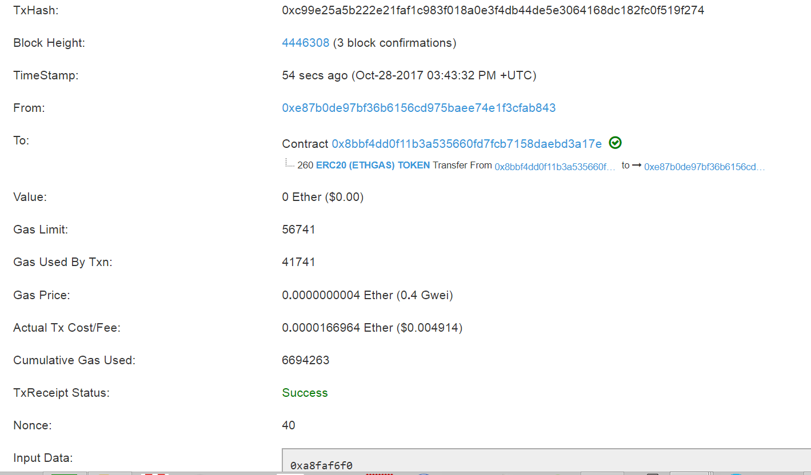
Notes:
Ethereum Transaction:
Tx hash, height of the chain, timestamp, from and to accounts, value transferred,
Gas limit, gas used, tx receipt (success in this case), nonce
In this case this is a “transaction” invoking a smat contract
How do you know this? “Value” field is 0. Of course, The smart contract execution incurs fees and the amount available is specified by gas limit.

Slide 9
Application of public key cryptography
Why ECC instead of RSA for private-public key generation
256 bit ECC is as strong as 3072 bits of RSA encryption
Here we use 256 bits
Consider an address: 0x ca35 b7d9 1545 8ef5 40ad e606 8dfe 2f44 e8fa 733c
10 X 4 X 4 bits = 10 X 16 = 160 bits address
0x indicates the notation used for representing the number: 0x means hexadecimal
Recall bytes32 is a better alternative for string
bytes32 xyz = “0x1234” etc. it has to be even number of hex digits
Remember this when we do the next exercise on Remix

Slide 10
Secure Hashing
Three functions are available: keccak, sha256, RIPEMD
SHA3 is deprecated
Lets apply these two and see them in operation.

Slide 11
Secure hash solidity code
pragma solidity ^0.5.0;
// hashing example
contract HashExample {
bytes32 public hashedValue;
bool public matched;
function hashMeKeccak (uint v, bytes32 mycode) public {
hashedValue = keccak256(abi.encodePacked(v, mycode)); }
function hashMeSha256 (uint v, bool f, bytes32 mycode) public {
hashedValue = sha256(abi.encodePacked(v, f, mycode)); }
function amICorrect(bytes32 myResponse) public {
if (myResponse == hashedValue)
matched = true; else matched =false; }
}

Slide 12
Lets work on the example code in Solidity Read the docs
Blind Auction
Lets
-- analyze it using a contract diagram
When analyzing code, use contract diagram to reverse engineer the code in terms of the data and functions defining the code.
--derive the contract diagram
--next step to simplify it by applying your domain expertise

