Slide 1
Web3 JavasScript API

Slide 2
References
https://web3js.readthedocs.io/en/1.0/
https://github.com/ethereum/wiki/wiki/JavaScript-API

Slide 3
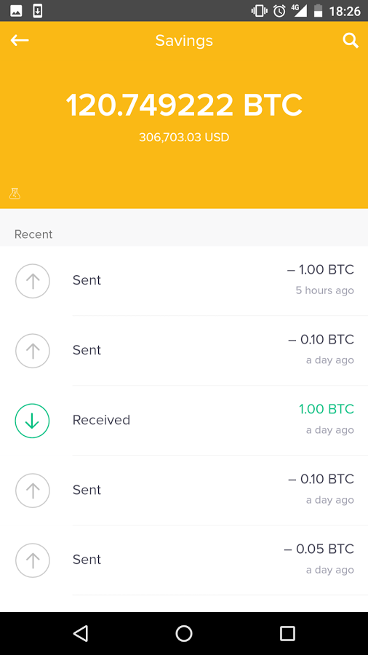
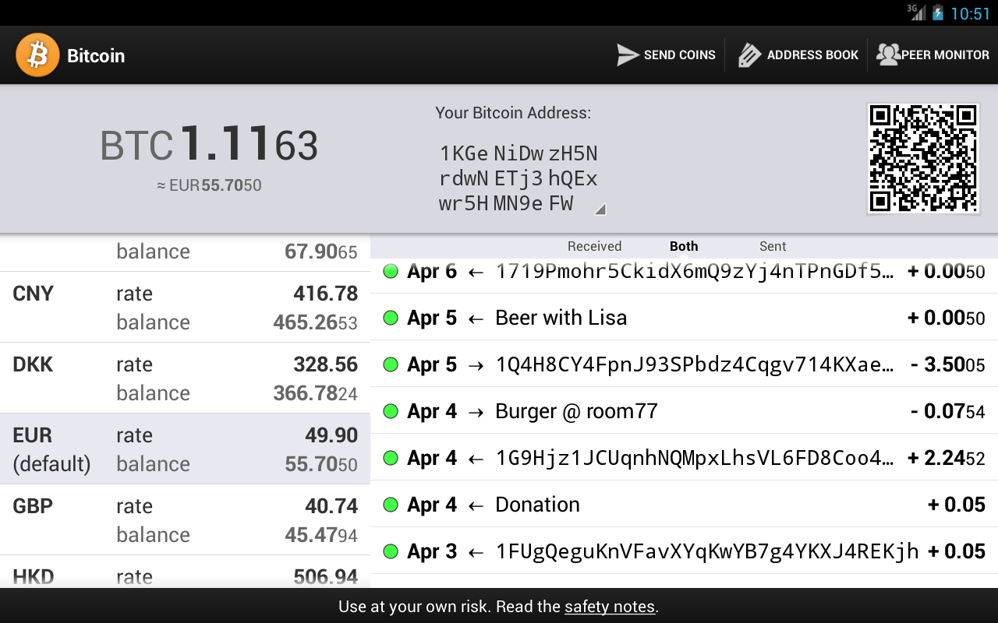
Introduction
A Dapp or a decentralized application depends on the functionality of a blockchain for its infrastructure and operations.
A Dapp in its simplest form has a client interface as a frontend and a back-end that includes the blockchain and the smart contracts.
Consider, For example, consider simple wallet application client and Bitcoin blockchain backend decentralized infrastructure. This is similar to the architecture of a web client and web browser but with one significant difference, the blockchain enables a decentralization infrastructure.
DApp
Bitcoin Blockchain Full Nodes
Bitcoin Blockchain Full Nodes
Bitcoin Blockchain Full Nodes
Notes:
Welcome to the third course in the Blockchain Specialization. This course is completely dedicated to design and development of decentralized application or in short Dapp, the most visible aspect to the clients in a decentralized system.

Slide 4
Hmm..
The client or front-end can be a web app (HTML and JS framework), command-line interface (CLI), desktop application, mobile application or even IOTs. Understand web front-end is outside the blockchain protocol and only link into the blockchain/smart contract using the artifacts generated by the smart contract compile process. Recall we discussed these artifacts generated by Remix IDE in Course 2.
Moreover a decentralized application can be created with non-blockchain back-end. IPFS (Interplanetary file system) is a an example of such an architecture. We will learn about IPFS in the next course.
We are familiar with web server-client, database server-client, how about a Dapp? What is the architecture of a Dapp? How do you develop one?
These are the questions we try to answer in this course.

Slide 5
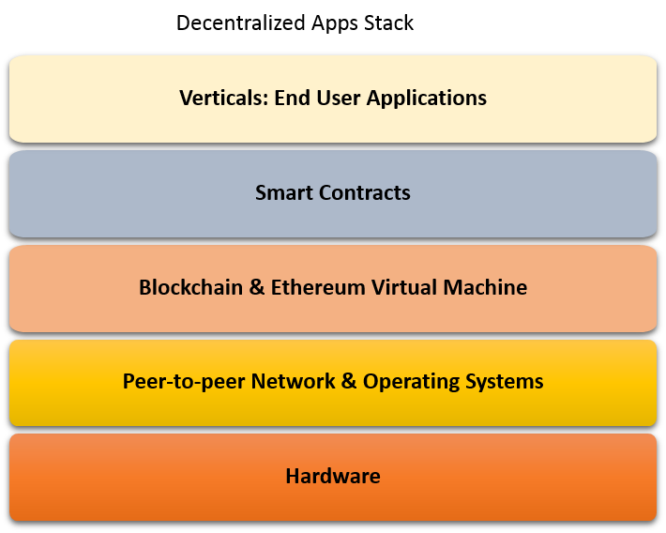
Recap of DApp Stack
Notes:
This is very high level view of the Dapp stack.
It has
In the next several slides we will dig deeper into the architecture of the blockchain-based Dapp using actual COMMANDs that are used to create the architectural components of the Dapp. It is important that you have mastered basics concepts from the Course 1, Course 2 and some knowledge of command line interface to get the best out of this course.

Slide 6
The Blockchain Server
sudo apt-get install software-properties-common
sudo add-apt-repository -y ppa:ethereum/ethereum
sudo apt-get update
sudo apt-get install ethereum
Ethereum blockchain protocol services: Blockchain Server
Notes:
We have been looking a bits and pieces of the blockchain infrastructure in the last two courses. Now it is time to put them together and have a grand view of the whole structure. This is where we begin this module.
We are going to coin the term blockchain server for representing the infrastructure and the blockchain functionality it provides. This nomenclature is drawn from similarity in a web server /web apps, mobile server/mobile client apps, database server/database client etc. So the term blockchain server for all the protocol functionality it provides.Blockchain server/ Dapps.
Here you see the set of commands that install the ethereum services and the application programming interfaces (APIs) it exposes to enable, client node creation, application development and transactions on the blockchain and the blockchain itself.
At this point you do not need to memorize the commands... just try to understand the concept of the “blockchain server” or the base on which the Dapps will be built.
The term blockchain server also helps separate the blockchain that represents the data structure (ledger) from the protocol services.
We have installed the founation, now lets create a node.

Slide 7
The Blockchain Node
geth --datadir ./ account new
geth --datadir ./ init customgenesis.json
geth --datadir ./ --maxpeers 95 --networkid 15 --port 303xx console
Initialize geth client “NODE”
Node 0: Bootnode:: Node, Accounts, EVM for smart contracts
enode://d66cfcd40b21fddb538272106cc7f08d4c8879df308c3e22d924de4771a315c1e21c84bf05107da739025d81d71f1006e7c1a5e3279d0a370d7bcfa4f6c1b38c
Notes:
Here we create a single node, node 0 or genesis node for our blockchain server, the network id for our blockchain server is 15 as you can observe in the third command line. It is still a private local chain.
Hmm, are you curious to know the network ids for other public networks?
the network id for the main Ethereum main network including metropolis is 1, · Ropsten, the public cross-client Ethereum testnet is 3, Rinkeby’s netowork id is 4, and there is even a Musicoin, the music blockchain
with networkid 7762959! When you deploy a public blockchain you should be aware of the network ids of other public nets, and when you are in a private environment once again you should be aware of other network ids in use, if any.
In the case shown, we are using the “geth” command provided by the Ethereum server we installed earlier,
To install a node by creating a new account number, the externally owned account (EOA). Recall that we have been discussed EOA in the earlier courses.
Initialize a node using custom genesis block, that has specifications of the first block of the chain
Specify the network id, the port to bind to, for the network activities related to the blockchain
Finally you also see the enode address for this genesis node or bootnode created. Enode is used by other nodes to connect to this bootnode to establish a peer-to-peer network on which the blockchain operates.
Recall that that peer-to-peer network is one of the fundamental concept in blockchain technology.
We have not listed all the commands needed for the networking details. That is beyond the scope of this course, the focus of which is on Dapp development.
We have completed creation of one node, lets create at least one more peer node.

Slide 8
Single Peer Node Creation and Connection Commands
geth --datadir ./ account new
geth --datadir ./ init customgenesis.json
geth --datadir ./ --networkid 15 --port 303xy console
admin.addPeer(" enode://d66cfcd40b21fddb538272106cc7f08d4c8879df308c3e22d924de4771a315c1e21c84bf05107da739025d81d71f1006e7c1a5e3279d0a370d7bcfa4f6c1b38c@199.109.195.123:303xx ")
Initialize geth client “NODE1”
“Add peer to bootnode”
Node 1: Node, Accounts, EVM for smart contracts
Peer nodes connect to blockchain server identified by networkid 15 to form the decentralized peer-to-to peer network.
Notes:
Here we are creating one more node Node 1 and adding it as a peer node to the bootnode we created earlier. After creation of the node, observe that we are using:
“Admin” API “addPeer” command (fourth command)
“Enode” address of bootnode we created earlier
The IP address and the binding port of the bootnode (303XX: where XX will be replaced by the number of the original node we created).

Slide 9
Multiple Peer Nodes
Node 1: Node, Accounts, EVM for smart contracts
Node n: Node, Accounts, EVM for smart contracts
Node 2: Node, Accounts, EVM for smart contracts
Initialize node & add peer node
Peer nodes connect to blockchain server identified by networkid 15 to form the decentralized peer-to-to peer network.
Notes:
Here you see multiple peer nodes 1..n. When you want join the blockchain networkid 15, install the base Ethereum server and then execute the commands as shown earlier for a single node creation and addition as a peer. Thus we have a peer-to-peer network enabling the blockchain operations.
There are alternate methods to create the network, we have shown a just one approach.

Slide 10
What is a Dapp?
Dapp, a decentralized application, solves a problem that requires blockchain services and blockchain infrastructure for realizing its purpose.
Typically design of a Dapp has a front-end, a blockchain back-end and the code connecting the two.
In such an architecture, the front-end of the Dapp channels any external stimulus from the users to the blockchain infrastructure and returns any response back to them.
--It initiates transactions to invoke functions on the smart contract that in turn records the transactions, state transitions and receipts on the blockchain.

Slide 11
What is a Dapp? ; Front-end Design
Front-end of the Dapp can be as simple as a command line interface.
It also can be a sophisticated web app or easy to use mobile app.
Front-end development may involve web development (html/js/css and web app frameworks such as express) for a web-client, mobile app development for a mobile client and so on.
We will use a simple basic web app as frontend for the Dapps we develop in this course.
Notes:
Push vs pull mode?

Slide 12
Blockchain Server-Client
Analogy time:
You can map the blockchain architecture we discussed here to the client/server architecture we are so familiar with in the context of web applications and database server/client, mobile server/client model.
Here blockchain server is the Ethereum “node” (not node.js) and underlying infrastructure, and client or the front-end is a web client with embedded web3.js script, communicating using JSON over RPC pipeline.

Slide 13
Web3 deploy script, Contract Address and ABI
Recall from Course 2, web3Deploy script is an important artifact generated by the remix compile process.
If you are programmatically assembling the Dapp without the help of any development environment
You will copy the web3deploy script into your web app, say in html/js file as a script,
deploy the smart contract using the functions in the script
invoke the smart contract function using the functions in the script, ABI and smart contract address
At this time, if you are a programmer, you can review the web3deploy script generated in the Remix IDE.
Dont worry, we plan to use an IDE to develop the Dapp later on in Module 2 of this course.

Slide 14
ABI (Application Binary Interface)
ContractBytecode
WebDeploy
script
Smart Contract
Remix
Compile process
Gas estimates
Function Hashes
InstanceBytecode
….others
Notes:
Here are some of the artifacts generated by the Remix smart contract Compile process and their use:
ABI: Application binary interface: Interface schema for transactions to invoke functions on the smart contract instance byte code.
Contract byte code: This is the byte code that is executed for instantiating a smart contract on the EVM.
(think of it like executing a constructor of the smart contract to create an object).
webDeployscript: This has two items (i) Json script to web applications to invoke smart contract functions
(ii) script for programmatically deploying a smart contract from a web application
Gas estimates: This provides the gas estimates for deploying the smart contract and for the function invocation
Function hashes: First 4 bytes of the function signatures to facilitate function invocation by a transaction
Instance byte code: The byte code of the smart contract instance; there is no schema or constructor for this code.
We will learn more about these and how to use them in building blockchain applications in the upcoming lessons.

Slide 15
Dapp with command line interface (CLI)
eth.sendTransaction({from:<address>, to:<address> , value: <value>})
Node0:geth client
Node1:geth client
NodeN:geth client
Distributed Ethereum blockchain server and network (say, network id 15)
Notes:
Here is a simple Dapp architecture with the nodes that we created earlier with geth command and ethereum blockchain server and network.
Once the nodes havebeen initialized and are on the same network, they can transact among them using command line interface.
Also you should able to deploy a smart contract from the command line. In this case, you will be using web3deploy script and interact with a smart contract using ABI definition and smart contract address. Be aware that these commands may have lengthy payload and parameters and may span multiple lines.
Moreover a command line interface may not be familiar to a non-programmer/user of the Dapp.
So we will use a simple but intuitive web interface as a front-end to the blockchain Dapp.

Slide 16
Architecture of a Dapp
Web App
Web App
Web App
….
web3
web3
web3
….
JSON/RPC
JSON/RPC
JSON/RPC
….
RPC port
RPC port
RPC port
….
Node1:geth client
Node2:geth client
….
NodeN:geth client
Distributed Ethereum blockchain protocol server network
Notes:
So far we have discussed various components of a blockchin server and geth client.
Here is a simple architecture for Dapp. We have multiple full nodes with only three of them Node1, Node2 and NodeN shown.
Geth command is used to expose the rpc port, using the command say 8544: geth --rpc --rpcport 8544
From the web client, functions including smart contract deploy and invoke functions are facilitated through web3.js module and web3 script.

Slide 17
What is an API?
API or Application Programming Interface is a convenient and standard way to expose a set of functions related to a specific data set and related services. APIs also lend to reusability of code.
An API publishes a set of functions or methods that can be used programmatically invoke operations, access data and store data.
Access to an API can be controlled by specific access methods, for example public keys, if so warranted by the application.
Here are some well-known examples of API:
--Twitter API to access tweets that can be filtered by query terms
--Google Maps API that allows for applications “embed” the map features such as geolocation in their own applications, leveraging and reusing the power of google map API.
Notes:
If we can get the link to publication “It is an API economy” it will be good.

Slide 18
Why are APIs important?
Blockchain server and node provide the blockchain functionality data structures. How do applications “call” them? Invoke them? Use them for accomplishing tasks of an application?
We need a well-defined standard approach to get things done for a Dapp.
Answer is in the APIs.
In our case, specific APIs expose the services of the blockchain server using standard functions. When you develop a Dapp, interaction with a geth node and blockchain server functionality is accomplished by invoking these APIs.
APIs
Notes:
Extra notes: no need to script it: May help in finding resources. The concept of APIs is not new. REST API is a very popular and a well-used API in any application context. It embeds the well-known functions GET, PUT and POST of HTTP protocol (reference of REST API). Twitter and facebook use the REST API for provisioning the data they collect for programmatic access from external applications.

Slide 19
Why in the context of Dapp are we learning APIs?
Blockchain technology has ushered in a whole new culture in software and systems development and management.
Software systems in the beginning were proprietary products. Slowly they moved on to become open source, and freeware.
With blockchain technology developers are only contributors to software, many of them help to run the network by standing up nodes, mining etc. More importantly they also propose and vote on the improvements and changes to the blockchain protocol.
Thus we want you to be more than developers; you can be contributors and committers to code, you can help in the governance and help shape the protocol.
That is the new blockchain technology culture.
To enable you to be informed developers in this context, you need a basic knowledge of the APIs and the inner workings.

Slide 20
Ethereum APIs: So what are the APIs Ethereum provides?
Two majors category of APIs are provided:
Geth management APIs: admin, debug, miner, personal, txpool
Web3 APIs: web3, eth and net
Geth management APIs support methods for management of the geth node.
Web3 APIs support methods for development of Dapps.
Next we will examine each category of APIs in detail.
Notes:
https://gavofyork.gitbooks.io/turboethereum/content/cli_tools.html

Slide 21
Geth Management APIs
admin:
The admin API allows you to use functions to work with your Geth instance, including network peer and RPC endpoint management.
Examples: admin.addPeer(..)
admin.nodeInfo()
You can observe that “admin” supports functions for management of the node.
Notes:
https://github.com/ethereum/go-ethereum/wiki/Management-APIs

Slide 22
Geth Management APIs
debug:
Examples: debug.dumpBlock(16)
Will return the block header details.
You can observe that debug object provides you the ability to peek into the blockchain, study and debug any issues.
Notes:
erhttps://github.com/ethereum/go-ethereum/wiki/Management-APIs

Slide 23
Geth Management APIs
miner:
The miner API allows you to control the node's mining operation and set various mining specific settings.
Very easy to understand.
Example: miner.start()
miner.stop() are sample functions that will start and stop the miner.
You can also say miner.start(6) where 6 parallel threads assigned to mining operation.
Notes:
https://github.com/ethereum/go-ethereum/wiki/Management-APIs

Slide 24
Geth Management APIs
personal:
Deals with creation and management of accounts within a node. It also manages private keys in the key store.
Example:
personal.newAccount() will create a new account within a node.
Notes:
https://github.com/ethereum/go-ethereum/wiki/Management-APIs

Slide 25
Geth Management APIs
txpool:
The txpool API gives you access to several non-standard RPC methods to inspect the contents of the transaction pool containing all the currently pending transactions as well as the ones queued for future processing.
Example:
txpool.inspect() lists you all the pending transactions for you to peruse them to identify any issues.
Notes:
https://github.com/ethereum/go-ethereum/wiki/Management-APIs

Slide 26
Web3 API
web3.js library when included in the Dapp
<script type="text/javascript" src="../dist/web3.js"></script>
Lets you use the web3 object provided by the web3.js library and all its objects.
It also lets you communicate with the local node through the RPC port.
It also provides access to eth object and its function via: web3.eth and
net object: web3.net and their respective functions.
Additionally to whisper API: web3.ssh is used for secure “gossiping” and enables the Whisper protocol that is a precursor for next generation Dapps.
Notes:
https://github.com/ethereum/wiki/wiki/JSON-RPC
https://github.com/ethereum/web3.js/tree/master/example

Slide 27
Importance of web3
Web3 is a javascript library that is specifically designed for use with web client of Ethereum Dapps.
It is portal through which all the underlying operations of the Ethereum node and blockchain server can be invoked.
For example: smart contract deployment, smart contract function invocation
You will use web3 in the development of the front end of the Dapp and for interacting with the blockchain.

Slide 28
Architecture of a Dapp: here is a revised architecture of a Dapp
Web App
Web App
Web App
….
web3
web3
web3
….
RPC
RPC
RPC
….
RPC port
RPC port
RPC port
….
Node1:geth client
Node2:geth client
….
NodeN:geth client
eth net ssh admin debug miner
txpool personal APIs
eth net ssh admin debug miner
txpool personal APIs
eth net ssh admin debug miner
txpool personal APIs
Distributed Ethereum blockchain protocol server network
Notes:
Now that we know the APis, Here is a simple architecture for Dapp. It comprises multiple full nodes with only three of them Node1, Node2 and NodeN shown.
Geth command is used to expose the rpc port: geth --rpc --rpcport 8544 --rpcapi=”web3,net,eth,admin,personal,debug’’
Blockchain functions including smart contract deploy and invoke functions are facilitated through web3.js module and web3 script. For example, eth and net objects can be instantiate within web3 module and their respective functions can be invoked from the web interface.

Slide 29
Tracing a call/request from a web front of Dapp (request-response.. )
So far we discussed structural and API details.
When a web request is initiated by a user, if it is regular web app request, it is directed to the http endpoint (say, port 8080) and to the web server to be executed.
For a Dapp:
--geth client has to expose a RPC endpoint using the command --rpcport XXXX where XXXX is the RPCport.
--A web3 object instantiated in the web page script (recall that web3.js is a javascript library)
--Requests/Calls on invoked on this web3 object
--Requests are transmitted as JSON over the RPC pipeline between the web client and the geth client
--requested call/function is executed using appropriate API and the results returned through the RPC pipeline.

Slide 30
Summary
Our goal d=going forward is to take apart web3 and
learn to program it well
This is the crucial part of a Dapp.
Lets learn fundamentals of web3 and to program with web3
Web App
….
web3
RPC
….
RPC port
Node1:geth client
eth net ssh admin debug miner
txpool personal APIs

