Slide 1
This presentation is based on WS-Membership: Failure Management in Web Services World
B. Ramamurthy Based on Paper by Werner Vogels and Chris Re

Slide 2
Figure 12.1 A network partition

Slide 3
Introduction to WS-Membership
An important factor in the successful deployment of federated web-services-based business activities will be the ability to guarantee reliable distributed operation and execution.
Failure management is essential for systems constructed out web services on the network.
ws-membership
a coordination service
a generic web-service interface for tracking registered web-services and
for providing membership monitoring information.
A prototype membership service
based on epidemic protocol techniques has been implemented
Context: Obduro project which focuses on global scalable distributed systems based on web-service technologies.

Slide 4
Obduro Project
Development of advanced distributed services in the context of WS Coordination framework
Development of high performance server technology for web services routing
Integration of reliability and other distributed services into coordination and choreography engines.
Development of a framework for global event management

Slide 5
Failure Management
Failure management is essential for building reliable distributed systems
Tracking which services are participating in an activity and what their status is drives the progress of the activity.
Ws-membership is developed in the context of ws-coordination standard of w3c.
Membership can be realized by simple heartbeat (as in Hadoop).
Failure detection can also be used as the building block to simplify the implementation of consensus.
Consensus is used when a set of processes have to agree upon the outcome of an operation.

Slide 6
WS-Membership
Membership services is about service availability
Coordination protocol
Tracks registered members
Presents membership updates to monitors
Two components
WS-Membership
Failure detection
Membership dissemination

Slide 7
Component services
Epidemic communication
State management
Development of advanced distributed services in the context of the web-services Coordination framework.
These services will include a failure management service, a consensus service and a lightweight distributed state-sharing engine.

Slide 8
The Membership Framework: Five Roles Modeled
Coordination service
Receives activation and membership requests and routes them to membership service
Membership Service
Provides failure detection of registered web-services and disseminates membership information

Slide 9
Five roles (contd.)
Member Service
A software component that has registered itself for failure detection, either directly with a Membership Service
Membership Proxy
A software component that is interposed between a member service and the Membership Service for reasons of efficiency or accuracy
Membership Monitor
This service registers itself with the Membership Service to receive changes to the membership state

Slide 10
Activation & Registration
Coordination service provides 2-step access to membership service:
Activation at a URI: Membership Service is created
createCoordinationContext (CoordinationType) returns coordinationContext
Registration: proxies and services register with Membership Service
requestMembership (serviceURI, coordContext, port for probe)
Other methods:
memberProbe, memberAlive, memberLeaves

Slide 11
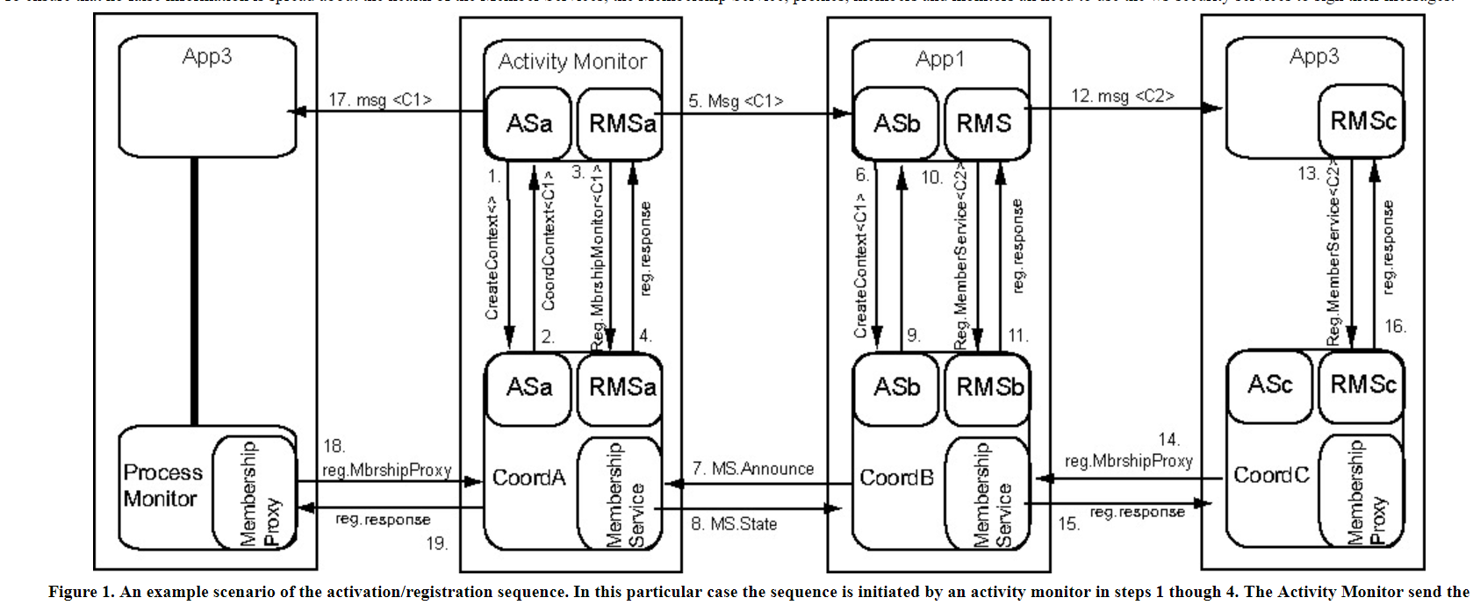
See Fig.1 for activation & registration sequence
Change App3 on the right end → App2

Slide 12
The Epidemic Membership
Based on gossip-style failure detection
This is a probabilistic approach to failure detection
It is based on epidemic state maintenance techniques which provide an excellent foundation for constructing loosely couples, asynchronous, autonomous distributed components.
Eventual consistency is reached (somewhat like the Chnady&Lamport algorithm).

Slide 13
Epidemic membership Service (EMS)
Each participant holds a list of known peers
Eventual consistency
Best for loosely coupled, asynchronous systems
Operational details:
Fig.2,3 : gossip received + local membership state → new membership state
Gossip: <app id, heartbeat counter, timestamp>
If Membership Service fails all members are marked failed.

Slide 14
Features of EMS
Strong mathematical underpinning allows us to compute probability of mistakes
Communication techniques used to exchanges messages are highly robust
Membership exchanges between members is asynchronous
Participants are able to make decisions autonomously about failures of other participants.

Slide 15
Types of information thru’ gossip
Members. This is the list of the Member Service URIs that are registered and are active. This information set includes a logical timestamp it was last updated.
Joined. A list of Member Services that have recently registered, with each the logical timestamp of the moment of registration.
Left. When a Member Service gracefully exits, it should send a MemberLeaves indication to the Membership Service it has registered with. This will remove the members from the Members list and place it in the Left set, annotated with the logical timestamp.
Failed. After a member has been detected as failed it is removed from the Members set and placed in this set, annotated with the logical timestamp.
Suspected. An option at Activation time is to specify a threshold that would mark a member as suspected, before it is marked failed.

Slide 16
Operational Details
EMS developed in the context of XEROX Clearing house project
Each participant maintains list of known peers
Periodically they update a heartbeat counter and send <address, heartbeat> msg to their peers.
Push-pull model instead of just push
Gossip model
Study Fig. 3 to understand operational details

Slide 17
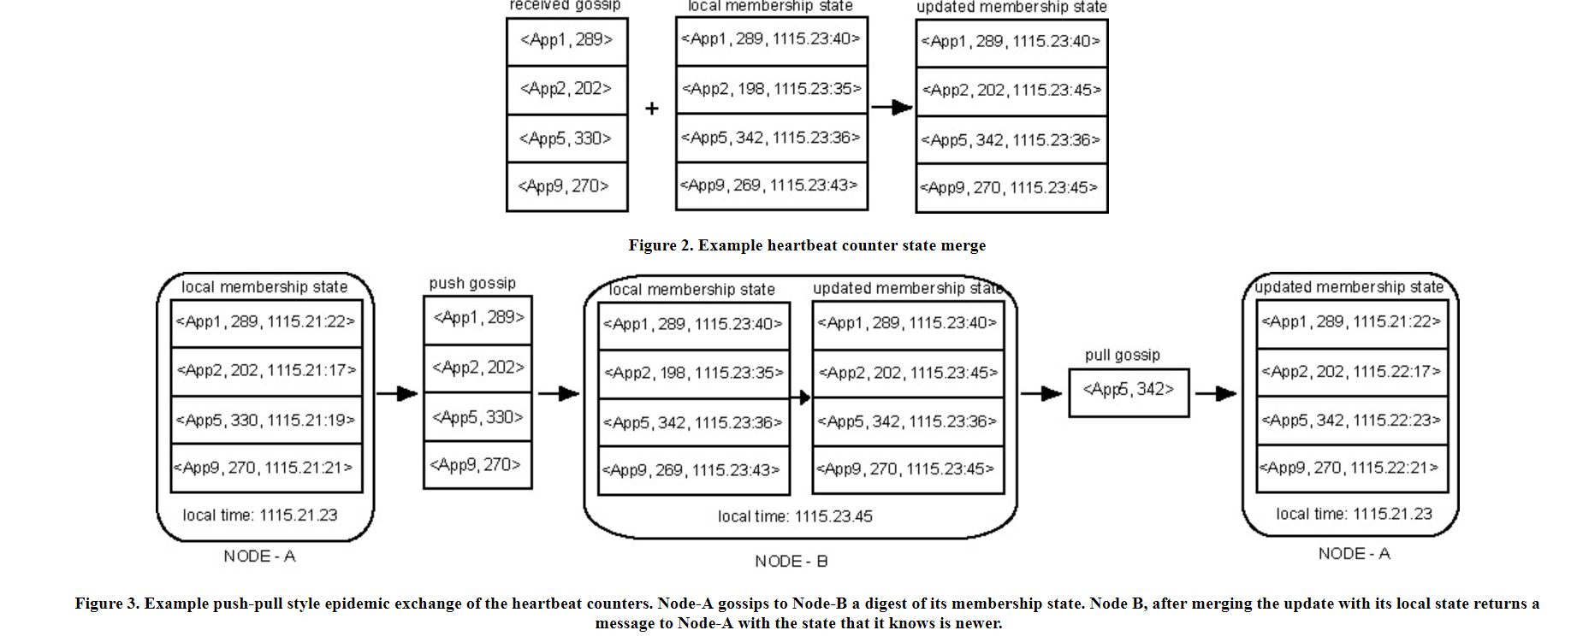
Fault model?
How would you use EMS to realize a fault model for your system?

